Slide 1
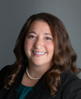
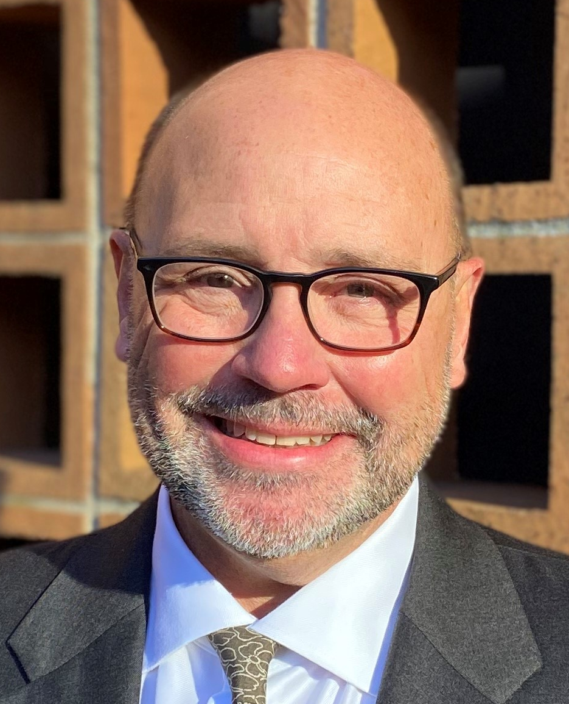
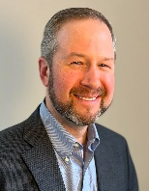
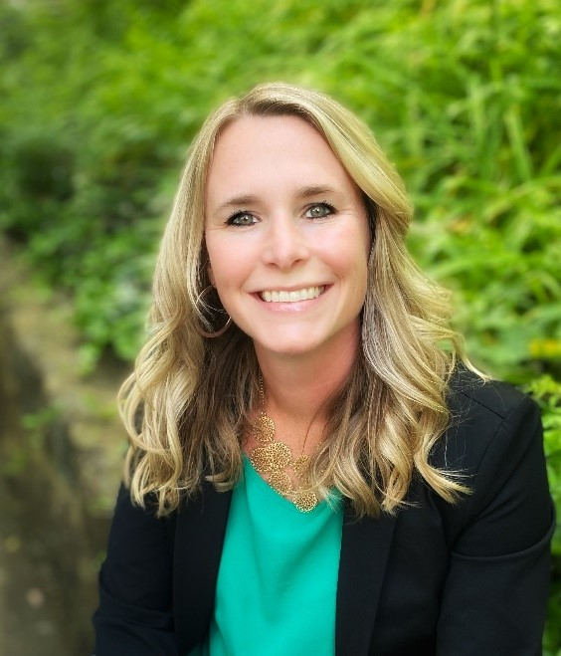
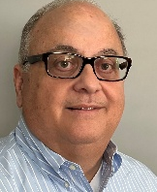

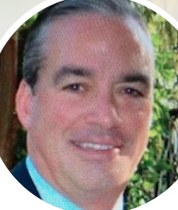
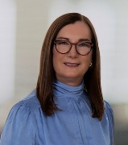
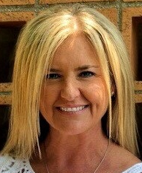



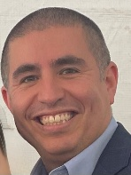
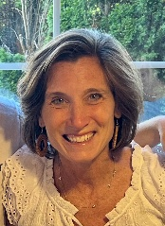
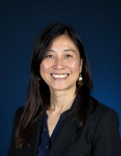
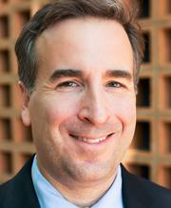
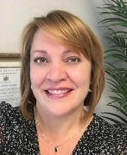
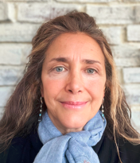
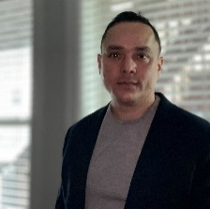
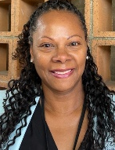
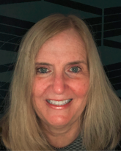
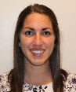

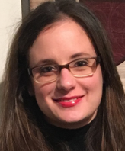

Financial Affairs Leadership Team
Updated July 2026
Nicole Tirella
Senior Vice President, CFO, & Treasurer
Internal Audit & Advisory Services
Procure to Pay (P2P)
Budget & Planning
Financial Operations
Randall Moore
Vice President,
Chief Procurement Officer
Brian Donaldson
Vice President, Financial Operations
Chris Stanich
Vice President,
Budget & Planning (Aug ‘26)
Risk Management
Debt & Treasury
Marion Candrea
AVP & Chief Audit Officer
Maria Cruz
AVP,
Financial Planning & Strategy
Jim Donohue
AVP, Risk Management
Diana Hoadley
AVP,
Debt, Treasury
Joseph Grossi
AVP,
Academic Planning & Support
Tony Rizzo
AVP,
Integrated Budget & Planning
Heather
Gillis
Assistant VP,
Procurement, Contracting, & Shared Services
Tim Busanoski
Associate Director, Debt
Kate
Gomes
Director, Risk Management
Richard
Kotowicz
Director,
Internal Audit
& Advisory Services
Lorraine Weiss
Director, Integrated Budget & Planning
Hiram Rodriguez
Executive Director, Admin
Budget & Planning
Laura Collins
Executive Director,
Revenue Management & Enrollment Strategy
Keith Haran
Executive Director,
Sourcing
University Controller
Karen Mahalo
AVP, & University Controller
Silvia Alberta
Associate Director, IT Audit &
Special Projects
Denise Greene
Executive Director, Payment Services
Del Reese
Executive Director Reporting & Systems Management
Maryellen Bliss
Assistant VP, Student Financial Services
Brianna Fanning
Assistant VP, Financial Accounting &
Reporting
Jarrod Cain
Assistant Director,
Data
Analytics
Jamie Simole
Associate Controller, Payroll Services
Missy Downs
Associate Controller, Research Financial Operations

Slide 2
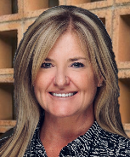
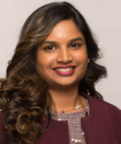
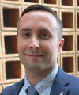
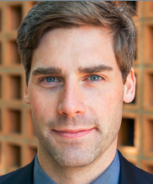
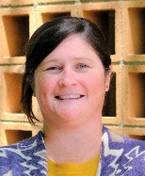
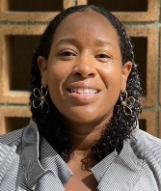
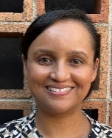
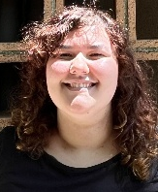
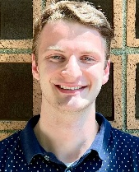
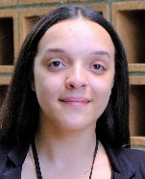
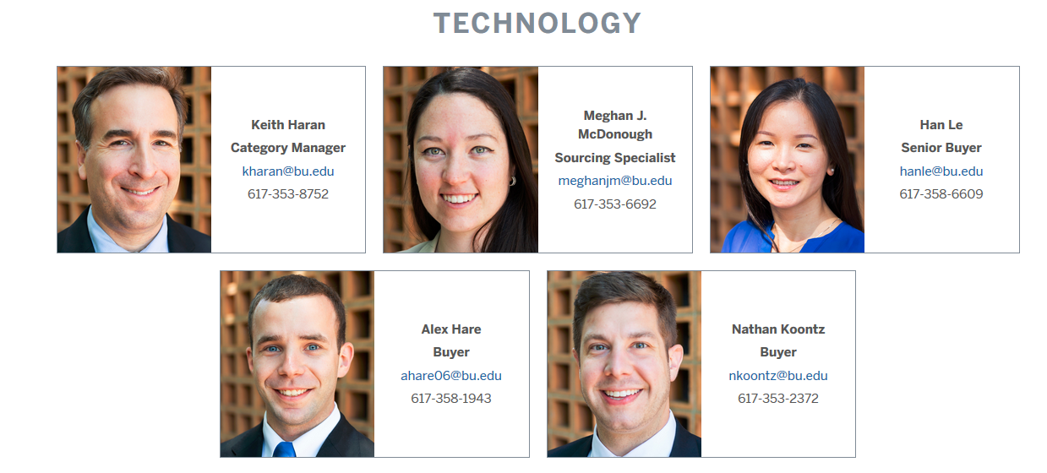
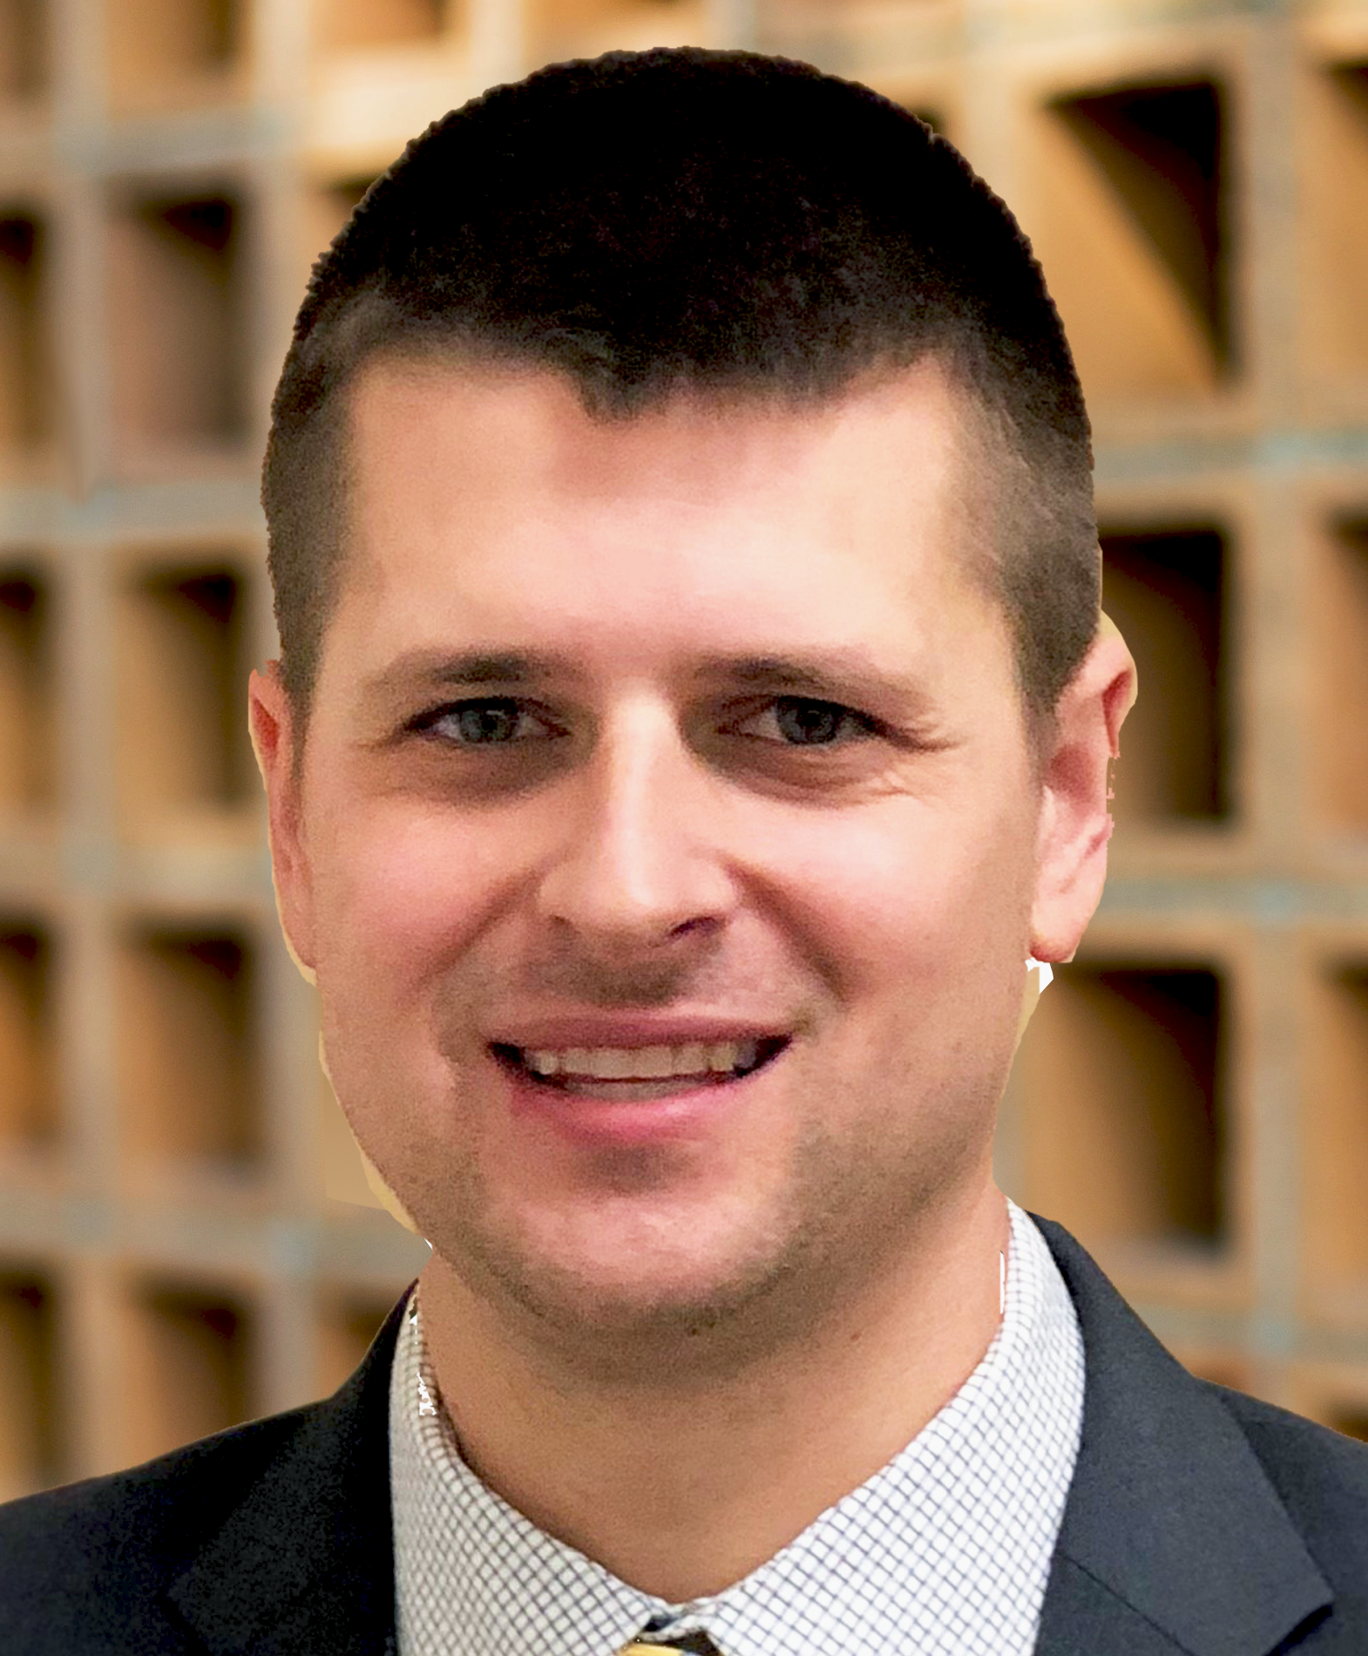
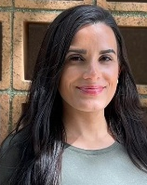
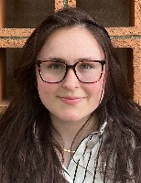
Randall Moore
Vice President,
Chief Procurement Officer
Updated July 2026
Procure to Pay (P2P)
Heather
Gillis, CCWP
Assistant Vice President,
Procurement, Contracting, & Shared Services
P2P Systems | Contracting | Procurement | Shared Services / Customer Success
Sri Teja
Kotha, MS
Senior Associate Director, P2P Systems
Paul
Takach, JD
Director of Contracts
Daniel Tremblay, MS
Senior
Contracts Administrator
Nikki
Mackay
Associate Director,
Contract Administration
Olivia Clachar
Senior Associate Director, Shared Services
Malika
Napoli, JD
AIA Contracts Specialist
Alex Hare
Contracts Administrator
Avery Stermel
Contracts Administrator
Christian de Penasse Mouwen
Contracts Administrator
Michelle Machado
Customer Success
Coordinator
Brittany
Valdez
Supplier Onboarding Coordinator
Gavin
Wilkie, MBA
Senior
Contracts Administrator
Leza Pereira
Customer Success Coordinator
Open
Training & Change
Management
Specialist
Julia Petrillo Contracts Administrator

Slide 3
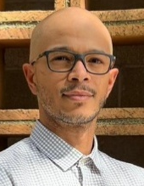

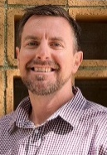
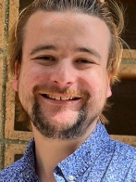
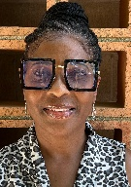
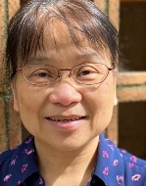
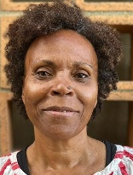
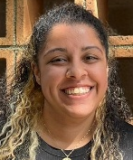
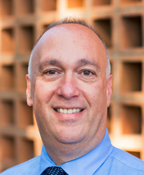
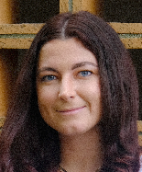
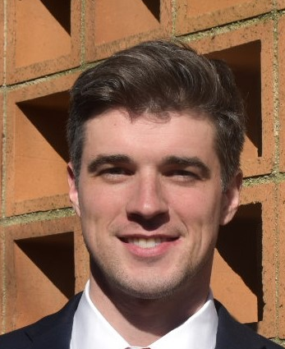
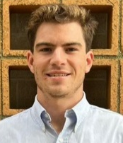
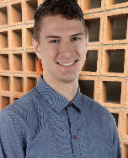
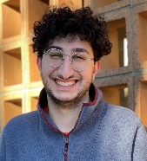
Randall Moore
Vice President,
Chief Procurement Officer
Updated July 2026
Procure to Pay (P2P) (continued)
` | Disbursement Processing / Payment Services | Analytics | Travel
Accounts Payable & Travel Services
Andrew Reagan
Associate Director, Payment Services
Juan Rodriguez
Assistant Director, Disbursement Processing
Chase Milanese
Associate Director, Travel & Card Services
Denise Greene
Executive Director, Payment Services
Shirley Hood
Card Services Specialist
Robert Blake
Senior Payment Services Manager
David Knox
Payment Services Coordinator
Lisa Chen
Payment Services Coordinator
Allison Lambert
Travel Clerk
Tamika Quinn
Payment Services Specialist
 | Research |  | Professional Services | Technologies, Auxiliaries, & Site | Facilities & Construction
Sourcing
Bob
Simboli
Senior Associate Director
Meghan
McKay, MBA Category Director
Brian Hanley
Associate
Category
Manager
Michela Stahl
Associate Category Manager
Keith Haran,
MBA
Executive Director,
Sourcing
Alec Reardon
Sourcing Specialist
Alex Mouwen
Senior Sourcing Specialist
Nick El-Dahr
Senior Sourcing Specialist, Travel

Slide 4
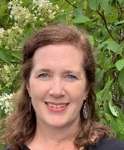
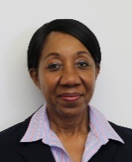

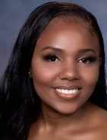
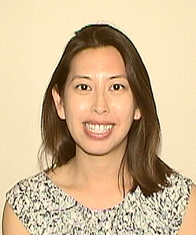

Marion Candrea
Associate Vice President,
Internal Audit & Advisory Services
Internal Audit & Advisory Services
Updated July 2026
Evaluate and Improve Risk Mgt, Internal Controls, Compliance Requirements, and Governance Processes
Audit & Advisory Services
Michelle Blanchette
Manager,
Audit & Advisory Services
Marline Ogunjobi
Manager,
Audit & Advisory Services
Dave Hruban
Construction Audit Manager
Richard Kotowicz
Director,
Audit & Advisory Services
Ishimwe “Nadine” Uwase
Project Manager
Kristin Law
Project Manager
Open
Senior Auditor
IT Audit & Special Projects
Identify and Assess IT Risks. Participate in University’s Enterprise Risk Management Program
Silvia Alberta
Associate Director, IT Audit &
Special Projects
Salman Aziz
IT Audit Manager
Data Analytics
Insights on Risks Using Data. Develop audit focused data analytical tools
Jarrod Cain
Assistant Director,
Data Analytics
Elaiya “Eli” Gonzalez
Data Analytics Manager
Open
Senior Data Analyst

Slide 5








Research Financial Operations
Updated July 2026
Missy Downs
Associate Controller, Research Financial Operations
Accounts Receivables & Cash Operations | Property Management | Cash Management | Financial Reporting & Reconciliation
Qi “Chris” Li
Assistant Director, AR & Cash Ops
Maura Blanchard
Assistant Director, Property Management
Kristin Sacca
Associate Director, Cash Management
Kristen Donovan
Associate Director, Research Receivables
Open
University Receivables Analyst
Scott Stewardson
Property Administrator
Jackie Chau
Senior Managing Research Receivables Analyst
Open
Senior Billing & Account Specialist
Tien Phung Truong
Senior Billing & Account Specialist
Open
Senior Billing & Account Specialist
Jacob Yannetti
Cash Application Analyst
Liam Hennessey
Property Administrator
Chrissy Grieves
Billing & Account Specialist
Open
Senior Billing & Account Specialist
Erinne Dull
Senior Staff Accountant

Slide 6






Payroll Services
Updated July 2026
Karen Mahalo
AVP, University Controller
` | Operations | Taxation and Garnishments | Technology
Payroll Services
Danielle Trahon
Senior Associate Director, Payroll Processing & Reconciliation
Open
Senior Associate Director, Payroll Technology & Projects
Kathy Sirois
Associate Director, Tax & Payment Processing
Jamie Simole
Associate Controller,
Payroll Services
Thompson Ludwig
Asst Director, Payroll & Time Administrator
Sarah Ahari
Payroll Accountant
Cherryce Williams
Senior Account Analyst
Ryan Peterson
Payroll & Time Administrator
Ida Winick-Lilkely
Payroll & Time Administrator
Wilma Miranda
Senior Payroll Tax Administrator
James Fernandes
Payroll & Time Administrator

Slide 7











Student Financial Services
Updated July 2026
Maryellen Bliss
Assistant Vice President, Student Account Services
` | Student Accounts Operations | Student Accounts Customer Service
Student Accounting Services
Bonita Huang
Associate Director, Student Accounts Operations
Eric Nyman
Senior Associate Director, Student Account Customer Services
Karen Cossette
Senior Business Analyst
Brittany Johnston
Assistant Director, Student Account Customer Services
Sarah Horikami
Assistant Director, Student Account Customer Services
McCayla Quinn
Senior Operations Analyst
Lisa Wong
Business Analyst
Ellie Krasner
Senior Student Financials Specialist
Jason Montezuma
Senior Student Financials Specialist
Ellen Millman
Reporting Specialist
Daryl Mencey
Student Financials Specialist
Nicholaos Mitsiu
Student Financials
Specialist
Kerry Pinette
Student Financials Specialist
Nick Santos
Student Financials Specialist
Veronica
Kelly
Operations
Specialist
Accounting & Analytics
Jennifer Buono
Director, Accounting & Analytics
Christine Michaelidis
Associate Director, Accounting & Analytics
Open
Senior Staff Accountant
Shihan Duan
Staff Accountant

Slide 8






Student Financial Services (continued)
Updated July 2026
Kathleen Hynes
Director, Student Financial Services & University Bursar
`
Mike Keegan
Associate Director
Cathy McLaughlin
Manager, Student Loans
Shaun Mathieu
Assistant Director
Jack Litwinsky
Senior Student Loan Specialist
Corrine DePatra
Student Loan Specialist

Slide 9










Updated July 2026
Brianna Fanning
Assistant VP, Financial Accounting & Reporting
Financial Accounting & Reporting
Student Financial Initiatives & Reporting | Tax | Cash, Investments and Gift Accounting | PP&E, Lease, and Debt Accounting
Taylor Harnish
Senior Financial Reporting Analyst
Joan Valeriano
Supervisor, Tax and Reporting
Cara Griffin
Supervisor of Cash, Investments, & Gift Accounting
Tom Jenkins
Supervisor of Financial Operations
Lindsey Hinze
Senior Staff Accountant
Cameron Burke
Senior Staff Accountant
Open
Tax Analyst
Julia Leone
Associate Controller, Strategic Financial Initiatives
Aaron Rosenweig
Staff Accountant, Cash
Cadrin Msumba
Staff Accountant, Gifts & Endowment
Alyssa Johnston
Staff Accountant, Operations
Tommy Nunez
Assistant Director,
Facilities Cost Analysis
Min Duan
Cost Analyst
Rossy Ramirez Warren
Staff Accountant, Investments

Slide 10




Chris Stanich
Vice President,
Budget & Planning (Aug ‘26)
Budget & Planning
Updated July 2026
Financial Planning & Forecasting
Del Reese
Executive Director, Financial Reporting & Strategic Planning
Hiram Rodriguez
Executive Director, Admin
Budget & Planning
Maria Cruz
AVP,
Financial Planning & Strategy
Maureen Mayer
Director, Data Analytics & Process
Eva Huang
Senior Financial Analyst
Deborah McGuire
Senior Budget Analyst
Open
Senior Budget Analyst
Integrated Budget & Planning
Lorraine Weiss
Director, Integrated Budget & Planning
Tony Rizzo
AVP,
Integrated Budget & Planning
Nate Stemple
Senior Budget Analyst
Brendan Karol-Griffin
Senior Budget Analyst
Maureen Tarantino
Senior Financial Analyst
Administrative Budget & Planning
Joseph Grossi
AVP, Academic Planning & Support
Laura Collins
Executive Director,
Revenue Management & Enrollment Strategy
Kris Pandeli
Senior Financial Analyst

Slide 11




Debt & Treasury Management
Updated July 2026
Diana Hoadley
Associate Vice President,
Debt, Treasury
Tim Busanoski
Associate Director, Debt
Peter Vuong
Treasury, Cash, & Forecasting Manager
Roger Tsang
Treasury Analyst

Slide 12

Updated July 2026
Financial Operations
Brian Donaldson
Vice President, Financial Operations
Matt Abrams
Assistant VP, Financial Operations & Strategic Projects

Slide 13

Updated July 2026
Risk Management
Jim Donohue
Associate Vice President, Risk Management
Kate Gomes Director, Risk Management
Jim Cahill
Specialist II,
Risk Management

Slide 14



Updated July 2026
Nicole Tirella
Senior Vice President, CFO, & Treasurer
Financial Affairs Administration
Brian Masterson
Director, Finance & Administration
Alexandra Hodakovski
Office Manager
Sarah Pettengill
Executive Assistant

