Slide 1
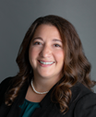
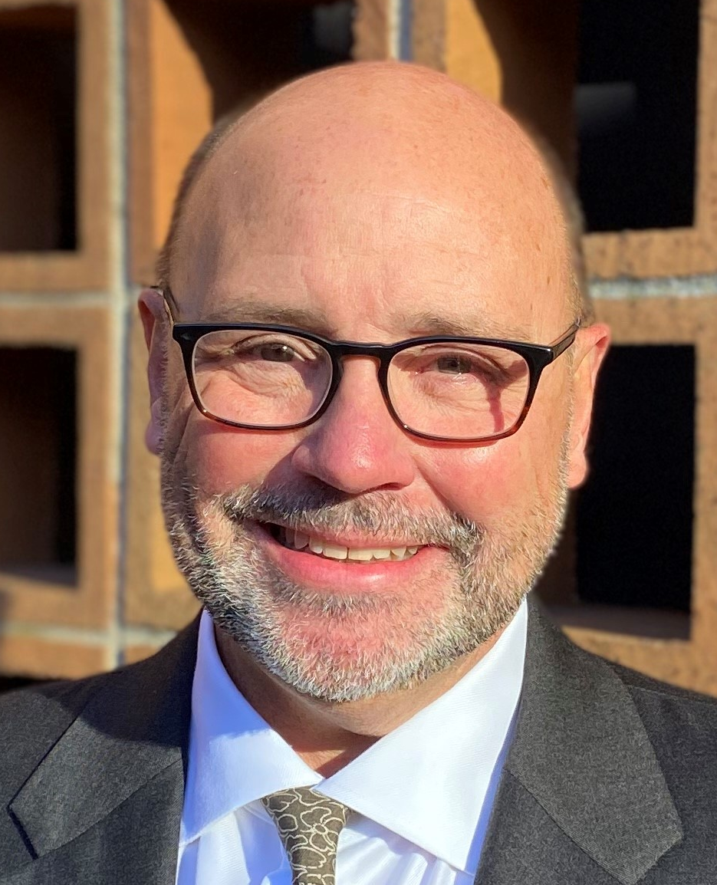
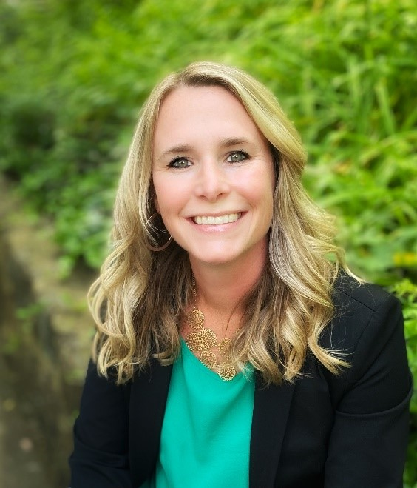
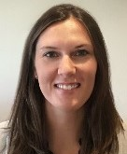
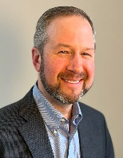
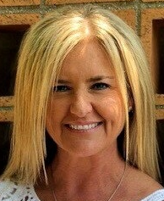

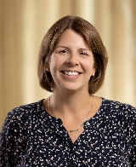

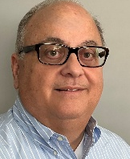
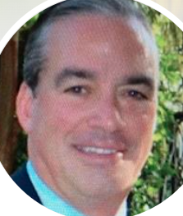
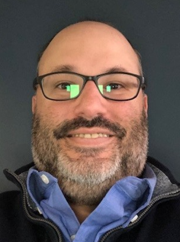
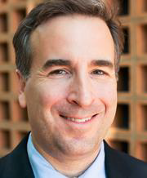
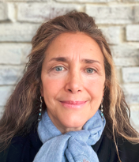
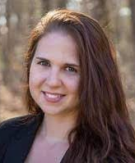
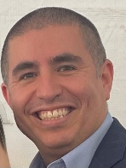
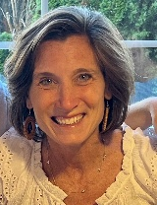

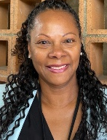

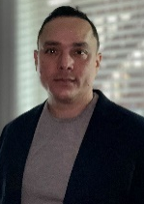
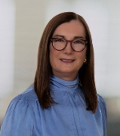
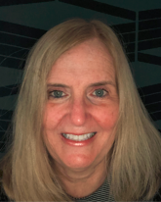
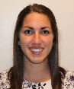
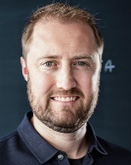
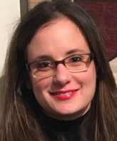
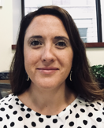
Financial Affairs Leadership Team
Updated Nov 2025
Nicole Tirella
Senior Vice President, CFO, & Treasurer
Procure to Pay (P2P)
Internal Audit & Advisory Services
Continuous Improvement & Data Analytics
Budget & Planning
Financial Operations
Randall Moore
AVP,
Chief Procurement Officer
Marion Candrea
AVP & Chief Audit Officer
Kelly Lockard
AVP,
Continuous Improvement & Data Analytics
Open
Vice President,
Budget & Planning
Brian Donaldson
Vice President, Financial Operations
Risk Management
Heather
Gillis
Assistant VP,
Procurement, Contracting, & Shared Services
Richard
Kotowicz
Director,
Internal Audit
& Advisory Services
Jen King
Executive Director, Consulting Services
Maria Cruz
AVP,
Budget & Planning
Joseph Grossi
AVP,
Academic Planning & Support
Jim Donohue
AVP, Risk Management
Matt Abrams
Assistant VP, Financial Operations & Strategic Projects
Keith Haran
Senior Director,
Sourcing
Silvia Alberta
Associate Director, IT Audit &
Special Projects
Meghan Chiasson
Director,
Consulting Services
Hiram Rodriguez
Executive Director
Budget & Planning
Laura Collins
Director,
Budgeting & Planning
Kate
Gomes
Director, Risk Management
University Controller
Open
AVP, & University Controller
Denise Greene
Senior Director, Payment Services
Jarrod Cain
Assistant Director,
Data
Analytics
Del Reese
Executive Director Financial Reporting & Strategic Planning
Debt & Treasury
Diana Hoadley
AVP,
Debt, Treasury
Maryellen Bliss
Assistant VP, Student Financial Services
Brianna Fanning
Assistant VP, Financial Accounting &
Reporting
Tim Busanoski
Associate Director, Debt
Missy Downs
Associate Controller, Research Financial Operations
Jamie Simole
Associate Controller, Payroll Services

Slide 2
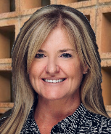
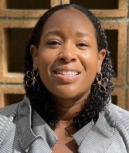
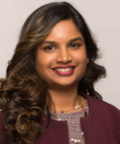
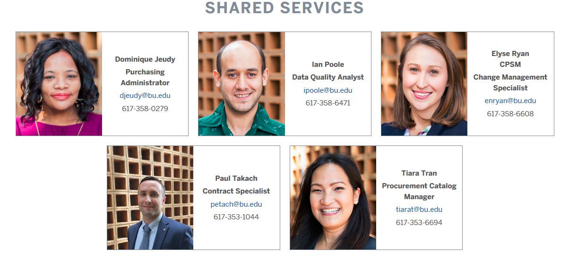
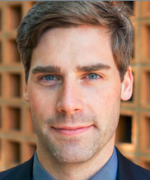
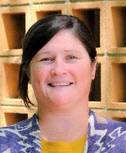
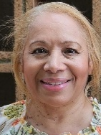
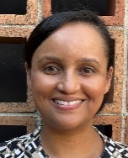
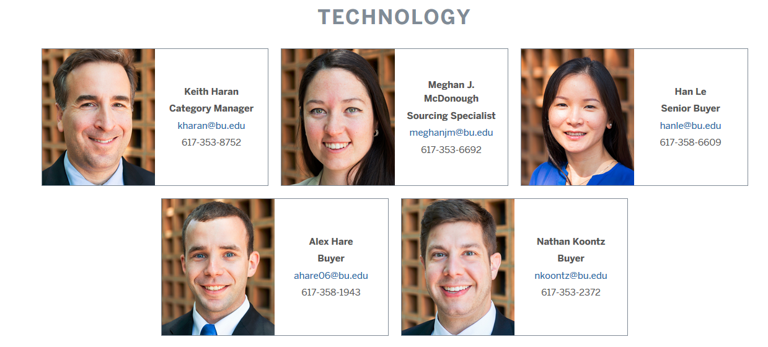
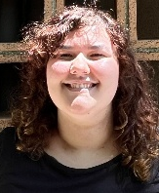
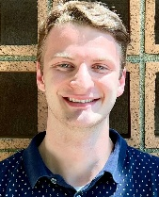
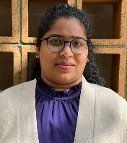
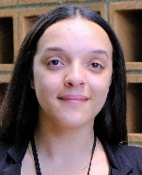
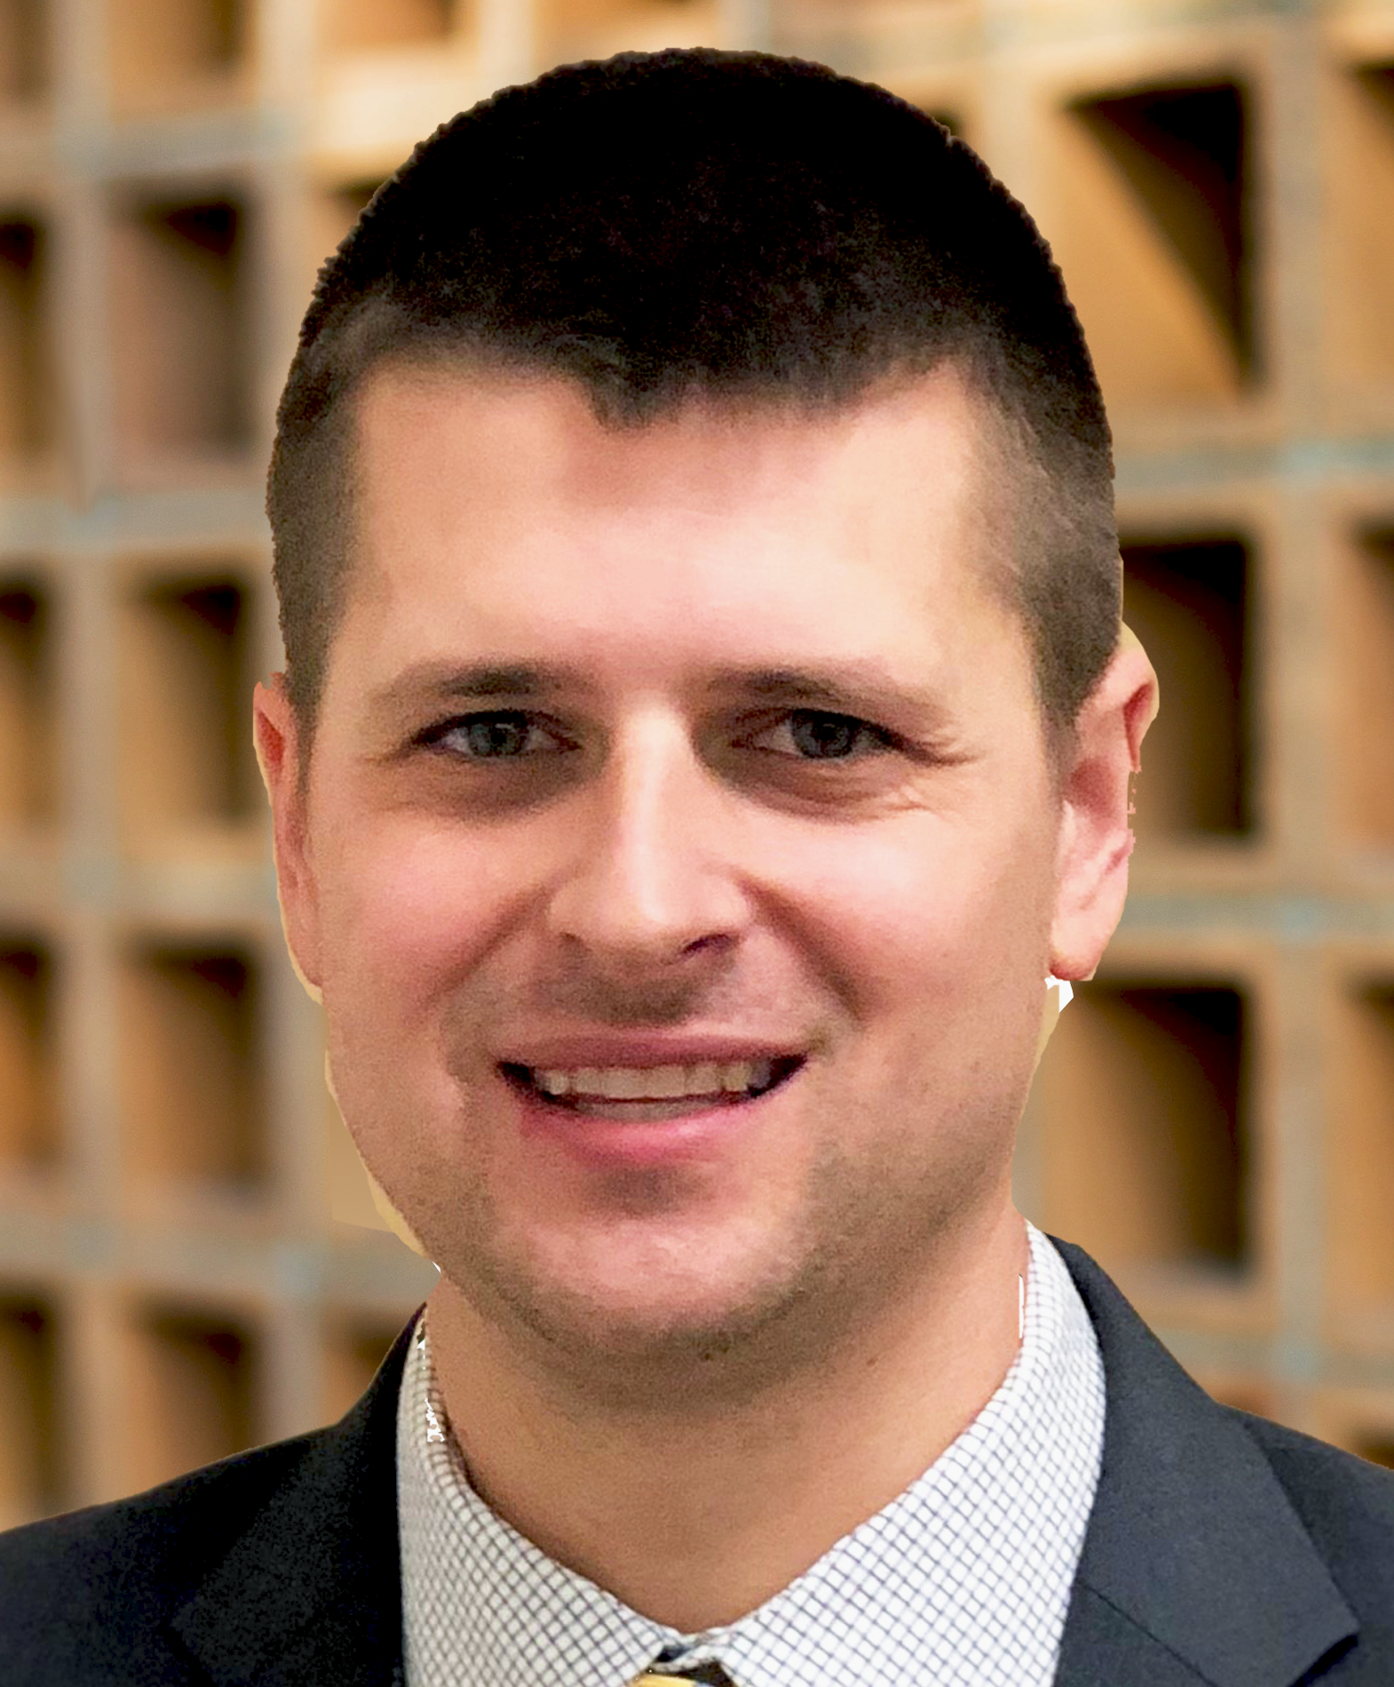
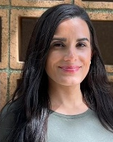
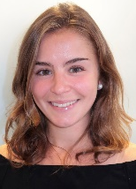
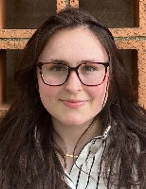
Randall
Moore
Associate Vice President,
Chief Procurement Officer
Updated Nov 2025
Procure to Pay (P2P)
Heather
Gillis, CCWP
Assistant Vice President,
Procurement, Contracting, & Shared Services
P2P Systems | Contracting | Procurement | Shared Services / Customer Success
Olivia Clachar
Associate Director, Shared Services
Sri Teja
Kotha, MS
Senior Associate Director, P2P Systems
Paul
Takach, JD
Associate Director,
Contracts
Daniel Tremblay, MS
Senior
Contracts Administrator
Nikki
Mackay
Senior
Contracts Administrator
Juana Rivera-Trivino
Supplier Onboarding Specialist
Malika
Napoli, JD
AIA Contracts Specialist
Alex Hare
Contracts Administrator
Avery Stermel
Contracts Administrator
Christian de Penasse Mouwen
Contracts Administrator
Mohana Puvvada
Customer Success
Coordinator
Brittany
Valdez
Supplier Onboarding Coordinator
Gavin
Wilkie, MBA
Senior
Contracts Administrator
Leza Pereira
Customer Success Coordinator
Emelyn Theriault
Training & Change
Management
Specialist
Julia Petrillo Contracts Administrator

Slide 3
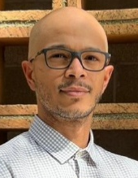
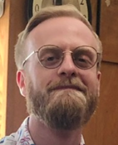
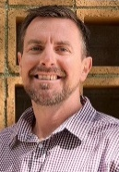
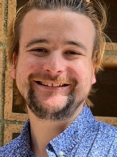
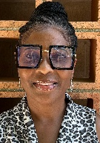
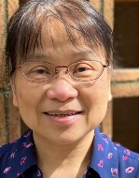
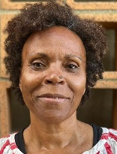
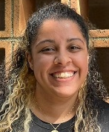
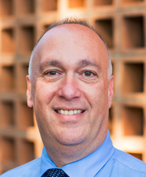
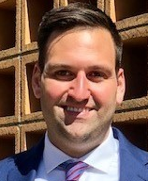





Randall
Moore
Associate Vice President,
Chief Procurement Officer
Updated Nov 2025
Procure to Pay (P2P) (continued)
` | Disbursement Processing / Payment Services | Analytics | Travel
Accounts Payable & Travel Services
Andrew Reagan
Associate Director, Payment Services
Juan Rodriguez
Assistant Director, Disbursement Processing
Chase Milanese
Associate Director, Travel & Card Services
Denise Greene
Senior Director, Payment Services
Robert Blake
Senior Payment Services Manager
Shirley Hood
Card Services Specialist
Open
Payment Services Clerk
Lisa Chen
Payment Services Coordinator
Allison Lambert
Travel Clerk
Tamika Quinn
Payment Services Specialist
 | Research $235.7M | Technology $80.3M | Professional Services $185.6M | Auxiliaries & Site $86.8M | Facilities & Construction $304.4M
Sourcing
Bob
Simboli
Senior Associate Director
Stephen Doolin, MBA
Category
Manager
Michela Stahl
Associate Category Manager
Meghan
McKay, MBA Senior Category Manager
Brian Hanley
Associate
Category
Manager
Keith Haran,
MBA
Senior Director,
Sourcing
Alec Reardon
Sourcing Specialist
Alex Mouwen
Sourcing Specialist
Nick El-Dahr
Sourcing Specialist, Travel

Slide 4






Marion Candrea
Associate Vice President,
Internal Audit & Advisory Services
Internal Audit & Advisory Services
Updated Nov 2025
Evaluate and Improve Risk Mgt, Internal Controls, Compliance Requirements, and Governance Processes
Audit & Advisory Services
Michelle Blanchette
Manager,
Audit & Advisory Services
Marline Ogunjobi
Manager,
Audit & Advisory Services
Dave Hruban
Construction Audit Manager
Richard Kotowicz
Director,
Audit & Advisory Services
Ishimwe “Nadine” Uwase
Project Manager
Kristin Law
Project Manager
Open
Senior Auditor
IT Audit & Special Projects
Identify and Assess IT Risks. Participate in University’s Enterprise Risk Management Program
Silvia Alberta
Associate Director, IT Audit &
Special Projects
Salman Aziz
IT Audit Manager
Data Analytics
Insights on Risks Using Data. Develop audit focused data analytical tools
Jarrod Cain
Assistant Director,
Data Analytics
Elaiya “Eli” Gonzalez
Data Analytics Manager
Open
Senior Data Analyst

Slide 5









Updated Nov 2025
Kelly Lockard
Associate Vice President, Continuous Improvement & Data Analytics
Continuous Improvement & Data Analytics (CIDA)
Internal Consulting Projects
Continuous Improvement
Jen King
Executive Director, Consulting Services
Steve Marois
Associate Director, Consulting Services
Marie Vearling
Manager, Consulting Services
Alex Barton
Senior
Consultant
Allison Reilly
Senior
Consultant, Data Solutions
Spencer Hilton
Senior
Consultant
Sagar Kamra
Senior Consultant, Data Solutions
Data Analytics
Report Automation & Data Analysis
Meghan Chiasson
Director, Consulting Services
Esther Hering
Manager, Consulting Services
Ian Poole
Senior Data Analytics Developer
Emily Perrotti
Senior Consultant, Data Solutions
Jake Blumenthal
Senior
Consultant

Slide 6










Research Financial Operations
Updated Nov 2025
Missy Downs
Associate Controller, Research Financial Operations
Accounts Receivables & Cash Operations | Property Management | Cash Management | Financial Reporting & Reconciliation
Qi “Chris” Li
Assistant Director, AR & Cash Ops
Maura Blanchard
Assistant Director, Property Management
Kristin Sacca
Associate Director, Cash Management
Kristen Donovan
Associate Director, Research Finance
Roger Tsang
Billing & Account Specialist
Scott Stewardson
Property Administrator
Jackie Chau
Senior Billing & Account Specialist
Tien Phung Truong
Senior Billing & Account Specialist
Erinne Dull
Senior Staff Accountant
Open
Cash Application Analyst
Liam Hennessey
Property Administrator
Chrissy Grieves
Billing & Account Specialist
Orson Williams
Billing & Account Specialist

Slide 7






Operations, taxation and garnishments, Technology
Updated Nov 2025
Open
AVP, University Controller
` | Operations | Taxation and Garnishments | Technology
Payroll Services
Danielle Trahon
Senior Associate Director, Payroll Processing & Reconciliation
Brenda Leary
Senior Associate Director, Payroll Technology & Projects
Kathy Sirois
Associate Director, Tax & Payment Processing
Jamie Simole
Associate Controller,
Payroll Services
Thompson Ludwig
Asst Director, Payroll & Time Administrator
Sarah Ahari
Payroll Accountant
Cherryce Williams
Senior Account Analyst
Ryan Peterson
Payroll & Time Administrator
Ida Winick-Lilkely
Payroll & Time Administrator
Wilma Miranda
Senior Payroll Tax Administrator
James Fernandes
Payroll & Time Administrator

Slide 8











Student Financial Services
Updated Nov 2025
Maryellen Bliss
Assistant Vice President, Student Account Services
` | Student Accounts Operations | Student Accounts Customer Service
Student Accounting Services
Bonita Huang
Associate Director, Student Accounts Operations
Eric Nyman
Senior Associate Director, Student Account Customer Services
Karen Cossette
Senior Business Analyst
Brittany Johnston
Assistant Director, Student Account Customer Services
Sarah Horikami
Assistant Director, Student Account Customer Services
McCayla Quinn
Senior Operations Analyst
Lisa Wong
Business Analyst
Ellie Krasner
Senior Student Financials Specialist
Jason Montezuma
Senior Student Financials Specialist
Ellen Millman
Reporting Specialist
Daryl Mencey
Student Financials Specialist
Nicholaos Mitsiu
Student Financials
Specialist
Kerry Pinette
Student Financials Specialist
Nick Santos
Student Financials Specialist
Veronica
Kelly
Operations
Specialist
Accounting & Analytics
Jennifer Buono
Director, Accounting & Analytics
Christine Michaelidis
Associate Director, Accounting & Analytics
Open
Senior Staff Accountant
Shihan Duan
Staff Accountant

Slide 9






Student Financial Services (continued)
Updated Nov 2025
Kathleen Hynes
Director, Student Financial Services & University Bursar
`
Mike Keegan
Associate Director
Cathy McLaughlin
Manager, Student Loans
Shaun Mathieu
Assistant Director
Jack Litwinsky
Senior Student Loan Specialist
Corrine DePatra
Student Loan Specialist

Slide 10









Updated Nov 2025
Brianna Fanning
Assistant VP, Financial Accounting & Reporting
Financial Accounting & Reporting
Student Financial Initiatives & Reporting | Tax | Cash, Investments and Gift Accounting | PP&E, Lease, and Debt Accounting
Open
Senior Financial Reporting Analyst
Joan Valeriano
Supervisor, Tax and Reporting
Cara Griffin
Supervisor of Cash, Investments, & Gift Accounting
Tom Jenkins
Supervisor of Financial Operations
Brittany Tessier
Tax Analyst
Lindsey Hinze
Senior Staff Accountant
Cameron Burke
Senior Staff Accountant
Julia Leone
Associate Controller, Strategic Financial Initiatives
Aaron Rosenweig
Staff Accountant, Cash
Open
Staff Accountant, Gifts & Endowment
Alyssa Johnston
Staff Accountant, Operations
Tommy Nunez
Assistant Director,
Facilities Cost Analysis
Min Duan
Cost Analyst
Rossy Ramirez Warren
Staff Accountant, Investments

Slide 11



Updated Nov 2025
Maria Cruz
AVP,
Budget & Planning
Budget & Planning
Budget & Planning
Lorraine Weiss
Director, Budget & Planning
Open
Asst VP, Budget & Planning
Deborah McGuire
Senior Budget Analyst
Jenny Beesley
Senior Budget Analyst
Open
Senior Budget Analyst
Eva Huang
Senior Financial Analyst
Maureen Tarantino
Senior Financial Analyst
Hiram Rodriguez
Executive Director
Budget & Planning
Financial Reporting & Strategic Planning
Maureen Mayer
Assistant Director, Data Analytics & Process
Del Reese
Executive Director Financial Reporting & Strategic Planning

Slide 12

Updated Nov 2025
Budget & Planning - Academic Support
Joseph Grossi
AVP, Academic Planning & Support
Laura Collins
Director,
Budgeting & Planning
Kris Paneli
Senior Financial Analyst

Slide 13



Debt & Treasury Management
Updated Nov 2025
Diana Hoadley
Associate Vice President,
Debt, Treasury
Tim Busanoski
Associate Director, Debt
Peter Vuong
Treasury, Cash, & Forecasting Manager
Andy Kay
Treasury Analyst

Slide 14
Updated Nov 2025
Financial Operations
Brian Donaldson
Vice President, Financial Operations
Matt Abrams
Assistant VP, Financial Operations & Strategic Projects

Slide 15

Updated Nov 2025
Risk Management
Jim Donohue
Associate Vice President, Risk Management
Kate Gomes Director, Risk Management
Jim Cahill
Specialist II,
Risk Management

Slide 16



Updated Nov 2025
Nicole Tirella
Senior Vice President, CFO, & Treasurer
Financial Affairs Administration
Brian Masterson
Director, Finance & Administration
Alexandra Hodakovski
Office Manager
Sarah Pettengill
Executive Assistant

