Slide 1
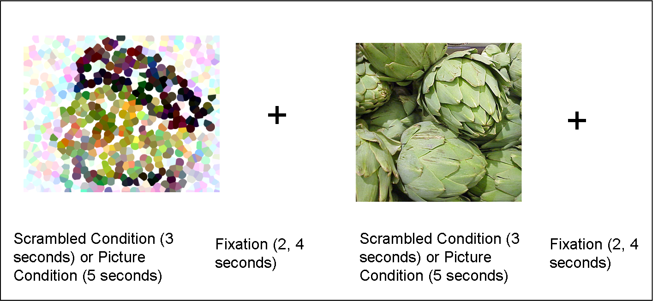
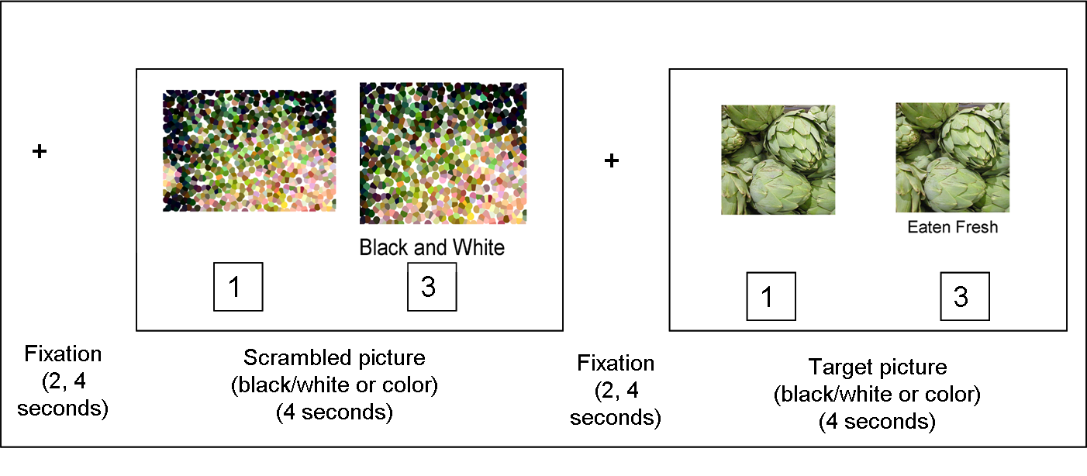
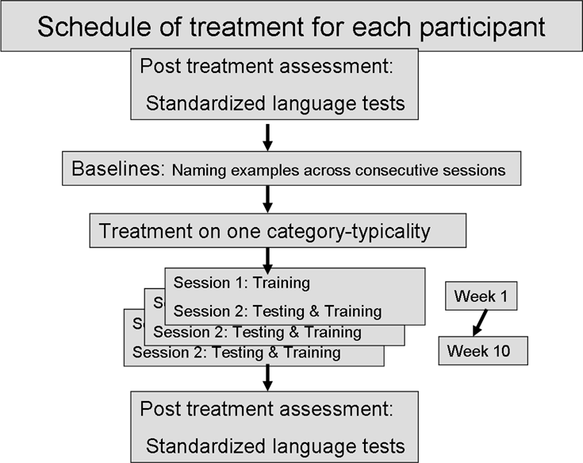
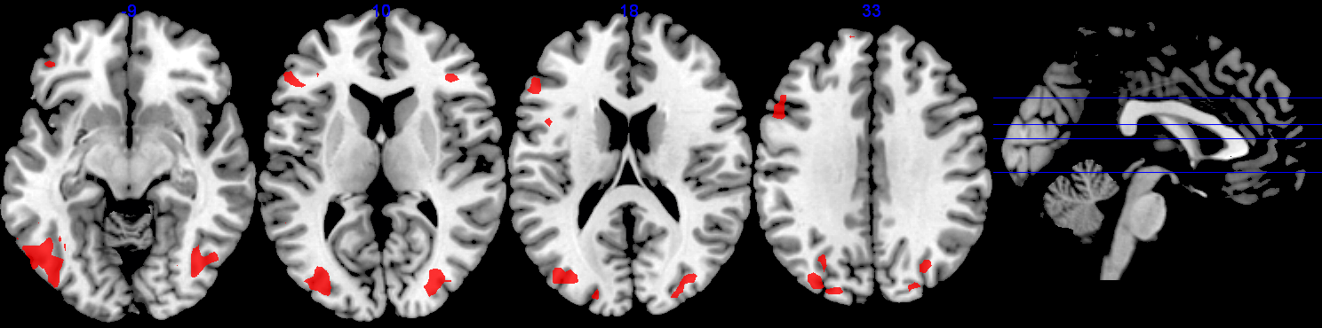
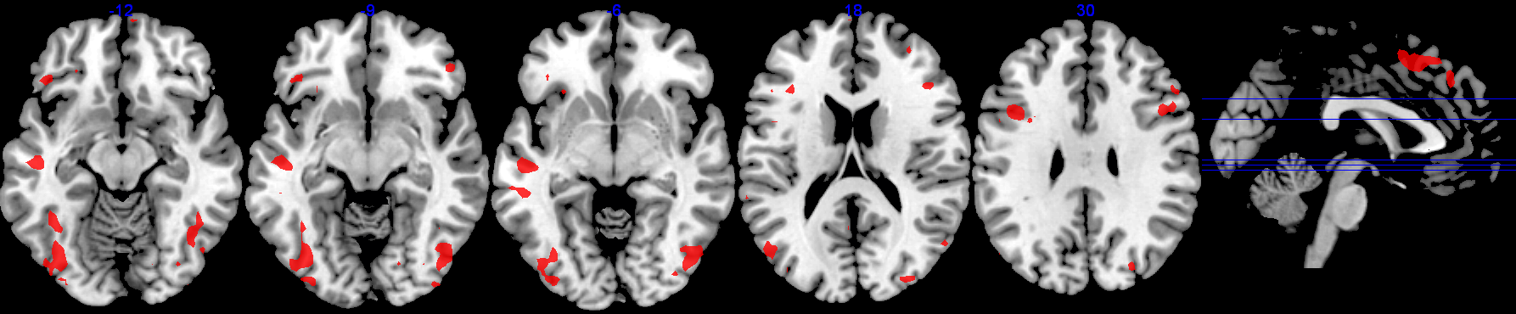
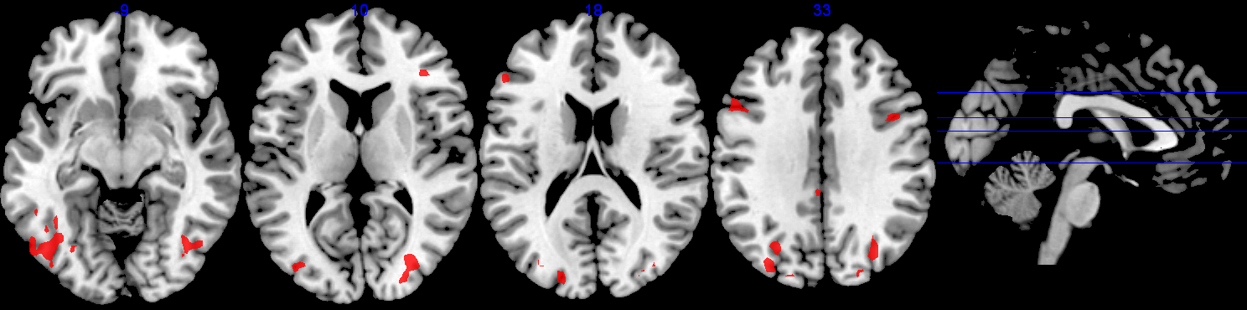
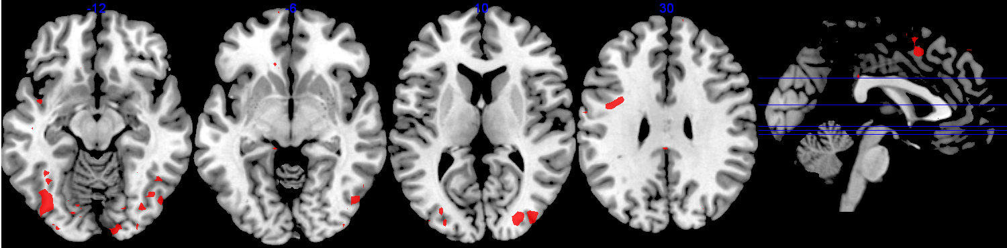
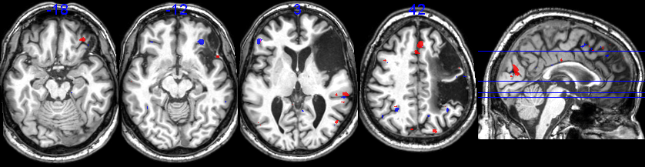
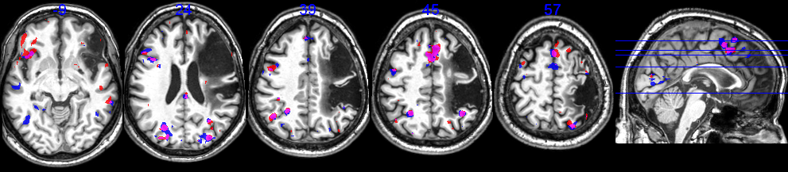
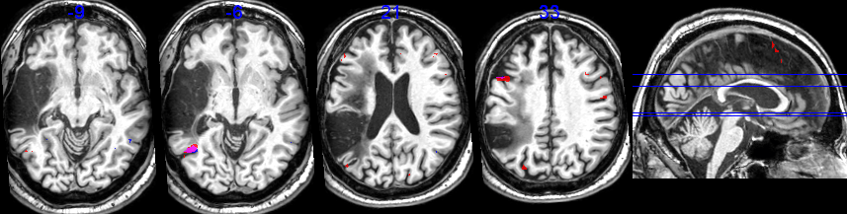
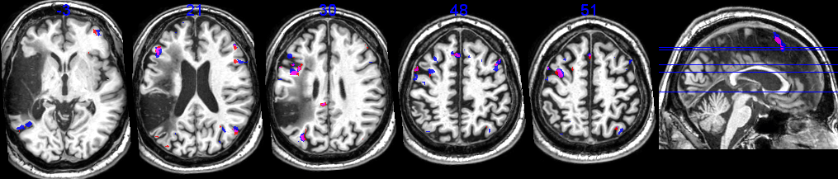
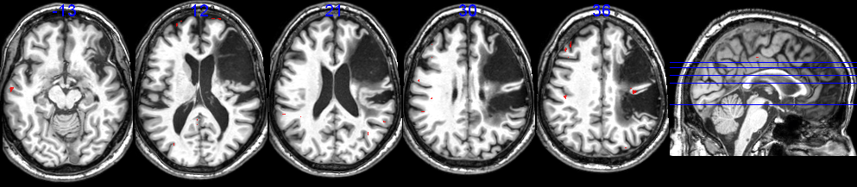
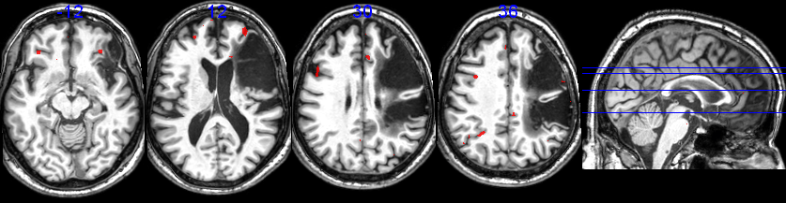
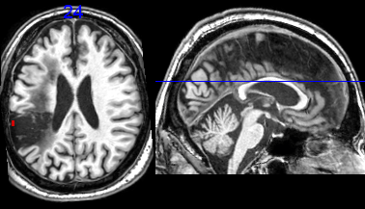
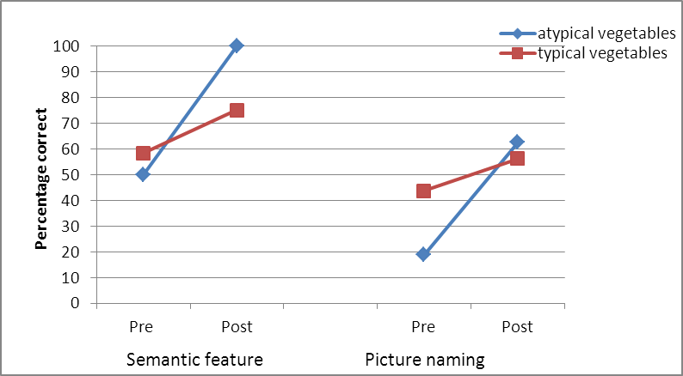
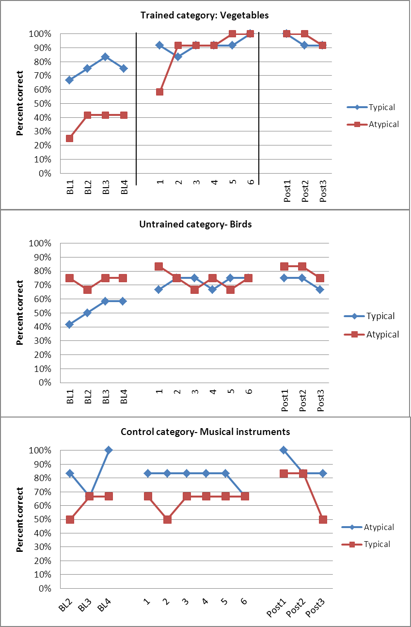
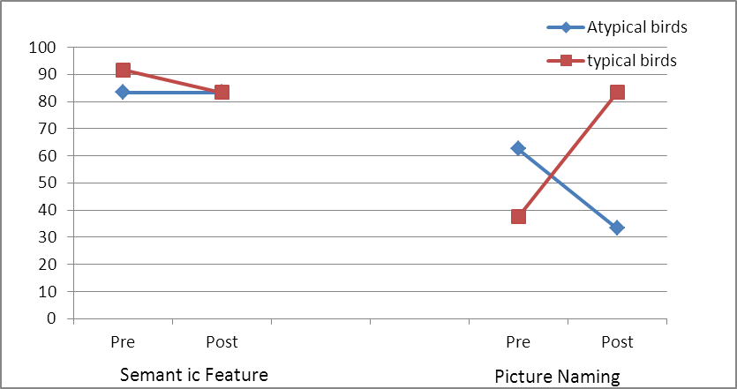
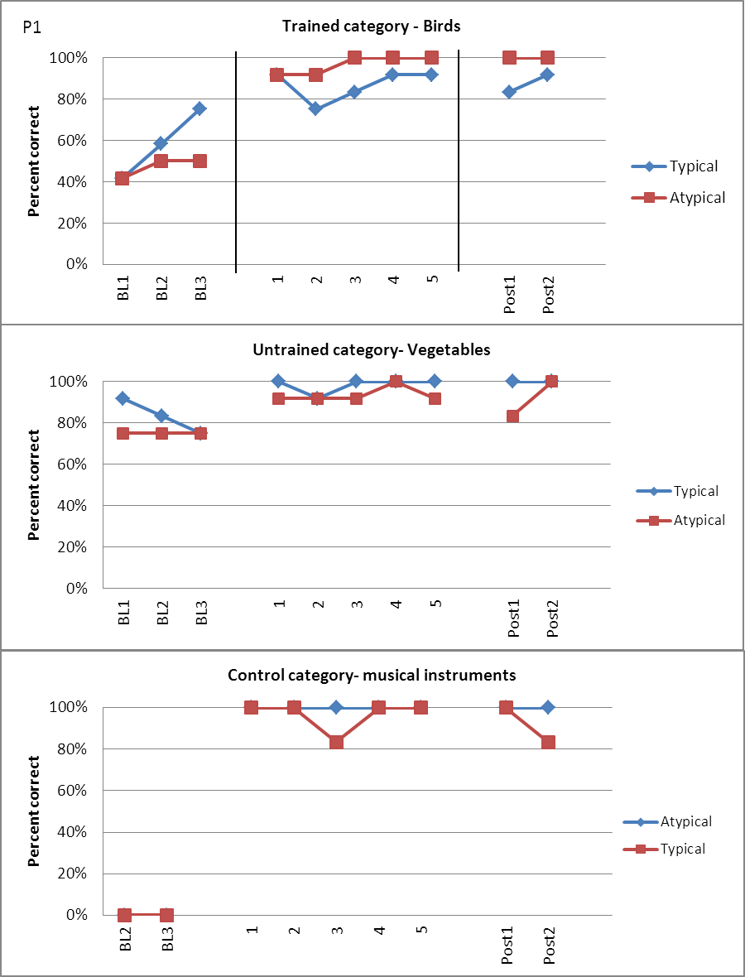
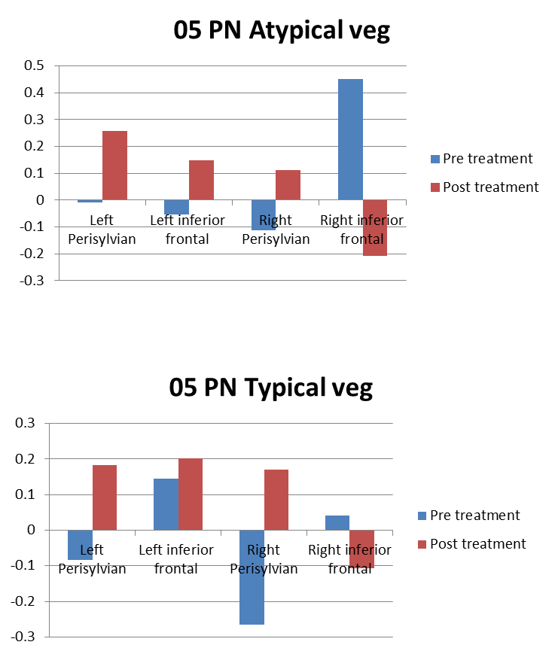
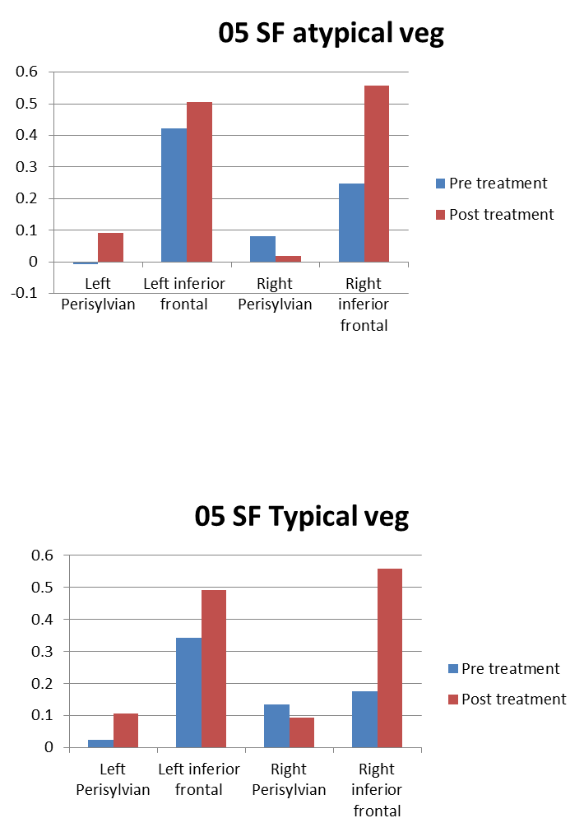
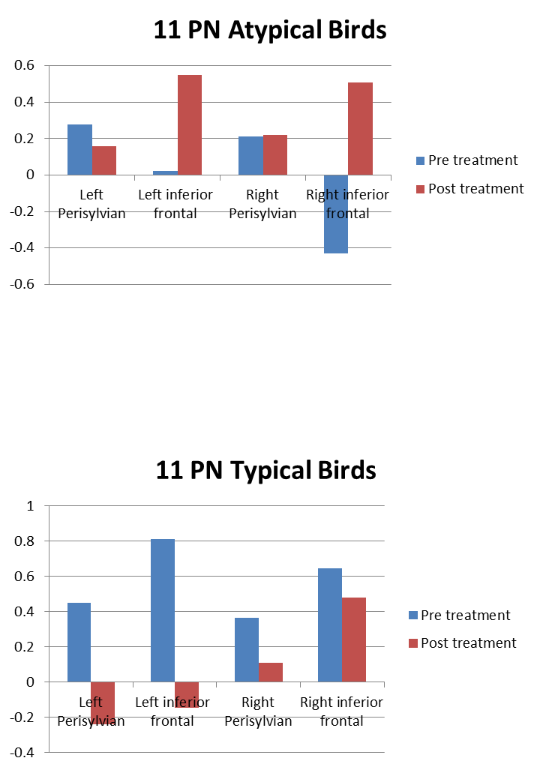
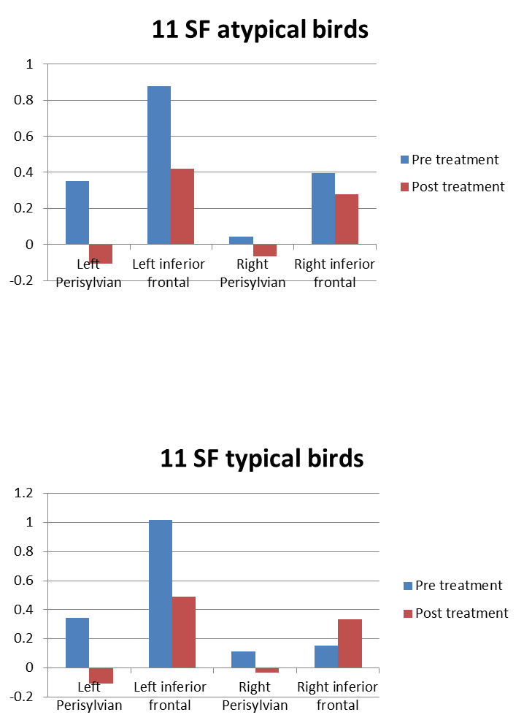
What is the role of the left hemisphere in recovery of language in patients with aphasia?
Swathi Kiran, Peter Glynn, Chaleece Sandberg, Israr Ul-Haq, Jennifer Richardson
Boston University
research suggest that a shift of language functions to the right hemisphere occurs primarily in regions homologous to damaged areas of the left hemisphere (Weiller et al., 1995; Abo et al., 2004; Xu et al., 2004), whereas other studies indicate that good recovery of language functions in aphasia is accompanied by greater perilesional than right hemisphere reorganization, and poor recovery of language functions is accompanied by greater right hemisphere then perilesional reorganization (Cao et al., 1999; Fernandez et al., 2004; Heiss et al., 1999; Heiss & Thiel, 2006; Hillis, 2002; Karbe, et al., 1998; Perani et al., 2003; Rosen, et al., 2000).
Rationale
Patients with aphasia
  N=3; 1 m, 2 f; age range: 55-67 (M: 59); R-handed; monolingual English-speaking
  CVA in LH with subsequent difficulties in word retrieval
Participants
Patients with aphasia
  N=3; 1 m, 2 f; age range: 55-67 (M: 59); R-handed; monolingual English-speaking
  CVA in LH with subsequent difficulties in word retrieval
Treatment Protocol
Semantic Feature Analysis (variation of Boyle & Coelho, 1995)
  Training set of 10 words
  For each word, participant:
    Chooses 6 features that belong to the word
    Answers 15 yes/no questions about the word
    Identifies whether word is abstract or concrete
    Generates a synonym for the word
P1: 10 weeks of treatment; abstract words in context of hospital
P2: 4 weeks of treatment; abstract words in context of hospital
P3: 10 weeks of treatment; abstract words in context of courthouse
  Untrained contexts used as controls
BUMA05 semfeat post+pre conj feat-ctrl thrs
BUMA05 PicNam post+pre conj pic-scram tg
BUMA11 PicNam post+pre conj pic-scram tg
BUMA11 semfeat post+pre conj feat-ctrl thrs
BUMA 05 semant feat- trained control
Discussion
All three patients improved on the trained abstract words; two patients also generalized to concrete words in the same context.
  All three patients showed increased activation in spared left hemisphere language areas after treatment. This supports the notion that better language recovery in chronic aphasia is associated with transfer of language function from compensation of the right hemisphere to spared language areas of the left hemisphere (Saur et al., 2006)
In both P1 and P2, much of left IFG was spared by the lesion and in P1, much of the left temporal lobe was also spared; however, P3’s lesion was quite large yet he showed similar results as the other two patients.
Abstract and concrete nouns tended to overlap in activation both before and after treatment, which is consistent with age-matched controls (Sandberg & Kiran, unpublished data).
Notably, however, the trained structure (abstract words) showed more increased activation than concrete words. This matches the behavioral results seen both during treatment and while scanning.
Conclusion
These tentative results suggest:
  Training abstract words increases activation in areas thought to process abstract words.
  Generalization from abstract to concrete words during treatment may coincide with increased neural activation for concrete words from pre- to post-treatment.
It is important to note that these patients were more highly functioning than the average aphasic patient with highly accurate responses on the fMRI task even before treatment.
Future research should focus on a larger sample, with a wider severity range.
References
Barry, C., & Gerhand, S. (2003). Both concreteness and age-of-acquisition affect reading accuracy but only concreteness affects comprehension in a deep dyslexic patient. Brain and Language, 84, 84-104.
Binder, J. R., Desai, R. H., Graves, W. W., & Conant, L. L. (2009). Where is the semantic system? A critical review and meta-analysis of 120 functional neuroimaging studies. Cerebral Cortex, 1-30.
Boyle, M., & Coelho, C. A. (1995). Application of Semantic Feature Analysis as a Treatment for Aphasic Dysnomia. Am J Speech Lang Pathol, 4(4), 94-98.
Cabeza, R. (2001). Cognitive neuroscience of aging: Contributions of functional neuroimaging. Scandinavian Journal of Psychology, 42, 277- 286.
Kiran, S., Sandberg, C., & Abbott (2009). Treatment for lexical retrieval using abstract and concrete words in persons with aphasia: Effect of complexity. Aphasiology, 23, 835-853.
Nickels, L., & Howard, D. (1995). Aphasic naming: What matters? Neuropsychologia, 33(10), 1281-1303.
Paivio, A. (1991). Dual coding theory: Retrospect and current status. Canadian Journal of Psychology, 45(3), 255-287.
Saur, D., et al. (2006). Dynamics of language reorganization after stroke. Brain, 129(6), 1371-1384.

