Slide 1
Guided BUying QRG
Quick Reference Guide
Invoice Exception Manually Match PO

Slide 2
Invoice Exception Manually Match PO

Slide 3
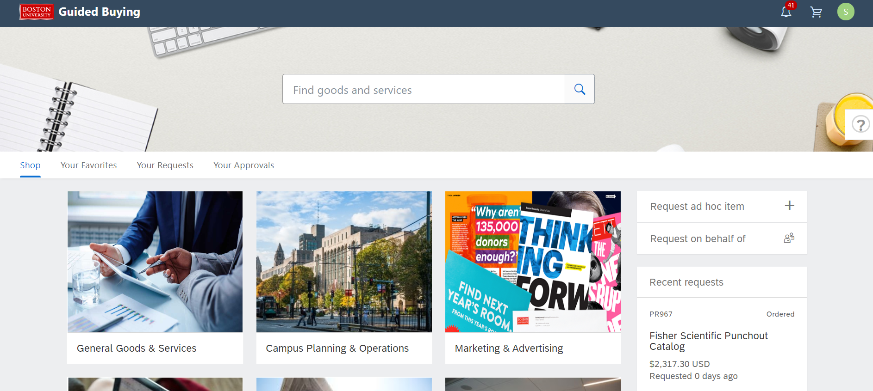
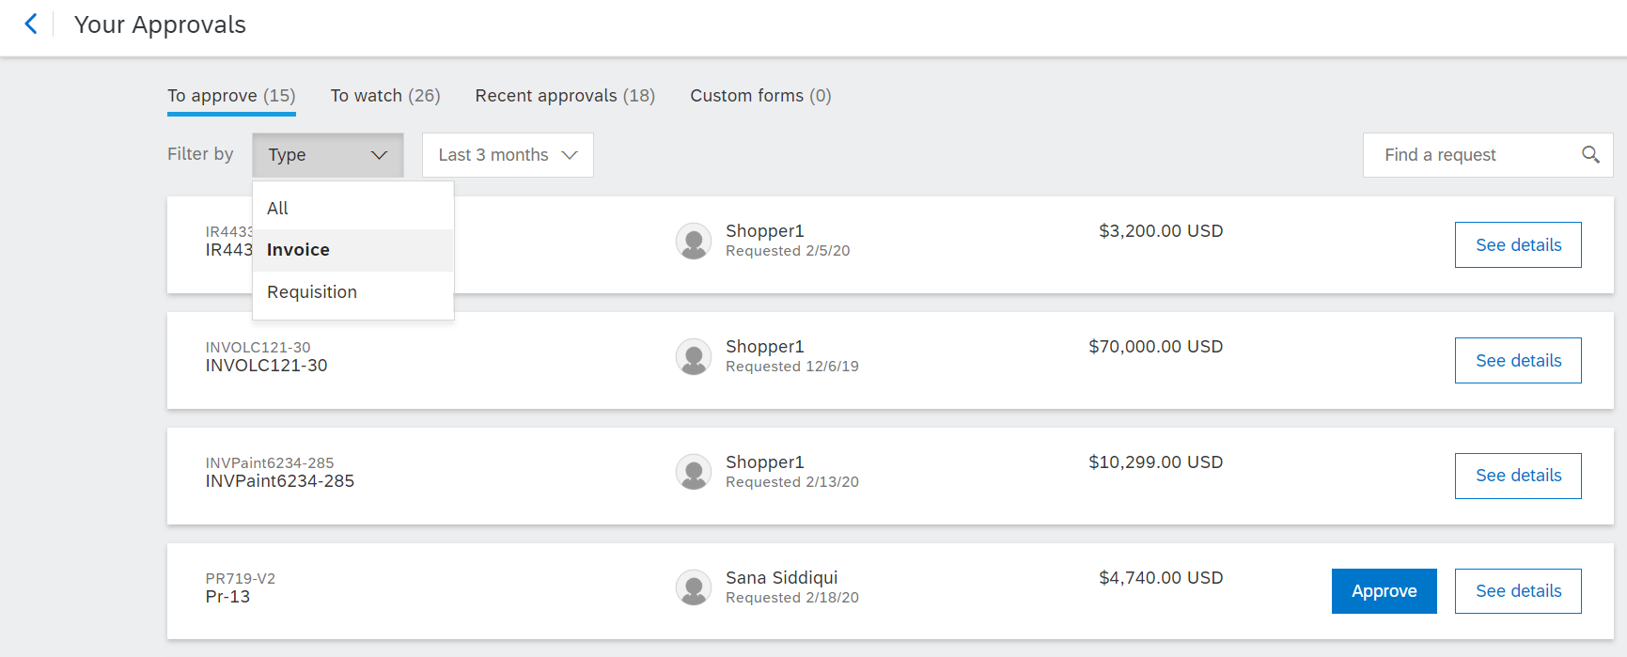
Invoice Exception Navigation
To view an invoice exception, navigate to the Invoice Reconciliation Document (IR) within Guide Buying.
1
1
Click on Your Approvals
2
Make sure that To Approve tab is highlighted.
3
From the Filter by drop down, click Invoice.
2
Click the See details button next to the (IR) invoice reconciliation for which you need to handle exceptions.
4
4
3

Slide 4
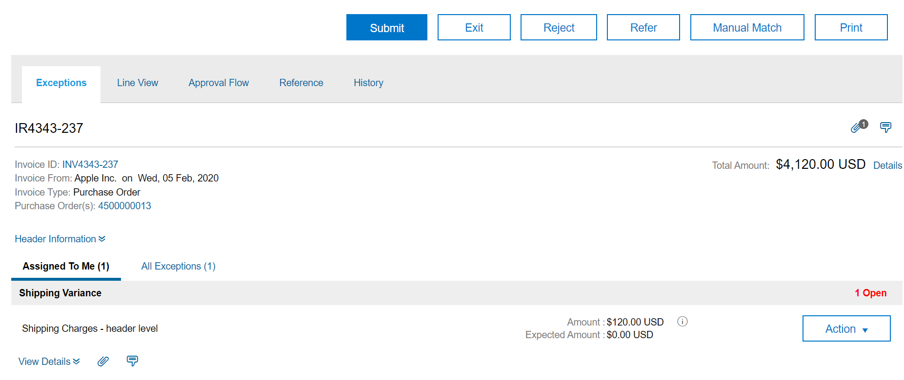
Invoice Exceptions
Handle Invoice Exceptions
In this example, we will look at the steps to handle a Shipping Variance.
5
Click the Exceptions tab to view the exceptions raised for the particular invoice.
5
6
Click the Assigned To Me tab to view the exceptions assigned to you for this invoice.
6

Slide 5
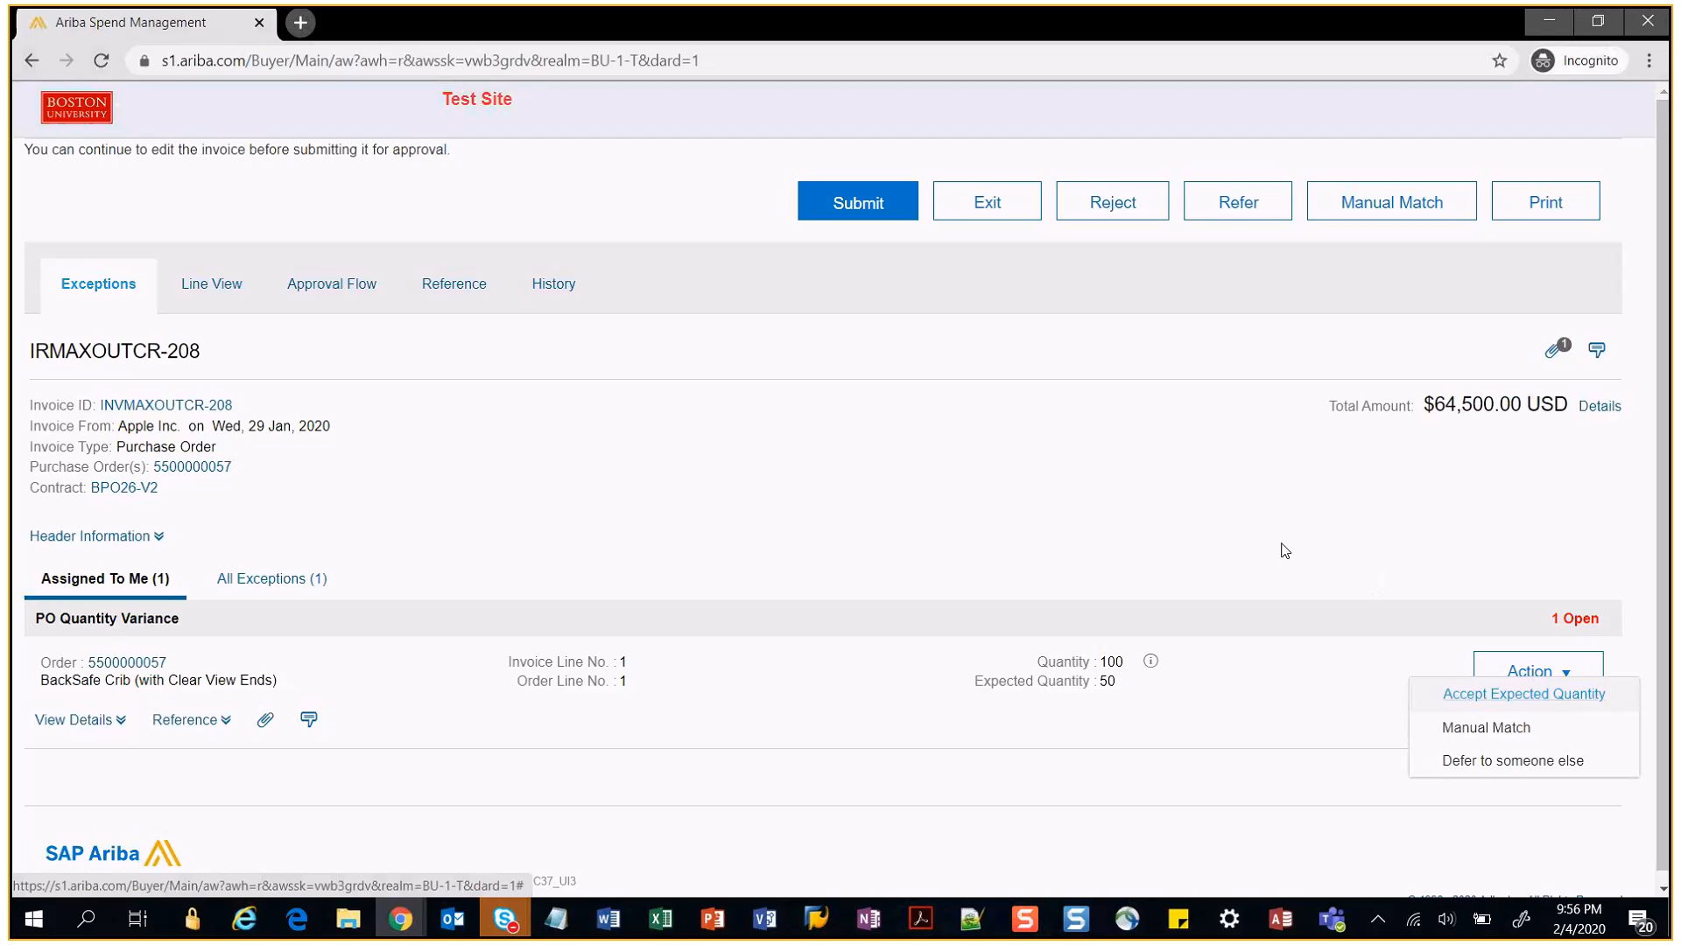
Invoice Exceptions
Handle Invoice Exceptions (Manual Match – 1 of 6)
Supplier submits Invoice against some other PO.
In such a case, you need to Manually match the correct PO number against the invoice by following the below procedure:
1
Click the Action drop-down button next to the exception.
2
Select the Manual Match option from the drop-down menu.
1
2

Slide 6
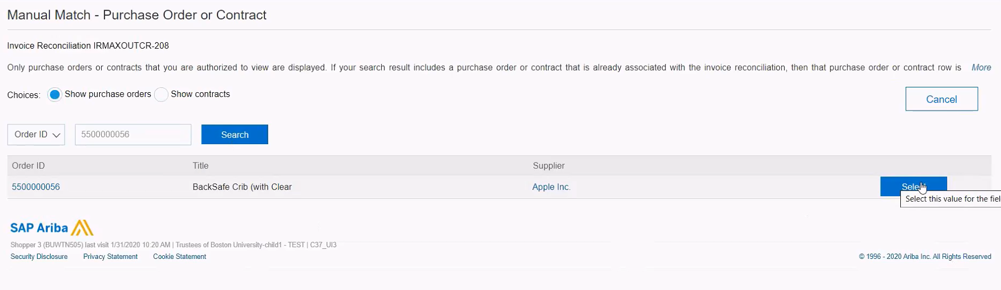
Invoice Exceptions
Handle Invoice Exceptions (Manual Match – 2 of 6)
Select Line Items
You can manually match the invoice line item with the PO line item.
3
Click the radio button next to Show PO.
3
4
Enter the correct PO number and click search
4
5
Click Select.
5

Slide 7
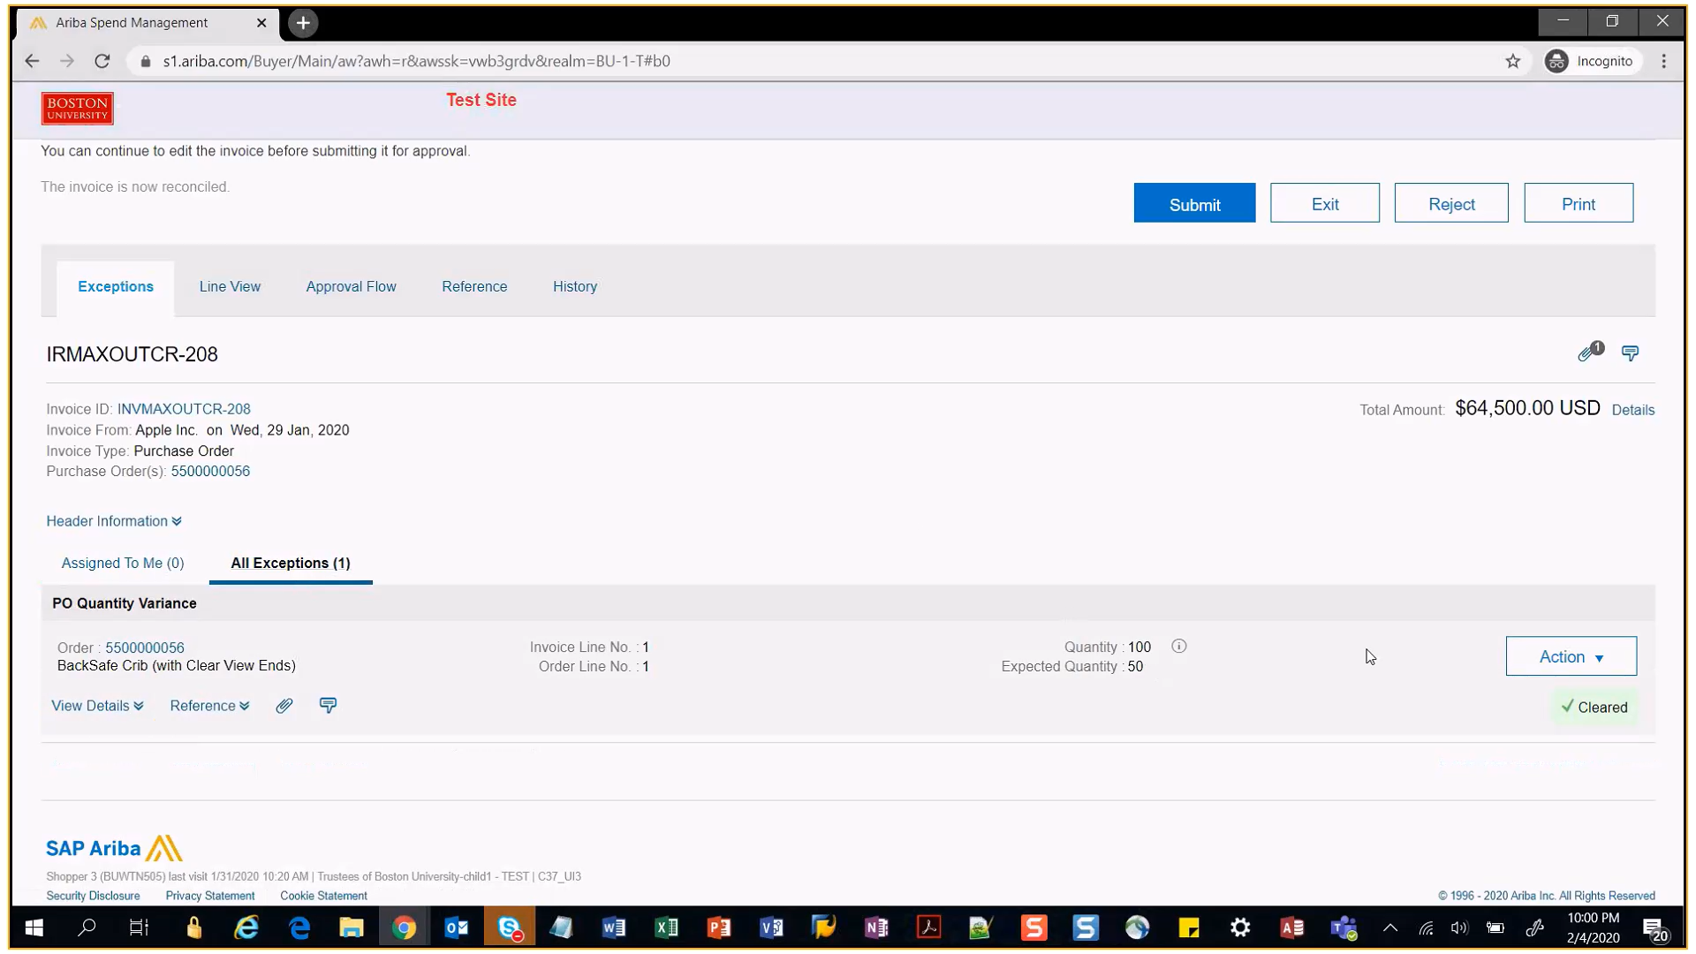
Invoice Exceptions
Handle Invoice Exceptions (Manual Match – 3 of 6)
Submit Invoice
After you handle the exception for the invoice, you can submit it as displayed:
7
6
The exception status has updated to cleared.
7
Click the Submit button.
6

Slide 8
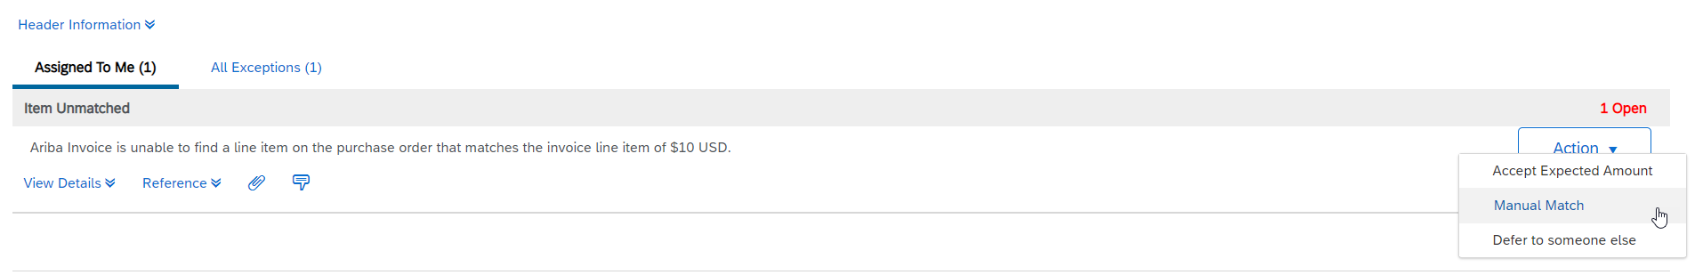
Invoice Exceptions
Handle Invoice Exceptions (Manual Match – 4 of 6) – Unmatched Item Exception
In case a Supplier submits Invoice with an additional item which is not present/available on the original PO (e.g. service charge, freight charge)
In such a case, an Unmatched Item Exception will be raised on the Invoice and will be sent to the Shopper
If you want to accept the additional item on the Invoice, you need to change the PO and add the exact same line item to the PO.
After adding the item to the PO, manually match the invoice item with the correct PO item number by following the below procedure:
1
Click the Action drop-down button next to the exception.
2
Select the Manual Match option from the drop-down menu.
1
2

Slide 9
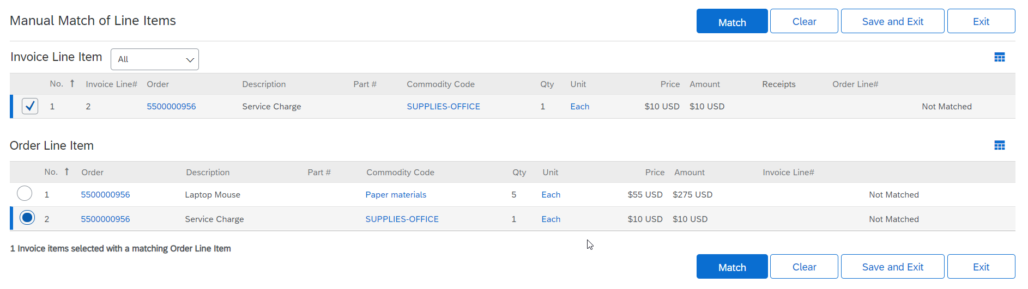
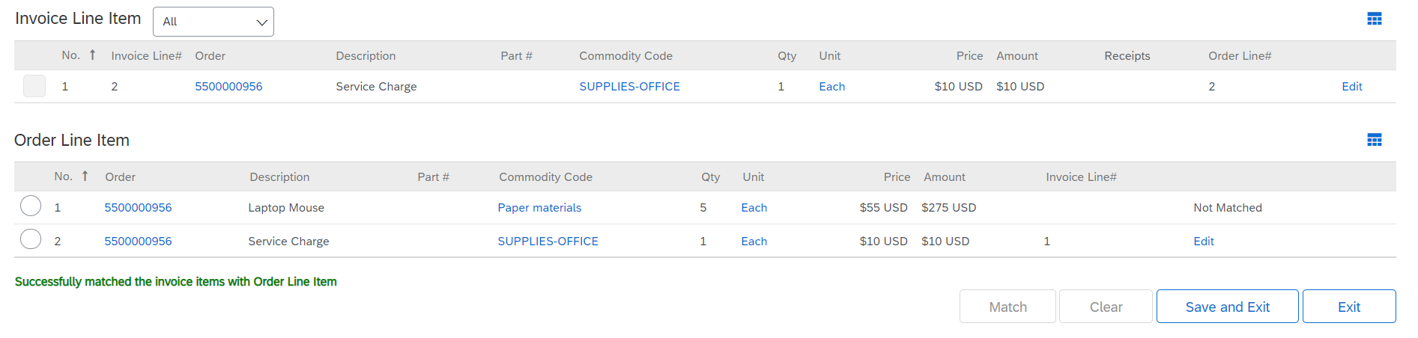
Invoice Exceptions
Handle Invoice Exceptions (Manual Match – 5 of 6) – Unmatched Item Exception
Select Line Items
You can manually match the invoice line item with the PO line item.
3
Select the check box against the Invoice item that is not matched.
3
4
Select the newly added item on the PO that now matches the invoice item
4
5
5
Click Match.
6
Success message will be shown after the match is complete
6
7
7
Click on Save and Exit button.

Slide 10
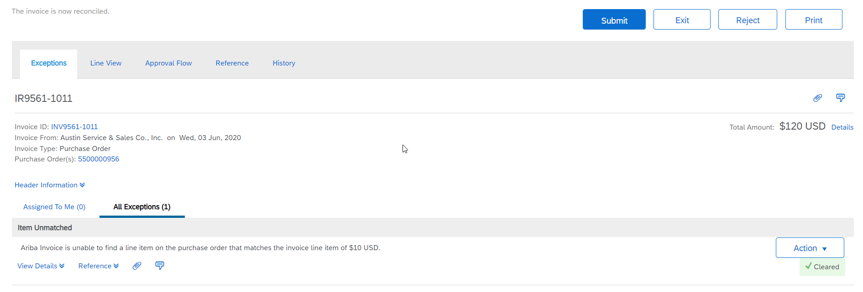
Invoice Exceptions
Handle Invoice Exceptions (Manual Match – 6 of 6) – Unmatched Item Exception
Submit Invoice
After you handle the exception for the invoice, you can submit it as displayed:
9
8
The exception status has updated to cleared.
9
Click the Submit button.
8

Slide 11
Additional Resources: Guides, FAQ, and Assistance
Guides & FAQs
How to Place Orders
FAQs
Invoice Guides and FAQ
Contact Us
Ordering Information: Submit a ticket to Sourcing & Procurement via the Financial Affairs Customer Service Portal.
Invoice & Payment Information: Submit a ticket to Accounts Payable via the Financial Affairs Customer Service Portal.
11

