Slide 1
Guided BUying QRG
Quick Reference Guide
Invoice Exception

Slide 2
Invoice Exceptions

Slide 3
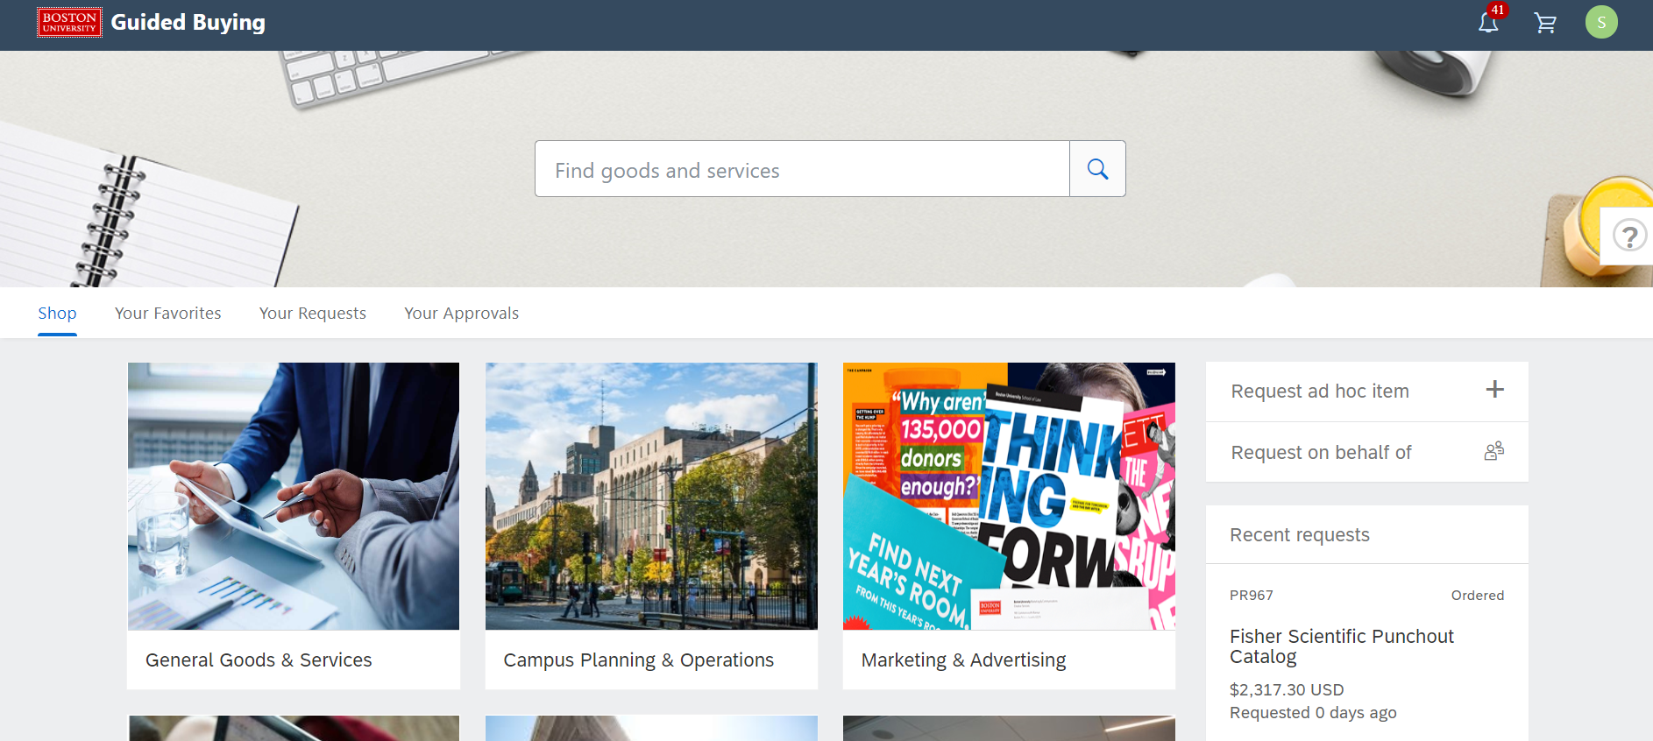
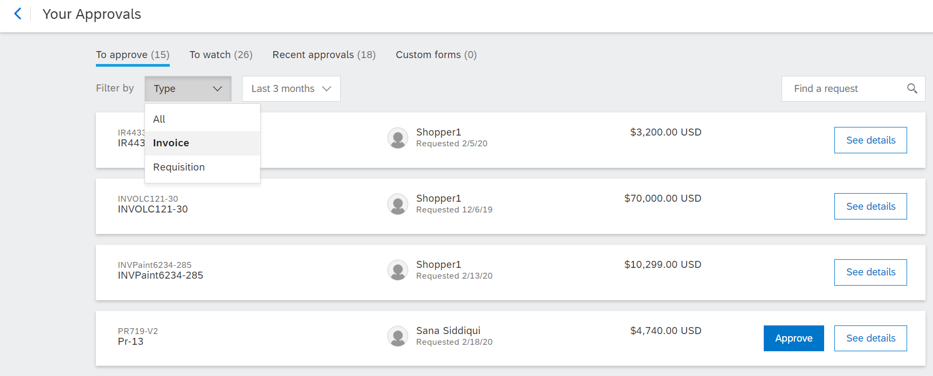
Invoice Exception Navigation
To view an invoice exception, navigate to the Invoice Reconciliation Document (IR) within Guide Buying.
1
1
Click on Your Approvals
2
Make sure that To Approve tab is highlighted.
3
From the Filter by drop down, click Invoice.
2
Click the See details button next to the (IR) invoice reconciliation for which you need to handle exceptions.
4
4
3

Slide 4
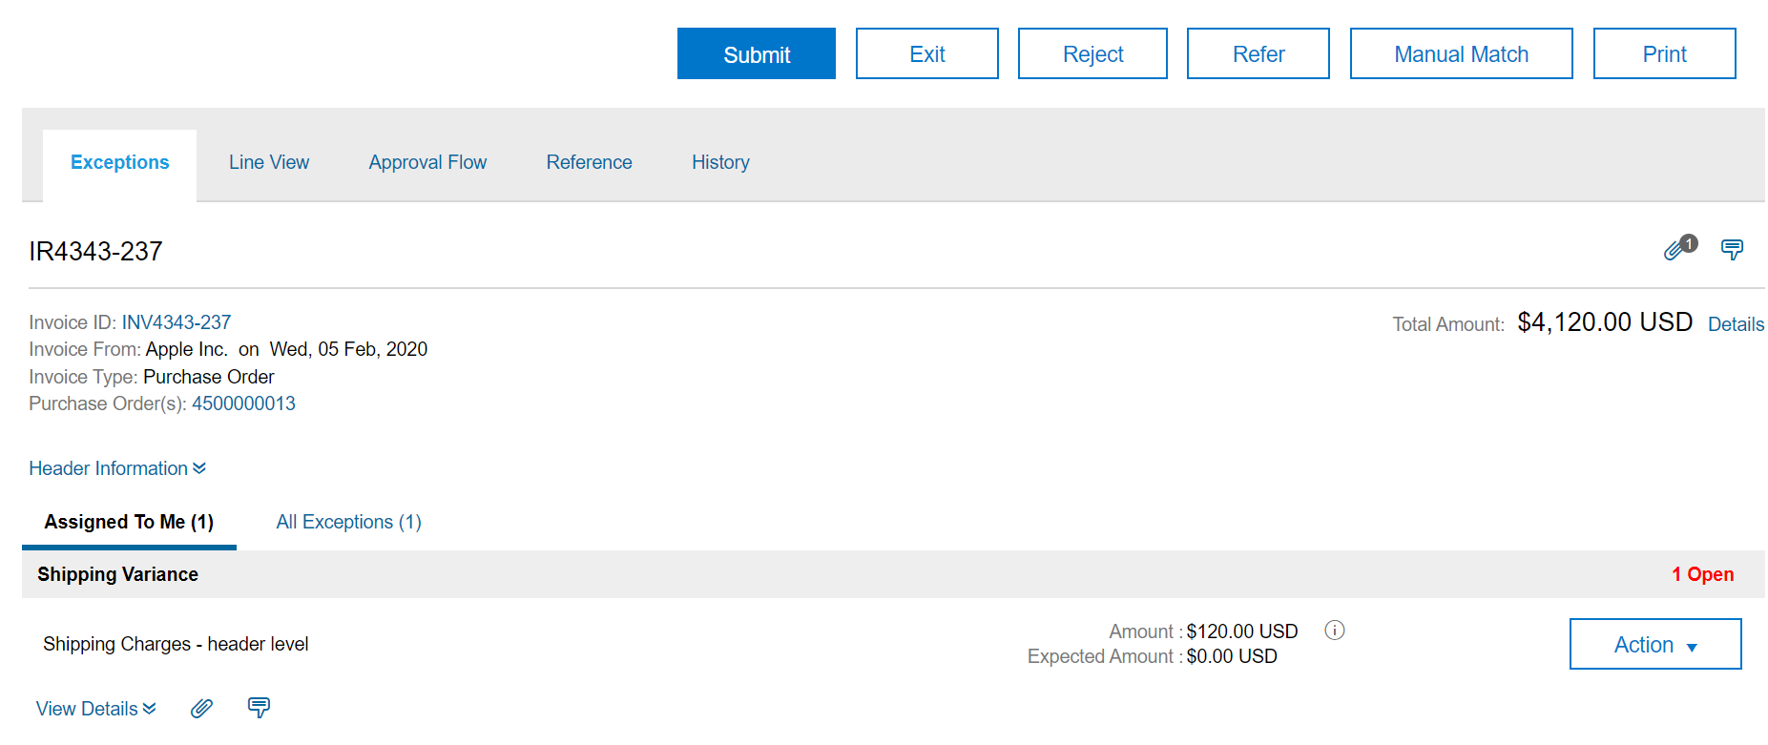
Invoice Exceptions
Handle Invoice Exceptions
In this example, we will look at the steps to handle a Shipping Variance.
5
Click the Exceptions tab to view the exceptions raised for the particular invoice.
5
6
Click the Assigned To Me tab to view the exceptions assigned to you for this invoice.
6

Slide 5
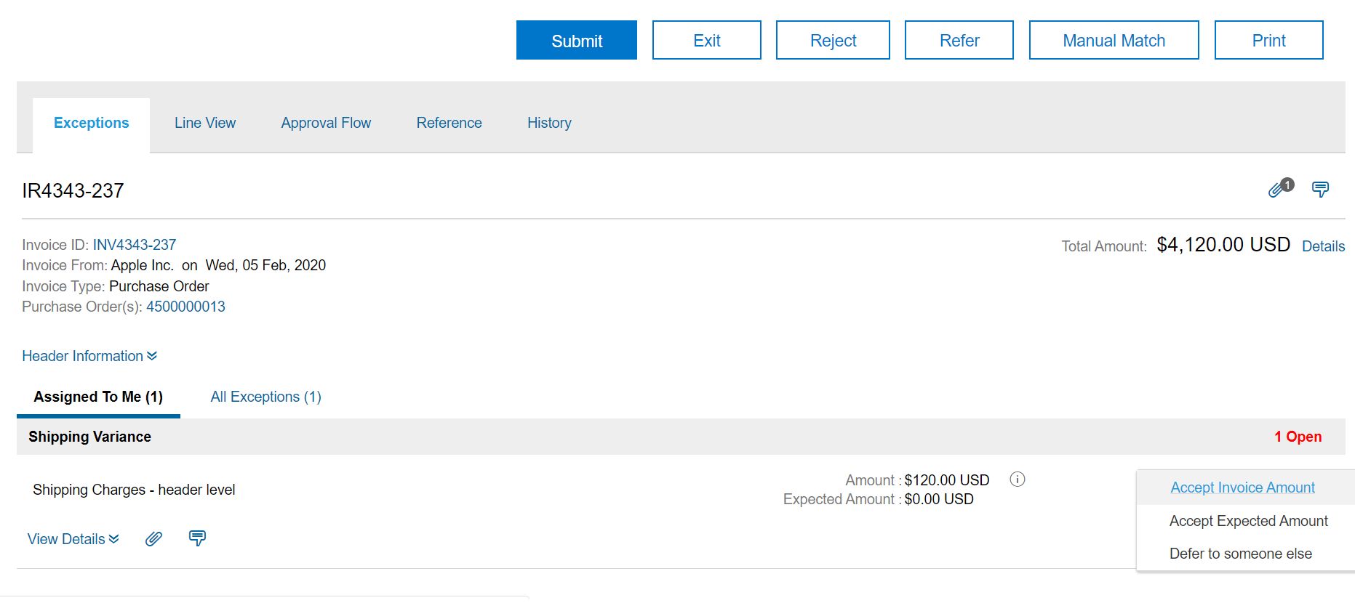
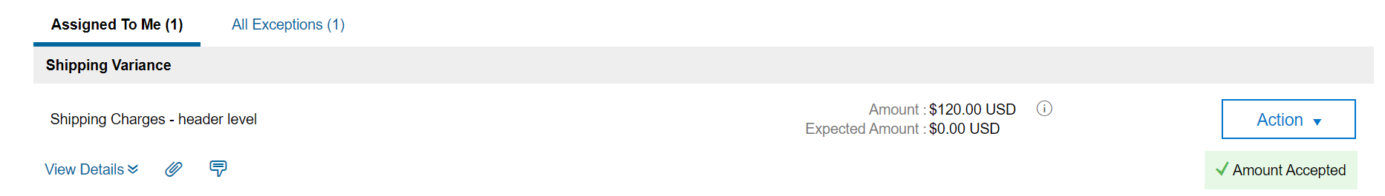
Invoice Exceptions
Handle Invoice Exceptions
Accept Invoice Amount
7
Click the Action drop-down button next to the exception. Select the required option from the drop-down menu.
7
8
You will receive a confirmation from the system after you handle the exception.
8
Note: Select Accept Invoice Amount if you want to choose the invoice amount or select Accept Expected Amount if you want to choose the PO amount.

Slide 6
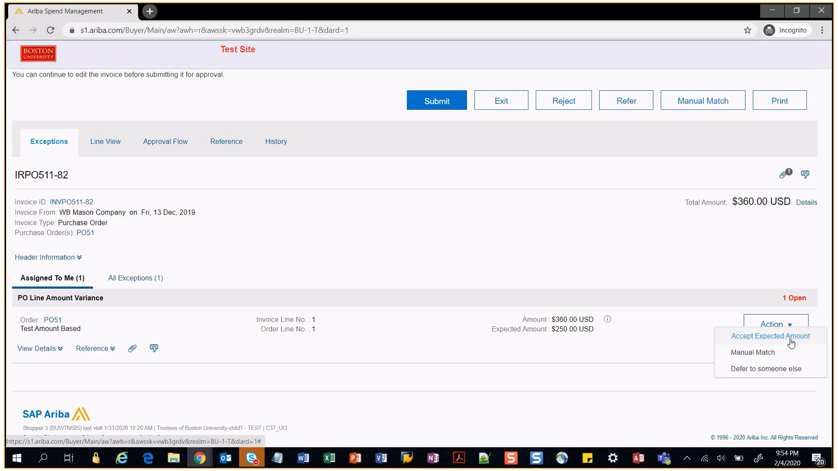
Invoice Exceptions
Handle Invoice Exceptions - Change Purchase Order (PO) details
For any amount or quantity variance between PO and Invoice, you need to update the PO details. You can also reject the invoice back to supplier.
1
If you want to accept the invoice amount, then you have to login to GB and update the PO details to match those in the invoice. Clicking on Action button doesn’t allow you to accept the Invoice amount.
2
1
2
If you don’t want to approve the expected amount, then you can reject the invoice by clicking Reject button.

Slide 7
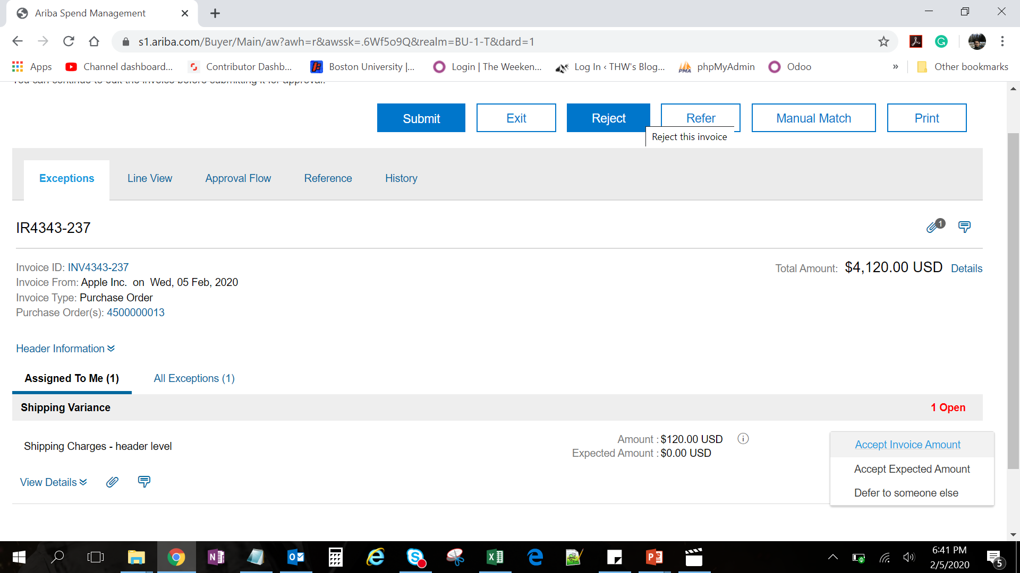
Invoice Exceptions
Handle Invoice Exceptions (Reject – 1 of 2)
You can also reject the invoice if amount is higher than allowed tolerance or the invoice contains incorrect information and requires resubmission from the supplier.
1
Click on the Reject button at the top.
1

Slide 8
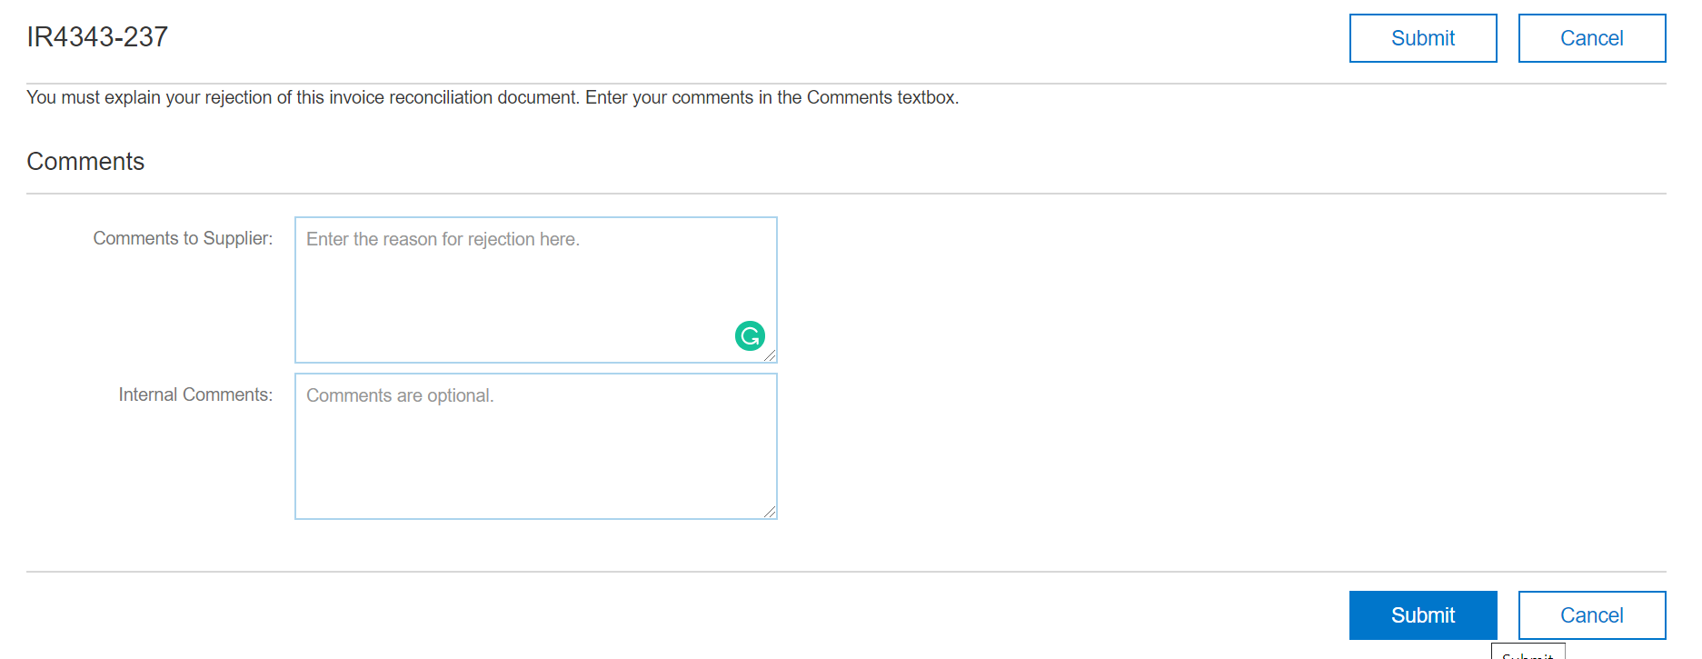
Invoice Exceptions
Handle Invoice Exceptions (Reject – 2 of 2)
There are two comments sections that allow you to send a message to the supplier regarding the invoice rejection. You also can create a separate message for internal recipients only.
2
Enter reason for rejection.
2
3
Click Submit.
3

Slide 9
Additional Resources: Guides, FAQ, and Assistance
Guides & FAQs
How to Place Orders
FAQs
Invoice Guides and FAQ
Contact Us
Ordering Information: Submit a ticket to Sourcing & Procurement via the Financial Affairs Customer Service Portal.
Invoice & Payment Information: Submit a ticket to Accounts Payable via the Financial Affairs Customer Service Portal.
9

