Slide 1
Supplementary Slides on Mitochonria

Slide 2
The Mitochondria Contain a Separate Chromosome
Mitochondrial DNA is circular and well conserved.
The mitochondrial genome has 37 genes and encodes rRNA, tRNA, and enzymes in central metabolism, including the citric acid cycle and oxidative phosphorylation.
  Mitochondria have their own ribosomes to allow synthesis of proteins within the organelle.
  However, the vast majority of mitochondrial proteins are encoded on nuclear DNA, synthesized in the cytosol, and imported into the mitochondria.
Mitochondrial DNA is maternally inherited.

Slide 3
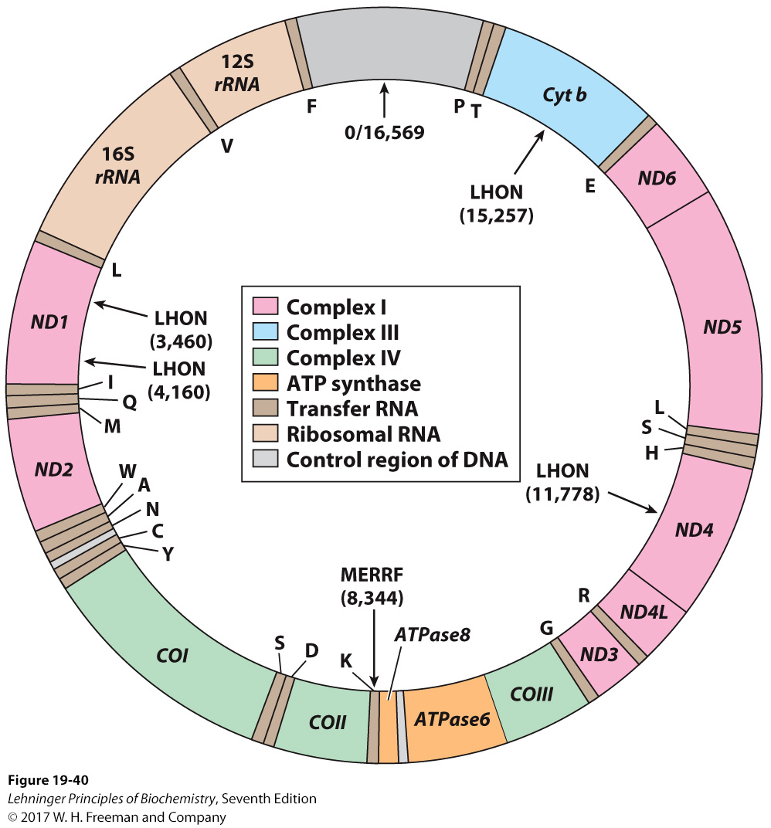
The Mitochondria Contains A Separate Chromosome
Notes:
FIGURE 19-40 Mitochondrial genes and mutations. A map of human mitochondrial DNA, showing the genes that encode proteins of Complex I, the NADH dehydrogenase(ND1 to ND6); the cytochrome b of Complex III (Cyt b);the subunits of cytochrome oxidase, Complex IV (COI to COIII); and two subunits of ATP synthase (ATPase6 andATPase8). The colors of the genes correspond to those of the complexes shown in Figure 19-7. Also included here are the genes for ribosomal RNAs (rRNA) and for some mitochondrion-specific transfer RNAs; tRNA specificity is indicated by the one-letter codes for amino acids. Arrows indicate the positions of mutations that cause Leber hereditary optic neuropathy (LHON) and myoclonic epilepsy and ragged-red fiber disease (MERRF). Numbers in parentheses indicate the position of the altered nucleotides(nucleotide 1 is at the top of the circle, and numbering proceeds counterclockwise)

Slide 4
Mutations in the Mitochondrial Genome Accumulate
Reactive Oxygens Species (ROS) resulting from the electron-transport chain creates mutations.
  Mutations are asymmetric: Some cells will have more mutations than others.
  When cells divide, daughter cells will have the same mutations as the parent cell.
  Some cell types divide often (e.g., epithelial), while others are stagnant during adulthood (e.g. myocytes).

Slide 5
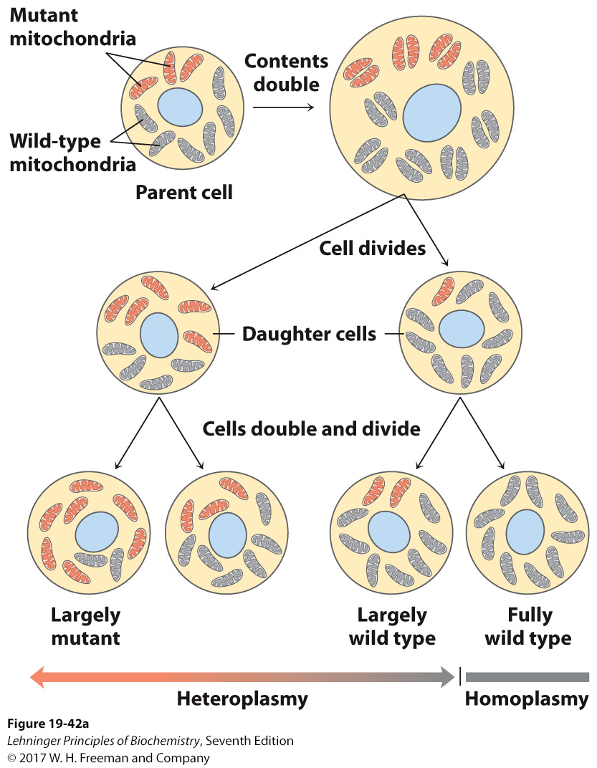
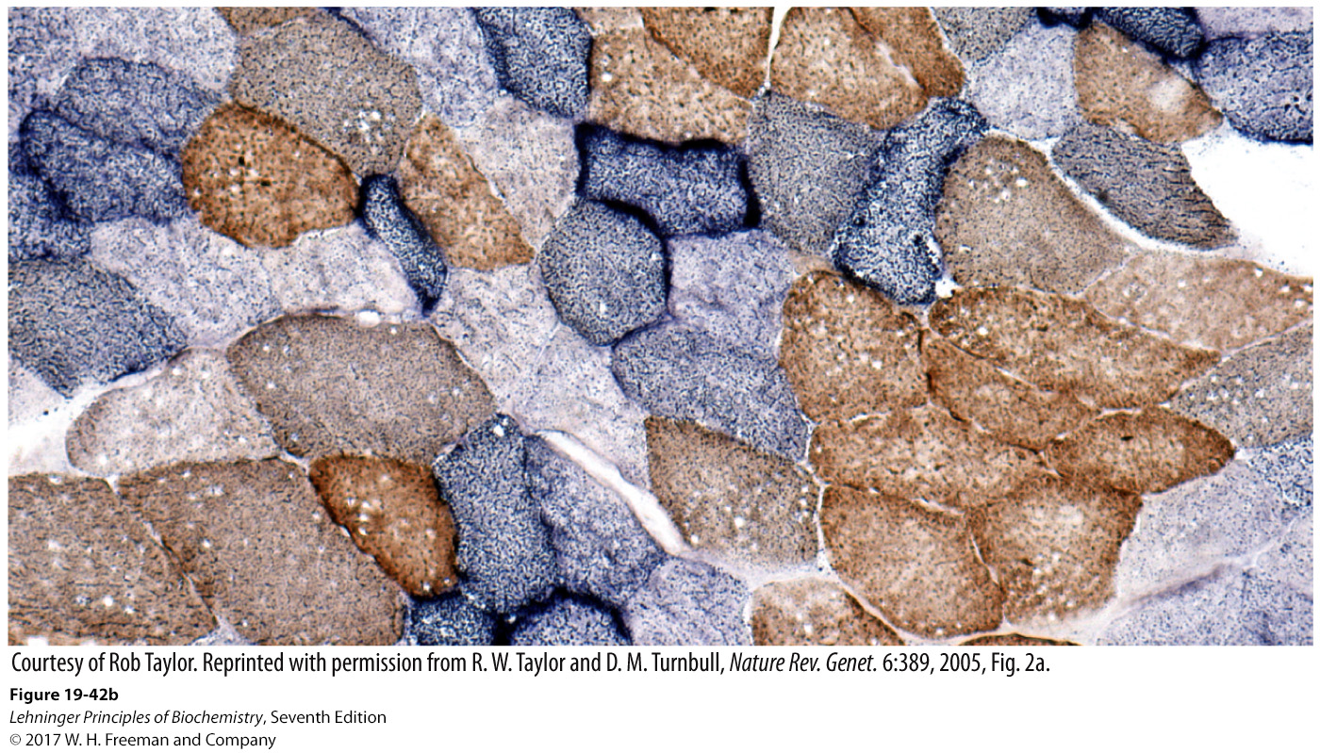
Mutations in the Mitochondrial Genome Accumulate
Each cell contains multiple mitochondria with differing amounts of mutations.
Cell division can result in heteroplasmy: a variation in the genetic makeup of mitochondria within a cell.
Notes:
FIGURE 19-42 Heteroplasmy in mitochondrial genomes. (a) When a mature egg cell is fertilized, all of the mitochondria in the resulting diploidcell (zygote) are maternal; none come from the sperm. If some fraction of the maternal mitochondria have a mutant gene, the random distribution of mitochondria during subsequent cell divisions yields some daughter cells with mostly mutant mitochondria, some with mostly wild-type mitochondria, and some in between. Thus daughter cells show a varying degree of heteroplasmy.(b) Different degrees of heteroplasmy produce different cellular phenotypes. This section of human muscle tissue is from an individual with defective cytochrome oxidase. The cells were stained so that wild-type cells are blue and cells with mutant cytochrome oxidase are brown. As the micrograph shows, different cells in the same tissue are affected to different degrees by the mitochondrial mutation

Slide 6
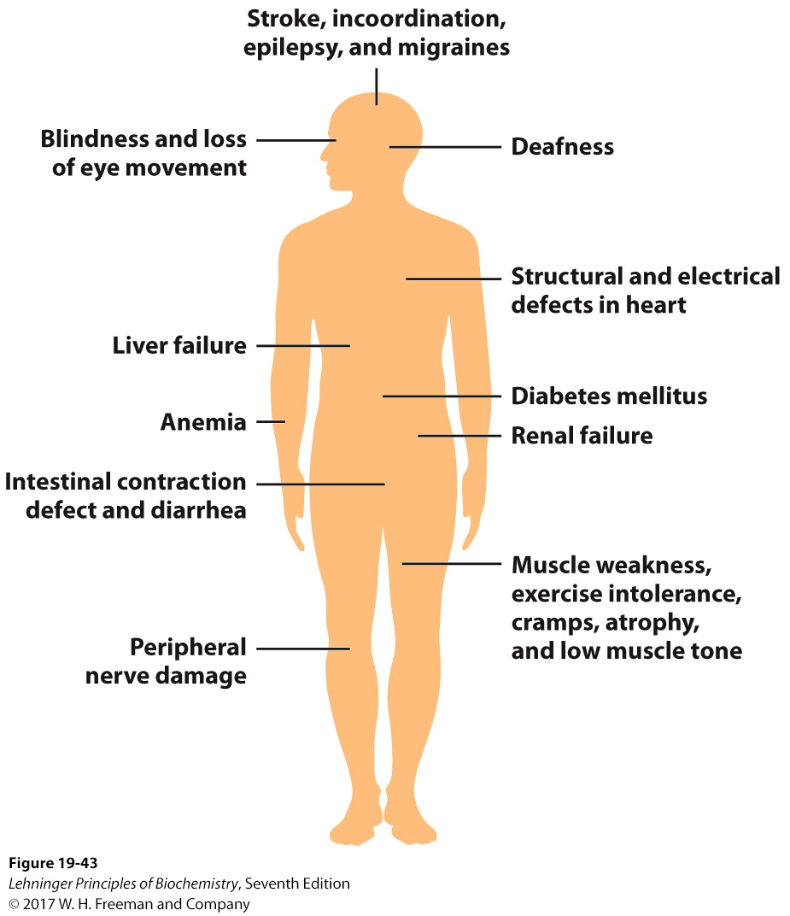
Mutations in the Mitochondrial Genome Result in Disorders
Notes:
FIGURE 19-43 Mutations that cause mitochondrial disorders. Mutations in genes that encode mitochondrial proteins can lead to disorders affecting many organs and organ systems.

Slide 7
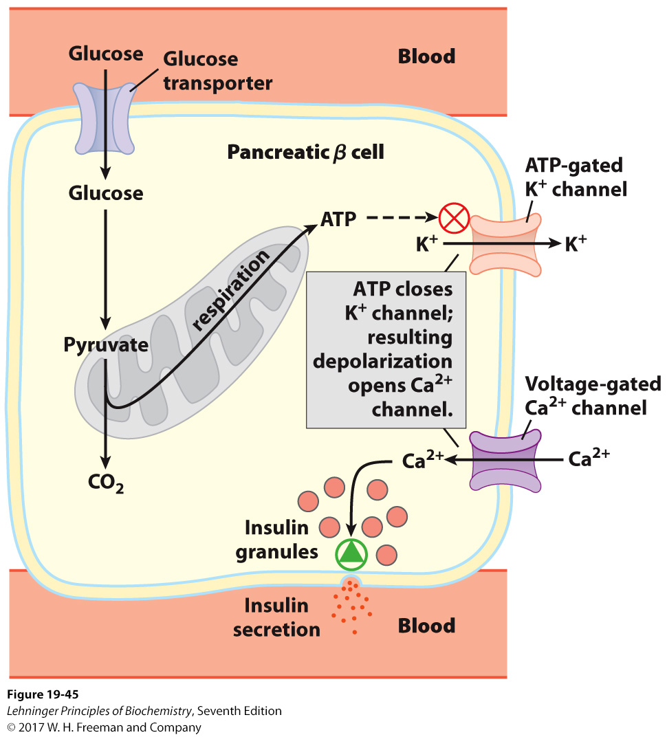
Mitochondrial Mutations Result in a Rare form of Diabetes
Defects in oxidative phosphorylation result in low [ATP] in the cell.
  Insulin cannot be released from the cell.
Notes:
FIGURE 19-45 A mitochondrial defect prevents insulin secretion. In the normal situation, as depicted here, when the blood glucose level rises, production of ATP in β cells increases. ATP, by blocking K1 channels, depolarizes the plasma membrane and thus opens voltage-gated Ca21 channels. The resulting influx of Ca21 triggers exocytosis of insulin- containing secretory vesicles, releasing insulin. When oxidative phosphorylation inβ cells is defective, [ATP] is never sufficient to trigger this process, and insulin is not released.

Slide 8
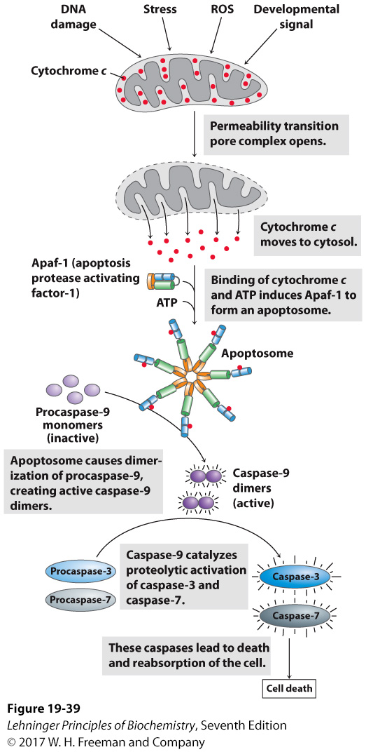
The Mitochondria Play an Initiating Role in Apoptosis
Notes:
FIGURE 19-39 Role of cytochrome c in apoptosis. Cytochrome c is a small, soluble, mitochondrial protein, located in the inter membrane space, that carries electrons between Complex III and Complex IV during respiration. In a completely separate role, as outlined here, it acts as a trigger for apoptosis by stimulating the activation of a family of proteases called caspases.

