Slide 1
Carbohydrate Synthesis in Plants
Calvin Cycle

Slide 2
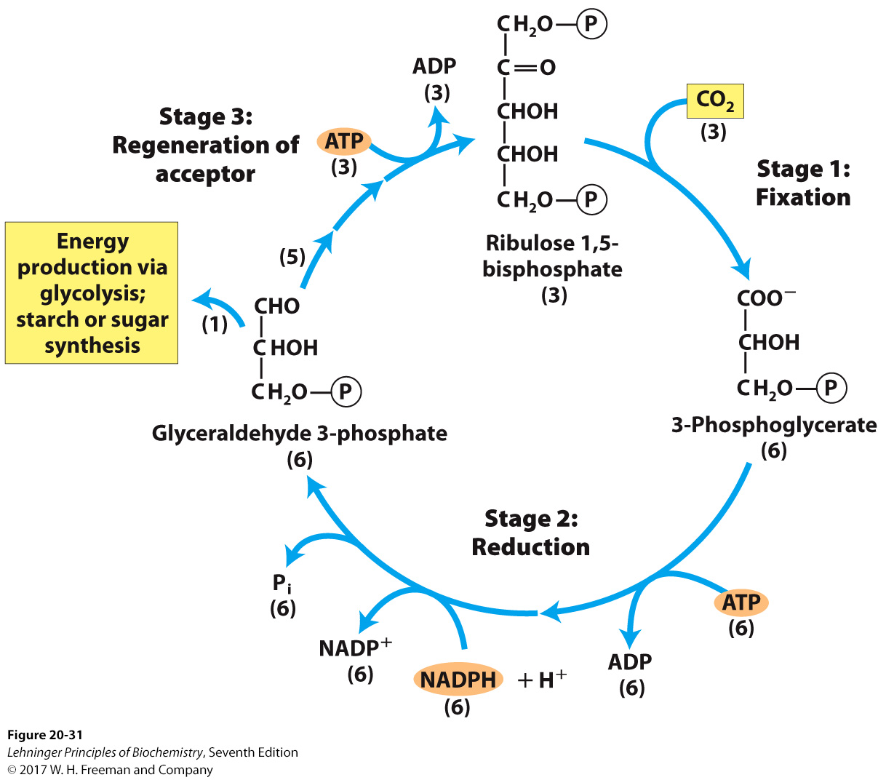
The Three Stages of the Calvin Cycle of CO₂ Assimilation
Photosynthesis
10 enzymes
(6)
(6)
(6)
Rubisco
(10)
(6)
(2)
(12)
(12)
(12)
chloroplast isoforms
(12)
(12)
3-phosphoglycerate kinase (3PGK)
glyceraldehyde 3-phosphate dehydrogenase (GAPDH)
(12)
(12)
  Overall: 6 CO₂ + 12 NADPH + 10 H₂O + 18 ATP → 2 glyceraldehyde 3-phosphate (GA3P) + 4 H⁺ + 12 NADP⁺ + 18 ADP + 16 P_{i}
*Ribulose 1,5-bisphosphate carboxylase/oxygenase (also RuBisCo)

Slide 3
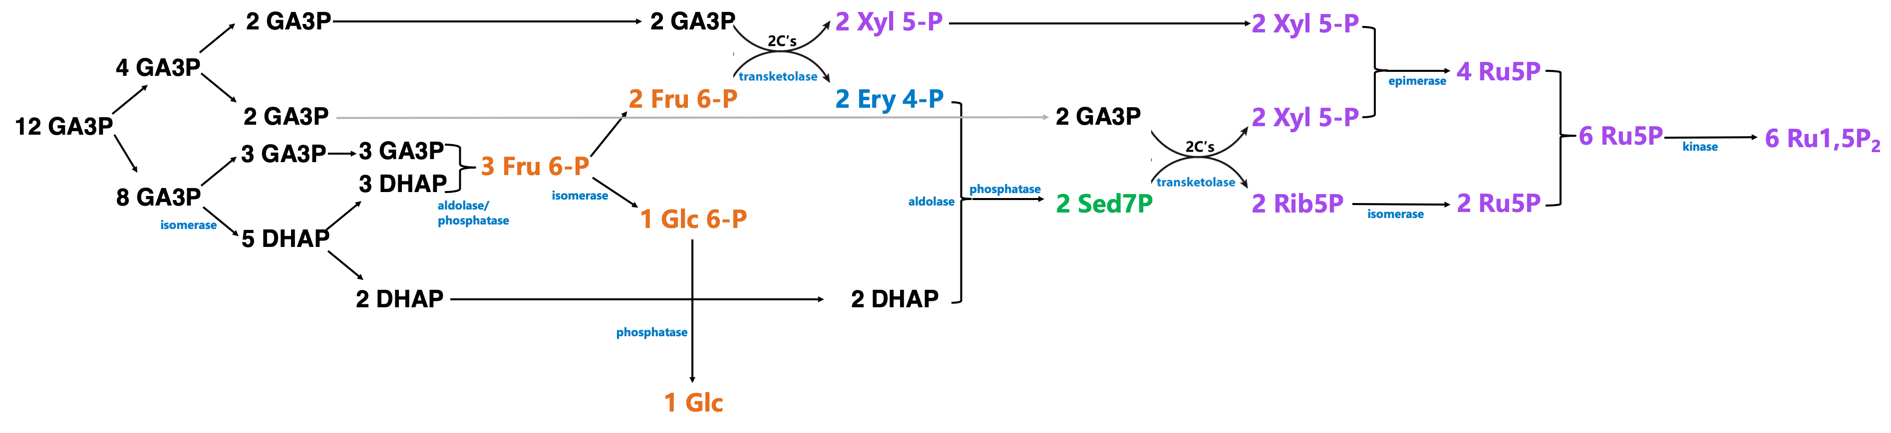
Photosynthesis
Third Stage of Calvin Cycle
Sugar key
3-Carbon sugars
4-Carbon sugars
5-Carbon sugars
6-Carbon sugars
7-Carbon sugars
There are 10 enzymes needed, five are gluconeogenic (TPI, aldolase, PGI, G6Pase, and FBPase) and five are new to the Clavin Cycle (transketolase, xylulose 5-phosphate epimerase, ribose 5-phosphate isomerase, ribulose 5-phosphate kinase, and sedoheptulose 7-phosphatase). The last two are only found in the chloroplasts.
This is a summary. What follows are the animated slides from lecture

Slide 4
The Three Stages of the Calvin Cycle of CO₂ Assimilation
Photosynthesis
Reverse of glycolysis: GA3P converted to DHAP by triose phosphate isomerase (TPI); GA3P and DHAP converted to fructose 1,6-bisphosphate (Fru 1,6-P₂) via aldolase, then to Fru 6-P via fructose 1,6-bisphosphatase, then Glc 6-P via phosphoglucoisomerase (PGI).
10 enzymes
(6)
(6)
(6)
Fru6P
DHAP
G3P
2
2
4
Rubisco
(10)
12-Cs
6-Cs
12-Cs
(6)
for Stage 3
10/12 glyceraldehyde-3-phosphate products (30 carbons) MUST be used to regenerate 6 ribulose-1,5-bisphosphate (30 carbons).
8
(2)
TPI
DHAP ⇌
(12)
(12)
5
Aldolase
3
3
Fructose-1,6-
bisphosphatase
Fru 1,6P₂
⇌
P_{i}
(12)
chloroplast isoforms
3
Fru6P
Fru6P
(12)
2
PGI
⇌
3-phosphoglycerate kinase (3PGK)
glyceraldehyde 3-phosphate dehydrogenase (GAPDH)
(12)
(12)
1
Glc6P
(12)
12 glyceraldehyde-3-phosphate are produced during the Calvin cycle in the assimilation of 6 carbons into Glc.
2/12 glyceraldehyde-3-phosphate products are pulled out of the cycle and used for Glc6P, then to other carbos.

Slide 5
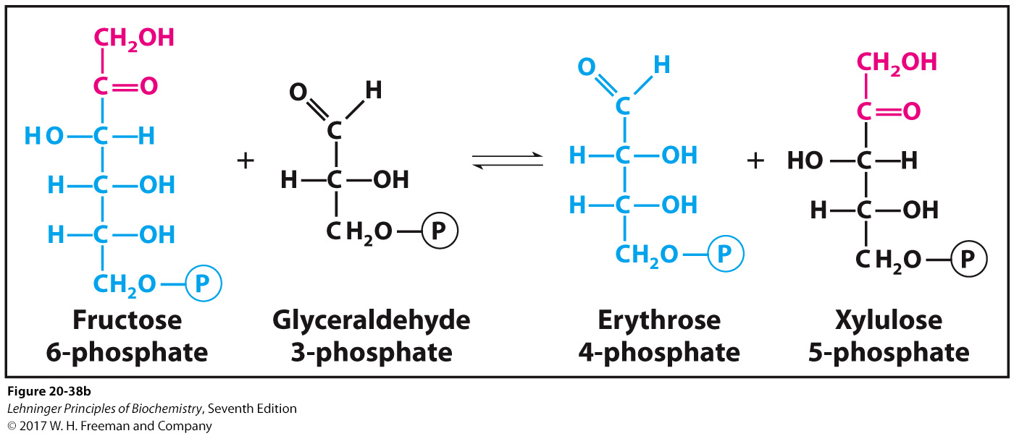
Stage 3: Regeneration of Ru 1,5-P₂
Photosynthesis
Third Stage of Calvin Cycle
We have 3-carbon compounds and need 5-carbon compounds: put 2 together to make 6 (stop at Fru6P), then can pull 2 carbons from 6 (leaving 4) and plus another 3-carbon compound make a 5-carbon sugar.
DO THIS TWICE.
Of the 12 GA3P, we have 8 for making 3 hexoses and 2 DHAP, plus 4 GA3P left
The 2 Fru6P, plus 2/4 GA3P to make 2 5-carbon sugars (Xyl5P).
From 4/8 GA3P*
12 → use 6 GA3P (4+2)
4 GA3P → 2 Fru 6-P
2 GA3P → 2 Xyl 5-P
+2 Ery 4-P
transketolase
2 GA3P left
2
2
2
2
*the other 4 go to make Glc(1) and DHAP(2) →use 6 GA3P

Slide 6
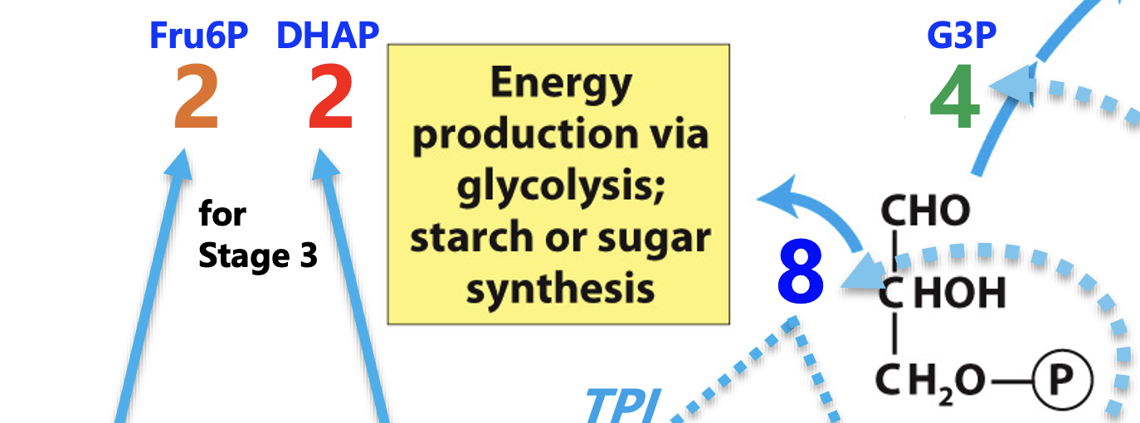
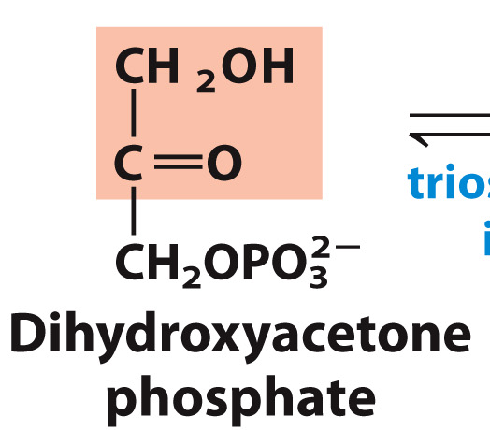
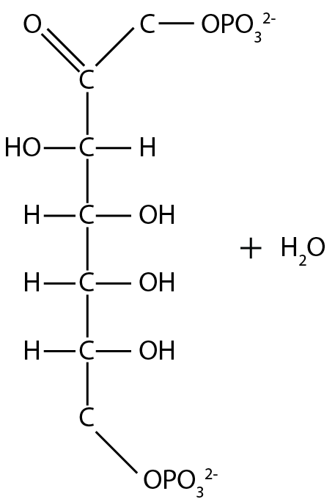
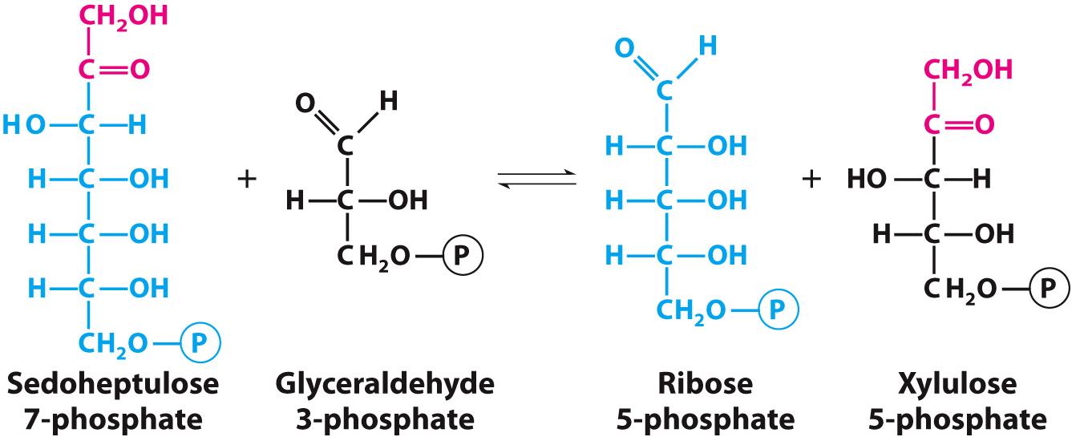
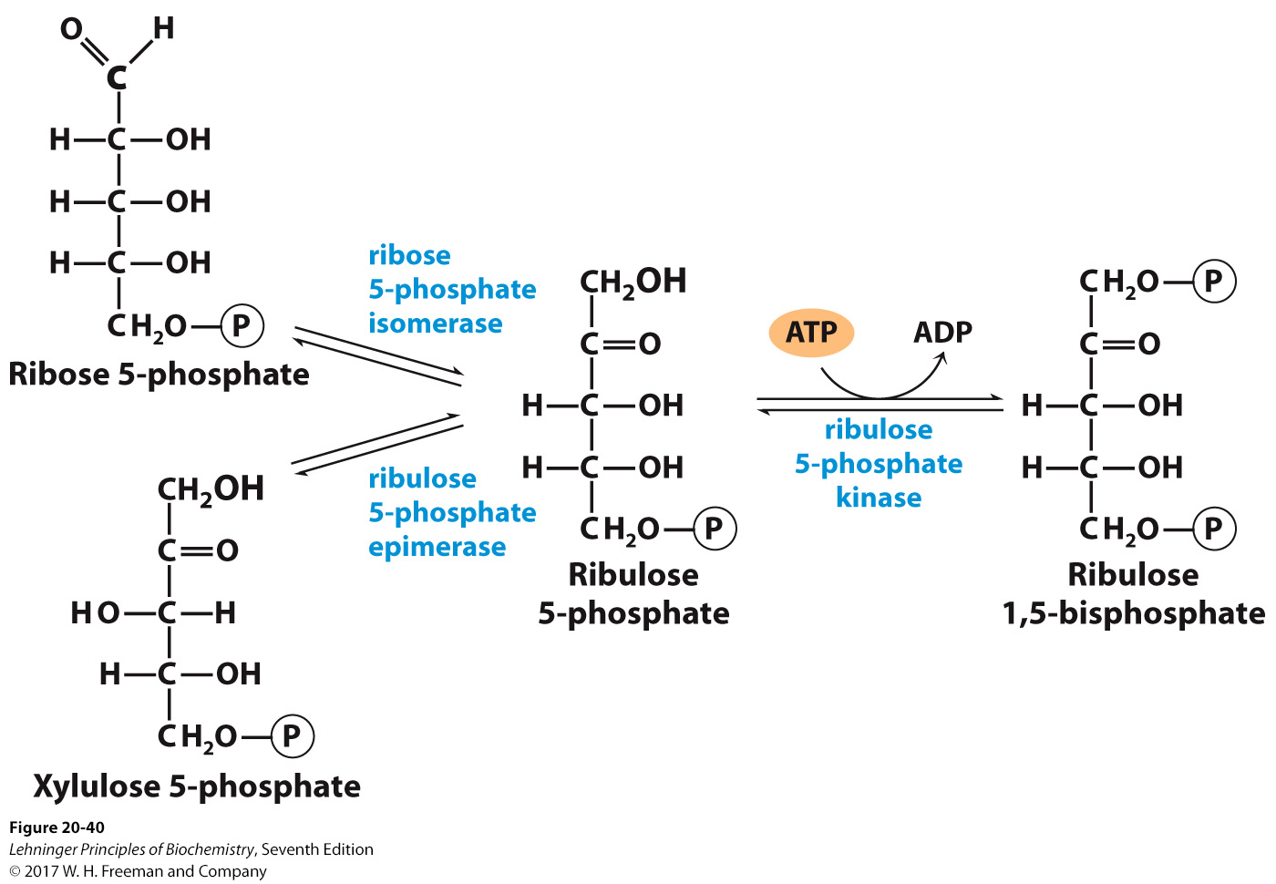
Photosynthesis
Stage 3
aldolase
sedoheptulose 1,7-bisphosphatase
transketolase
⇌
⇌
2
2
2
2
2
2
2
2. We have two 4-carbon Ery 4-P and still have 2 GA3Ps and 2DHAP. Do aldol condensation with DHAP and Ery 4-P to get Sedoheptulose 1,7-bisphosphate (Sed 1,7-P₂).
3. If Sed 1,7-P₂ loses the C7-phosphate, as a ketose, we can pull 2 carbons off and put on our remaining 2 aldoses (GA3P) using transketolase as we did with Fru 6P.
2
6
Sedoheptulose 1,7-bisphosphate dephosphorylated to sedoheptulose 7-phosphate (S7P) via sedoheptulose 1,7-bisphosphatase
  This enzyme is unique to plants.
Finally, RuP phosphorylated to ribulose 1,5-bisphosphate by phosphoribulokinase
  This enzyme is also unique to plants and regulated by NADPH
2 from Fru6-P
2 from Ery4-P
6
6
2+2=4

Slide 7
Pentose Phosphate Pathway
Providing reduced electrons and ribose

Slide 8
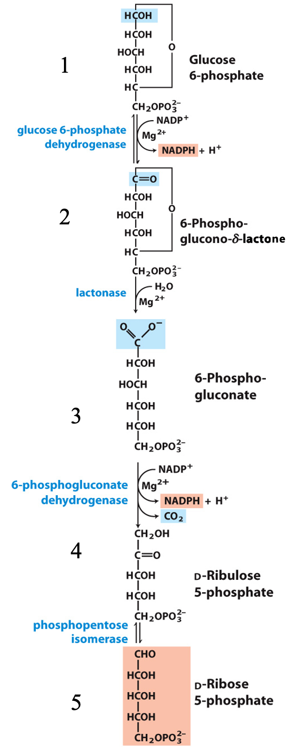
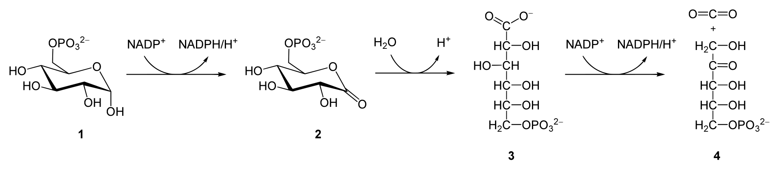
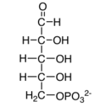
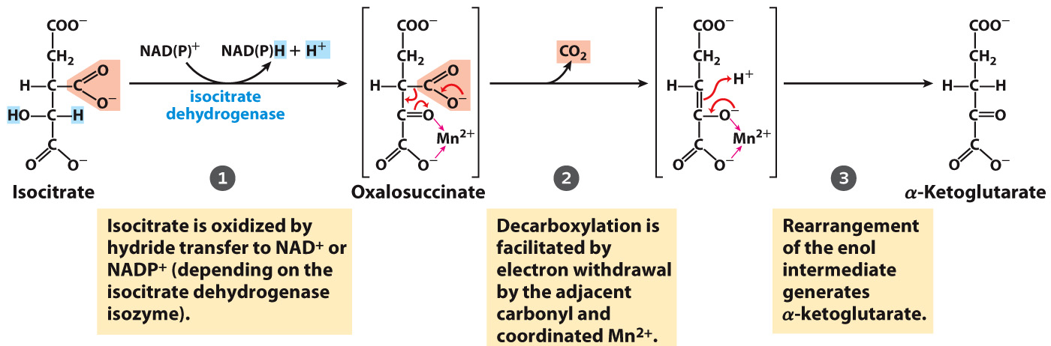
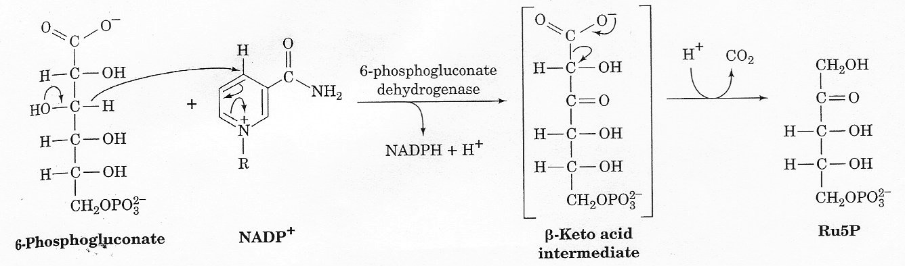
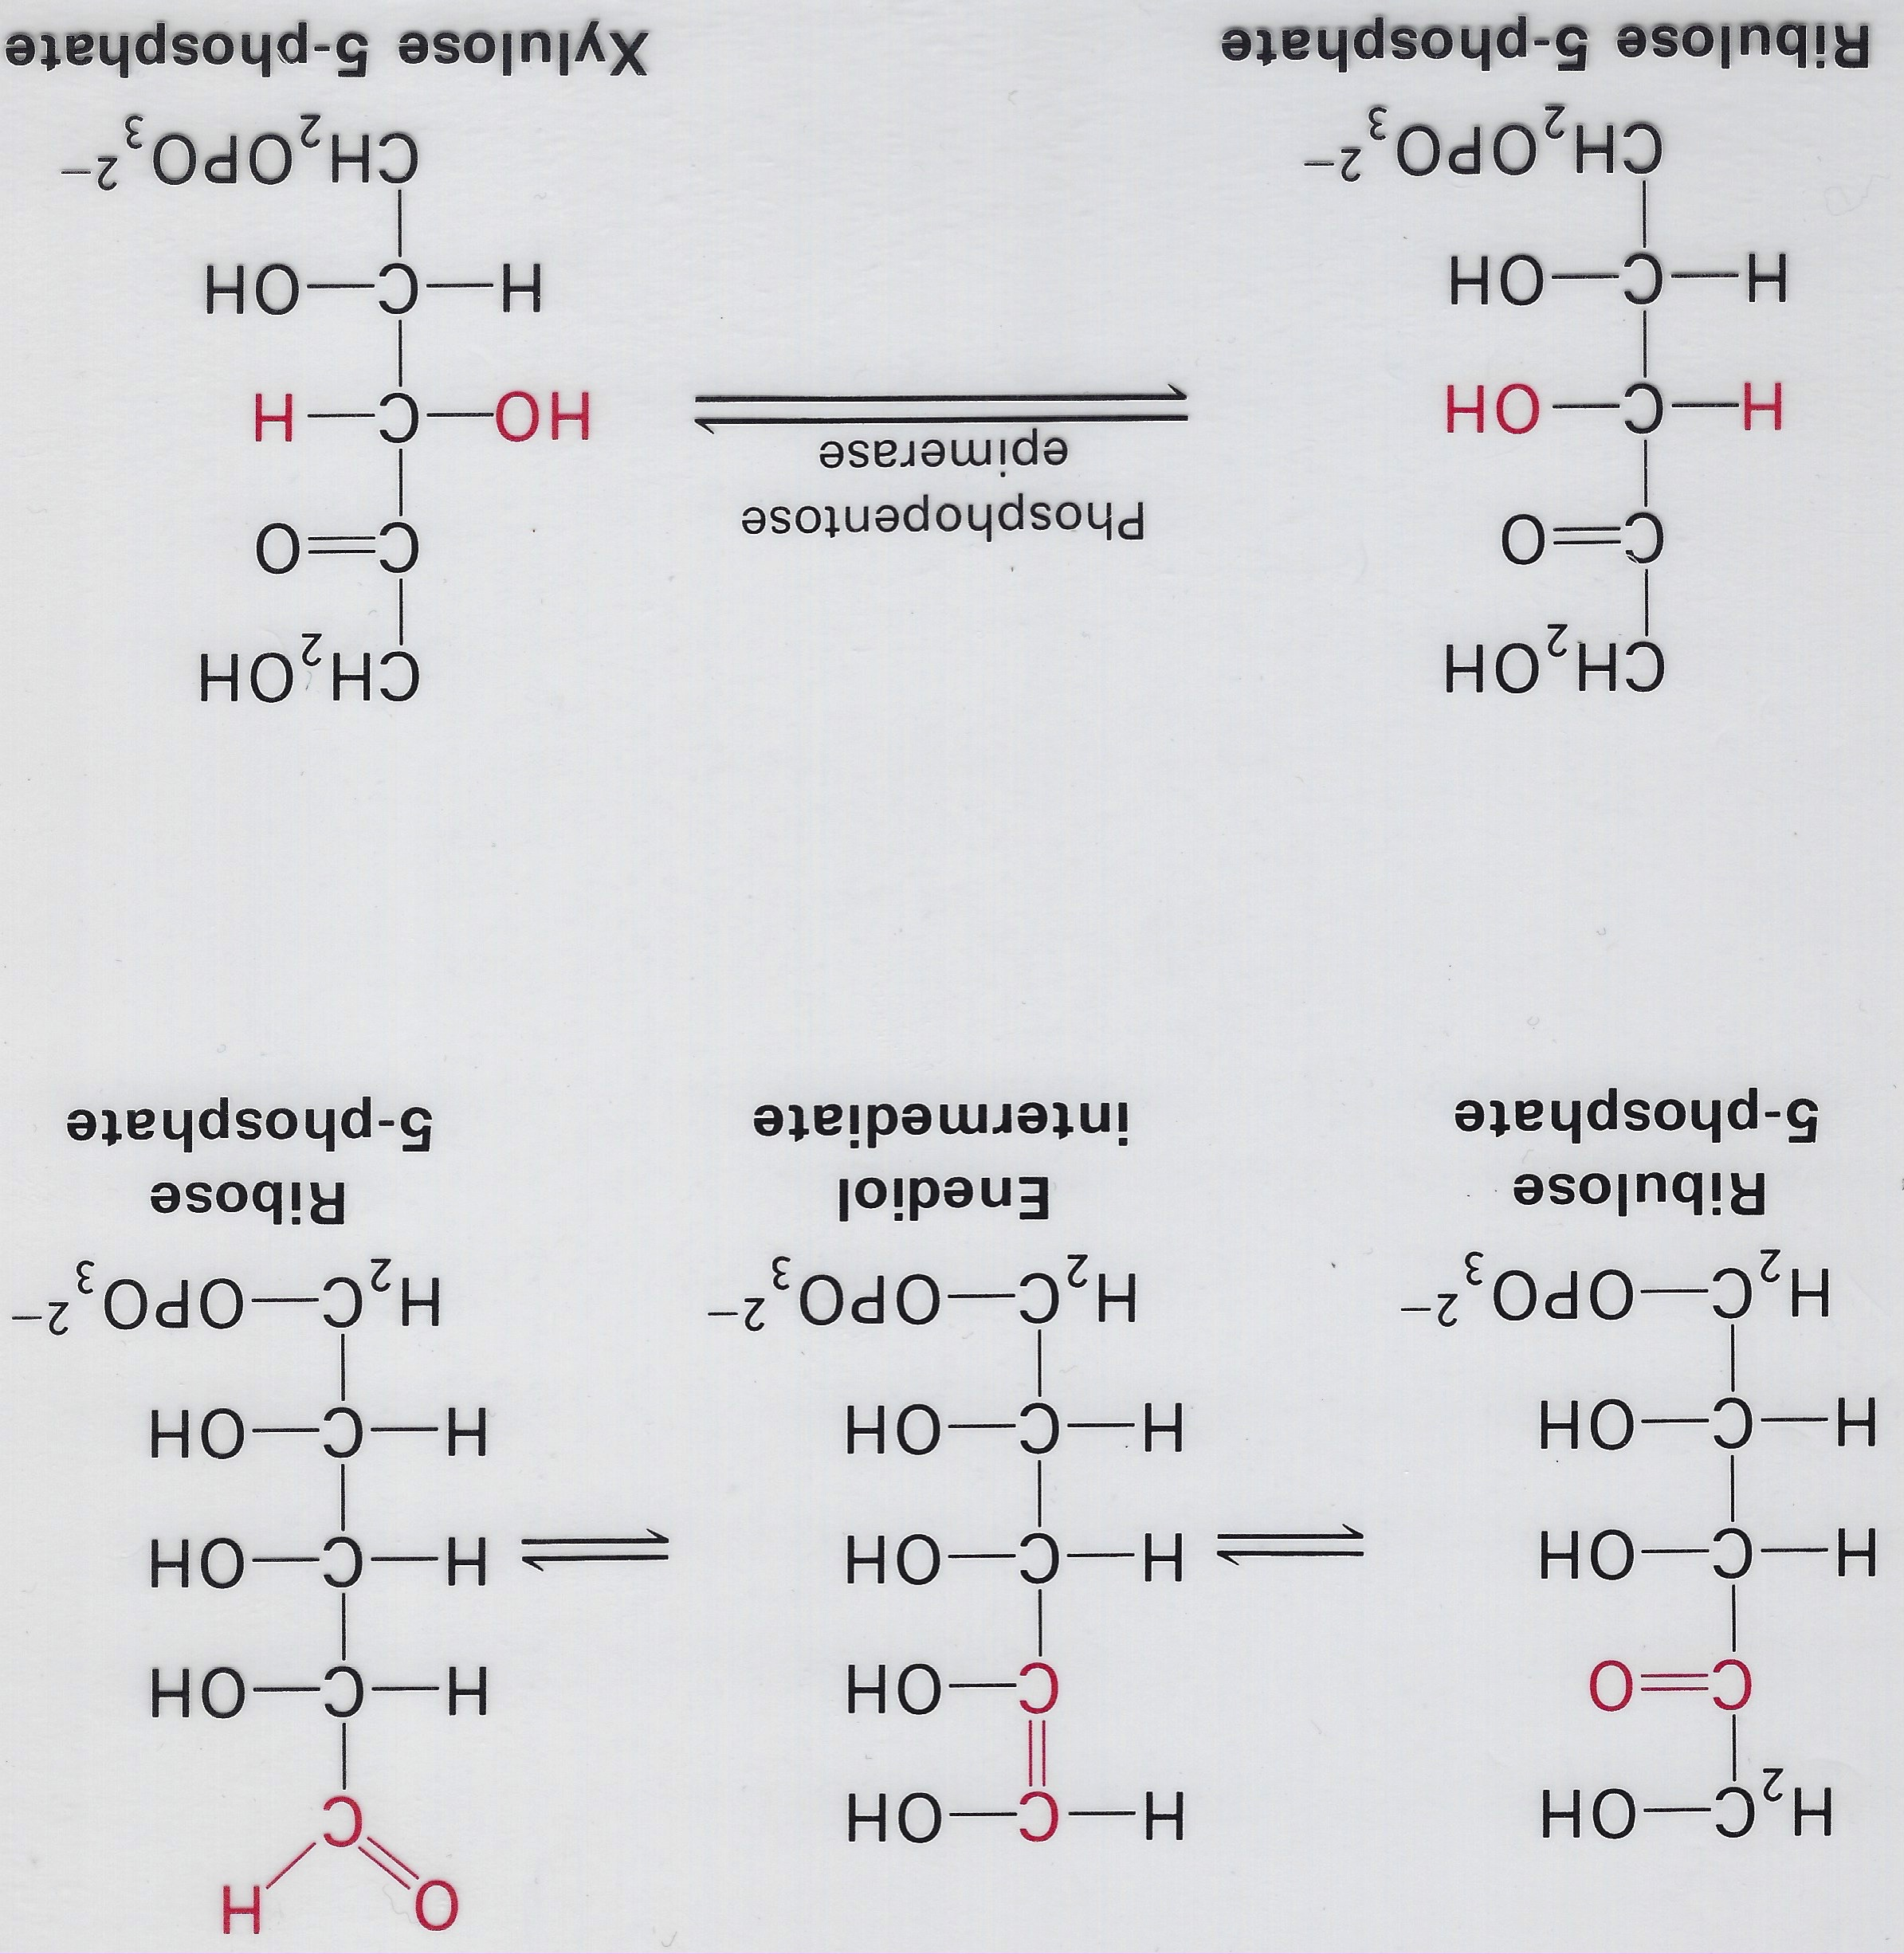
5
Overall, 4 steps of oxidative branch of PPP
Mechanism much like that of isocitrate dehydrogenase
Mechanism
Mechanism

Slide 9
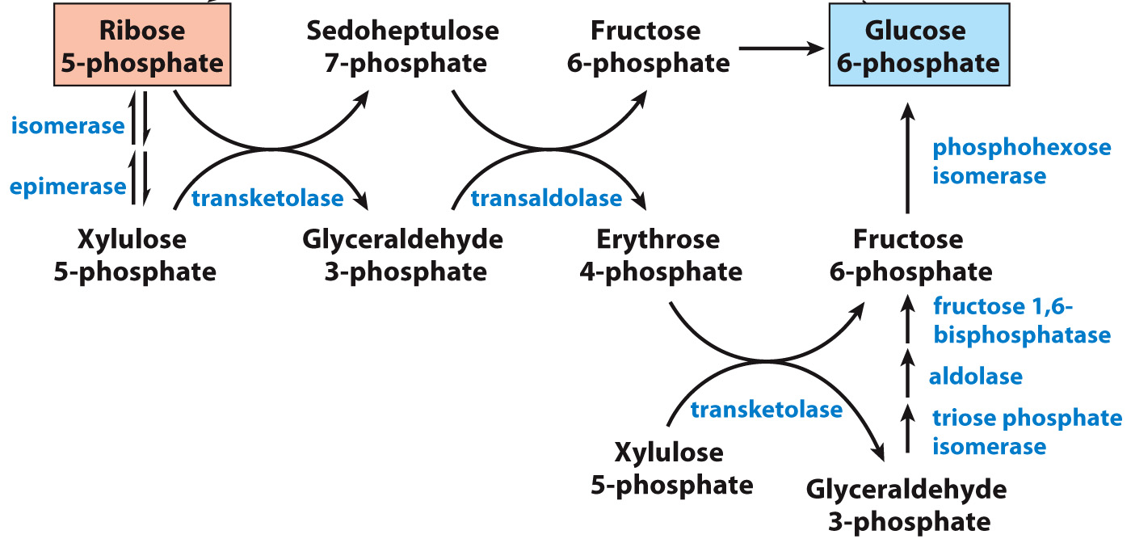
Pentose Phosphate Pathway
(aldose)
(ketose)
(ketose)
Phosphohexose isomerase
2
(aldose)
→
2C′s
3C′s
6
Ru 5-P
→
4
(ketose)
(ketose)
(aldose)
(aldose)
2C′s
(ketose)
(aldose)
Non-oxidative Phase
Interconverts Rib 5-P to form Glc 6-P
Complete conversion of ribose-5-phosphate to glucose-6-phosphate requires 6 Rib 5-P (30 carbons) to make 5 Glc 6-P (30 carbons).

Slide 10
Pentose Phosphate Pathway
(aldose)
(ketose)
(ketose)
Phosphohexose isomerase
2
2
(aldose)
2C′s
3C′s
Ru 5-P
2
2
(ketose)
→
(ketose)
(aldose)
(aldose)
4
2C′s
→
2
(ketose)
(aldose)
Non-oxidative Phase
Interconverts Rib 5-P to form Glc 6-P
Complete conversion of ribose-5-phosphate to glucose-6-phosphate requires 6 Rib 5-P (30 carbons) to make 5 Glc 6-P (30 carbons).

Slide 11
Pentose Phosphate Pathway
(aldose)
(ketose)
(ketose)
Phosphohexose isomerase
2
2
2
(aldose)
2C′s
3C′s
Ru 5-P
2
2
2
(ketose)
→
(ketose)
(aldose)
(aldose)
4
2C′s
→
2
(ketose)
(aldose)
Non-oxidative Phase
Interconverts Rib 5-P to form Glc 6-P
Complete conversion of ribose-5-phosphate to glucose-6-phosphate requires 6 Rib 5-P (30 carbons) to make 5 Glc 6-P (30 carbons).

Slide 12
Pentose Phosphate Pathway
(aldose)
(ketose)
(ketose)
Phosphohexose isomerase
2
2
2
(aldose)
2C′s
3C′s
Ru 5-P
2
2
2
2
(ketose)
→
(ketose)
(aldose)
(aldose)
4
2C′s
----------------------------→
2
2
(ketose)
(aldose)
Non-oxidative Phase
Interconverts Rib 5-P to form Glc 6-P
Complete conversion of ribose-5-phosphate to glucose-6-phosphate requires 6 Rib 5-P (30 carbons) to make 5 Glc 6-P (30 carbons).

Slide 13
Pentose Phosphate Pathway
(aldose)
(ketose)
(ketose)
Phosphohexose isomerase
2
(aldose)
→
2C′s
3C′s
4
Ru 5-P
→
2
(ketose)
(ketose)
(aldose)
(aldose)
2C′s
(ketose)
(aldose)
2
Non-oxidative Phase
Interconverts Rib 5-P to form Glc 6-P
Complete conversion of ribose-5-phosphate to glucose-6-phosphate requires 6 Rib 5-P (30 carbons) to make 5 Glc 6-P (30 carbons).

Slide 14
Pentose Phosphate Pathway
(aldose)
(ketose)
(ketose)
Phosphohexose isomerase
(aldose)
2C′s
3C′s
5
Ru 5-P
→
1
(ketose)
(ketose)
(aldose)
(aldose)
2C′s
---------------→
(ketose)
(aldose)
2
Non-oxidative Phase
Interconverts Rib 5-P to form Glc 6-P
Complete conversion of ribose-5-phosphate to glucose-6-phosphate requires 6 Rib 5-P (30 carbons) to make 5 Glc 6-P (30 carbons).

Slide 15
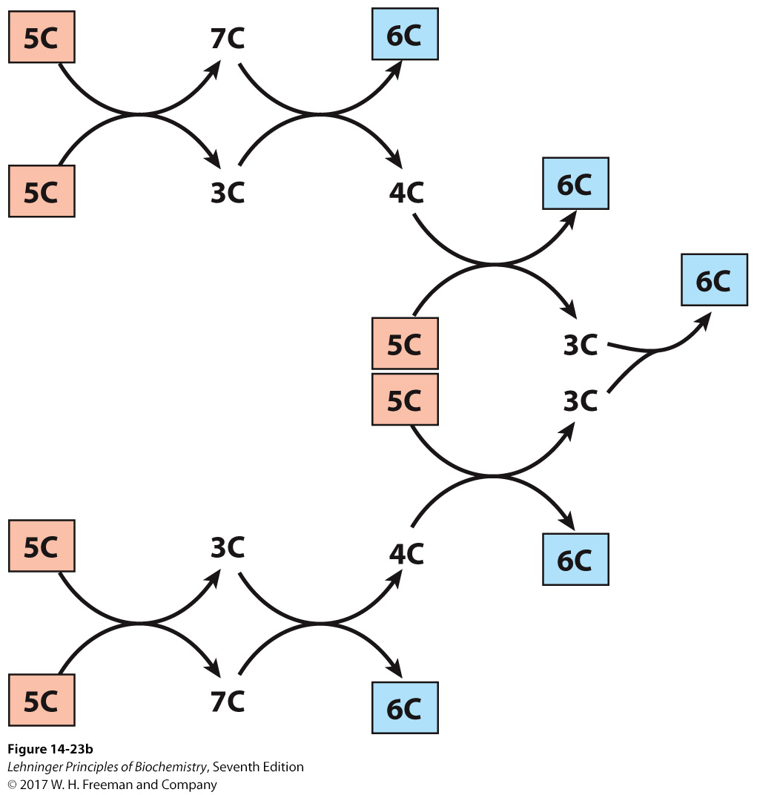
Pentose Phosphate Pathway
(aldose)
4
5
6
(ketose)
(ketose)
2
Phosphohexose isomerase
2
6
2
2
(aldose)
2C′s
3C′s
Ru 5-P
2
2
4
2
(ketose)
2
2
1
(ketose)
(aldose)
(aldose)
2C′s
2C′s
2
(ketose)
(aldose)
Non-oxidative Phase
Interconverts Rib 5-P to form Glc 6-P
No ATP is used in the non-oxidative phase.
Complete conversion of ribose-5-phosphate to glucose-6-phosphate requires 6 Rib 5-P (30 carbons) to make 5 Glc 6-P (30 carbons).

Slide 16
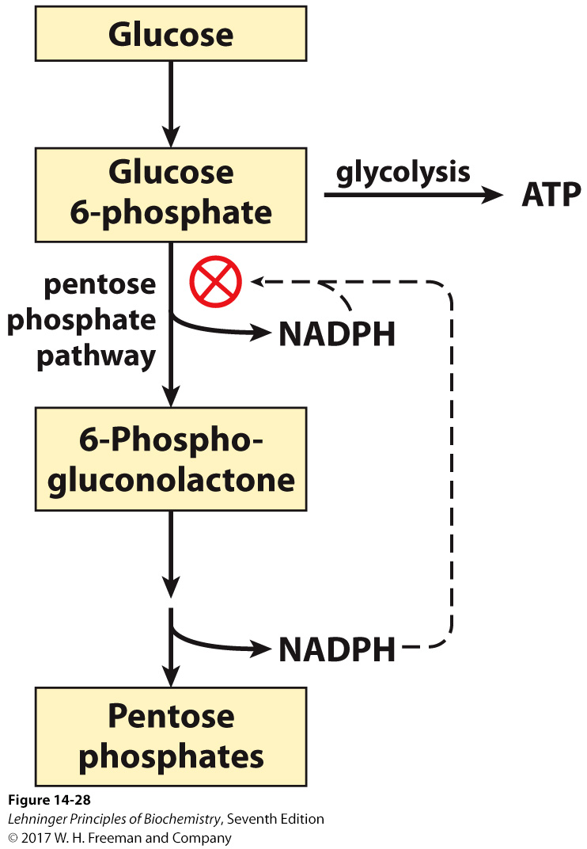
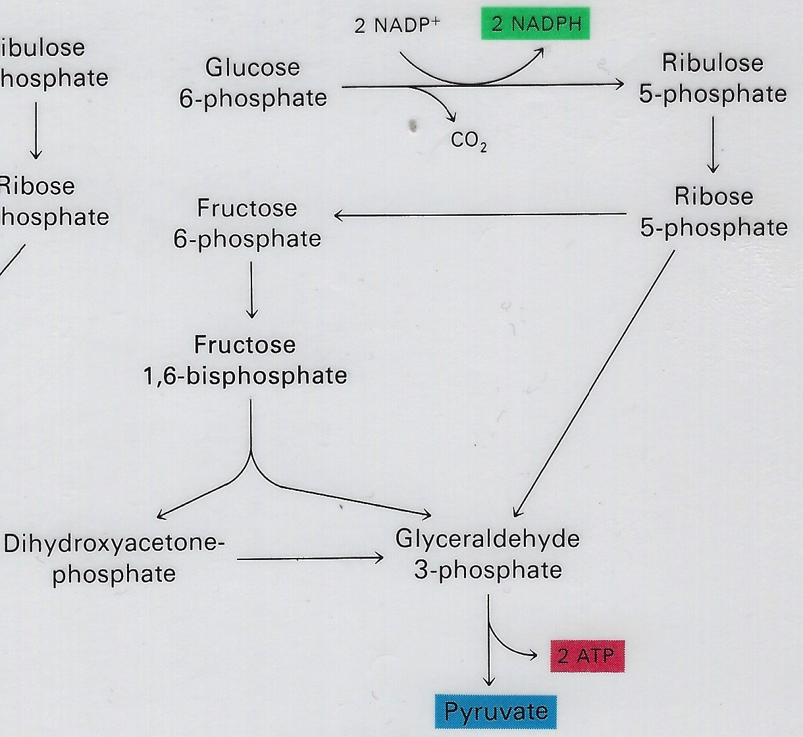
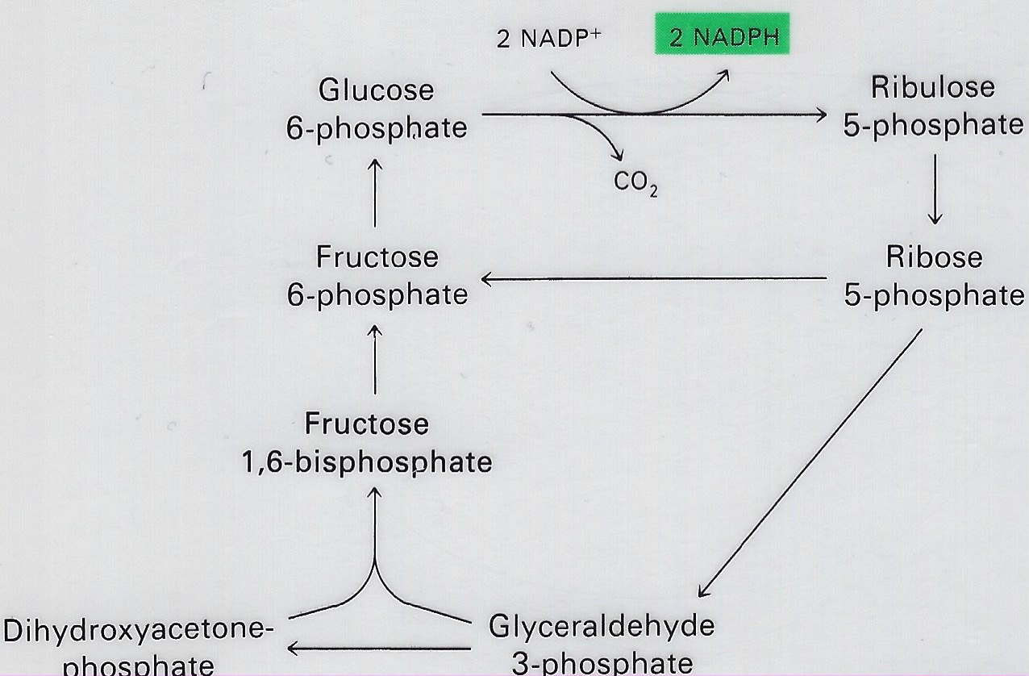
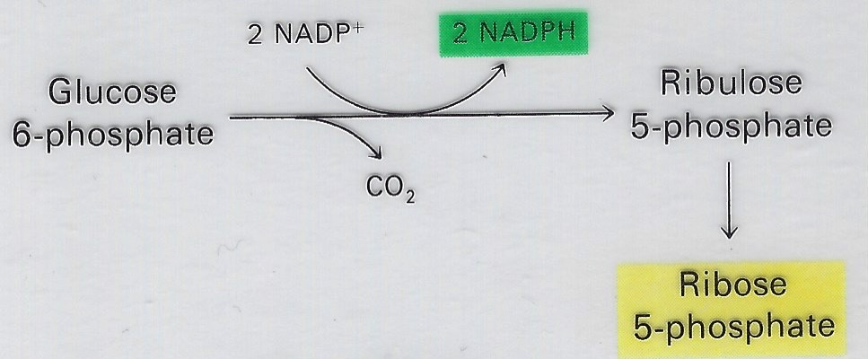
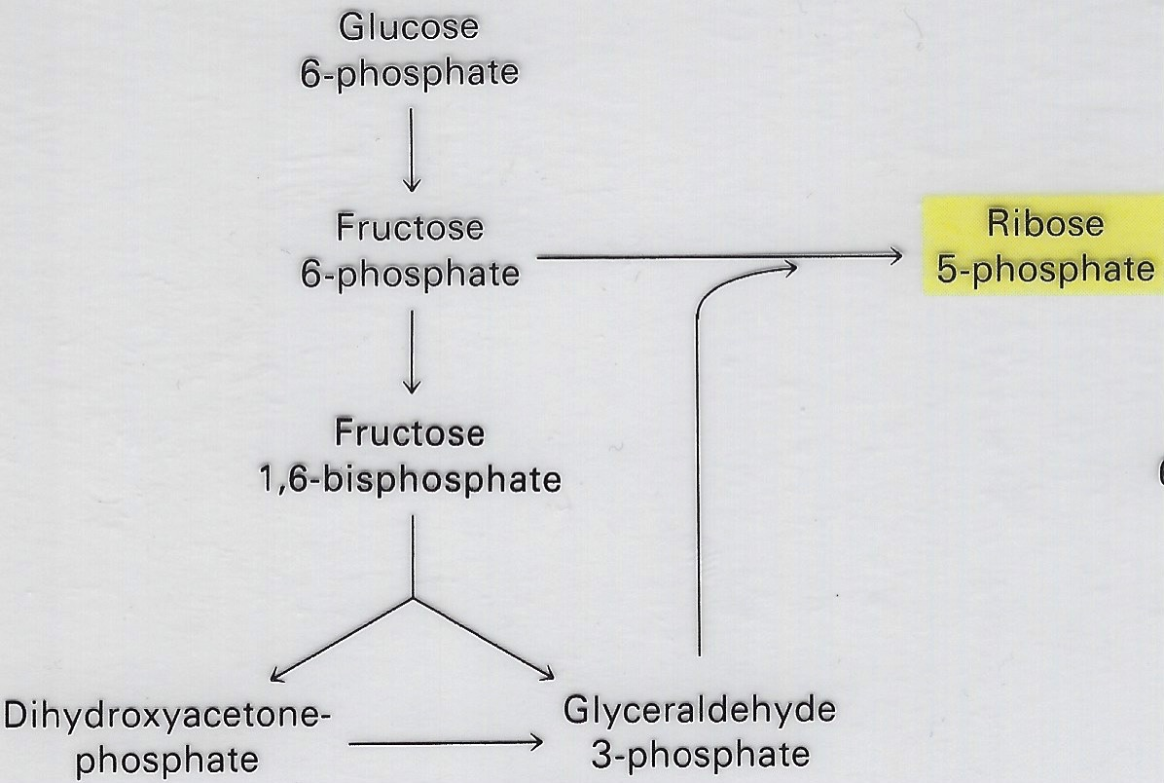
Pentose Phosphate Pathway
NADPH Regulates Partitioning into Glycolysis versus Pentose Phosphate Pathway
•Used in tissues
needing NADPH
and ATP
– ATP is low
Dihydroxyacetone- phosphate
phosphate
phosphate
Used in tissues needing both Rib 5-P & NADPH
  ATP is plentiful
Used in tissues requiring more NADPH than Rib 5-P
  such as the liver and adipose tissue
Used in tissues requiring more Rib 5-P than NADPH
  such as the lymphocytes and fast growing tissues/cancer cells

