Slide 1
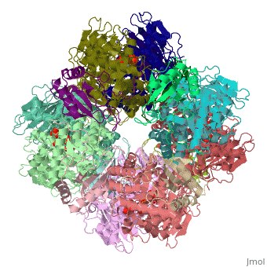
  RUBISCO
There are several slides, most of which were shown in class, but the animation for some has been included. Some of the slides try to show all the steps, while others concentrate on some steps and delete others.

Slide 2
The first catalytic intermediate is the endiolate formation
RUBISCO
(Ribulose 1,5-bisphosphate carboxylase/oxygenase)
Carboxylase
Mechanism
Not covered in text or class is the tautomerization to convert the C2-endiolate to the C3-endiolate
Immediately after CO₂ binding, the nucleophilic attack by the C2-enol forms the β-keto acid intermediate
H-carbamate
Tautomerization & CO₂ binding
:Carbamate
:His²⁹⁴
endiolate
This graphic shows how close the carbamate is to both the C2 and C3 carbons
<2 Å
carbamate
Mg⊕⊕
β-keto acid
endiolate
Notes:
MECHANISM FIGURE 20–34 First stage of CO₂ assimilation: rubisco's carboxylase activity. The CO₂-fixation reaction is catalyzed by ribulose 1,5-bisphosphate carboxylase/oxygenase (rubisco). The overall reaction accomplishes the combination of one CO₂ and one ribulose 1,5-bisphosphate to form two molecules of 3-phosphoglycerate, one of which contains the carbon atom from CO₂ (red). Additional proton transfers (not shown), involving Lys²⁰¹, Lys¹⁷⁵, and His²⁹⁴, occur in several of these steps.

Slide 3
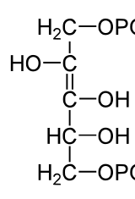
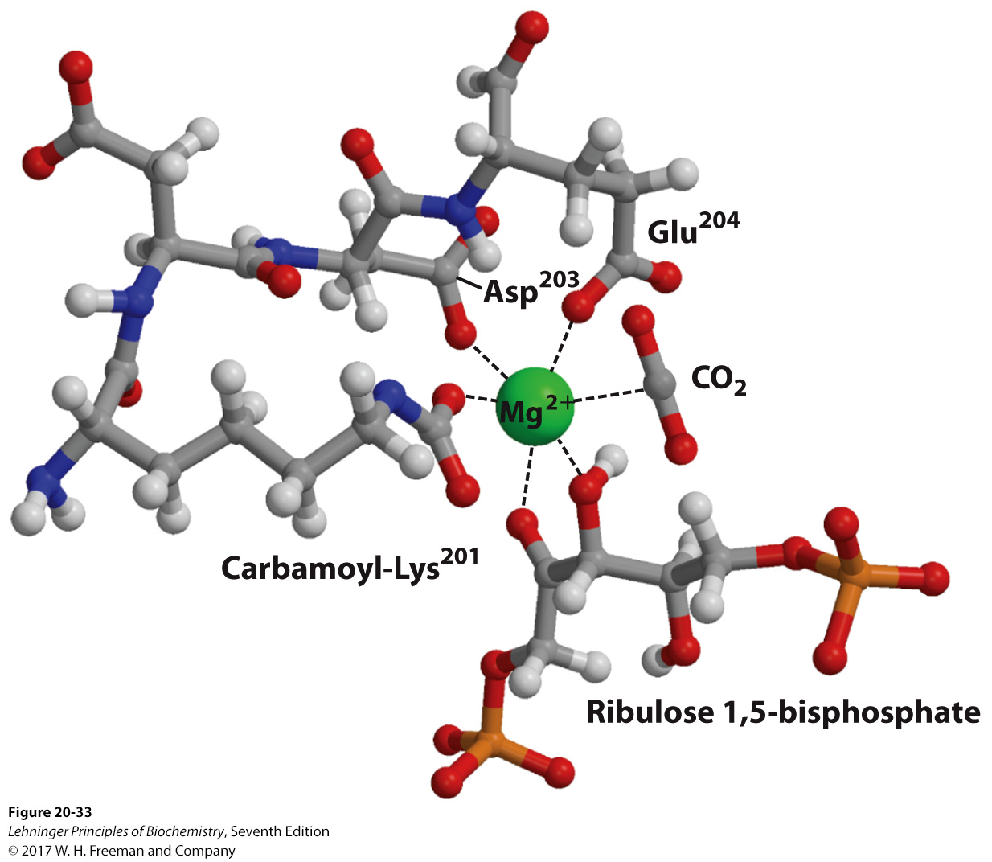
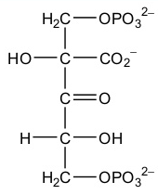
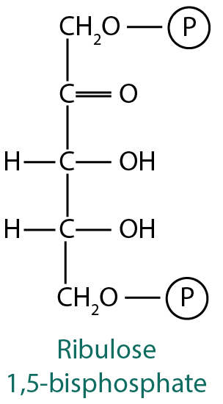
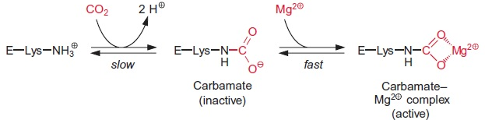
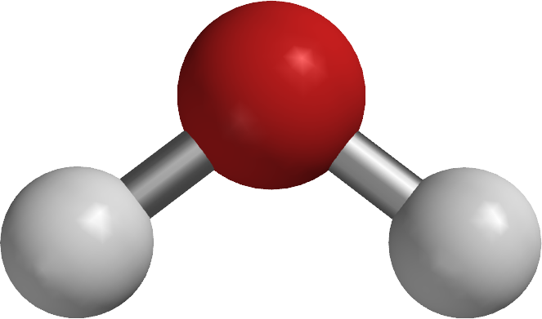
endiol intermediate
Role of Mg²⁺
Animated Slide of the RUBISCO mechanism
Notice that Mg²⁺ is held by negatively charged side chains of:
  Glu, Asp, and carbamoylated Lys
Mg²⁺ brings together the reactants in a correct orientation and stabilizes the negative charge that forms upon the nucleophilic attack by the enediolate on CO₂.
℗
℗
β-ketoacid intermediate
:His-294
CO₂ carbamoylation
201
201
201
Rubisco is inactive until Lys²⁰¹ is carbamoylated by CO₂. (But, in the apo-enzyme Lys²⁰¹ inaccessible).
Rubisco activase (an enzyme sometimes triggered by light) changes Rubisco conformation, in an ATP-dependent manner, to expose Lys²⁰¹.
Notes:
FIGURE 20–33 Central role of Mg²⁺ in the catalytic mechanism of rubisco. (Derived from PDB ID 1RXO) Mg²⁺ is coordinated in a roughly octahedral complex with six oxygen atoms: one oxygen in the carbamate on Lys²⁰¹; two in the carboxyl groups of Glu²⁰⁴ and Asp²⁰³; two at C-2 and C-3 of the substrate, ribulose 1,5-bisphosphate; and one in the other substrate, CO2. A water molecule occupies the CO₂-binding site in this crystal structure. In this figure a CO₂ molecule is modeled in its place. (Residue numbers refer to the spinach enzyme.)
C2-reduced to OH
“CO2” reduced to COO
C3 oxidized from OH to COO
FIGURE 20–35 Role of rubisco activase in the carbamoylation of Lys²⁰¹ of rubisco. When the substrate ribulose 1,5-bisphosphate is bound to the active site, Lys²⁰¹ is not accessible. Rubisco activase couples ATP hydrolysis to expulsion of the bound sugar bisphosphate, exposing Lys²⁰¹; this Lys residue can now be carbamoylated with CO₂ in a reaction that is apparently not enzyme-mediated. Mg²⁺ is attracted to and binds to the negatively charged carbamoyl-Lys, and the enzyme is thus activated.

Slide 4
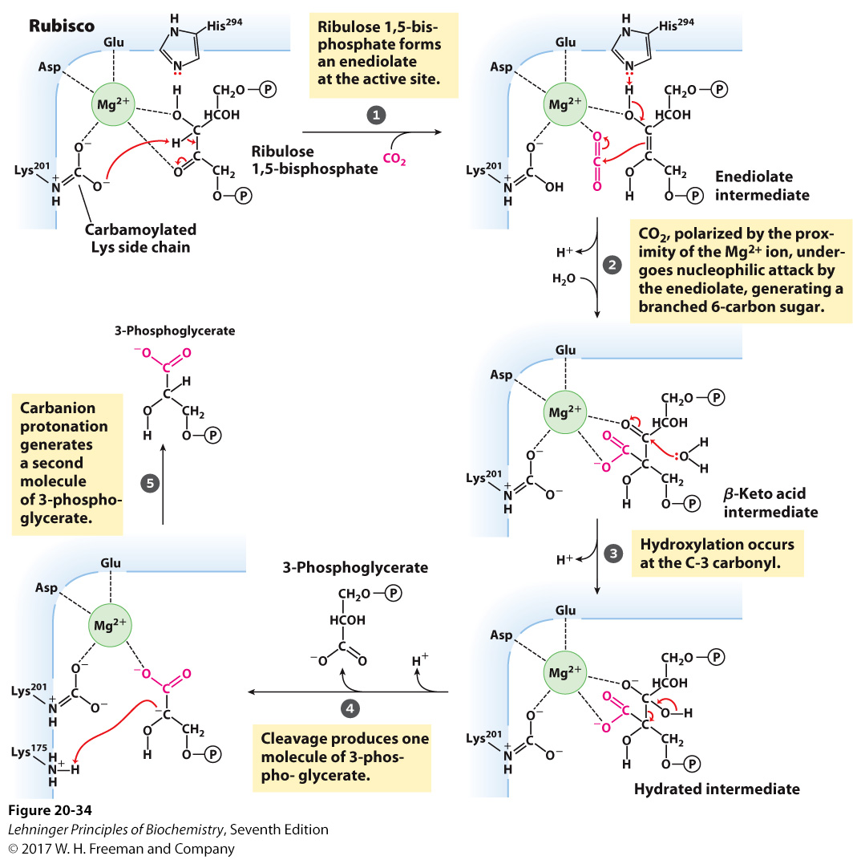
Rubisco
Carboxylase
Mechanism―
Overview from Textbook
–
Mg²⁺ facilitates interaction of carbamoylated Lys to ribulose 1,5-bisphosphate → forms enediolate intermediate
O
C
O
Hydroxylation at C-3 of ribulose-1,5-bisphosphate by water
O
C
O
O
C
O
C3-tetrahedral intermediate
Notes:
MECHANISM FIGURE 20–34 First stage of CO₂ assimilation: rubisco's carboxylase activity. The CO₂-fixation reaction is catalyzed by ribulose 1,5-bisphosphate carboxylase/oxygenase (rubisco). The overall reaction accomplishes the combination of one CO₂ and one ribulose 1,5-bisphosphate to form two molecules of 3-phosphoglycerate, one of which contains the carbon atom from CO₂ (red). Additional proton transfers (not shown), involving Lys²⁰¹, Lys¹⁷⁵, and His²⁹⁴, occur in several of these steps.

Slide 5
RUBISCO
(Ribulose 1,5-bisphosphate carboxylase/oxygenase)
Carboxylase versus Oxygenase
Mechanism
Here are the two overall reactions RUBISCO catalyzes
Both RUBISCO reactions require activation by carbamoylation
2-phospho-
H₂C O P
Notes:
MECHANISM FIGURE 20–34 First stage of CO₂ assimilation: rubisco's carboxylase activity. The CO₂-fixation reaction is catalyzed by ribulose 1,5-bisphosphate carboxylase/oxygenase (rubisco). The overall reaction accomplishes the combination of one CO₂ and one ribulose 1,5-bisphosphate to form two molecules of 3-phosphoglycerate, one of which contains the carbon atom from CO₂ (red). Additional proton transfers (not shown), involving Lys²⁰¹, Lys¹⁷⁵, and His²⁹⁴, occur in several of these steps.

Slide 6
RUBISCO
(Ribulose 1,5-bisphosphate carboxylase/oxygenase)
Carboxylase versus Oxygenase
Mechanism
Showing the (C2) carbon-(C3)carbon bond cleavage is initiated by water attack of the carbonyl
endiolate
β-keto acid
Gem-diol
:Lys¹⁷⁵
–
2-phosphglycolate
:Lys¹⁷⁵
β-keto peroxide
Notes:
MECHANISM FIGURE 20–34 First stage of CO₂ assimilation: rubisco's carboxylase activity. The CO₂-fixation reaction is catalyzed by ribulose 1,5-bisphosphate carboxylase/oxygenase (rubisco). The overall reaction accomplishes the combination of one CO₂ and one ribulose 1,5-bisphosphate to form two molecules of 3-phosphoglycerate, one of which contains the carbon atom from CO₂ (red). Additional proton transfers (not shown), involving Lys²⁰¹, Lys¹⁷⁵, and His²⁹⁴, occur in several of these steps.

Slide 7
The tautomerization is not shown here
carbamate:
:His²⁹⁴
⁺H:Lys¹⁷⁵
This shows the last step of protonation of the carbanion
Notes:
MECHANISM FIGURE 20–34 First stage of CO₂ assimilation: rubisco's carboxylase activity. The CO₂-fixation reaction is catalyzed by ribulose 1,5-bisphosphate carboxylase/oxygenase (rubisco). The overall reaction accomplishes the combination of one CO₂ and one ribulose 1,5-bisphosphate to form two molecules of 3-phosphoglycerate, one of which contains the carbon atom from CO₂ (red). Additional proton transfers (not shown), involving Lys²⁰¹, Lys¹⁷⁵, and His²⁹⁴, occur in several of these steps.

