Slide 1
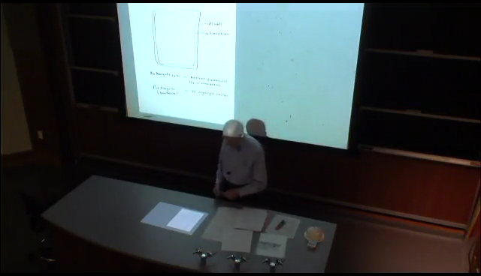
Goals for Biochem II:
Problem: A simple E. coli cell need only salts and a simple carbon source like acetic acid for growth. How is that possible?
Dr. Kornberg: Lecture 01.20.17 (35:58-42:12)
(6 min)
All of these questions are answered, thus making LIFE possible, by what is termed INTERMEDIARY METABOLISM
FIRST, let’s review some chemical principles and reactions…
Notes:
FIGURE 1–12 Structural hierarchy in the molecular organization of cells. The organelles and other relatively large components of cells are composed of supramolecular complexes, which in turn are composed of smaller macromolecules and even smaller molecular subunits. For example, the nucleus of this plant cell contains chromatin, a supramolecular complex that consists of DNA and basic proteins (histones). DNA is made up of simple monomeric subunits (nucleotides), as are proteins (amino acids).

