Slide 1
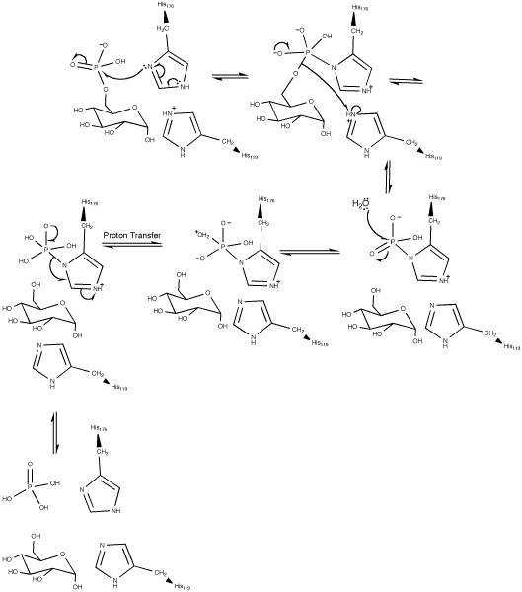
Gluconeogenesis
Fru 6-P to Glucose [Fru 6-P→Glc 6-P→Glc]
Mechanism
❶
❷
❹
❸
Glucose 6-phosphate → glucose
  by glucose 6-phosphatase
  segregated in the endoplasmic reticulum
  cleaves phosphate with His at active site
  Water hydrolyzes the His-P_{i}
  DOES NOT generate ATP
\❺
Glucose 6-phosphatase
ΔG°’ = –3.3 kcal/mol

