Slide 1
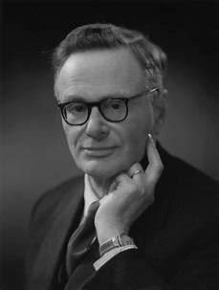
The Citric Acid Cycle
a.k.a. Krebs Cycle,
a.k.a. Tricarboxylic Acid Cycle (TCA)
Notes:
FIGURE 16–7 Reactions of the citric acid cycle. The carbon atoms shaded in pink are those derived from the acetate of acetyl-CoA in the first turn of the cycle; these are not the carbons released as CO₂ in the first turn. Note that in succinate and fumarate, the two-carbon group derived from acetate can no longer be specifically denoted; because succinate and fumarate are symmetric molecules, C-1 and C-2 are indistinguishable from C-4 and C-3. The number beside each reaction step corresponds to a numbered heading on pages xxx–xxx). The red arrows show where energy is conserved by electron transfer to FAD or NAD⁺, forming FADH₂ or NADH + H⁺. Steps 1, 3, and 4 are essentially irreversible in the cell; all other steps are reversible. The nucleoside triphosphate product of step 5 may be either ATP or GTP, depending on which succinyl-CoA synthetase isozyme is the catalyst.

Slide 2
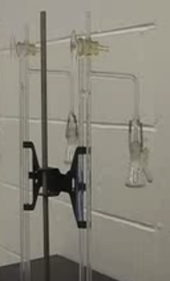
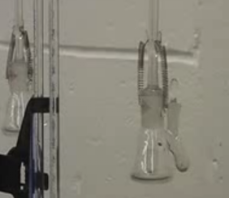
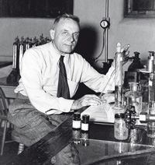
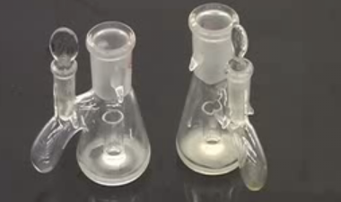
Time B.C. (Before the Cycle)
Otto Warburg
1883-1970
Manometer
Warburg Apparatus
-respiration
-Measure rates of O₂ consumption
Substrates
(e.g., glucose)
UTube instructions
CO₂ trap
Tissues
CO₂ → H₂CO₃ → 2H⁺ + CO₃⁻² → K₂CO₃ + H₂O
(http://youtu.be/M-HYbZwN43o)
Notes:
1 mole any gas was 22.4 L

Slide 3
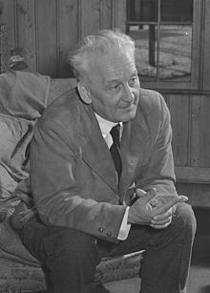
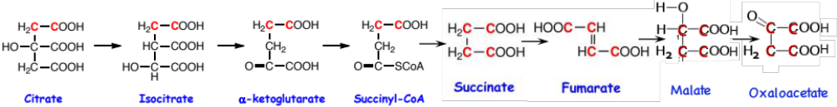
Time B.C. (Before the Cycle)
O-leic
M-alonic
S-uccinic
G-lutaric
A-dipic
P-imelic
In 1920 BC, what was known about respiration?
Glycolysis gives rise to pyruvate
Adding pyruvate to respiring tissues in a Warburg apparatus, there are 2.5 O₂ consumed:
Any intermediate in the process will be oxidized at a rate ≥pyruvate
Many intermediates were tried, but few met this criteria, they were:
succinate, fumarate, malate, alpha-ketoglutarate, etc.
2^{1/2}O₂ + C₃H₄O₃ → → → → → 3CO₂ + 2H₂O
2^{1/2}O₂ + C₃H₄O₃ → 3CO₂ + 2H₂O
Albert Szent-Györgyi
1893-1986
glutarate → succinate → fumarate → malate → oxaloacetate
α-ketoglutarate
5) Others had already worked out several compounds and their interconversion. Specifically, Albert Szent-Györgi had worked out the interconversion of the dicarboxylic acids. Carl Martinus worked out the interconversion of the tricarboxylic acids
|
citrate → aconitate → isocitrate
6) In 1937, with help of German biochemist Franz Koop, Carl Martinus, demonstrated a series of reactions using citrate that produced α−ketoglutarate. Thus tricarboxylic acid and dicarboxylic acids would be interconverted with loss of CO₂, but also support respiration.
1/2
Notes:
Not covered in textbook- cut and dried; empirical science
Cycle was revolutionary: recall in a pathway: When a→2b→2c→4d means that if you put in a mole of a, you will get 4 moles of d.
Krebs was a student of Warburg;

Slide 4
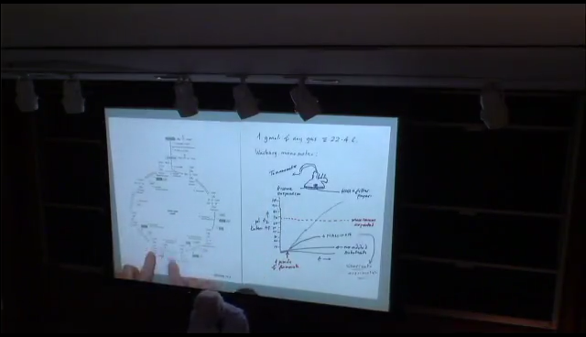
Time B.C. (Before the Cycle)
O-leic
M-alonic
S-uccinic
G-lutaric
A-dipic
P-imelic
Dr. Kornberg: Lecture 02.08.17 (19:54-20:39)
(1 min)
Notes:
History of the discovery of the cycle
Several of the components and reactions of the citric acid cycle were established in the 1930s by the research of Albert Szent-Györgyi, who received the Nobel Prize in Physiology or Medicine in 1937 specifically for his discoveries pertaining to fumaric acid, a key component of the cycle.^{[8]} He was able to make this discovery successful with the help of pigeon breast muscle. Because this tissue maintains its oxidative capacity well after breaking down in the "Latapie" mill and releasing in aqueous solutions, breast muscle of the pigeon was very well qualified for the study of oxidative reactions.^{[9]} The citric acid cycle itself was finally identified in 1937 by Hans Adolf Krebs and William Arthur Johnson while at the University of Sheffield,^{[10]} for which the former received the Nobel Prize for Physiology or Medicine in 1953, and for whom the cycle is sometimes named (Krebs cycle).^{[11]}

Slide 5
Time B.C. (Before the Cycle)
O-leic
M-alonic
S-uccinic
G-lutaric
A-dipic
P-imelic
glutarate → succinate → fumarate → malate → oxaloacetate
citrate → aconitate → isocitrate
Hans Krebs
1900-1981
“pyruvate” (acetate)
Krebs confirmed that the pathway was consistent with succinate, fumarate, and malate proved to be useful because all these molecules increased oxygen consumption in the pigeon breast muscle.
Dr. Kornberg: Lecture 02.08.17 (19:54-20:39)
(1 min)
The first clue came from an experiment with fumarate. Krebs did careful measurements using the Warburg manometer. Fumarate gave greater than expected oxygen consumption in the pigeon breast muscle.
3O₂ + C₄H₄O₄→4CO₂ + 2H₂O
∴1 µmole fumarate would consume 3 µmole O₂
Malonic acid inhibition of the succinate → fumarate step prevented this increase…. BUT, succinate accumulated!
How can fumarate give rise to succinate? There must be a cycle
Tested by showing that using succinate or fumarate you could detect the formation of citrate.
Later in 1937, he proposed that pyruvate would combine with oxaloacetate to make citrate in a cycle he called the Citric Acid Cycle. Later, Fritz Lipmann showed that it was acetyl-CoA and not pyruvate.
Notes:
History of the discovery of the cycle
Several of the components and reactions of the citric acid cycle were established in the 1930s by the research of Albert Szent-Györgyi, who received the Nobel Prize in Physiology or Medicine in 1937 specifically for his discoveries pertaining to fumaric acid, a key component of the cycle.^{[8]} He was able to make this discovery successful with the help of pigeon breast muscle. Because this tissue maintains its oxidative capacity well after breaking down in the "Latapie" mill and releasing in aqueous solutions, breast muscle of the pigeon was very well qualified for the study of oxidative reactions.^{[9]} The citric acid cycle itself was finally identified in 1937 by Hans Adolf Krebs and William Arthur Johnson while at the University of Sheffield,^{[10]} for which the former received the Nobel Prize for Physiology or Medicine in 1953, and for whom the cycle is sometimes named (Krebs cycle).^{[11]}

