Slide 1
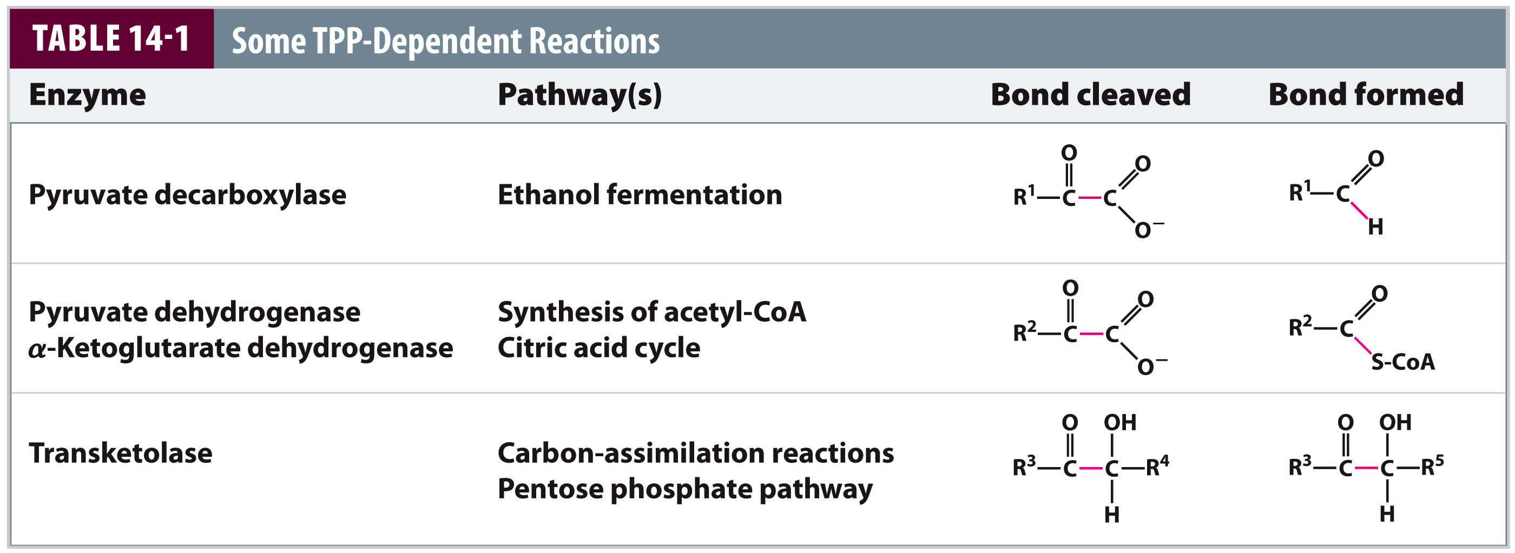
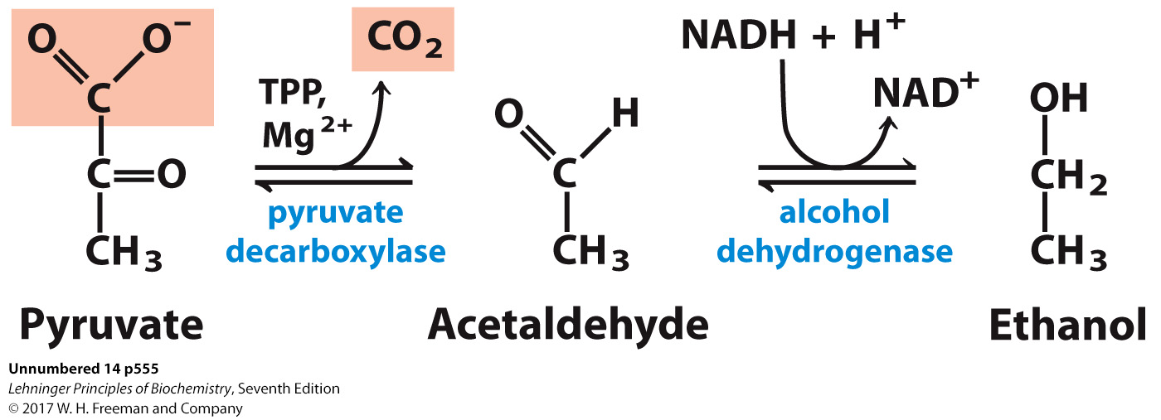
Fermentation: Alcohol Dehydrogenase
Like LDH, highly thermo-dynamically favorable (ΔG°’ = –6 kcal/mol)
  This reaction pulls the entire fermentation pathway.

Slide 2
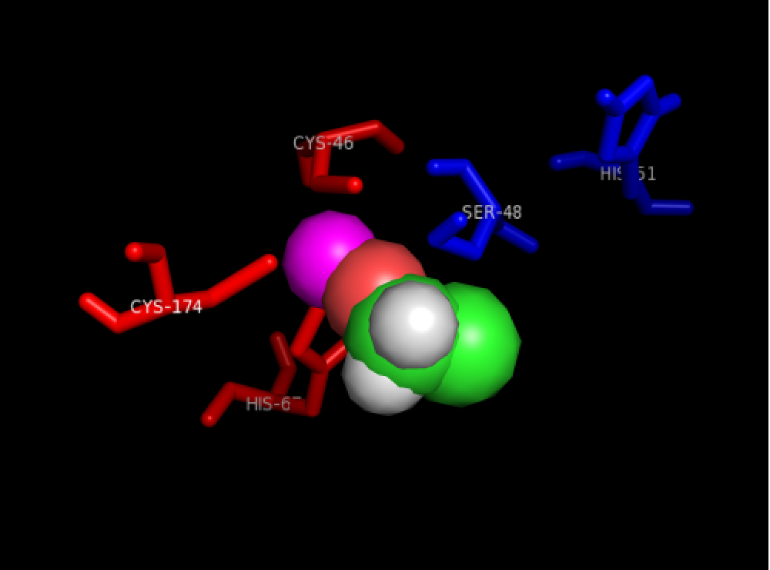
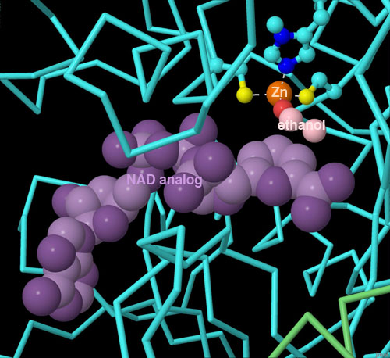
Fermentation: Alcohol Dehydrogenase (ADH)
His,2Cys: bind Zn²⁺
Ser/His: acid-base catalysis
Zn²⁺
acetaldehyde
Acid catalysis from Ser/His
Base catalysis
Notes:
MECHANISM FIGURE 14–15a,b Thiamine pyrophosphate (TPP) and its role in pyruvate decarboxylation. (a) TPP is the coenzyme form of vitamin B1 (thiamine). The reactive carbon atom in the thiazolium ring of TPP is shown in red. In the reaction catalyzed by pyruvate decarboxylase, two of the three carbons of pyruvate are carried transiently on TPP in the form of a hydroxyethyl, or “active acetaldehyde,” group (b), which is subsequently released as acetaldehyde.

Slide 3
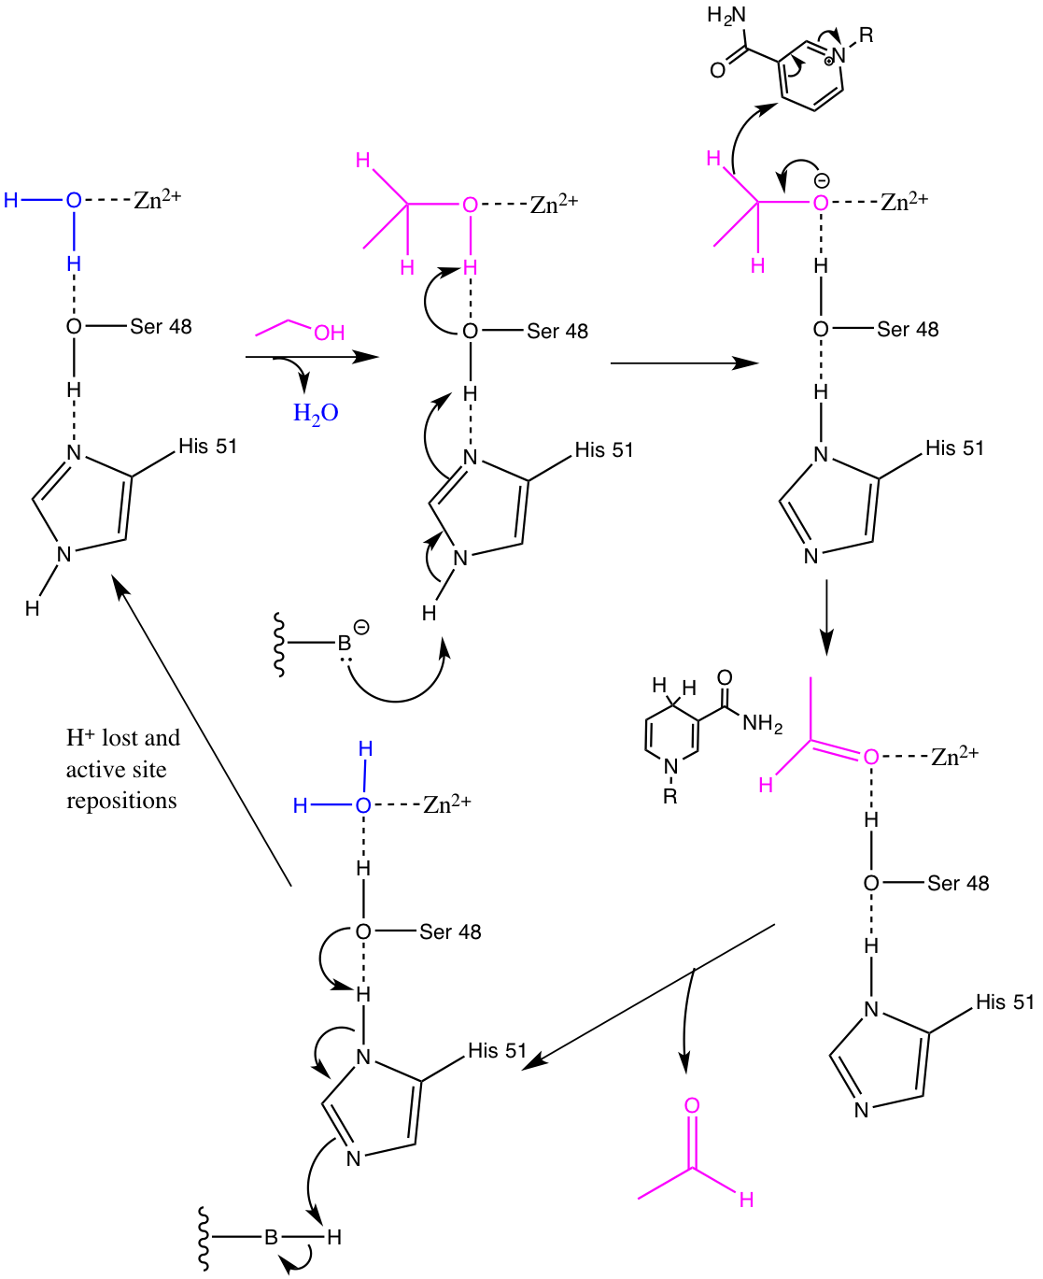
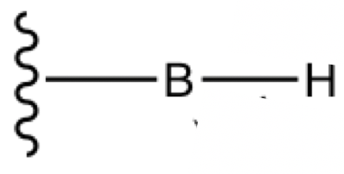
Fermentation: Alcohol Dehydrogenase (ADH)
NAD⁺
Ethanol
Acid catalysis
H⁺
Base is re-
protonated and
NADH
:
Acetaldehyde
Notes:
MECHANISM FIGURE 14–15a,b Thiamine pyrophosphate (TPP) and its role in pyruvate decarboxylation. (a) TPP is the coenzyme form of vitamin B1 (thiamine). The reactive carbon atom in the thiazolium ring of TPP is shown in red. In the reaction catalyzed by pyruvate decarboxylase, two of the three carbons of pyruvate are carried transiently on TPP in the form of a hydroxyethyl, or “active acetaldehyde,” group (b), which is subsequently released as acetaldehyde.

Slide 4
Fermentation: Alcohol Dehydrogenase (ADH)
NAD⁺
Ethanol
Acid catalysis
H⁺
Base is re-
protonated and
NADH
:
Acetaldehyde
Notes:
MECHANISM FIGURE 14–15a,b Thiamine pyrophosphate (TPP) and its role in pyruvate decarboxylation. (a) TPP is the coenzyme form of vitamin B1 (thiamine). The reactive carbon atom in the thiazolium ring of TPP is shown in red. In the reaction catalyzed by pyruvate decarboxylase, two of the three carbons of pyruvate are carried transiently on TPP in the form of a hydroxyethyl, or “active acetaldehyde,” group (b), which is subsequently released as acetaldehyde.

