Slide 1
Where does alcohol go
once it is ingested?

Slide 2
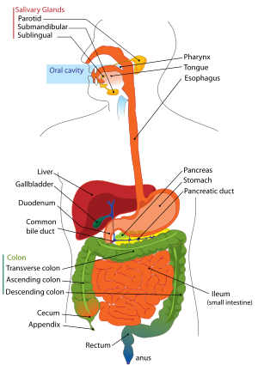

Slide 3
How does our body cope with alcohol once it is ingested?
What does our body do with that alcohol?

Slide 4
Let’s take a look at a model of alcohol processing.

Slide 5
Lucy and the chocolate factory video

Slide 6
What happens if the conveyer belt speeds up?
Perform the lab procedure.

Slide 7
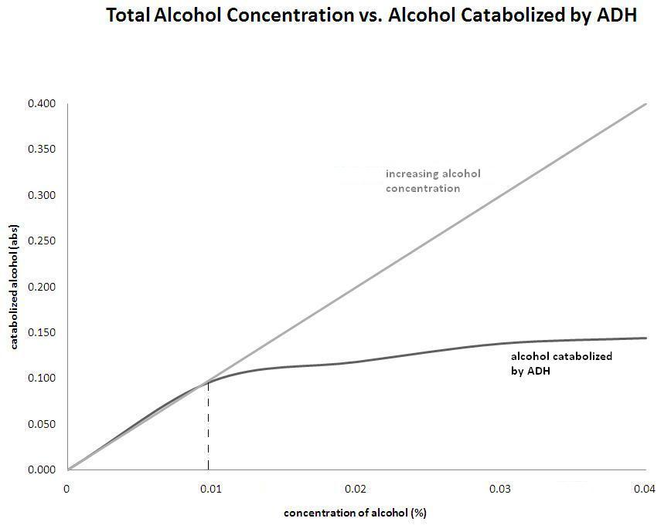

Slide 8
What happens to the unprocessed alcohol?

