Slide 1
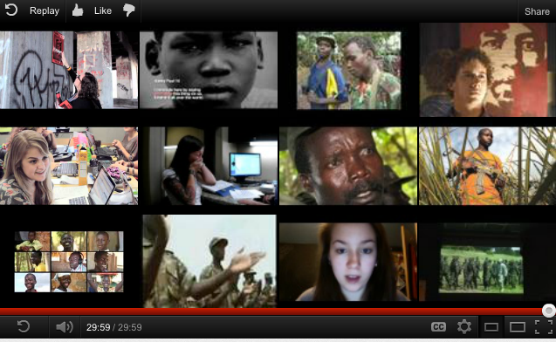
Teaching about Human Rights in Africa: What do we do with
Kony 2012?
Barbara Anderson
African Studies Center, UNC-CH
March 29, 2012

Slide 2
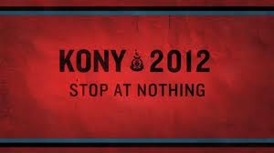
Where we are going today
What is “Kony 2012” and why do we care?
Background context for Kony and the LRA
Some observations on “Kony 2012”
Teaching about Human Rights in Africa
Helping students with social media engagement
Resources for teaching and learning “Kony2012”

Slide 3
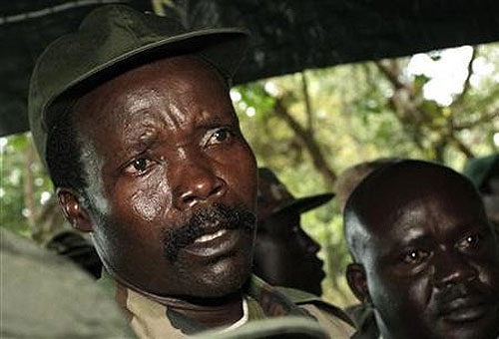
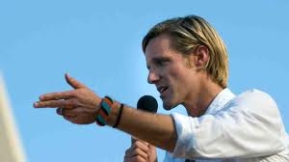
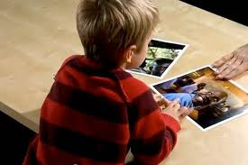
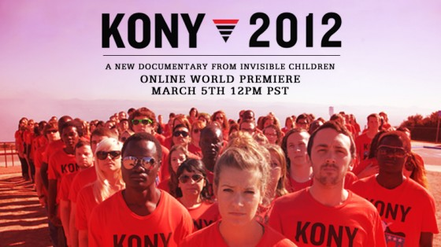
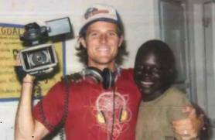
“Kony 2012” video phenomenon
85,876,173 views on YouTube
3,530,673 people have “pledged support

Slide 4
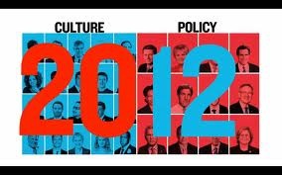
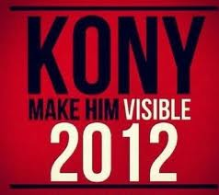

Contact Culture Makers and Policy Makers
Donate to TRI
April 20, 2012 Blanket the Night

Slide 5
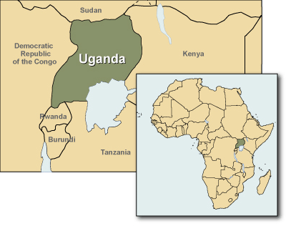
Background Context for Kony and LRA
This is part of a conflict that has been going on since the colonial era
See handout: “A Brief Guide to the LRA and Joseph Kony”

Slide 6
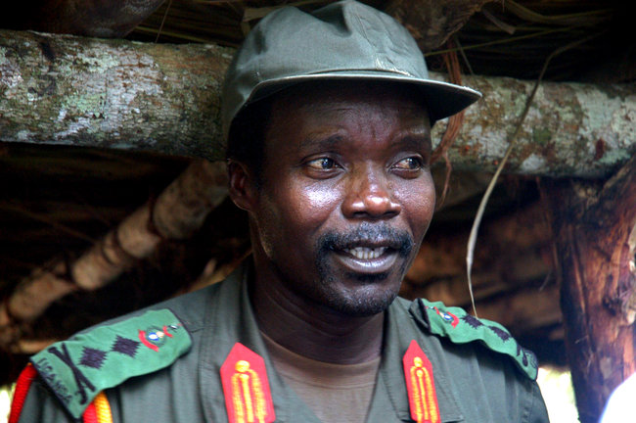
Kony and the LRA
1988 established Lord’s Resistance Army
Initially began to advocate for the Acholi people of northern Uganda, but they quickly rejected him.
“Christian” militia
Aimed at personal power and wealth
Abduction of children as soldiers and concubines

Slide 7
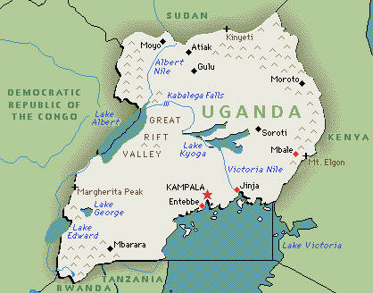
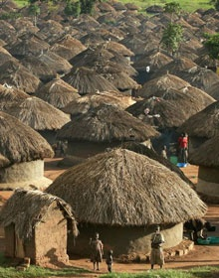
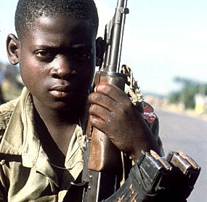

Slide 8
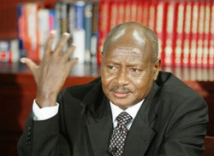
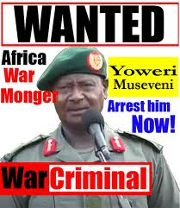
Yoweri Kaguta Museveni
Became President of Uganda January 1986; took power by military force, then elected in May 1996.
Numerous human rights violations before and after taking office
Has always wanted a military solution to LRA; US military aid helps Museveni

Slide 9
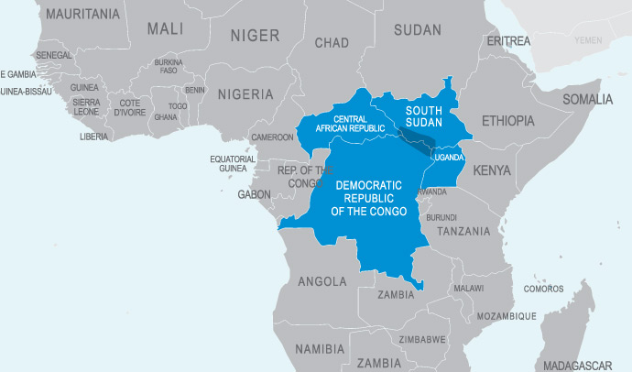

Slide 10
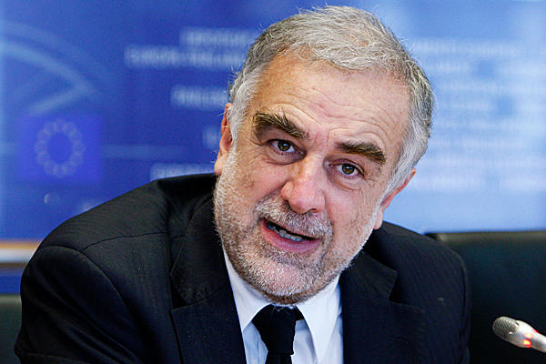
Many Attempts to get Kony
ICC warrants in 2005
UN sent Special Ops, trained in jungle combat into Congo in 2006; none survived.
Bush had authorized the Pentagon to send a team of 17 counterterrorism advisers to train Ugandan troops and provided $ millions of aid, including fuel trucks, satellite phones and night-vision goggles, to the Ugandan Army
Luis Moreno-Ocampo, ICC
2008 Peace Agreement In Juba; Kony did not appear
“Lord's Resistance Army Disarmament and Northern Uganda Recovery Act,” ratified by both houses spring 2010
100 advisers to help Uganda in Oct. 2011

Slide 11
Observations on “Kony 2012”
“Saving Africa”
Call to social action or consumerism?
The Danger of a Single Story

Slide 12
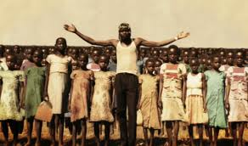
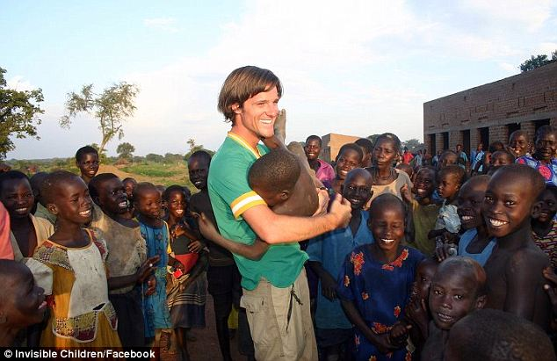
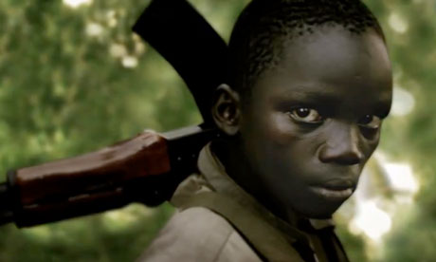
“Saving Africa”
An old mission that stereotypes Africa and Africans.

Slide 13
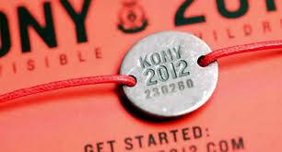
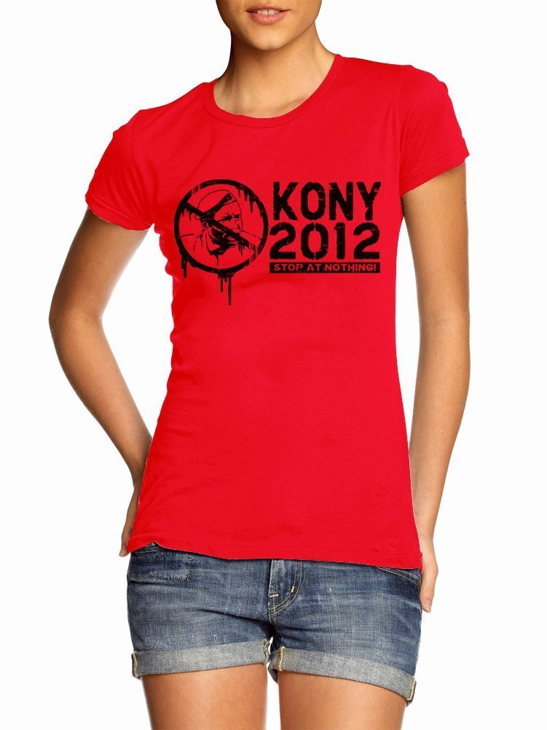

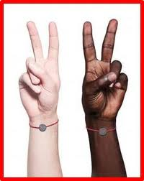
Kony 2012 Message/Merchandise:
Activism or Consumerism?
http://invisiblechildrenstore.myshopify.com/?limit=all

Slide 14
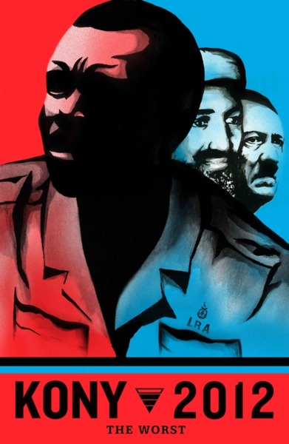
The Danger of a Single Story
Where are the African Voices here?
What are the consequences of US action?
What are Africans doing about these problems?
http://www.ted.com/talks/chimamanda_adichie_the_danger_of_a_single_story.html

Slide 15
Some Guidelines (See handout)
Critical Inquiry requires:
Historical context
Complicating the analysis
Differentiating between cause and effect
Importance of “Timely and Appropriate” responses
Listening to African perspectives
Open-ended evaluations of social justice organizations
Risk of Students accepting these stereotypes :
Violent Crises are part of the “African Condition”
Africa is all the same
Africans have little capacity to solve problems

Slide 16
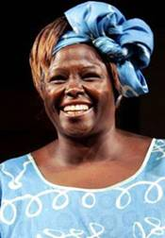
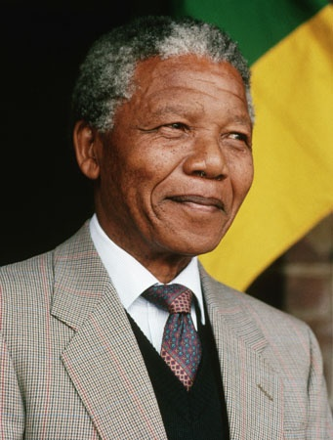
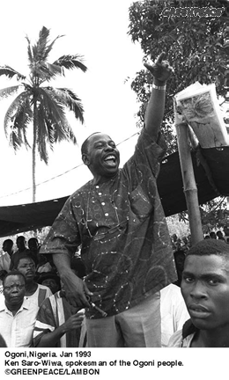
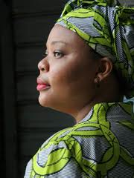
Teaching about Human Rights in Africa
What are Africans doing?
Be careful about where you start the lesson
Find connections to the US
Look for complexity!
Be careful about African “special capacity” and avoid the “unimaginable”
Use African heroes and justice movements, even when you don’t have to!

Slide 17
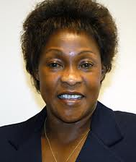
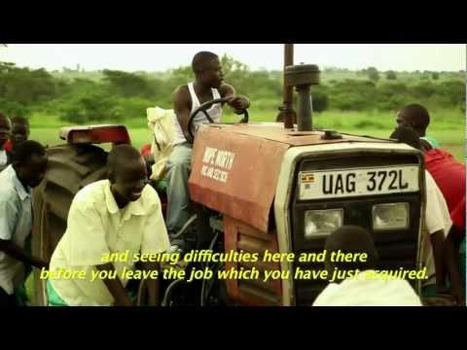
What have Ugandans been doing?
Betty Bigombe
“The Thing that Happened”
http://www.youtube.com/watch?v=HFRPYyOH9Tc
Documentary short about Ugandans helping abducted returnees to heal
Ugandan negotiator

Slide 18
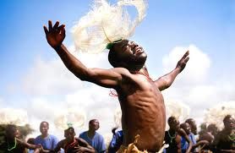
War Dance
Documentary about children in Northern Uganda participating in a national performance competition, similar to US school competitions.
Available to borrow from the ASC at UNC-CH

Slide 19
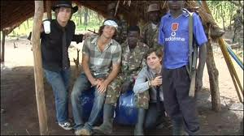
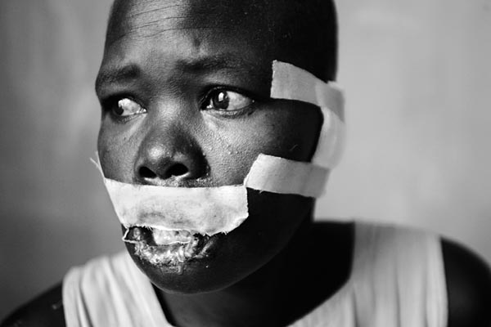
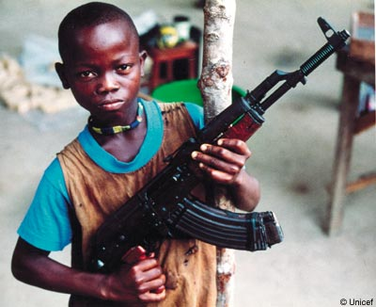
Where do you start the story?

Slide 20

Find the connections to the US
African commentators indicate that US response is more influenced by:
oil reserves recently found in the area--and other strategic minerals, and
larger concerns related to "global terrorism" in the larger region, than it is a US concern for capturing Kony-- (focus would be on eastern Congo where there is much greater violence that the LRA is currently responsible for)
AFRICOM: “sustained security engagement through military-to-military programs, military-sponsored activities, and other military operations as directed to promote a stable and secure African environment in support of U.S. foreign policy”

Slide 21
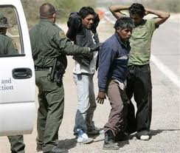
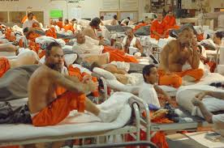
Find the connections to the US
What are the Human Rights issues in the U.S.?
In our state?
Who works on these issues?
Who should work on these issues?
http://www.hrw.org/united-states/us-program
[for world issues: www.hrw.org ]

Slide 22
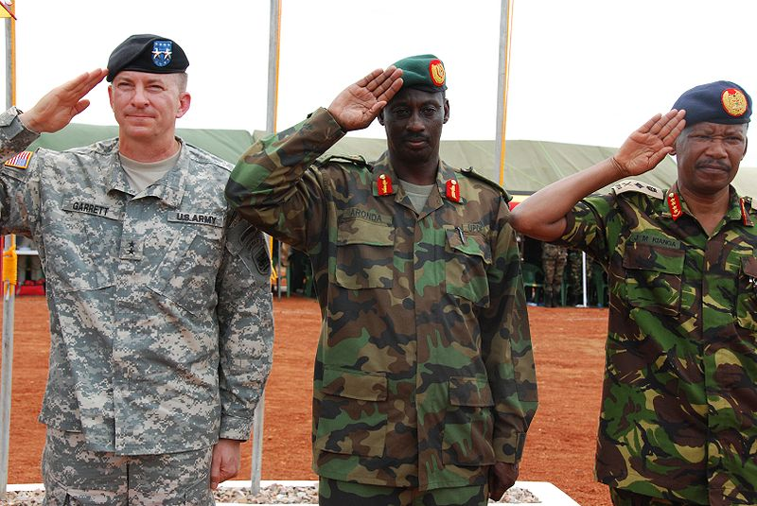
Look for Complexity!

Slide 23
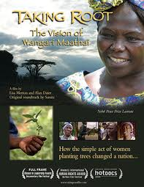
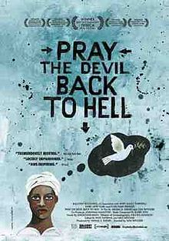
Other films about African responses to human rights abuses

Slide 24

Kony2012 Teachable Moment:
Articles for Educators on Viral Social Media and Students
(see handout on Media Inquiry)
http://mindshift.kqed.org/2012/03/kony-2012-viral-video-prompts-a-teachable-moment/
http://spotlight.macfound.org/blog/entry/how-to-tell-a-true-activism-story-the-teachable-moments-of-kony-2012/
Notes:
Kids can easily get swept up in the tide of celebrity “do goodism” and quickly miss the larger forces at work behind viral videos. For kids, it’s exciting to get caught up in the energy of a cause, and, as [Dana] Boyd notes, “young people feel like they did something by getting a celebrity to pay attention to a cause.” And yes, let’s face it — kids also suffer from FOMO – “fear of missing out.”
But as Henry Jenkins, a USC professor and researcher of youth participatory culture points out, “this critique … ignores the possibility that the movie may be meaningful in mobilizing young people as civic actors… Even when young people want to create social change, finding ways to get meaningfully involved, particularly in world affairs, is described by many … as a challenge. A key strength of Invisible Children, and one that Kony 2012 exhibits as well, is the way it offers young people actionable steps, concrete channels to express a pre-existing activist desire.”

Slide 25
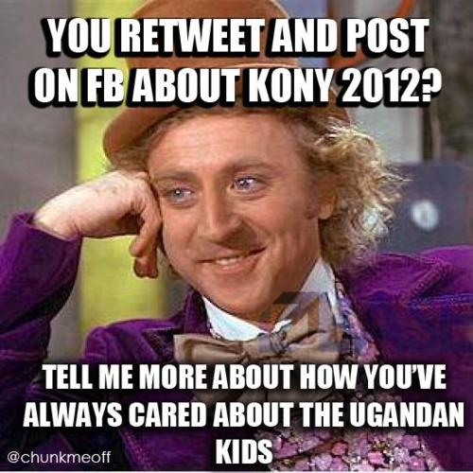
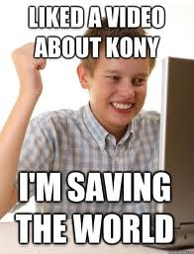
Help our students escape this!

Slide 26
Special thanks to the ASA outreach council
Much of the material in this presentation has been provided by members of the Outreach Council. Thanks go especially to Barbara Brown at Boston University, John Metzler at Michigan State University, and Martha Saavedra at UC Berkeley.

Slide 27
Resources for Teaching
www.africa.unc.edu has 2 lists of urls compiled by scholars
http://africa.unc.edu/outreach/index.asp has a lending library of films and books free to NC teachers, as well as online resources
Today’s handouts from the ASA Outreach Council will be available next week at www.africa.unc.edu , including this slide show

Slide 28
Take a few minutes to respond:
What are “Human Rights”?
How do you know when these rights are being “abused”?
What are the greatest Human Rights challenges in the US?
In our state?
Who is working on these? Who should work on these?

Slide 29
Human Rights Definition
human rights pl.n. The basic rights and freedoms to which all humans are entitled, often held to include the right to life and liberty, freedom of thought and expression, and equality before the law.
The American Heritage® Dictionary of the English Language, Fourth Edition copyright ©2000 by Houghton Mifflin Company. Updated in 2009. Published by Houghton Mifflin Company. All rights reserved.

Slide 30
UN Declaration of Human Rights
30 Articles, beginning with:
Article 1. All human beings are born free and equal in dignity and rights. They are endowed with reason and conscience and should act towards one another in a spirit of brotherhood.
Article 2. Everyone is entitled to all the rights and freedoms set forth in this Declaration, without distinction of any kind, such as race, colour, sex, language, religion, political or other opinion, national or social origin, property, birth or other status. Furthermore, no distinction shall be made on the basis of the political, jurisdictional or international status of the country or territory to which a person belongs, whether it be independent, trust, non-self-governing or under any other limitation of sovereignty.
Article 3. Everyone has the right to life, liberty and security of person.
Article 4. No one shall be held in slavery or servitude; slavery and the slave trade shall be prohibited in all their forms.
Article 5. No one shall be subjected to torture or to cruel, inhuman or degrading treatment or punishment.
Article 6. Everyone has the right to recognition everywhere as a person before the law.
http://www.un.org/en/documents/udhr
Remind you of anything?

Slide 31
Human Rights Watch
http://www.hrw.org/
Check this web site frequently—it covers the world and has very current reports
http://www.hrw.org/united-states/us-program
This will give students an opportunity to think about human rights issues in the US.

