Slide 1
Introduction to C++: Part 2

Slide 2
Tutorial Outline: Part 2
References and Pointers
The formal concepts in OOP
More about C++ classes

Slide 3
Pass by Value
main()
RectangleArea1(float L, float W)
float L
copy
float L
float W
copy
float W
C++ defaults to pass by value behavior when calling a function.
The function arguments are copied when used in the function.
Changing the value of L or W in the RectangleArea1 function does not effect their original values in the main() function
When passing objects as function arguments it is important to be aware that potentially large data structures are automatically copied!

Slide 4
Pass by Reference
main()
RectangleArea3(const float& L, const float& W)
float L
reference
float L
float W
reference
float W
Pass by reference behavior is triggered when the & character is used to modify the type of the argument.
This is the type of behavior you see in Fortran, Matlab, Python, and others.
Pass by reference function arguments are NOT copied. Instead the compiler sends a pointer to the function that references the memory location of the original variable. The syntax of using the argument in the function does not change.
Pass by reference arguments almost always act just like a pass by value argument when writing code EXCEPT that changing their value changes the value of the original variable!!
The const modifier can be used to prevent changes to the original variable in main().

Slide 5
void does not return a value.
void RectangleArea4(const float& L, const float& W, float& area) {
area= L*W ;
}
In RectangleArea4 the pass by reference behavior is used as a way to return the result without the function returning a value.
The value of the area argument is modified in the main() routine by the function.
This can be a useful way for a function to return multiple values in the calling routine.

Slide 6
In C++ arguments to functions can be objects…which can contain any quantity of data you’ve defined!
  Example: Consider a string variable containing 1 million characters (approx. 1 MB of RAM).
    Pass by value requires a copy – 1 MB.
    Pass by reference requires 8 bytes!
Pass by value could potentially mean the accidental copying of large amounts of memory which can greatly impact program memory usage and performance.
When passing by reference, use the const modifier whenever appropriate to protect yourself from coding errors.
  Generally speaking – use const anytime you don’t want to modify function arguments in a function.
“C makes it easy to shoot yourself in the foot; C++ makes it harder, but when you do it blows your whole leg off.” – Bjarne Stroustrop

Slide 7

A first C++ class
#include <iostream>
using namespace std;
class BasicRectangle
{
public:
// width
float W ;
// length
float L ;
};
int main()
{
cout << "Hello world!" << endl;
BasicRectangle rectangle ;
rectangle.W = 1.0 ;
rectangle.L = 2.0 ;
return 0;
}
Start a new project. Call it BasicRectangle.
In the main.cpp, we’ll define a class called BasicRectangle
First, just the basics: length and width
Enter the code on the right before the main() function in the main.cpp file (copy & paste is fine) and create a BasicRectangle object in main.cpp:

Slide 8
Basic C++ Class Syntax
class keyword
Name of class
Curly braces at the beginning and end followed by a semi-colon
class BasicRectangle
{
public:
// width ;
float W ;
// length
float L ;
};
Internal variables are called members
public keyword indicates everything following the keyword is accessible by any other code outside of this class.
The class can now be used to declare an object named rectangle. The width and length of the rectangle can be set.
BasicRectangle rectangle ;
rectangle.W = 1.0 ;
rectangle.L = 2.0 ;

Slide 9
Accessing data in the class
Public members in an object can be accessed (for reading or writing) with the syntax:
object.member
Next let’s add a function inside the object (called a method) to calculate the area.
int main()
{
cout << "Hello world!" << endl;
BasicRectangle rectangle ;
rectangle.W = 1.0 ;
rectangle.L = 2.0 ;
return 0;
}

Slide 10
class BasicRectangle
{
public:
// width ;
float W ;
// length
float L ;
float Area() {
return W * L ;
}
};
int main()
{
cout << "Hello world!" << endl;
BasicRectangle rectangle ;
rectangle.W = 21.0 ;
rectangle.L = 2.0 ;
cout << rectangle.Area() << endl ;
return 0;
}
method Area does not take any arguments, it just returns the calculation based on the object members.
Methods are accessed just like members:
object.method(arguments)

Slide 11
Basic C++ Class Summary
C++ classes are defined with the keyword class and must be enclosed in a pair of curly braces plus a semi-colon:
class ClassName { …. } ;
The public keyword is used to mark members (variables) and methods (functions) as accessible to code outside the class.
The combination of data and the functions that operate on it is the OOP concept of encapsulation.

Slide 12
Encapsulation in Action
In C – calculate the area of a few shapes…
In C++ with Circle and Rectangle classes…not possible to miscalculate.
/* assume radius and width_square are assigned
already ; */
float a1 = AreaOfCircle(radius) ; // ok
float a2 = AreaOfSquare(width_square) ; // ok
float a3 = AreaOfCircle(width_square) ; // !! OOPS
Circle c1 ;
Rectangle r1 ;
// ... assign radius and width ...
float a1 = c1.Area() ;
float a2 = r1.Area() ;

Slide 13
Now for a “real” class
Defining a class in the main.cpp file is not typical.
Two parts to a C++ class:
  Header file (my_class.h)
    Contains the interface (definition) of the class – members, methods, etc.
    The interface is used by the compiler for type checking, enforcing access to private or protected data, and so on.
    Also useful for programmers when using a class – no need to read the source code, just rely on the interface.
  Source file (my_class.cc)
    Compiled by the compiler.
    Contains implementation of methods, initialization of members.
  In some circumstances there is no source file to go with a header file.

Slide 14
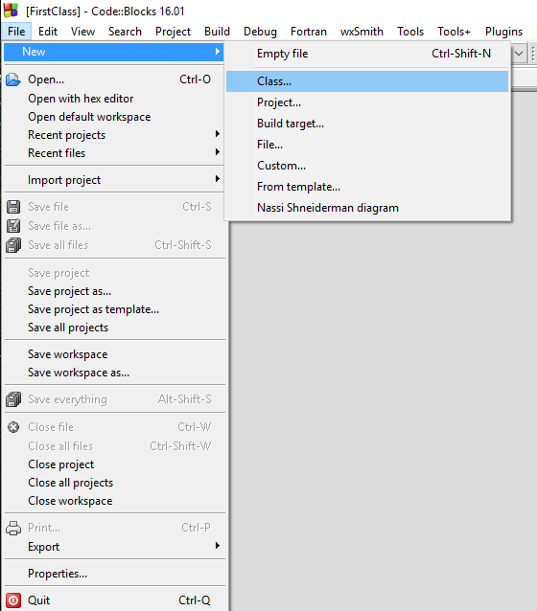
Create a new class in C::B
Using an IDE is especially convenient in C++ to keep the details straight when defining a class
  Typically header and source files are needed
  Some default methods are created to save you some typing
Create another project in C::B, call it Shapes.
Once open, go the File menu, click New, then click Class.
This opens a wizard GUI that helps get things started.
This will create the header and source files for you.

Slide 15
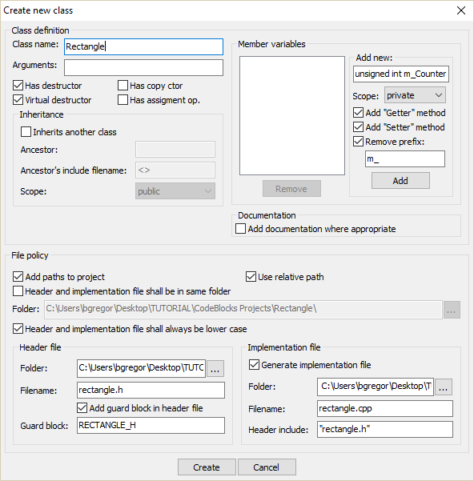
Name the class Rectangle
Uncheck the Documentation option
  This will just confuse things for now
Click Create!

Slide 16
rectangle.h
rectangle.cpp
#ifndef RECTANGLE_H
#define RECTANGLE_H
class Rectangle
{
public:
Rectangle();
virtual ~Rectangle();
protected:
private:
};
#endif // RECTANGLE_H
#include “rectangle.h"
Rectangle::Rectangle()
{
//ctor
}
Rectangle::~Rectangle()
{
//dtor
}
2 files are automatically generated: rectangle.h and rectangle.cpp

Slide 17
Modify rectangle.h
#ifndef RECTANGLE_H
#define RECTANGLE_H
class Rectangle
{
public:
Rectangle();
virtual ~Rectangle();
float m_length ;
float m_width ;
float Area() ;
protected:
private:
};
#endif // RECTANGLE_H
As in the sample BasicRectangle, add storage for the length and width to the header file. Add a declaration for the Area method.
The protected keyword will be discussed later.
The private keyword declares anything following it (members, methods) to be visible only to code in this class.

Slide 18
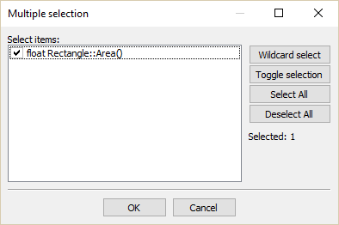
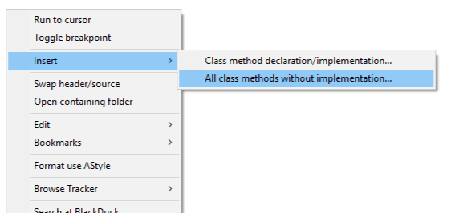
Modify rectangle.cpp
This will now contain the code for the Area() method.
Use the C::B environment to help out here!
Open rectangle.cpp (under Sources/src)
Right-click and choose Insert/All class methods without implementation
The Area() method is automatically found from the header file.
Click OK.

Slide 19
rectangle.cpp
The Area() method now has a basic definition added.
The syntax:
class::method
tells the compiler that this is the code for the Area() method declared in rectangle.h
Now take a few minutes to fill in the code for Area().
  Hint – look at the code used in BasicRectangle...
#include "rectangle.h"
Rectangle::Rectangle()
{
//ctor
}
Rectangle::~Rectangle()
{
//dtor
}
float Rectangle::Area()
{
}

Slide 20
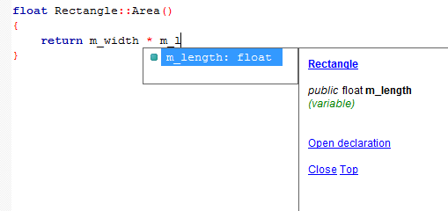
More C::B assistance
You may have noticed C::B trying to help when entering the code for Area()
Press the Tab key to accept the suggestion
It will offer up variable names, member names, class names, etc. that match what you’re typing when appropriate to save you effort.
  This can be a huge convenience when dealing with large code bases.

Slide 21
Last Step
Go to the main.cpp file
Add an include statement for “rectangle.h”
Create a Rectangle object in main()
Add a length and width
Print out the area using cout.
Hint: just like the BasicRectangle example…

Slide 22
Solution
You should have come up with something like this:
#include <iostream>
using namespace std;
#include "rectangle.h"
int main()
{
Rectangle rT ;
rT.m_width = 1.0 ;
rT.m_length = 2.0 ;
cout << rT.Area() << endl ;
return 0;
}

Slide 23
References and Pointers
Part 1 introduced the concept of passing by reference when calling functions.
  Selected by using the & character in function argument types: int add (int &a, int b)
References hold a memory address of a value.
  int add (int &a, int b)→ a has the value of a memory address, b has an integer value.
  Used like regular variables and C++ automatically fills in the value of the reference when needed:
  int c = a + b ; → “retrieve the value of a and add it to the value of b”

Slide 24
References and Pointers
From C there is another way to deal with the memory address of a variable: via pointer types.
Similar syntax in functions except that the & is replaced with a *:
int add (int *a, int b)
To get a value from a pointer requires a manual dereferencing by the programmer:
int c = *a + b ; → “retrieve the value of a and add it to the value of b”

Slide 25
 | Reference | Pointer
Declaration | int &ref ; | int *ptr ;
Set memory address to something in memory | int a = 0 ; int &ref = a ; | int a = 0 ; int *ptr = &a ;
Fetch value of thing in memory | cout << ref ; | cout << *ptr ;
Can refer/point to nothing (null value)? | No | Yes
Can change address that it refers to/points at? | No. int a = 0 ; int b = 1 ; int &ref = a ; ref = b ; // value of a is now 1! | Yes int a = 0 ; int b = 1 ; int *ptr = &a ; ptr = &b ; // ptr now points at b
Object member/method syntax | MyClass obj ; MyClass &ref = obj ; ref.member ; ref.method(); | MyClass obj ; MyClass *ptr = obj ; ptr->member ; ptr->method(); // OR (*ptr).member ; (*ptr).method() ;
int a = 0 ;
int &ref = a ;
int *ptr = &a ;
int a: 4 bytes in memory at address 0xAABBFF with a value of 0.
Value stored in ref: 0xAABBFF
Value stored in ptr: 0xAABBFF

Slide 26
When to use a reference or a pointer
Both references and pointers can be used to refer to objects in memory in methods, functions, loops, etc.
Avoids copying due to default call-by-value C++ behavior
  Could lead to memory/performance problems.
  Or cause issues with open files, databases, etc.
If you need to:
  Hold a null value (i.e. point at nothing), use a pointer.
  Re-assign the memory address stored, use a pointer.
Otherwise, use a reference.
  References are much easier to use!
  No need to check if a reference has a null value…since they can’t hold one.
// Pointer to a null value
int *a = NULL ; // C-style
int *b = nullptr ; // C++11 style.
// Reference to a null value
// won't compile.
int &c = nullptr ;

Slide 27
Null Value Checking
// Pointer version
void add(const int *a, const int b, int *c)
{
if (a && c) { // check for null pointer
*c = *a + b ;
}
}
// a && c → this means if a AND c are not // null
// Reference version
void add(const int &a, const int b, int &c)
{
c = a + b ;
}
A null value means the pointer is not currently pointing at anything.
  It’s a good idea to check before accessing the value they point at.
References cannot be null, so the code on the right does not need checking.

Slide 28
The formal concepts in OOP
Encapsulation
Inheritance
Abstraction
Polymorphism
Object-oriented programming (OOP):
  Defines classes to represent data and logic in a program. Classes can contain members (data) and methods (internal functions).
  Creates instances of classes, aka objects, and builds the programs out of their interactions.
The core concepts in addition to classes and objects are:
  Encapsulation
  Inheritance
  Polymorphism
  Abstraction
OOP

Slide 29
Core Concepts
Encapsulation
  As mentioned while building the C++ class in the last session.
  Bundles related data and functions into a class
Inheritance
  Builds a relationship between classes to share class members and methods
Abstraction
  The hiding of members, methods, and implementation details inside of a class.
Polymorphism
  The application of the same code to multiple data types
  There are 3 kinds, all of which are supported in C++. However only 1 is actually called polymorphism in C++ jargon (!)

Slide 30
C++ Classes
#ifndef RECTANGLE_H
#define RECTANGLE_H
class Rectangle
{
public:
Rectangle();
virtual ~Rectangle();
float m_length ;
float m_width ;
float Area() ;
protected:
private:
};
#endif // RECTANGLE_H
Open the Part 2 Shapes project in C::B
In the Rectangle class C::B generated two methods automatically.
Rectangle() is a constructor. This is a method that is called when an object is instantiated for this class.
  Multiple constructors per class are allowed
~Rectangle() is a destructor. This is called when an object is removed from memory.
  Only one destructor per class is allowed!
  (ignore the virtual keyword for now)

Slide 31
Encapsulation
Bundling the data and area calculation for a rectangle into a single class is and example of the concept of encapsulation.

Slide 32
Construction and Destruction
The constructor is called when an object is created.
This is used to initialize an object:
  Load values into member variables
  Open files
  Connect to hardware, databases, networks, etc.
The destructor is called when an object goes out of scope.
Example:
Object c1 is created when the program reaches the first line of the function, and destroyed when the program leaves the function.
void function() {
ClassOne c1 ;
}

Slide 33
When an object is instantiated…
#include "rectangle.h"
int main()
{
Rectangle rT ;
rT.m_width = 1.0 ;
}
The rT object is created in memory.
When it is created its constructor is called to do any necessary initialization.
  Here the constructor is empty so nothing is done.
The constructor can take any number of arguments like any other function but it cannot return any values.
  Essentially the return value is the object itself!
What if there are multiple constructors?
  The compiler chooses the correct one based on the arguments given.
#include "rectangle.h"
Rectangle::Rectangle()
{
//ctor
}
Note the constructor has no return type!

Slide 34
A second constructor
#include "rectangle.h"
/* OK to do this */
Rectangle::Rectangle(float width, float length)
{
m_width = width ;
m_length = length ;
}
rectangle.h
class Rectangle
{
public:
Rectangle();
Rectangle(float width, float length) ;
/* etc */
};
OR
rectangle.cpp
#include "rectangle.h“
/* Better to do this */
Rectangle::Rectangle(float width, float length) :
m_width(width),m_length(length) { }
Two styles of constructor. Above is the C++11 member initialization list style. At the top is the old way. C++11 is preferred.
With the old way the empty constructor is called automatically even though it does nothing – it still adds a function call.
Same rectangle.h for both styles.

Slide 35
Member Initialization Lists
Syntax:
Colon goes here
MyClass(int A, OtherClass &B, float C):
m_A(A),
m_B(B),
m_C(C) {
/* other code can go here */
}
Members assigned and separated with commas. Note: order doesn’t matter.
Additional code can be added in the code block.

Slide 36
And now use both constructors
#include <iostream>
using namespace std;
#include "rectangle.h"
int main()
{
Rectangle rT ;
rT.m_width = 1.0 ;
rT.m_length = 2.0 ;
cout << rT.Area() << endl ;
Rectangle rT_2(2.0,2.0) ;
cout << rT_2.Area() << endl ;
return 0;
}
Both constructors are now used. The new constructor initializes the values when the object is created.
Constructors are used to:
  Initialize members
  Open files
  Connect to databases
  Etc.

Slide 37
Default values
#ifndef RECTANGLE_H
#define RECTANGLE_H
class Rectangle
{
public:
Rectangle();
virtual ~Rectangle();
// could do:
float m_length = 0.0 ;
float m_width = 0.0 ;
float Area() ;
protected:
private:
};
#endif // RECTANGLE_H
C++11 added the ability to define default values in headers in an intuitive way.
Pre-C++11 default values would have been coded into constructors.
If members with default values get their value set in constructor than the default value is ignored.
  i.e. no “double setting” of the value.

Slide 38
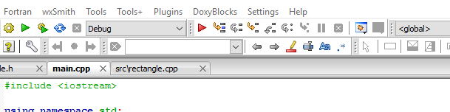
Using the C::B Debugger
To show how this works we will use the C::B interactive debugger to step through the program line-by-line to follow the constructor calls.
Make sure you are running in Debug mode. This turns off compiler optimizations and has the compiler include information in the compiled code for effective debugging.

Slide 39
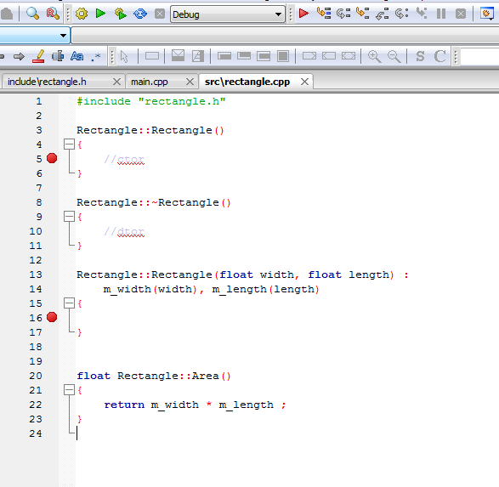
Add a Breakpoint
Breakpoints tell the debugger to halt at a particular line so that the state of the program can be inspected.
In rectangle.cpp, double click to the left of the lines in the constructors to set a pair of breakpoints. A red dot will appear.
Click the red arrow to start the code in the debugger.

Slide 40
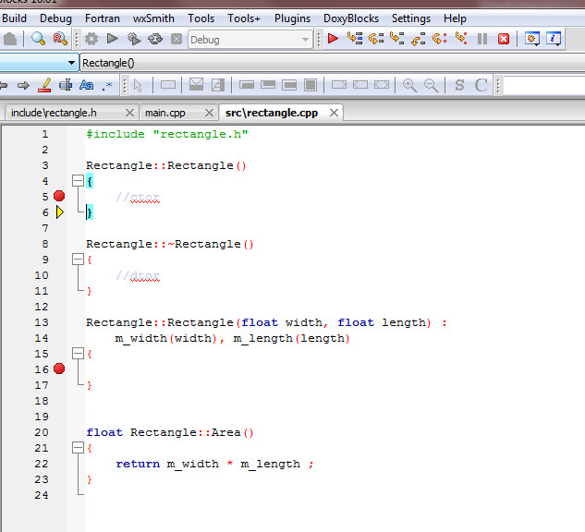
The program has paused at the first breakpoint in the default constructor.
Use the Next Line button to go back to the main() routine.
Press the red arrow to continue execution – stops at the next breakpoint.

Slide 41
Default constructors and destructors
The two methods created by C::B automatically are explicit versions of the default C++ constructors and destructors.
Every class has them – if you don’t define them then empty ones that do nothing will be created for you by the compiler.
  If you really don’t want the default constructor you can delete it with the delete keyword.
  Also in the header file you can use the default keyword if you like to be clear that you are using the default.
class Foo {
public:
Foo() = delete ;
// Another constructor
// must be defined!
Foo(int x) ;
};
class Bar {
public:
Bar() = default ;
};

Slide 42
Custom constructors and destructors
You must define your own constructor when you want to initialize an object with arguments.
A custom destructor is always needed when internal members in the class need special handling.
  Examples: manually allocated memory, open files, hardware drivers, database or network connections, custom data structures, etc.

Slide 43

Destructors
This class just has 2 floats as members which are automatically removed from memory by the compiler.
Destructors are called when an object is destroyed.
Destructors have no return type.
There is only one destructor allowed per class.
Objects are destroyed when they go out of scope.
Destructors are never called explicitly by the programmer. Calls to destructors are inserted automatically by the compiler.
Rectangle::~Rectangle()
{
//dtor
}
~House() destructor
House object

Slide 44
Destructors
Example:
class Example {
public:
Example() = delete ;
Example(int count) ;
virtual ~Example() ;
// A pointer to some memory
// that will be allocated.
float *values = nullptr ;
};
Example::Example(int count) {
// Allocate memory to store "count"
// floats.
values = new float[count];
}
Example::~Example() {
// The destructor must free this
// memory. Only do so if values is not
// null.
if (values) {
delete[] values ;
}
}

Slide 45
Scope
Scope is the region where a variable is valid.
Constructors are called when an object is created.
Destructors are only ever called implicitly.
int main() { // Start of a code block
// in main function scope
float x ; // No constructors for built-in types
ClassOne c1 ; // c1 constructor ClassOne() is called.
if (1){ // Start of an inner code block
// scope of c2 is this inner code block
ClassOne c2 ; //c2 constructor ClassOne() is called.
} // c2 destructor ~ClassOne() is called.
ClassOne c3 ; // c3 constructor ClassOne() is called.
} // leaving program, call destructors for c3 and c1 ~ClassOne()
// variable x: no destructor for built-in type

Slide 46
Copy, Assignment, and Move Constructors
The compiler will automatically create constructors to deal with copying, assignment, and moving.
  Moving is an optimization feature that’s part of C++11. It is used to avoid copies in some situations.
Dealing with the details of these constructors is outside of the scope of this tutorial
How do you know if you need to write one?
  When the code won’t compile and the error message says you need one!
  OR unexpected things happen when running.
You may require custom code when...
  dealing with open files inside an object
  The class manually allocated memory
  Hardware resources (a serial port) opened inside an object
  Etc.
Rectangle rT_1(1.0,2.0) ;
// Now use the copy constructor
Rectangle rT_2(rT_1) ;
// Do an assignment, with the
// default assignment operator
rT_2 = rT_1 ;

Slide 47
So Far…
Define a C++ class
  Adding members and methods
Use separate header and source files for a C++ class.
Class constructors & destructors
OOP concept: Encapsulation

Slide 48

The formal concepts in OOP
Encapsulation
Inheritance
Abstraction
Polymorphism
Next up: Inheritance
OOP

Slide 49
Inheritance
Inheritance is the ability to form a hierarchy of classes where they share common members and methods.
  Helps with: code re-use, consistent programming, program organization
This is a powerful concept!
Molecule
Inorganic
Organic
Mineral
Protein

Slide 50
Inheritance
Superclass
Base Class
The class being derived from is referred to as the base, parent, or super class.
The class being derived is the derived, child, or sub class.
For consistency, we’ll use superclass and subclass in this tutorial. A base class is the one at the top of the hierarchy.
Molecule
Inorganic
Organic
Mineral
Protein
Subclass

Slide 51
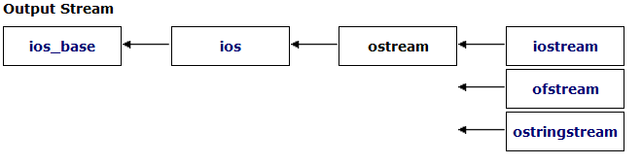
Inheritance in Action
Streams in C++ are series of characters – the C+ I/O system is based on this concept.
cout is an object of the class ostream. It is a write-only series of characters that prints to the terminal.
There are two subclasses of ostream:
  ofstream – write characters to a file
  ostringstream – write characters to a string
Writing to the terminal is straightforward:
cout << some_variable ;
How might an object of class ofstream or ostringstream be used if we want to write characters to a file or to a string?

Slide 52
Inheritance in Action
For ofstream and ofstringstream the << operator is inherited from ostream and behaves the same way for each from the programmer’s point of view.
The ofstream class adds a constructor to open a file and a close() method.
ofstringstream adds a method to retrieve the underlying string, str()
If you wanted a class to write to something else, like a USB port…
  Maybe look into inheriting from ostream!
    Or its underlying class, basic_ostream which handles types other than characters…

Slide 53
Inheritance in Action
#include <iostream> // cout
#include <fstream> // ofstream
#include <sstream> // ostringstream
using namespace std ;
void some_func(string msg) {
cout << msg ; // to the terminal
// The constructor opens a file for writing
ofstream my_file("filename.txt") ;
// Write to the file.
my_file << msg ;
// close the file.
my_file.close() ;
ostringstream oss ;
// Write to the stringstream
oss << msg ;
// Get the string from stringstream
cout << oss.str() ;
}

Slide 54
Public, protected, private
“There are only two things wrong with C++: The initial concept and the implementation.”
– Bertrand Meyer (inventor of the Eiffel OOP language)
class Rectangle
{
public:
Rectangle();
Rectangle(float width, float length) ;
virtual ~Rectangle();
float m_width ;
float m_length ;
float Area() ;
protected:
private:
};
These keywords were added by C::B to our Rectangle class.
These are used to control access to different parts of the class during inheritance by other pieces of code.

Slide 55
C++ Access Control and Inheritance
A summary of the accessibility of members and methods:
Access | public | protected | private
Same class | Yes | Yes | Yes
Subclass | Yes | Yes | No
Outside classes | Yes | No | No
Inheritance
class Super {
public:
int i;
protected:
int j ;
private:
int k ;
};
class Sub : public Super {
// in methods, could access
// i and j from Parent only.
};
Outside code
Sub myobj ;
Myobj.i = 10 ; // public - ok
Myobj.j = 3 ; // protected - Compiler error
Myobj.k = 1 ; // private - Compiler error

Slide 56
Inheritance
class A
class B : public A
public
public A
public
protected
protected A
protected
private
private
With inheritance subclasses have access to private and protected members and methods all the way back to the base class.
Each subclass can still define its own public, protected, and private members and methods along the way.
class C : public B
public A
public
public B
protected A
protected
protected B
private

Slide 57
Single vs Multiple Inheritance
A
C++ supports creating relationships where a subclass inherits data members and methods from a single superclass: single inheritance
C++ also support inheriting from multiple classes simultaneously: Multiple inheritance
This tutorial will only cover single inheritance.
Generally speaking…
  Multiple inheritance requires a large amount of design effort
  It’s an easy way to end up with overly complex, fragile code
  Java, C#, and Python (all came after C++) exclude multiple inheritance on purpose to avoid problems with it.
B
C
D
  With multiple inheritance a hierarchy like this is possible to create…this is nicknamed the Deadly Diamond of Death.

Slide 58
Abstraction
Having private (internal) data and methods separated from public ones is the OOP concept of abstraction.

Slide 59
C++ Inheritance Syntax
Inheritance syntax pattern:
class SubclassName : public SuperclassName
Here the public keyword is used.
  Methods implemented in class Sub can access any public or protected members and methods in Super but cannot access anything that is private.
Other inheritance types are protected and private.
class Super {
public:
int i;
protected:
int j ;
private:
int k ;
};
class Sub : public Super {
// ...
};

Slide 60
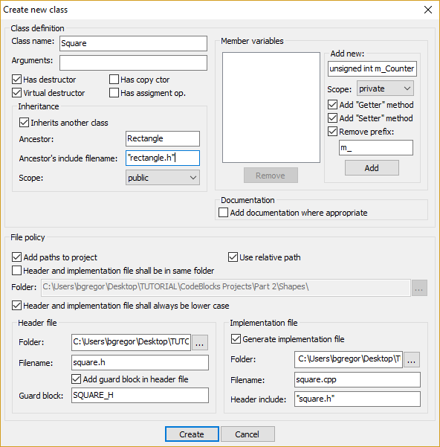
It is now time to inherit
The C::B program will help with the syntax when defining a class that inherits from another class.
With the Shapes project open, click on File → New → Class
Give it the name Square and check the “Inherits another class” option.
Enter Rectangle as the superclass and the include as “rectangle.h” (note the lowercase r)
Click Create!

Slide 61
square.h
square.cpp
#ifndef SQUARE_H
#define SQUARE_H
#include "rectangle.h"
class Square : public Rectangle
{
public:
Square();
virtual ~Square();
protected:
private:
};
#endif // SQUARE_H
#include "square.h"
Square::Square()
{
//ctor
}
Square::~Square()
{
//dtor
}
Note that subclasses are free to add any number of new methods or members, they are not limited to those in the superclass.
2 files are automatically generated: square.h and square.cpp
Class Square inherits from class Rectangle

Slide 62

A new constructor is needed.
A square is, of course, just a rectangle with equal length and width.
The area can be calculated the same way as a rectangle.
Our Square class therefore needs just one value to initialize it and it can re-use the Rectangle.Area() method for its area.
Go ahead and try it:
  Add an argument to the default constructor in square.h
  Update the constructor in square.cpp to do…?
  Remember Square can access the public members and methods in its superclass

Slide 63
Solution 1
#ifndef SQUARE_H
#define SQUARE_H
#include "rectangle.h"
class Square : public Rectangle
{
public:
Square(float width);
virtual ~Square();
protected:
private:
};
#endif // SQUARE_H
#include "square.h"
Square::Square(float length)
{
m_width = width ;
m_length = length ;
}
Square can access the public members in its superclass.
Its constructor can then just assign the length of the side to the Rectangle m_width and m_length.
This is unsatisfying – while there is nothing wrong with this it’s not the OOP way to do things.
Why re-code the perfectly good constructor in Rectangle?

Slide 64
The delegating constructor
class class_c {
public:
int max;
int min;
int middle;
class_c(int my_max) {
max = my_max > 0 ? my_max : 10;
}
class_c(int my_max, int my_min) : class_c(my_max) {
min = my_min > 0 && my_min < max ? my_min : 1;
}
class_c(int my_max, int my_min, int my_middle) :
class_c (my_max, my_min){
middle = my_middle < max &&
my_middle > min ? my_middle : 5;
}
};
C++11 added a new constructor type called the delegating constructor.
Using member initialization lists you can call one constructor from another.
Even better: with member initialization lists C++ can call superclass constructors!
Square::Square(float length) :
Rectangle(length,length)
{
// other code could go here.
}
Reference:
https://msdn.microsoft.com/en-us/library/dn387583.aspx

Slide 65
Solution 2
#ifndef SQUARE_H
#define SQUARE_H
#include "rectangle.h"
class Square : public Rectangle
{
public:
Square(float width);
virtual ~Square();
protected:
private:
};
#endif // SQUARE_H
#include "square.h"
Square::Square(float length) :
Rectangle(length, length) {}
Square can directly call its superclass constructor and let the Rectangle constructor make the assignment to m_width and m_float.
This saves typing, time, and reduces the chance of adding bugs to your code.
  The more complex your code, the more compelling this statement is.
Code re-use is one of the prime reasons to use OOP.

Slide 66

Trying it out in main()
What happens behind the scenes when this is compiled….
#include <iostream>
using namespace std;
#include "square.h"
int main()
{
Square sQ(4) ;
// Uses the Rectangle Area() method!
cout << sQ.Area() << endl ;
return 0;
}
sQ.Area()
Square class does not implement Area() so compiler looks to superclass
Finds Area() in Rectangle class.
Inserts call to Rectangle.Area() method in compiled code.

Slide 67
More on Destructors
When a subclass object is removed from memory, its destructor is called as it is for any object.
Its superclass destructor is than also called .
Each subclass should only clean up its own problems and let superclasses clean up theirs.
Square object is removed from memory
~Square() is called
~Rectangle() is called

