Slide 1

Advanced SCC Usage
Research Computing Services
Katia Oleinik (koleinik@bu.edu)

Slide 2
Shared Computing Cluster
Shared - transparent multi-user and multi-tasking environment
Computing - heterogeneous environment:
  interactive jobs
  single processor and parallel jobs
  graphics job
Cluster - a set of connected via a fast local area network computers

Slide 3

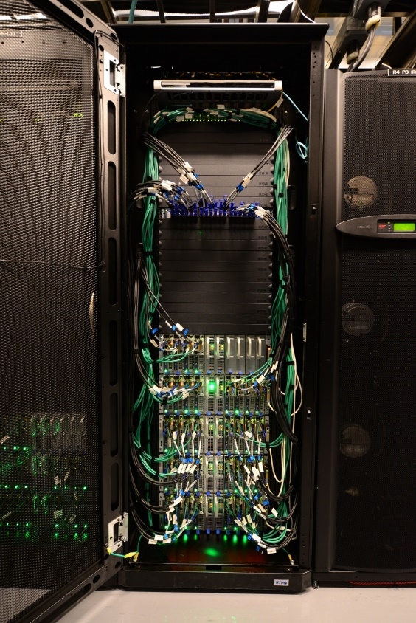

Shared Computing Cluster
Ethernet
Infiniband switch
Compute nodes
Server Cabinets
Rear view

Slide 4
SCC resources
Processors: Intel and AMD
CPU Architecture: sandybridge, ivybridge, nehalem, buldozer
Ethernet connection: 1 or 10 Gbps
Infiniband: FDR, QDR ( or none )
GPUs: NVIDIA Tesla K40m, M2070 and M2050
Number of cores: 8, 12, 16, 64
Memory: 24GB – 512GB
Scratch Disk: 244GB – 886GB
Technical Summary:
http://www.bu.edu/tech/support/research/computing-resources/tech-summary/

Slide 5
SCC General limits
All login nodes are limited to 15min. of CPU time
Default wall clock time limit – 12 hours
Maximum number of processors – 512

Slide 6
SCC General limits
1 processor job (batch or interactive) – 720 hours
omp job (16 processors or less) – 720 hours
mpi job (multi-node job) – 120 hours
gpu job – 48 hours
Interactive Graphics job (virtual GL) – 48 hours

Slide 7
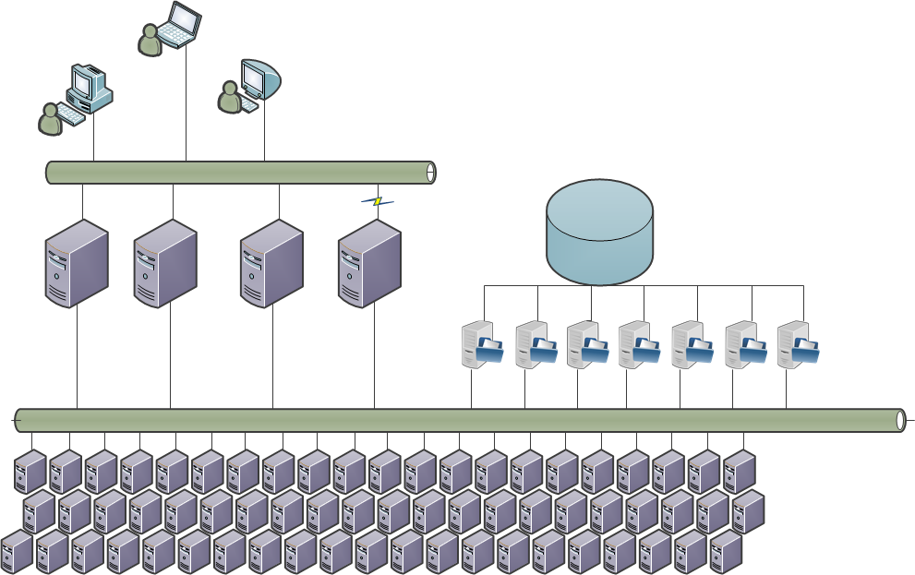
SCC organization
Public Network
SCC1
SCC2
GEO
SCC4
File Storage
Login nodes
Private Network
Compute nodes
More than 400 nodes with ~7000 CPUs and 236 GPUs

Slide 8
SCC Login nodes
Login nodes are designed for light work:
- text editing
- light debugging
- program compilation
- file transfer

Slide 9
Service Models - shared and buy-in
Buy-In: purchased by individual faculty or research groups through the Buy-In program with priority access for the purchaser.
Shared: paid for by BU and university-wide grants and are free to the entire BU Research Computing community.
~60
~40

Slide 10
SCC Compute Nodes
Buy-in nodes:
  All buy-in nodes have a hard limit of 12 hours for non-member jobs. The time limit for group member jobs is set by the PI of the group;
  About 60% of all nodes are buy-in nodes. Setting time limit for a job larger than 12 hours automatically excludes all buy-in nodes from the available resources;
  All nodes in a buy-in queue do not accept new non-member jobs if a project member submitted a job or running a job anywhere on the cluster.

Slide 11
SCC: running jobs
Types of jobs:
  Interactive job – running interactive shell: run GUI applications, code debugging, benchmarking of serial and parallel code performance;
  Interactive Graphics job ( for running interactive software with advanced graphics ) .
  Batch job – execution of the program without manual intervention;

Slide 12
SCC: interactive jobs
 | qsh | qlogin / qrsh
X-forwarding is required | ✓ | —
Session is opened in a separate window | ✓ | —
Allows for a graphics window to be opened by a program | ✓ | ✓
Current environment variables can be passed to the session | ✓ | —
Batch-system environment variables ($NSLOTS, etc.) are set | ✓ | —

Slide 13
SCC: running interactive jobs
  Request appropriate resources for the interactive job:
  - Some software (like MATLAB, STATA-MP) might use multiple cores.
  - Make sure to request enough resources if the program needs more than 8GB of memory;

Slide 14
SCC: submitting batch jobs
  Using STDIN (pipe in command via STDIN):
scc1 % echo cal -y | qsub
  Using -b y option:
scc1 % qsub -b y cal -y
  Using script:
scc1 % qsub <script_name>

Slide 15
SCC: batch jobs
  Script organization:
#!/bin/bash -l
#Time limit
#$ -l h_rt=12:00
#Project name
#$ -P krcs
#Send email-report at the end of the job
#$ -m e
#Load modules:
module load R/R-3.1.1
#Run the program
Rscript my_R_program.R

Slide 16
SCC: requesting resources (job options)
General Directives
Directive | Description
-l h_rt=hh:mm:ss | Hard run time limit in hh:mm:ss format. The default is 12 hours.
-P project_name | Project to which this jobs is to be assigned. This directive is mandatory for all users associated with any Med.Campus project.
-N job_name | Specifies the job name. The default is the script or command name.
-o outputfile | File name for the stdout output of the job.
-e errfile | File name for the stderr output of the job.
-j y | Merge the error and output stream files into a single file.
-m b|e|a|s|n | Controls when the batch system sends email to you. The possible values are – when the job begins (b), ends (e), is aborted (a), is suspended (s), or never (n) – default.
-M user_email | Overwrites the default email address used to send the job report.
-V | All current environment variables should be exported to the batch job.
-v env=value | Set the runtime environment variable env to value.
-hold_jid job_list | Setup job dependency list. job_list is a comma separated list of job ids and/or job names which must complete before this job can run. See Advanced Batch System Usage for more information.

Slide 17
SCC: requesting resources (job options)
Directives to request SCC resources
Directive | Description
-l h_rt=hh:mm:ss | Hard run time limit in hh:mm:ss format. The default is 12 hours.
-l mem_total =#G | Request a node that has at least this amount of memory. Current possible choices include 94G, 125G, 252G ( 504G – for Med. Campus users only).
-l cpu_arch=ARCH | Select a processor architecture (sandybridge, nehalem). See Technical Summary for all available choices.
-l cpu_type=TYPE | Select a processor type (E5-2670, E5-2680, X5570, X5650, X5670, X5675). SeeTechnical Summary for all available choices.
-l gpus=G/C | Requests a node with GPU. G/C specifies the number of GPUs per each CPU requested and should be expressed as a decimal number. See Advanced Batch System Usage for more information.
-l gpu_type=GPUMODEL | Current choices for GPUMODEL are M2050, M2070 and K40m.
-pe omp N | Request multiple slots for Shared Memory applications (OpenMP, pthread). This option can also be used to reserve larger amount of memory for the application. N can vary from 1 to 16.
-pe mpi_#_tasks_per_node N | Select multiple nodes for MPI job. Number of tasks can be 4, 8, 12 or 16 and N must be a multiple of this value. See Advanced Batch System Usage for more information.

Slide 18
SCC: requesting resources (job options)
Directives to request SCC resources (continuation)
Directive | Description
-l eth_speed=1 | Ethernet speed (1 or 10 Gbps).
-l mem_free =#G | Request a node that has at least this amount of free memory. Note that the amount of free memory changes!
-l scratch_free =#G | Request a node that has at least this amount of available disc space in scratch.
  List various resources that can be requested
scc1 % man qstat
scc1 % qconf -sc

Slide 19
SCC: tracking the jobs
  Checking the status of a batch job
scc1 % qstat -u <userID>
  List only running jobs
scc1 % qstat -s r <userID>
  Get job information:
scc1 % qsub -j <jobID>
  Display resources requested by the user jobs
scc1 % qstat -r <userID>

Slide 20
SCC: tracking the jobs
  1. Login to the compute node
scc1 % ssh scc-ca1
  2. Run top command
scc1 % top -u <userID>
Top command will give you a listing of the processes running as well as memory an CPU usage
  3. Exit from the compute node
scc1 % exit

Slide 21

My job failed… WHY?

Slide 22
SCC: job analysis
  If the job ran with "-m e" flag, an email will be sent at the end of the job:
Job 7883980 (smooth_spline) Complete
User = koleinik
Queue = p-int@scc-pi2.scc.bu.edu
Host = scc-pi2.scc.bu.edu
Start Time = 08/29/2015 13:18:02
End Time = 08/29/2015 13:58:59
User Time = 01:05:07
System Time = 00:03:24
Wallclock Time = 00:40:57
CPU = 01:08:31
Max vmem = 6.692G
Exit Status = 0

Slide 23

SCC: job analysis
The default time for interactive and non-interactive jobs on the SCC is 12 hours.
Make sure you request enough time for your application to complete:
Job 9022506 (myJob) Aborted
Exit Status = 137
Signal = KILL
User = koleinik
Queue = b@scc-bc3.scc.bu.edu
Host = scc-bc3.scc.bu.edu
Start Time = 08/18/2014 15:58:55
End Time = 08/19/2014 03:58:56
CPU = 11:58:33
Max vmem = 4.324G
failed assumedly after job because:
job 9022506.1 died through signal KILL (9)

Slide 24
SCC: job analysis
  Dear Admins,
  I submitted a job and it takes longer than I expected.
  Is it possible to extend the time limit?
  Unfortunately, no…
  The batch system does not allow to alter the time limit.

Slide 25
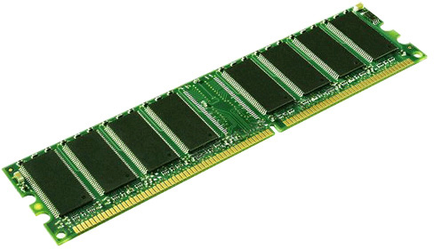
SCC: job analysis
The memory (RAM) varies from node to node (some nodes have only 3GB of memory per slot, while others up to 16GB) . It is important to know how much memory the program needs and request appropriate resources.
Job 1864070 (myBigJob) Complete
User = koleinik
Queue = linga@scc-kb8.scc.bu.edu
Host = scc-kb8.scc.bu.edu
Start Time = 10/19/2014 15:17:22
End Time = 10/19/2014 15:46:14
User Time = 00:14:51
System Time = 00:06:59
Wallclock Time = 00:28:52
CPU = 00:27:43
Max vmem = 207.393G
Exit Status = 137
  Show RAM of a node
scc1 % qhost -h scc-kb8

Slide 26
SCC: job analysis
Currently, on the SCC there are nodes with:
16 cores & 128GB = 8GB/per slot
16 cores & 256GB = 16GB/per slot
12 cores & 48GB = 4GB/per slot
8 cores & 24GB = 3GB/per slot
8 cores & 96GB = 12GB/per slot
64 cores & 256GB = 4GB/per slot
64 cores & 512GB = 8GB/per slot
Available only to Med. Campus users

Slide 27
SCC: job analysis
Example:
Single processor job needs 10GB of memory.
-----------------------------------------------------------
# Request a node with at least 12 GB per slot
#$ -l mem_total=94G

Slide 28
SCC: job analysis
Example:
Single processor job needs 50GB of memory.
-----------------------------------------------------------
# Request a large memory node (16GB of memory per slot)
#$ -l mem_total=252G
# Request a few slots
#$ -pe omp 3

Slide 29

SCC: job analysis
Job 1864070 (myParJob) Complete
User = koleinik
Queue = budge@scc-hb2.scc.bu.edu
Host = scc-hb2.scc.bu.edu
Start Time = 11/29/2014 00:48:27
End Time = 11/29/2014 01:33:35
User Time = 02:24:13
System Time = 00:09:07
Wallclock Time = 00:45:08
CPU = 02:38:59
Max vmem = 78.527G
Exit Status = 137
Some applications try to detect the number of cores and parallelize if possible.
One common example is MATLAB.
Always read documentation and available options to applications. And either disable parallelization or request additional cores.
If the program does not allow to control the number of cores used – request the whole node.

Slide 30
SCC: job analysis
Example:
MATLAB by default will use up to 12 CPUs.
-----------------------------------------------------------
# Start MATLAB using a single thread option:
matlab -nodisplay -singleCompThread -r "n=4, rand(n), exit"

Slide 31
SCC: job analysis
Example:
Running MATLAB Parallel Computing Toolbox.
-----------------------------------------------------------
# Request 4 cores:
#$ -pe omp 4
matlab -nodisplay -r "matlabpool open 4, s=0; parfor i=1:n, s=s+i; end, matlabpool close, s, exit"

Slide 32
SCC: job analysis
  The information about past job can be retrieved using qacct command:
Information about a particular job:
scc1 % qacct -j <jobID>
Information about all the jobs that ran in the past 3 days:
scc1 % qacct -o <userID> -d <number of days> -j

Slide 33
SCC: quota and project quotas
  My job used to run fine and now it fails… Why?
Check your disc usage in the home directory:
scc1 % quota
Check the disc usage by your project
scc1 % pquota -u <project name>

Slide 34
SCC: SU usage
  Use acctool to get the information about SU (service units) usage:
My project(s) total usage on all hosts yesterday (short form):
scc1 % acctool y
My project(s) total usage on shared nodes for the past moth
scc1 % acctool -host shared -b 1/01/15 y
My balance for the project scv
scc1 % acctool p scv -balance -b 1/01/15 y
My balance for all the projects I belong to
scc1 % acctool -balance y

Slide 35

My job is to slow… How I can speed it up?

Slide 36
SCC: optimization
  Before you look into parallelization of your code, optimize it!
  There are a number of well know techniques in every language.
  There are also some specifics in running the code on the cluster!

Slide 37
SCC: optimization - IO
  Reduce the number of I/O to the home directory/project space (if possible);
  Group smaller I/O statements into larger where possible
  Utilize local /scratch space
  Optimize the seek pattern to reduce the amount of time waiting for disk seeks.
  If possible read and write numerical data in a binary format

Slide 38
SCC: optimization
  Many languages allow operations on vectors/matrices;
  Pre-allocate arrays before accessing them within loops;
  Reuse variables when possible and delete those that are not needed anymore;
  Access elements within your code according to the storage pattern in this language (FORTRAN, MATLAB, R – in columns; C, C++ - rows)
  email SCC (help@scc.bu.edu)
  The members of our group will be happy to assist you with the tips how to improve the performance of your code for the specific language/application.

Slide 39
SCC: parallelization
  Running multiple jobs (tasks) simultaneously
  openMP/multithreaded jobs ( use some or all the cores on one node)
  MPI (uses multiple cores possibly across a number of nodes)
  GPU parallelization
  SCC tutorials
  There are a number of tutorials that cover various parallelization techniques in R, MATLAB, C and FORTRAN.

Slide 40
SCC: Array jobs
  An array job executes independent copy of the same job script. The number of tasks to be executed is set using -t option to the qsub command, .i.e:
scc1 % qsub -t 1-10 <my_script>
  The above command will submit an array job consisting of 10 tasks, numbered from 1 to 10. The batch system sets up SGE_TASK_ID environment variable which can be used inside the script to pass the task ID to the program:
#!/bin/bash -l
Rscript my_R_program.R $SGE_TASK_ID

Slide 41
SCC: Job dependency
  Some jobs may be required to run in a specific order. For this applization, the job dependency can be controlled using "-hold_jid" option:
scc1 % qsub -N job1 script1
scc1 % qsub -N job2 -hold_jid job1 script2
scc1 % qsub -N job3 -hold_jid job2 script3
  A job might need to wait until the remaining jobs in the group have completed (aka post-processing).
  In this example, lastjob won’t start until job1, job2, and job3 have completed.
scc1% qsub -N job1 script1
scc1% qsub -N job2 script2
scc1% qsub -N job3 script3
scc % qsub -N lastJob -hold_jid "job*" script4

Slide 42
SCC: Links
  Research Computing website: http://www.bu.edu/tech/support/research/
  RCS software: http://sccsvc.bu.edu/software/
  RCS examples: http://rcs.bu.edu/examples/
  Please contact us at help@scc.bu.edu if you have any problem or question

