Slide 1

Graphics and Images for
Publication and Presentation
Aaron Fuegi aarondf@bu.edu
Scientific Computing and Visualization
Information Services & Technology
Boston University

Slide 2
Outline
Data Visualization Tips
Image Files
  Raster Image Files vs. Vector Image Files
  Printing Images
  Anti-aliasing
Working with Applications
  MATLAB
  Adobe Photoshop
  Microsoft Excel
Additional Resources

Slide 3
PowerPoint Tips
High contrast background and text color.
Not too much text on any slide.
Standard, simple fonts.
  24 pt. size minimum in general. Larger is better.

Slide 4
Charts - Use Strongly Contrasting Colors

Slide 5
Or Use One Exceptional Color for Emphasis

Slide 6
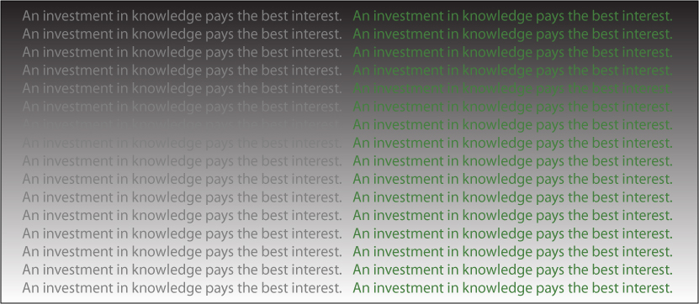
Legibility Depends on the Contrast in Value

Slide 7
Accessibility Issues
Color Blindness
  Use high contrast colors. Avoid using both Reds and Greens.
  Try to indicate differences with an additional means beyond color, such as different symbols or text.
  See http://safecolours.rigdenage.com/palettefiles.html for color palettes as experienced by the color blind.
Low Vision
  Use particularly large fonts and, again, high contrast colors.

Slide 8
Publications Requirements
Read carefully and provide them what they want.
Comments
  DPI (dots per inch) – Only means anything when a size is given. If no size is given, assume a fairly large size such as 8”x10”. At 300 DPI an 8”x10” image needs to be 2400x3000 pixels.
  Format – Commonly requested formats Tiff, High Quality Jpeg, RAW (digital camera format – does not apply to computer generated imagery)

Slide 9
Image File Formats
Raster
  tiff, png, bmp, jpg, gif
Vector
  Portable Document Format - .pdf
  PowerPoint - .ppt
  Adobe Illustrator - .ai
  Photoshop - .psd
  PostScript - .ps
  Encapsulated PostScript - .eps
  Drawing and CAD packages

Slide 10
Raster Image Files
Raster image files are composed of a grid of pixels.
Each pixel contains color information.
Storing A Pixel’s Color Information
  24 bit full color (16.7 million colors) – png, tiff, rgb, bmp, jpg
    Note: An alpha channel controlling transparency when present is also 8 bits so files with one are 32 bit files.
  8 bit color map (256 colors) – gif, tiff, rgb
  Bitmap (black and white only) – tiff, bmp
Compression
  Lossless (png, tiff, rgb)
  Lossy (jpg)

Slide 11
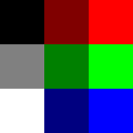
24 Bit Full Color Pixel Values
(16.7 million possible colors)
R G B R G B R G B
0 0 0 128 0 0 255 0 0
128 128 128 0 128 0 0 255 0
255 255 255 0 0 128 0 0 255
000000 800000 ff0000
808080 008000 00ff00
ffffff 000080 0000ff

Slide 12
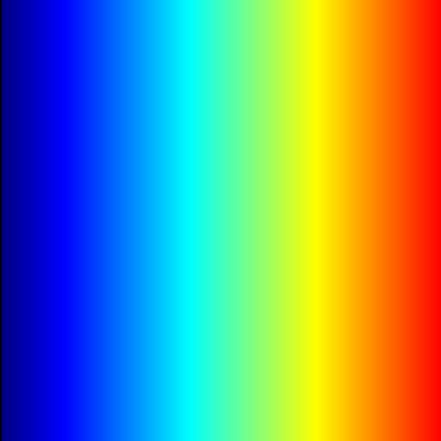
8 Bit Color Map or Gray Scale (256 possible colors)
- Many packages give you tools for editing the color map
Index # R G B
Black
Red
Yellow
Green
Cyan
Blue
Magenta
Dk red
Dk green
Dk blue
White
0 0 0 0
1 255 0 0
2 255 255 0
3 0 255 0
4 0 255 255
5 0 0 255
6 255 0 255
7 128 0 0
8 0 128 0
9 0 0 128
.
250 128 128 128
.
255 255 255 255
0 7 1
250 8 3
255 9 5

Slide 13
Raster Image Quality
There are several ways to affect image quality
  Resolution/Number of Pixels/DPI
  Number of available colors
  Anti-aliasing
  Compression

Slide 14
Vector Files
Many packages create their own proprietary formats.
Vector files are usually resolution independent.
They can be easily printed at different resolutions.
Line thickness may be an issue.
Converting to raster image format should be done with care and only as a last step when necessary. The transformation to a raster image is completely nonreversible.
  Use anti-aliasing if possible.

Slide 15
Printing Images – RGB vs. CMYK Color Model
Computer Monitors – RGB Color – Additive color model
  The default color is Black and the more Red, Green, and Blue light projected, the closer you get to White.
Printers – CMYK Color – Subtractive color model
  The default color is White, and your objective in printing is to block out color/intensity by printing Cyan, Magenta, Yellow (and Black) ink. You get Black when you use the greatest amount of ink.

Slide 16
Printing Images (continued)
These two models, additive and subtractive color, are opposites and it is not possible to directly translate from one to the other. Printers (and the conversion software) nowadays do a very good job however of approximating this translation.
See http://en.wikipedia.org/wiki/CMYK_color_model for more details

Slide 17
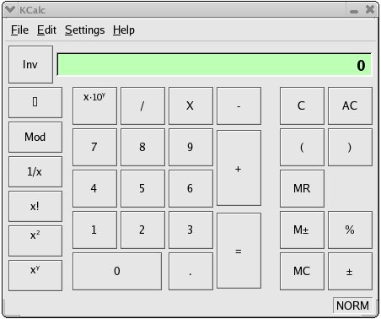
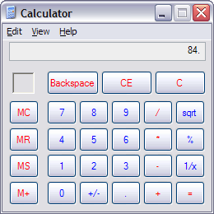
Screen Capture
From a Windows PC:
Full screen – press the Print Screen key and the image will be copied to the clipboard. Press “Ctrl v” to paste it.
Single window - highlight the window, press the Alt key and the Print Screen key. Press “Ctrl v” to paste it.
From Linux:
“import file.ext” lets you select the area you wish to capture. The import command has lots of options, type “import –help”
Use a graphics card that has hardware antialiasing and be sure to enable it before doing a screen capture.

Slide 18
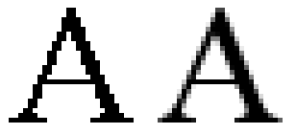
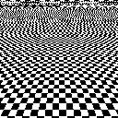
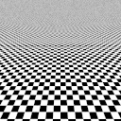
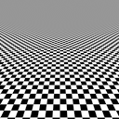
Aliasing and Anti-aliasing
Aliased and Anti-aliased Text
Aliased and Anti-aliased Checkerboard Pattern
Notes:
Almost always want to enable anti-aliasing when available. Applies to raster image files only generally.

Slide 19
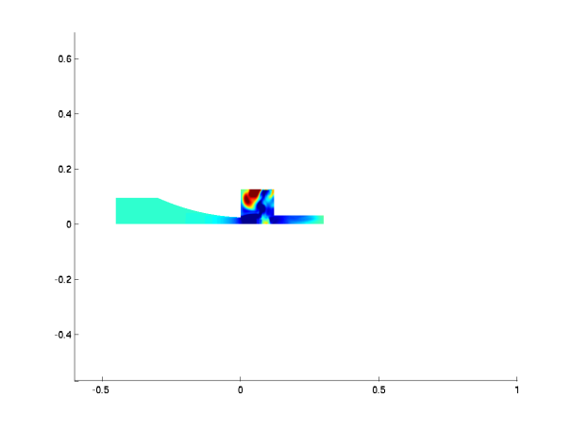
High Resolution MATLAB Output
Original MATLAB code section (this is just the section related to the appearance and printing of the plot):
colormap('jet');
axis([ -.6 1 0 .125]);
shading interp
axis equal;
% place the print command here to print each figure
printfile = ['test','.tiff']
print('-dtiff',printfile)
generates the 1200x900 pixel image on the right above:

Slide 20
We wanted to generate the image at a higher resolution, without the axes, without any white space on the left and right, and with only a small amount of white space above and below.
Here is the new code section:
colormap(jet(256)); % Increases colormap to a full 256 entries from default. Recommended you ALWAYS do this for all colormaps.
axis([ -.6 1 0 .125]);
shading interp
axis image; % Condenses figure around displayed material and sets the aspect ratio so that the data units are the same in both
% directions.
axis off % suppress axis display
set(gcf,'Renderer','Zbuffer') % Use software renderer only. Default 'opengl' renderer takes advantage of graphics hardware on
% local machine. This can be good but also can result in exceeding the capacity of the graphics card at high resolutions leading
% to corrupted images.
set(gcf,'color','white') % Change figure background color to white
set(gca, 'Position', [0 0 1 1]);
myfiguresize = [0 0 8.0 2.0] % Set figure size. This results in a 8x2 inch(default unit) image. Combined with the -r#### DPI
% resolution in the print command below, this controls the size of the output image in pixels.
set(gcf,'PaperPosition',myfiguresize);
mypos = get(gcf,'Position');
mypos(3) = mypos(4);
set(gcf,'Position',mypos); % In combination, applies the size and position set above.
% place the print command here to print each figure
printfile = ['test','.tiff']
print('-dtiff','-r1024',printfile) % Prints to a tiff output image at 1024 DPI. With the 8x2 inch settings above this results in an 8192
% (1024 x 8) by 2048 (1024 x 2) tiff image file.
This generates the new very large 8192x2048 pixel image:

Slide 21
Note on MATLAB
It is also important to note that many of the changes in the previous slide have no effect on the figure shown on screen and only affect the output image file. The only changes that do show up in the MATLAB figure display result from the “axis off” and “axis image” commands in the second code section on the previous slide.
Antialiasing in MATLAB:
http://www.mathworks.com/matlabcentral/fileexchange/20979-myaa-my-anti-alias-for-matlab

Slide 22
Photoshop Tips
Image -> Image Size
  Rescale the image up or down
Image -> Canvas Size
  Crop or Expand (such as add a blue border around the edge of) the Image Area
Things to Consider
  Units – choose appropriate units.
  For Image Size, algorithm used to adjust.
  For Canvas Size, positioning of current image within new area.

Slide 23
Photoshop Tips Continued
Layer -> Flatten Image
  Eliminates layers and prepares to save as a raster image. Only to be done at end of process and do not delete the original layered Photoshop file. Do a “Save as” to a new name after you flatten the image.
Image -> Mode
  Needs to be set appropriately to the image file format you plan to save to. RGB Color, 8 Bits/Channel is most common. However, if you want to save a GIF file, will need to set to Indexed Color.

Slide 24
Excel Tips
Excel Plots are manipulated by selecting elements of them with the Mouse and then right-clicking and generally choosing “Format Element”; this can also generally be done through the Chart Tools -> Layout toolbar. Precise control over plot size is very tricky given this. You can set the whole “Chart Area” to be a specific size but Excel adapts the smaller elements somewhat as it sees fit. If you need a plot of a particular size in another application, trial and error is often necessary.

Slide 25
Additional Materials to Explore
Introduction to Image Files Tutorial http://www.bu.edu/tech/research/training/tutorials/imagefiles/
Edward Tufte, “The Visual Display of Quantitative Information”, etc…
http://www.edwardtufte.com/tufte/books_vdqi
Maureen Stone, “Choosing Colors for Data Visualization” http://www.perceptualedge.com/articles/b-eye/choosing_colors.pdf
Jiro Doke, “Making Pretty Graphs” in MATLAB http://blogs.mathworks.com/loren/2007/12/11/making-pretty-graphs/

Slide 26
Tutorial Survey
Please open a browser and go to:
  http://scv.bu.edu/survey/tutorial_evaluation.html
To fill out the tutorial survey. Thanks for coming.
Tutorials slides available on the web from: http://www.bu.edu/tech/research/training/tutorials/list/

