Slide 1
OpenGL & OpenSceneGraph
Graphics Programming

Slide 2
Graphics Programming
OpenGL
Low-level API
cross-language
cross-platform
2D, 3D computer graphics
OpenSceneGraph
Higher level, built upon OpenGL
Written in standard C++
Windows, Linux, Mac and few more
2D, 3D computer graphics

Slide 3
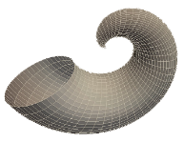


Tutorial Overview
Computer Graphics
Models
Transformations
OpenGL
Overview
Window/events
OSG
Overview
Hands-on
Lighting
Texture
Colors
Hands-on
Double/Single Buffer

Slide 4
Simple GLUT program
Step0.c
#include <stdio.h>
#include <stdlib.h>
#include <GL/glut.h>
void display(void);
void init(void);
int main(int argc, char **argv)
{
/* GLUT Configuration */
glutInit(&argc, argv);
/* Create Window and give a title*/
glutCreateWindow("Sample GL Window");
/* Set display as a callback for the current window */
glutDisplayFunc(display);
/* Set basic openGL states */
init();
/* Enter GLUT event processing loop,
which interprets events and calls respective callback routines */
glutMainLoop();
/* Exit the program */
return 0;
}
/* display is called by the glut main loop once for every animated frame */
void display(void){}
/* called once to set up basic opengl state */
void init(void){}

Slide 5
Steps to edit, compile and run the program
Edit the source file in the editor, save it and exit
>make file_name
>file_name
For step0.c:
>make step0
>step0

Slide 6
Geometric Primitives
Points
Polygons
Coordinates
Lines
Size
Vertices
Width
Stippling
Vertices
Outline/solid
Normals

Slide 7

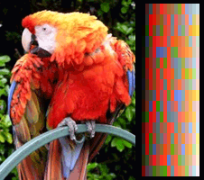
Colors: RGBA vs. Color-Index
Color mode
RGBA mode
Color-Index Mode
Notes:
On a color Computer screen, the hardware causes each pixel on the screen to emit different amounts of red, green and blue light. These are called RGB values. They are often stored together with a forth “A”-value, called alpha, which is used for blending and transparency.
In general, use the RGBA mode for your OpenGL applications; it provides more flexibility than the color-index mode for effects such as shading, lighting, color mapping, fog, antialiasing, and blending.
Consider using the color-index mode in the following cases:
If you have a limited number of bit-planes available; the color-index mode can produce less-coarse shading than the RGBA mode.
If you are not concerned about using "real" colors; for example, using several colors in a topographic map to designate relative elevations.
When you're porting an existing application that uses color-index mode extensively.
When you want to use color-map animation and effects in your application. (This is not possible on true-color devices.)

Slide 8
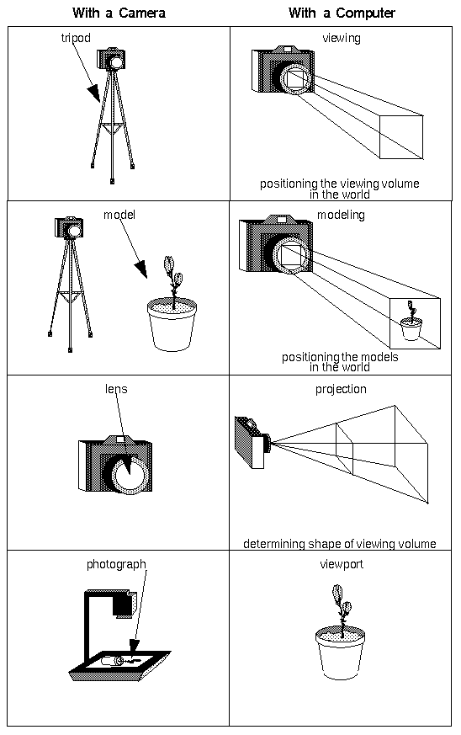
Viewing: Camera Analogy
Positioning the Camera
Positioning the Model
Choose a camera lens and adjust zoom
Mapping to screen
Viewing Transformation
Modeling Transformation
Projection Transformation
Viewport Transformation
Notes:
Viewing: Camera Analogy

Slide 9
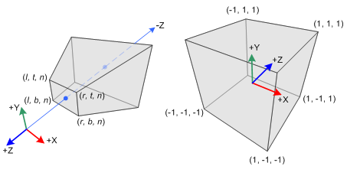
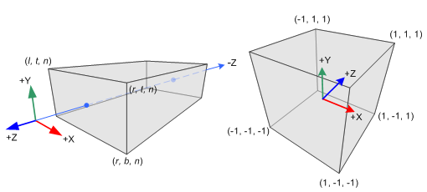
Projection
Perspective vs. Orthographic
All objects appear the same size regardless the distance;
Orthographic views make it much easier to compare sizes of the objects. It is possible to accurately measure the distances
All views are at the same scale
Very useful for cartography, engineering drawings, machine parts.
Objects which are far away are smaller than those nearby;
Does not preserve the shape of the objects.
Perspective view points give more information about depth; Easier to view because you use perspective views in real life.
Useful in architecture, game design, art etc.

Slide 10
Setting up the scene and adding color
Step1.c
void mydraw(void) {
glColor3f( 1.0, 0.0, 0.0); /* red color */
glutSolidTeapot(.5); /* draw teapot */
}
void display(void) { /* called every time the image has to be redrawn */
glClear(GL_COLOR_BUFFER_BIT | GL_DEPTH_BUFFER_BIT); /* initialize color and depth buffers */
mydraw(); /* call the routine that actually draws what you want */
glutSwapBuffers(); /* show the just-filled frame buffer */
}
void init(void) { /* called once to set up basic opengl state */
glEnable(GL_DEPTH_TEST); /* Use depth buffering for hidden surface elimination. */
glMatrixMode(GL_PROJECTION); /* Set up the projection matrix */
glLoadIdentity();
// left,right,bottom,top,near,far
glFrustum(-1.0, 1.0, -1.0, 1.0, 1., 10.0); // perspective view
// glOrtho (-1.0, 1.0, -1.0, 1.0, 1., 10.0); // orthographic view
// gluPerspective(45.0f, 1., 1., 10.); // perspective view
glMatrixMode(GL_MODELVIEW); /* Set up the model view matrix */
glLoadIdentity();
eye center up-dir
gluLookAt(0.,0.,2.,0.,0.,0.,0.,1.,0.); /* Camera position */
}
int main(int argc, char **argv){ …..}

Slide 11
GLUT primitives
void glutSolidSphere(GLdouble radius, GLint slices, GLint stacks);
void glutWireSphere(GLdouble radius, GLint slices, GLint stacks);
void glutSolidCube(GLdouble size);
void glutSolidCone(GLdouble base, GLdouble height, GLint slices, GLint stacks);
void glutSolidTorus(GLdouble innerRadius, GLdouble outerRadius, GLint nsides, GLint rings);
void glutSolidDodecahedron(void); // radius sqrt(3)
void glutSolidTetrahedron(void); // radius sqrt(3)
void glutSolidIcosahedron(void) // radius 1
void glutSolidOctahedron(void); // radius 1

Slide 12
Callback routines & Window Resizing
Step2.c
void keypress( unsigned char key, int x, int y) { … }
void mousepress( int button, int state, int x, int y) { … }
void resize(int width, int height) {
double aspect;
glViewport(0,0,width,height); /* Reset the viewport */
aspect = (double)width / (double)height; /* compute aspect */
glMatrixMode(GL_PROJECTION);
glLoadIdentity(); //reset projection matrix
if (aspect < 1.0) { glOrtho(-4., 4., -4./aspect, 4./aspect, 1., 10.); }
else { glOrtho(-4.*aspect, 4.*aspect, -4., 4., 1., 10.); }
glMatrixMode(GL_MODELVIEW);
glLoadIdentity();
gluLookAt(0., 0., 5., 0., 0., 0., 0., 1., 0.);
}
int main(int argc, char **argv) {
……
glutDisplayFunc(display); /* Set display as a callback for the current window */
glutReshapeFunc(resize); /* Set callback function that respond to resizing the window */
glutKeyboardFunc (keypress); /* Set callback function that responds on keyboard pressing */
glutMouseFunc(mousepress); /* Set callback function that responds on the mouse click */
init();
glutMainLoop();
return 0;
}

Slide 13
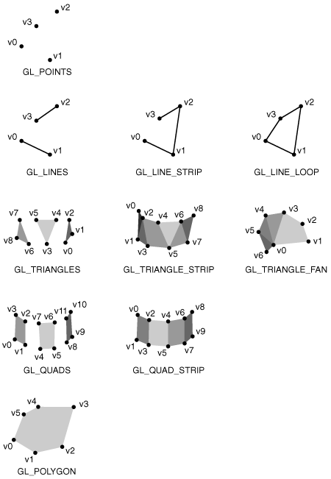
OpenGL Primitives
glBegin(GL_LINES);
glVertex3f(10.0f, 0.0f, 0.0f);
glVertex3f(20.0f, 0.0f, 0.0f);
glVertex3f(10.0f, 5.0f, 0.0f);
glVertex3f(20.0f, 5.0f, 0.0f);
glEnd();

Slide 14
Define a box
Step3.c
void boxDef( float length, float height, float width)
{
glBegin(GL_QUADS);
/* you can color each side or even each vertex in different color */
glColor3f(0., .35, 1.);
glVertex3f(-length/2., height/2., width/2.);
glVertex3f( length/2., height/2., width/2.);
glVertex3f( length/2., height/2.,-width/2.);
glVertex3f(-length/2., height/2.,-width/2.);
/* add here other sides */
…..
glEnd();
}

Slide 15
OpenGL Transformations
Vertex Data
ModelView Matrix
Projection Matrix
Perspective Division
Viewport Transformation
Object Coordinates
Eye
Coordinates
Clip
Coordinates
Device
Coordinates
Window
Coordinates

Slide 16
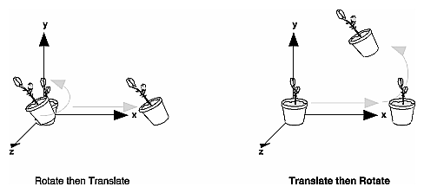
Model View Transformations
glMatrixMode(GL_MODELVIEW);
glLoadIdentity();
glTranslate(x, y, z); /* transformation L */
glRotate (angle, x, y, z); /* transformation M */
glScale (x, y, z); /* transformation N */
Order of operations: L * M * N * v
Draw Geometry

Slide 17
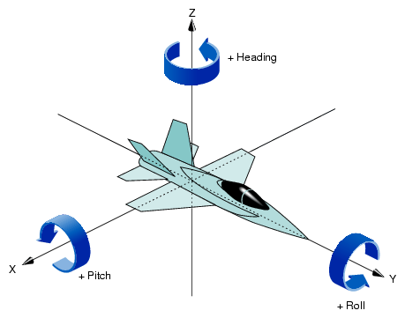
Model View Transformations
View from a plane
Orbit an object
void pilotView( … )
{
glRotatef(roll, 0.0, 0.0, 1.0);
glRotatef(pitch, 0.0, 1.0, 0.0);
glRotatef(heading, 1.0, 0.0, 0.0);
glTranslatef(-x, -y, -z);
}
void polarView( … )
{
glTranslatef(0.0, 0.0, -distance);
glRotated(-twist, 0.0, 0.0, 1.0);
glRotated(-elevation, 1.0, 0.0,0.0);
glRotated(azimuth, 0.0, 0.0, 1.0);
}

Slide 18
OpenGL Display Lists
// create one display list
GLuint index = glGenLists(1);
// compile the display list
glNewList(index, GL_COMPILE);
glBegin(GL_TRIANGLES);
glVertex3fv(v0);
glVertex3fv(v1);
glVertex3fv(v2);
glEnd();
glEndList();
...
// draw the display list
glCallList(index);
...
// delete it if it is not used any more
glDeleteLists(index, 1);

Slide 19

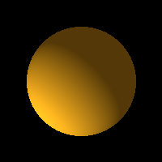

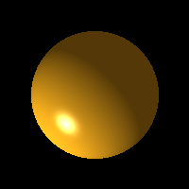

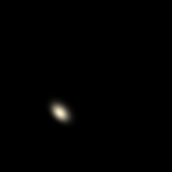
Lighting
Ambient Light
has no source, considered to be everywhere.
glLightfv(GL_LIGHT0, GL_AMBIENT, light_amb)
Diffuse Light
shines upon an object indirectly
glLightfv(GL_LIGHT0, GL_DIFFUSE, light_diff)
Specular Light
highlights an object with a reflective color.
glLightfv(GL_LIGHT0, GL_SPECULAR, light_spec)
Ambient
Ambient, Diffuse & Specular
Ambient & Diffuse
Diffuse
Diffuse & Specular
Specular

Slide 20
Light(s) Position
At least 8 lights available.
Light
Positional / Spotlight
Directional
GLfloat light_pos[] = { x, y, z, w } // 4th value: w=1 – for positional, w=0 – for directional
glLightfv (GL_LIGHT0, GL_POSITION, light_pos)

Slide 21
Material Properties
Ambient
default = (0.2, 0.2, 0.2, 1.0)
GLfloat mat_amb [] = {0.1, 0.5, 0.8, 1.0};
Diffuse
GLfloat mat_diff [] = {0.1, 0.5, 0.8, 1.0};
glMaterialfv(GL_FRONT_AND_BACK, GL_DIFFUSE, mat_diff);
Specular
default = (0.0, 0.0, 0.0, 1.0)
GLfloat mat_spec [] = {1.0, 1.0, 1.0, 1.0};
Shininess
Emission
GLfloat low_shininess [] = {5.}; // the higher value the smaller and brighter (more focused) the highlight
controls the size and brightness of the highlight, value range (0. to 128.) default =0.0
GLfloat mat_emission[] = {0.3, 0.2, 0.2, 0.0};
emissive color of material (usually to simulate a light source), default = (0.0, 0.0, 0.0, 1.0)
glMaterialfv(GL_FRONT_AND_BACK, GL_AMBIENT, mat_amb);
In real life diffuse and ambient colors are set to the same value default = (0.8, 0.8, 0.8, 1.0)
glMaterialfv(GL_FRONT, GL_SPECULAR, mat_spec);
glMaterialfv(GL_FRONT, GL_SHININESS, low_shininess);
glMaterialfv(GL_FRONT, GL_EMISSION, mat_emission);

Slide 22
Default Lighting values
Parameter Name | Default Value | Meaning
GL_AMBIENT | (0.0, 0.0, 0.0, 1.0) | ambient RGBA intensity of light
GL_DIFFUSE | (1.0, 1.0, 1.0, 1.0) | diffuse RGBA intensity of light
GL_SPECULAR | (1.0, 1.0, 1.0, 1.0) | specular RGBA intensity of light
GL_POSITION | (0.0, 0.0, 1.0, 0.0) | (x, y, z, w) position of light
GL_SPOT_DIRECTION | (0.0, 0.0, -1.0) | (x, y, z) direction of spotlight

Slide 23
Default Material values
Parameter Name | Default Value | Meaning
GL_AMBIENT | (0.2, 0.2, 0.2, 1.0) | ambient color of material
GL_DIFFUSE | (0.8, 0.8, 0.8, 1.0) | diffuse color of material
GL_AMBIENT_AND_DIFFUSE |  | ambient and diffuse color of material
GL_SPECULAR | (0.0, 0.0, 0.0, 1.0) | specular color of material
GL_SHININESS | 0.0 | specular exponent in the range of 0.0 to 128.0
GL_EMISSION | (0.0, 0.0, 0.0, 1.0) | emissive color of material (to simulate a light)

Slide 24
A simple way to define light
Light:
  set diffuse to the color you want the light to be
  set specular equal to diffuse
  set ambient to 1/4 of diffuse.
Material:
  set diffuse to the color you want the material to be
  set specular to a gray (white is brightest reflection, black is no reflection)
  set ambient to 1/4 of diffuse

Slide 25
Enable Lighting
/* Enable a single OpenGL light. */
glLightfv(GL_LIGHT0, GL_DIFFUSE, light_diffuse);
glLightfv(GL_LIGHT0, GL_POSITION, light_position);
glEnable(GL_LIGHT0);
glEnable(GL_LIGHTING);
glClearColor (0.0, 0.0, 0.0, 0.0); // background color
glShadeModel (GL_SMOOTH); // shading algorithm
glMaterialfv(GL_FRONT, GL_SPECULAR, mat_specular);
glMaterialfv(GL_FRONT, GL_SHININESS, mat_shininess);
glEnable(GL_NORMALIZE); //enable normalizing to avoid problems with light!
…
glBegin(GL_QUADS); // specify a normal either per vertex or per polygon
glNormal3f(0, 0, 1);
glVertex3fv(a);
glVertex3fv(b);
glVertex3fv(c);
glVertex3fv(d);
glEnd();

Slide 26
OpenGL Helpful Materials
Online documentation
OpenGL: http://www.opengl.org
GLUT: http://www.freeglut.org
Examples:
Books:
From OpenGL.org (examples and tutorials): http://www.opengl.org/code
“Red book”: OpenGL Programming Guide. Woo, Neider, Davis, Shreiner. ISBN 0-201-60458-2.
“Blue book”: OpenGL Reference Manual. Shreiner. ISBN 0-201-65765-1
Reference: http://www.glprogramming.com/blue/

Slide 27
OpenSceneGraph
Open source
3D Graphics
Use: visual simulation, scientific visualization and modeling, games
Written in C++ using OpenGL
Runs on a variety of OS: Windows, Linux, Mac OS X
Website: http://www.openscenegraph.org
Many utility functions, including 3D file readers

Slide 28
OpenSceneGraph as a “middleware”
3D Application
Top level user’s application
Scene graph middleware
OpenSceneGraph
Low-level rendering API
OpenGL

Slide 29
Setting Environment Variables
% setenv OSG_NOTIFY_LEVEL FATAL
% setenv LD_LIBRARY_PATH /usr/local/OpenSceneGraph/lib
% make ex_simple_viewer
% ex_simple_viewer
% ex_simple_viewer cow.obj

Slide 30
Building first OSG program
ex_simple_viewer.cpp
// load the nodes from the command line arguments.
osg::Node* model = osgDB::readNodeFile(argv[1]);
// initialize the viewer and set the scene to render
osgViewer::Viewer viewer;
viewer.setSceneData(model);
viewer.setCameraManipulator(new osgGA::TrackballManipulator());
// normal viewer usage.
return viewer.run();

Slide 31
Add geometric primitive
ex_cone.cpp
// Create a vector to represent the "center of the cone"
Vec3 vcen(xcen, ycen, zcen);
Cone* cone = new Cone(vcen, radius, height);
// Create a drawable object based on the cone
ShapeDrawable *drawable = new ShapeDrawable(cone);
drawable->setColor(Vec4(color[0], color[1], color[2],
color[3]));
Geode* geode = new Geode();
geode->addDrawable(drawable);

Slide 32
Combining Geometry
ex_arrow.cpp
MatrixTransform* arrow = new MatrixTransform;
arrow->setMatrix(Matrix::scale(1.0, 1.0, 1.0));
arrow->addChild(cone);
arrow->addChild(cylinder);

Slide 33
Solving the scaling problem
ex_vec_arrow.cpp
make_vec_arrow(shaft_radius, total_length, r, g, b)
{
cone_radius = 2*shaft_radius;
cone_height = cone_radius;
shaft_length = total_length - cone_height;
cylinder = make_cylinder(0.0, 0.0, shaft_length/2.0,
shaft_radius, shaft_length, r, g, b, 1.0);
cone = make_cone(0.0, 0.0, shaft_length + cone_height/4.0,
cone_radius, cone_height, r, g, b, 1.0);
vec_arrow = new Group;
vec_arrow->addChild(cylinder);
vec_arrow->addChild(cone);
}

Slide 34
Assignment
% cp ex_vec_arrow.c play_axes.cpp
Modify play_axes.cpp to display three unit-length arrows at the origin.
  First is RED point in the +X direction
  Second is GREEN point in the +Y direction
  Third is BLUE point in the +Z direction
% make play_axes.cpp
Solution: soln_axes.cpp

Slide 35
“Cloning”
ex_twin_arrows.cpp
transform1 = new MatrixTransform(Matrix::translate(2, 2, 0));
transform1->addChild(arrow);
transform2 = new MatrixTransform(Matrix::translate(-2, -2, 0));
transform2->addChild(arrow);
rootnode->addChild(transform1);
rootnode->addChild(transform2);

Slide 36
Assignment
Modify the last example, so that you can animate the PositionAttitudeTransform “arrow” and see what happens …
Solution is left to you

Slide 37
OpenSceneGraph Resources
Online
www.OpenSceneGraph.org
Examples
http://www.openscenegraph.org/projects/osg/wiki/Support/Tutorials
www.openscenegraph.org/documentation/ OpenSceneGraphReferenceDocs
Books
www.osgbooks.com
OpenSceneGraph Quick Start Guide
OpenSceneGraph Reference Guides
OpenSceneGraph 3.0: Beginner's Guide

Slide 38
Final Notes
Please fill out an online evaluation of this tutorial:
scv.bu.edu/survey/tutorial_evaluation.html
System help
help@twister.bu.edu, help@katana.bu.edu
Web-based tutorials
www.bu.edu/tech/research/tutorials
Consultation by appointment
Katia Oleinik(koleinik@bu.edu)

