Slide 1
Using Outlook 2010

Slide 2
Benefits of Using Outlook
Now
  Better formatting of HTML mail (with bullets, fonts, etc.)
  Great calendar, ability to send meeting requests that automatically enter your calendar
  Great task manager
Once we move to the Exchange server in the Fall
  You’ll be able to see other people’s calendars (if they give you access)
  Ability to send Instant Messages (Chat)
  Much larger inbox! (4gb)

Slide 3
Before we start
If you use Eudora…
  Open Eudora and go to Tools->Options ->Checking Mail
  Check the box that says Leave mail on the server
  Make sure there is no number set in the “for how many days” box. (i.e. never take mail off the server)
This won’t affect your Eudora, but it will keep Eudora from stealing all your mail from Outlook.

Slide 4
How to set up Outlook
The following slides show you how you set up Outlook to use the IMAP server. In the Fall, we will switch you to the new Exchange server.

Slide 5
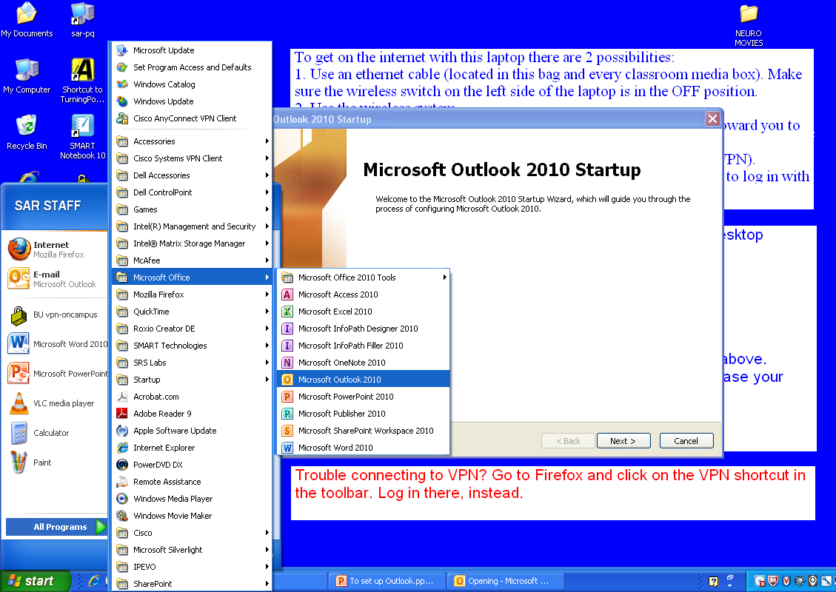
1
2

Slide 6
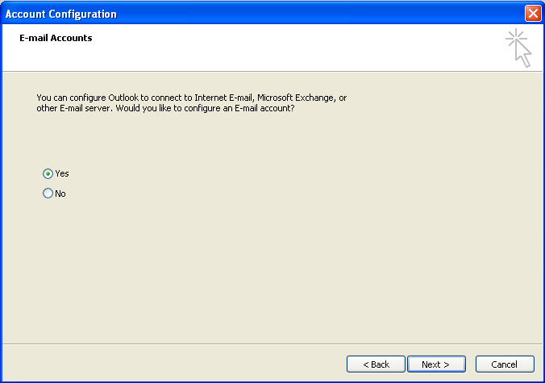
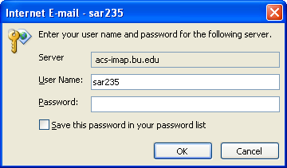
If you see this, you are on ...Track A
More likely, you see this.
So you’re on Track B

Slide 7
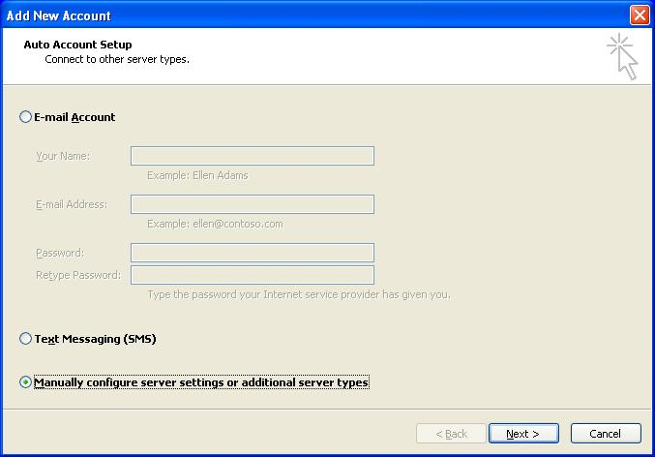
Track A
2
1

Slide 8
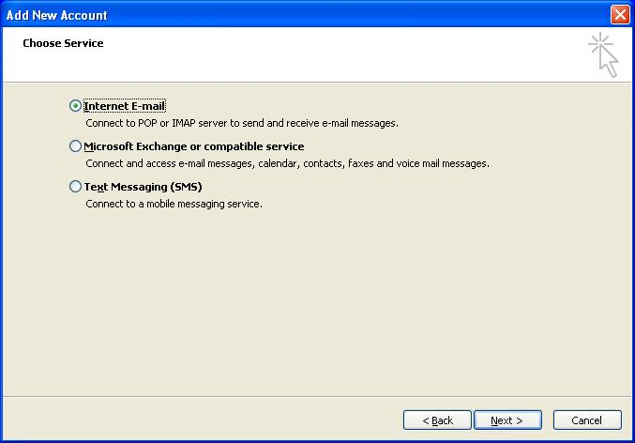
Track A
1
2

Slide 9
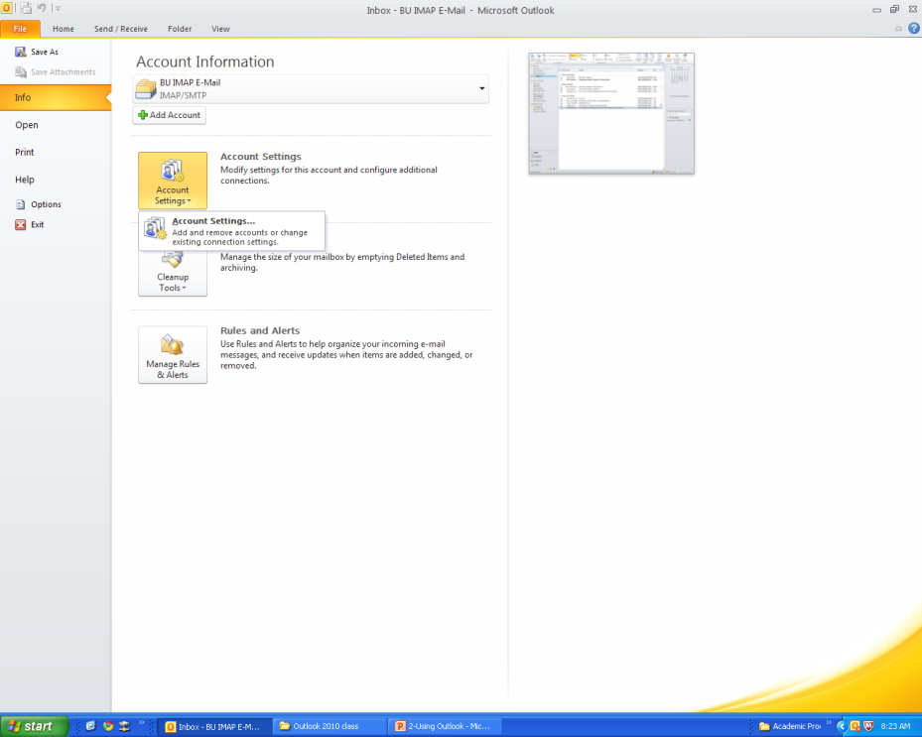
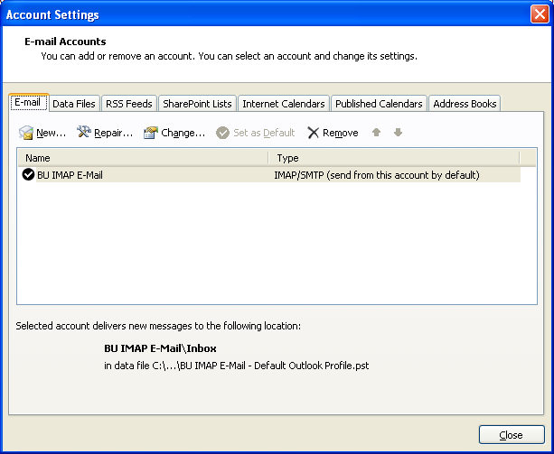
Track B

Slide 10
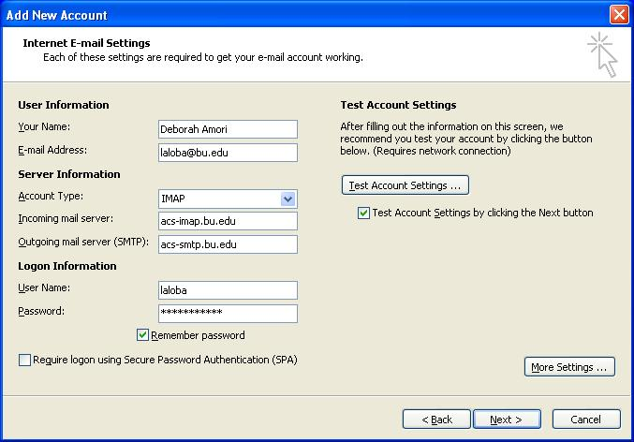
This is where Track A and B merge
1
2

Slide 11
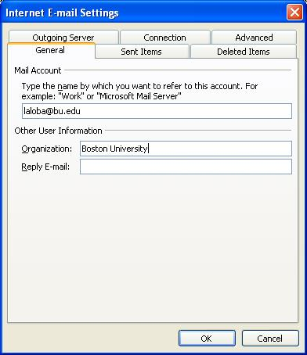
2
1

Slide 12
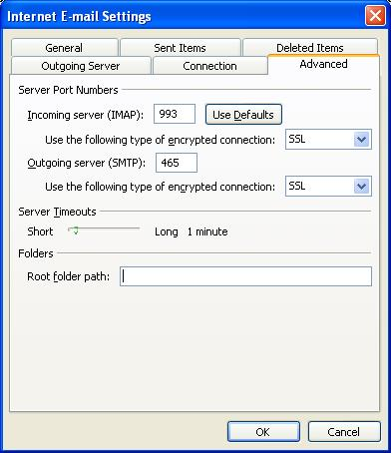

Slide 13
Hit OK, Next, Close etc.
Close Outlook completely
Then open Outlook again and go to File->Account Settings
Double-click the account you just created (ie username@bu.edu)

Slide 14
1

Slide 15
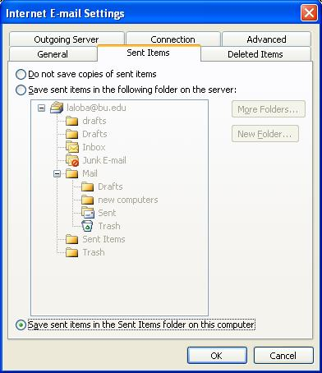
2
1

Slide 16
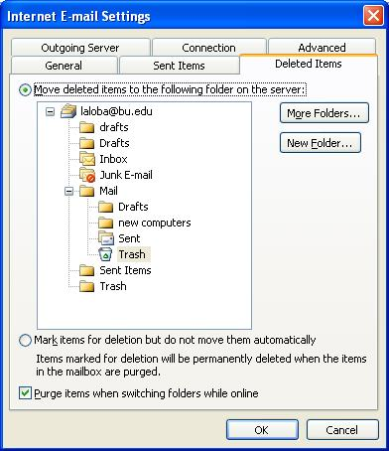
1
2
3
Hit OK, Next, Close etc.

Slide 17
How to set up the BU Directory
The following slides show you how you set up the ldap server, which will automatically look up the email address of anyone who is part of the BU community.

Slide 18
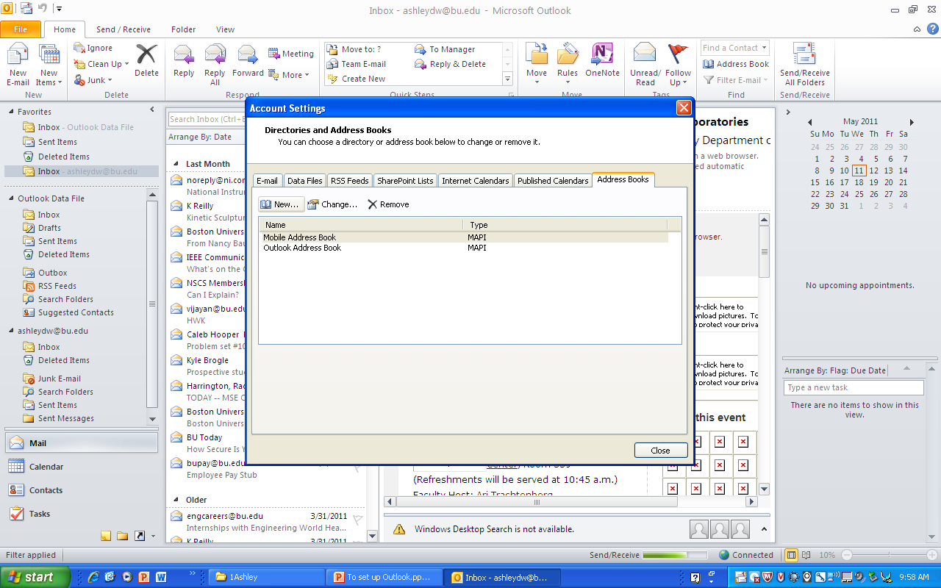
go to File->Account Settings and click Address Books
2
1

Slide 19
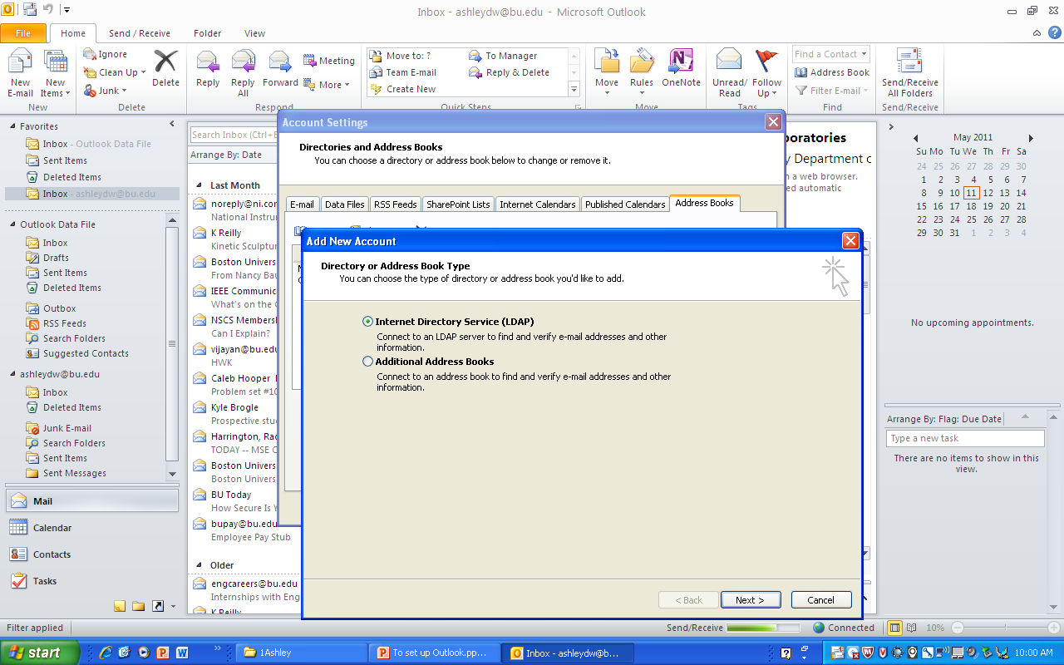

Slide 20
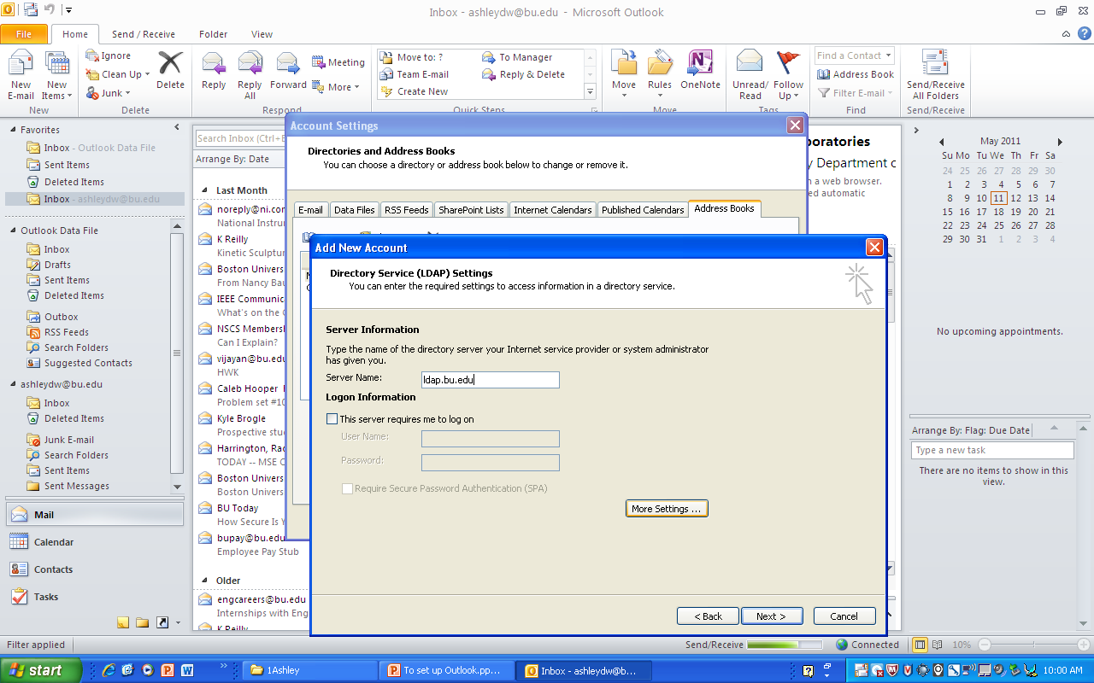
Type: ldap.bu.edu, then click More Settings
1
2

Slide 21
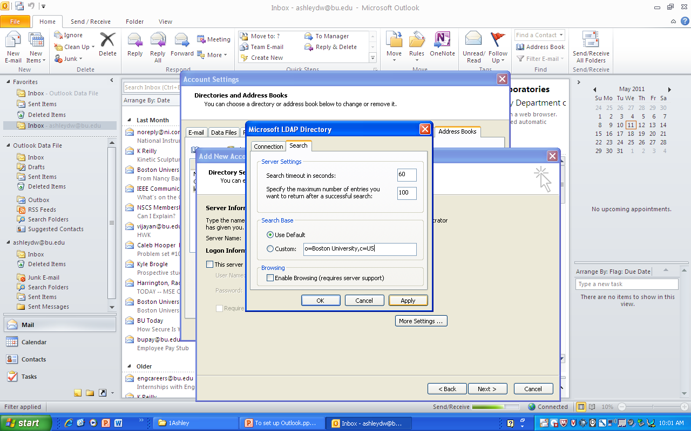
O=Boston University,c=US
1
2
3

Slide 22
Hit OK, Next, Close etc.
Close Outlook completely

Slide 23
How to move your address book(s) to Outlook
The following slides will show you how to import a Thunderbird address book. You might have more than one to import- you can do this procedure multiple times.

Slide 24
To import your Thunderbird address books, Part 1
Open Thunderbird and go into address books
Highlight one of the address books on the left
Tools->Export,
Name the file address1 and then change the “Save as type” to Comma Separated.
Save the file to your Desktop

Slide 25
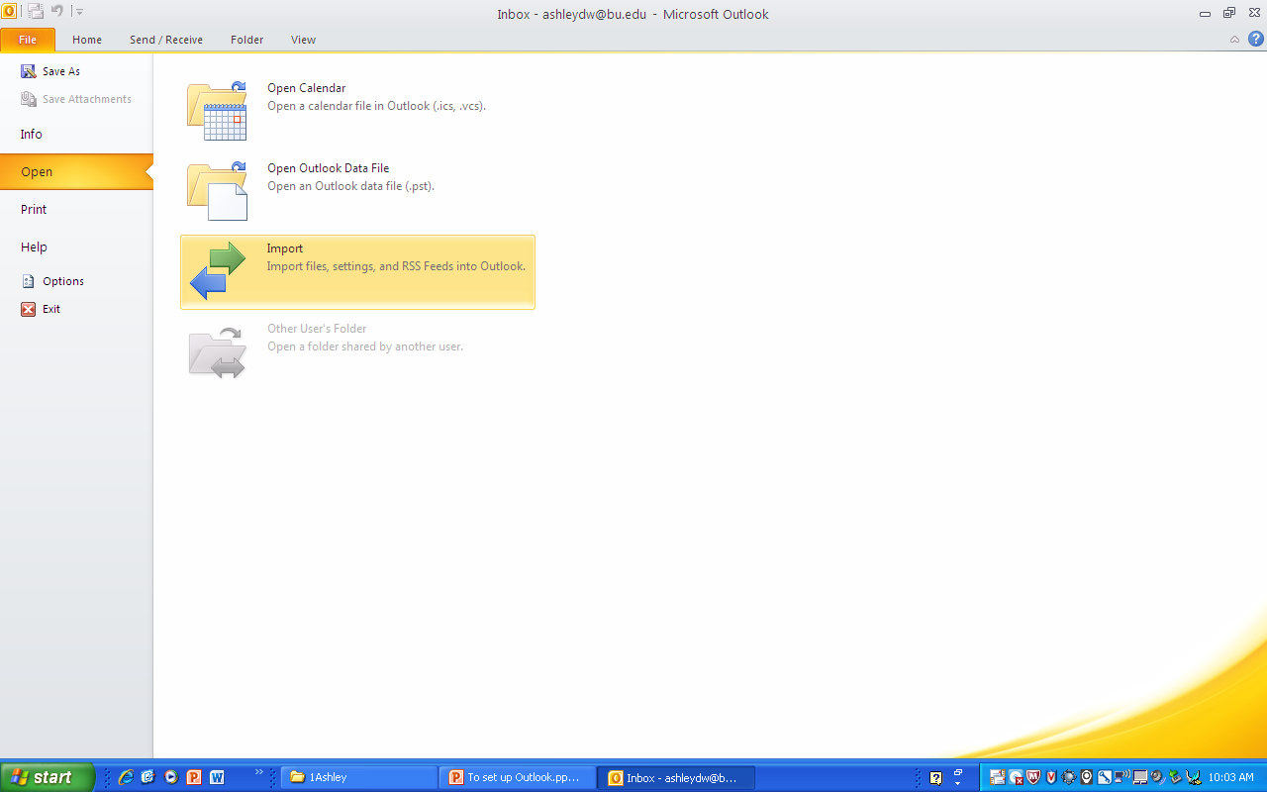
Part 2
Open Outlook
Go to File->Open->Import (as shown below)

Slide 26
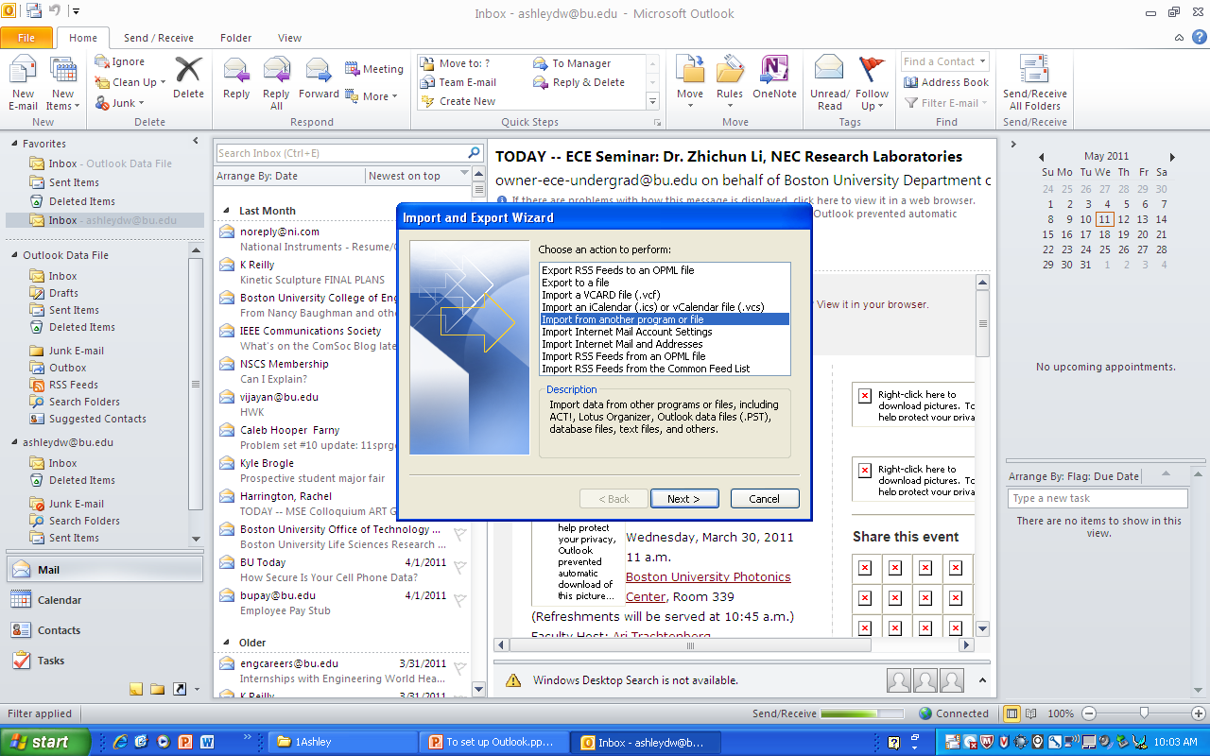
1

Slide 27
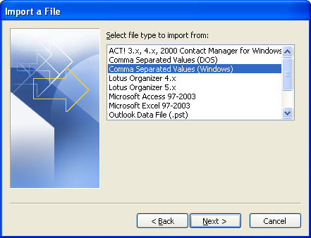

Slide 28
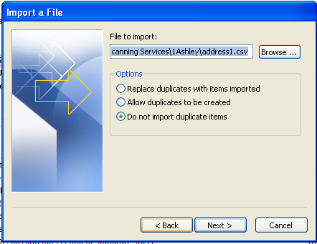
Browse to the file on your desktop. It should be called address1.csv

Slide 29
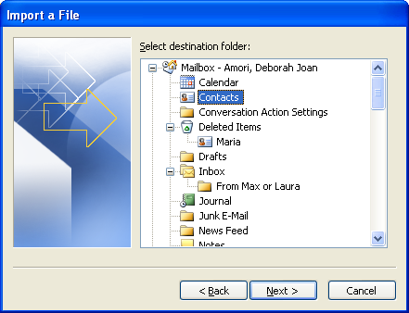

Slide 30
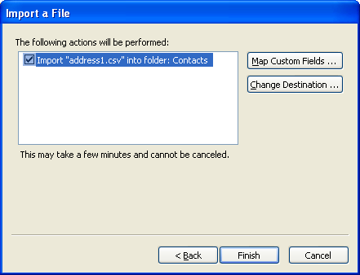

Slide 31
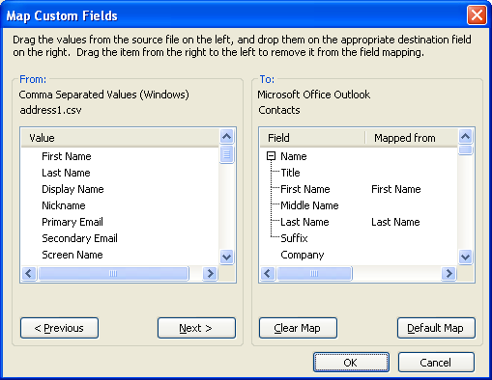
Go through the list on the right and make sure that for every field you tended to enter information into in Thunderbird, there is a matching set of field names. (For example, “First Name” in Outlook is mapped from “First Name” in Thunderbird.)

Slide 32
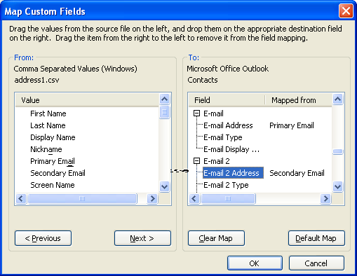
The most important fields to check are the email fields. Email Address should match to Primary Email, and Email 2 Address should match Secondary Email.
Drag the fields from the left column and drop them in the appropriate row on the right.

Slide 33
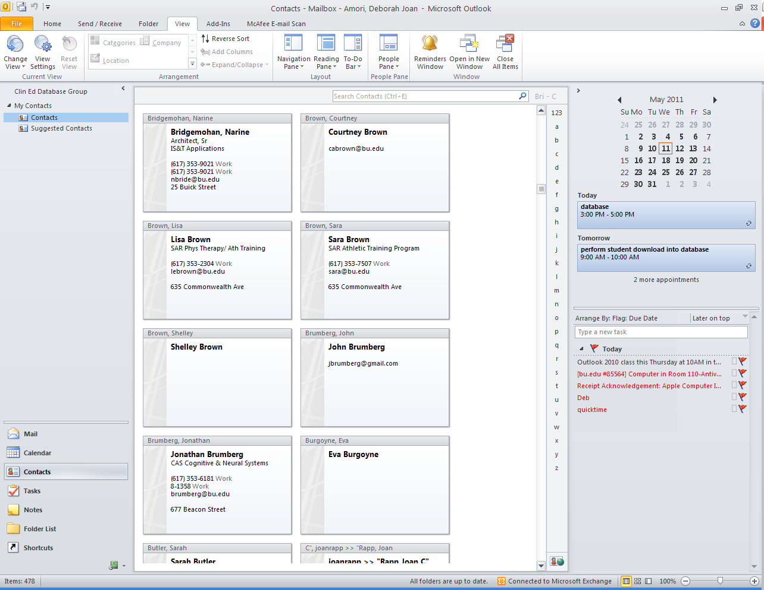
2
This is best way to look at your imported contacts.
3
Change view to business card view
1

Slide 34
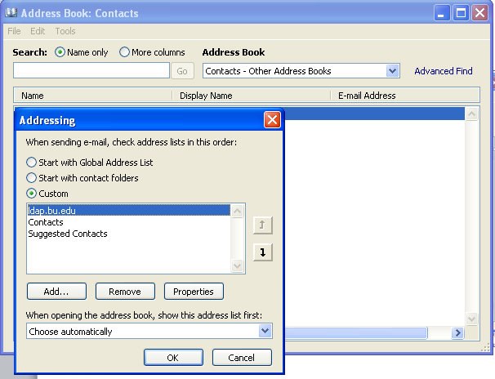
Make the BU Directory your primary search location.
Do this in Home tab->Address Book, Tools->Options.
Change the order so that ldap is on top, then Contacts.

Slide 35
To use your address book…
Start a new message
Type somebody’s last name
Tab to the next line and wait a few seconds to see if the name is found.
If not, click on the check names button (see next slide).
Note you can do the same for CC and BCC

Slide 36
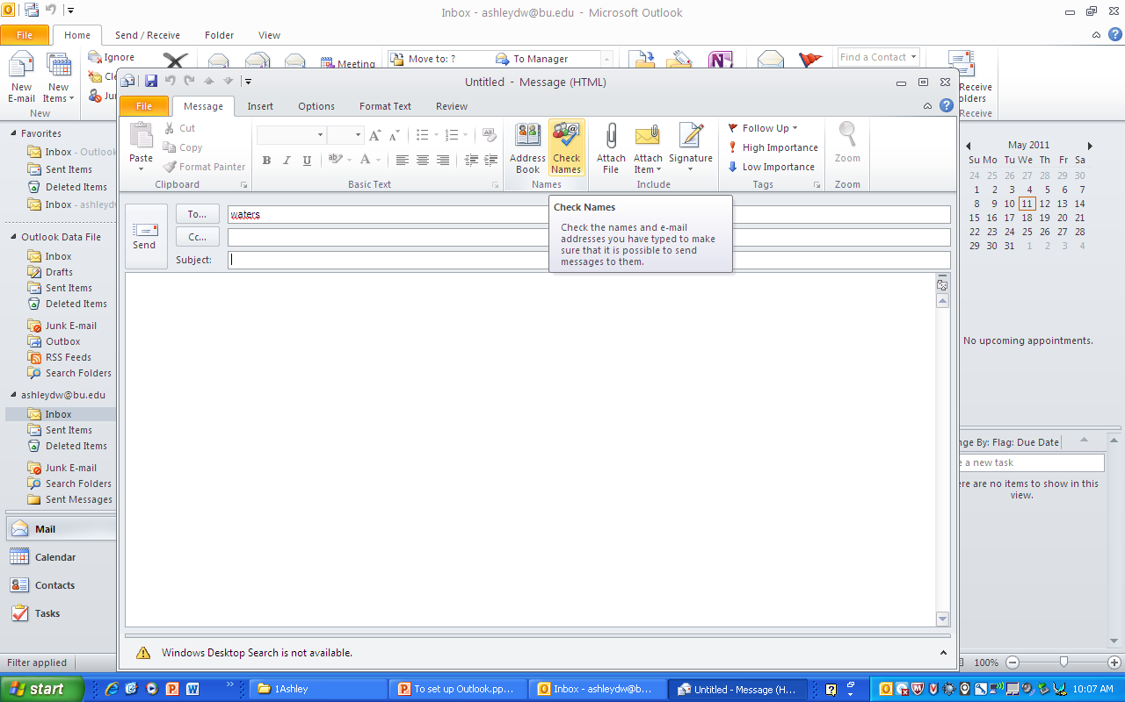
If you see a red line underneath the name, BU can’t find the address. Click on Check Names.

Slide 37
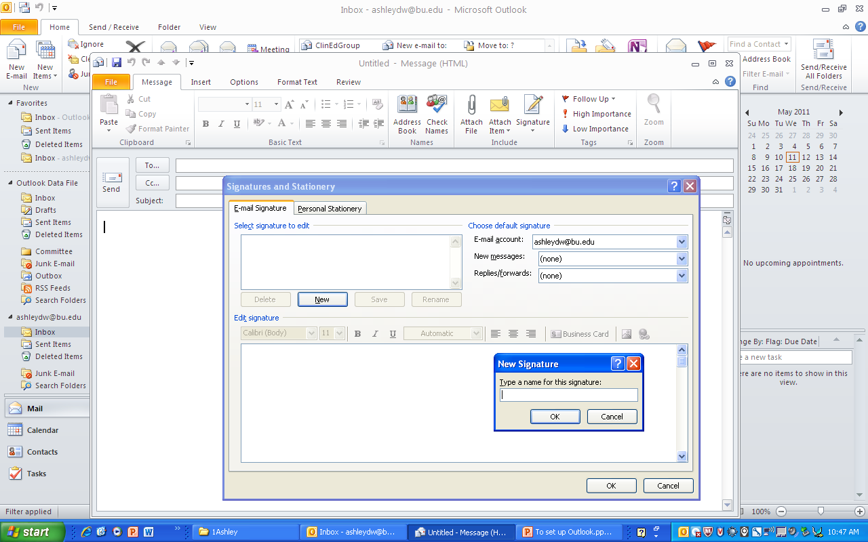
How to create a signature, part 1.

Slide 38
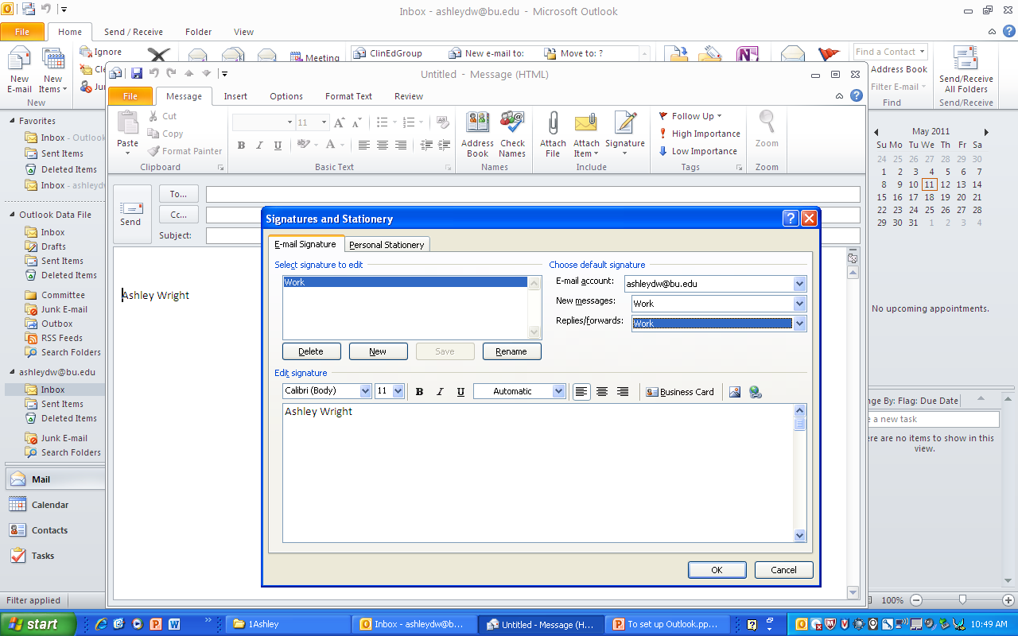
How to create a signature, part 2.

Slide 39
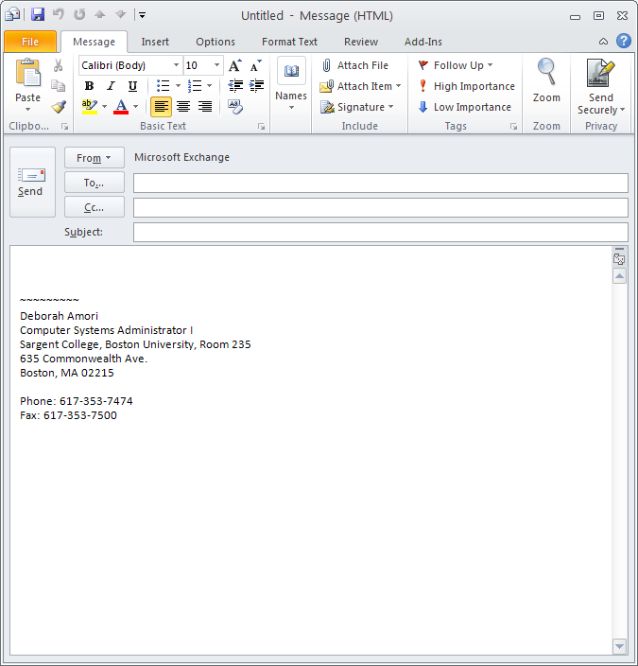
How to attach a file.

Slide 40
General Email Topics
The following slides show you:
How to distinguish between the server mail and your local mail
How to set up your favorites folder links
How to sort by name, date, subject, etc

Slide 41
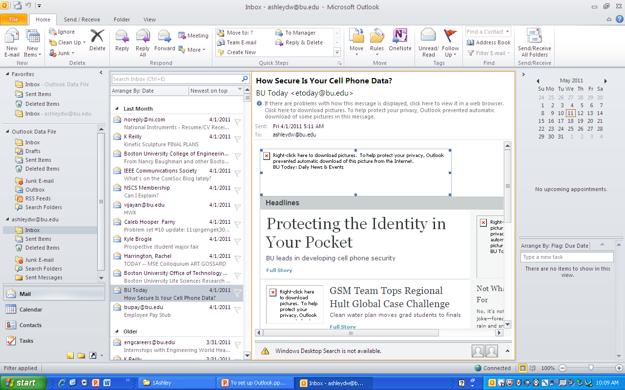
Local Mail
Server Mail

Slide 42
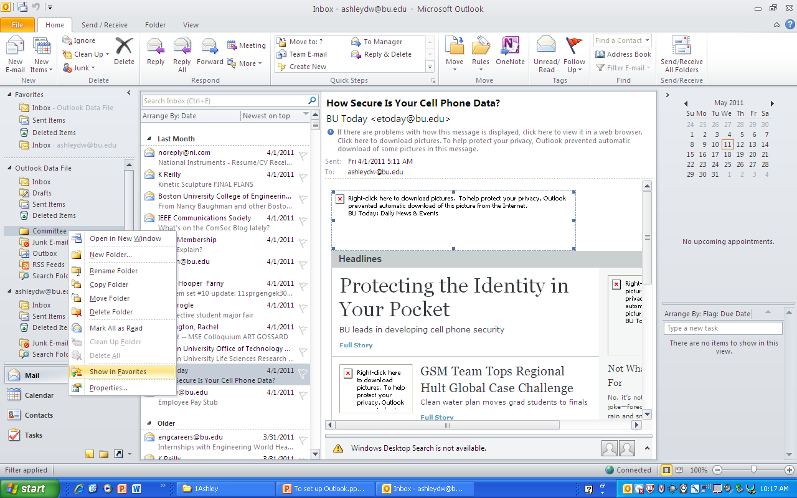
1. How to add to favorites.
2. Outlook doesn’t show images automatically. Right click here if you want to see the images from a trusted source.

Slide 43
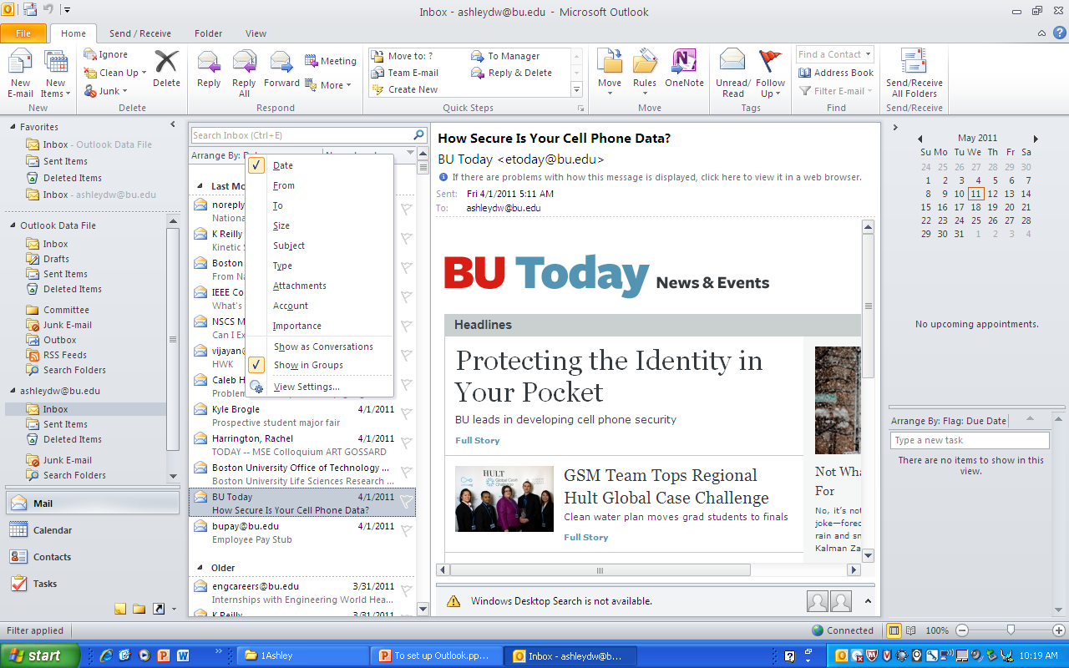
Right click here to sort email.

Slide 44
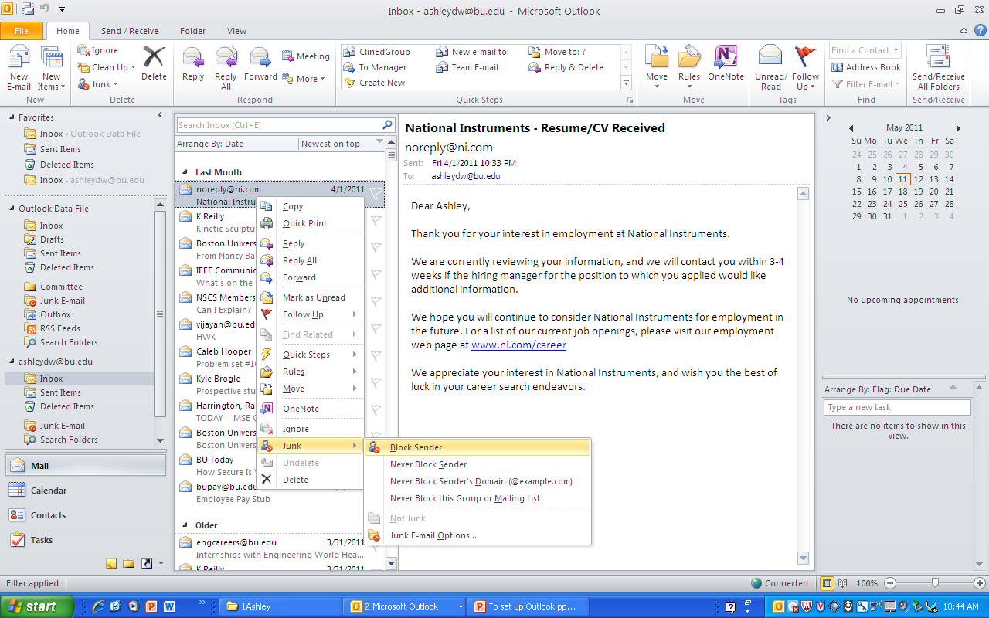
How to mark email as Junk email. This will cause all future emails from this sender to skip your Inbox and go directly to Junk.

Slide 45
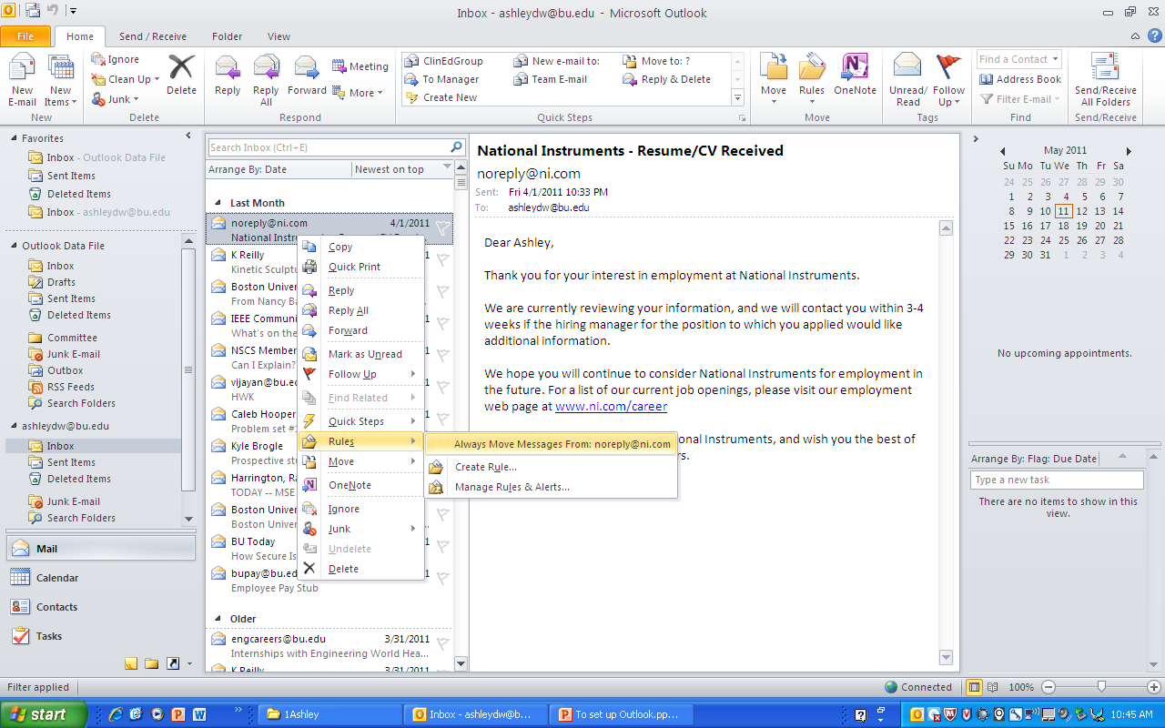
How to create a rule so that all future mail from a sender goes into one folder.

Slide 46
Quick Demos:
How to start a new mail message
How to find someone’s address
How to add a CC or Bcc
How to reply to a message
How to send
How to switch between plain text and HTML
How to highlight and change font

Slide 47
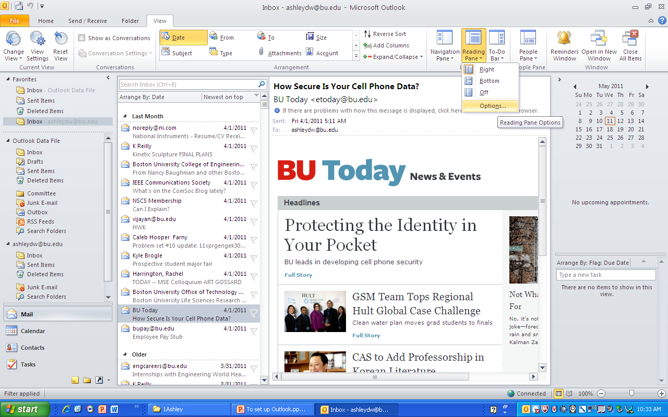

Slide 48
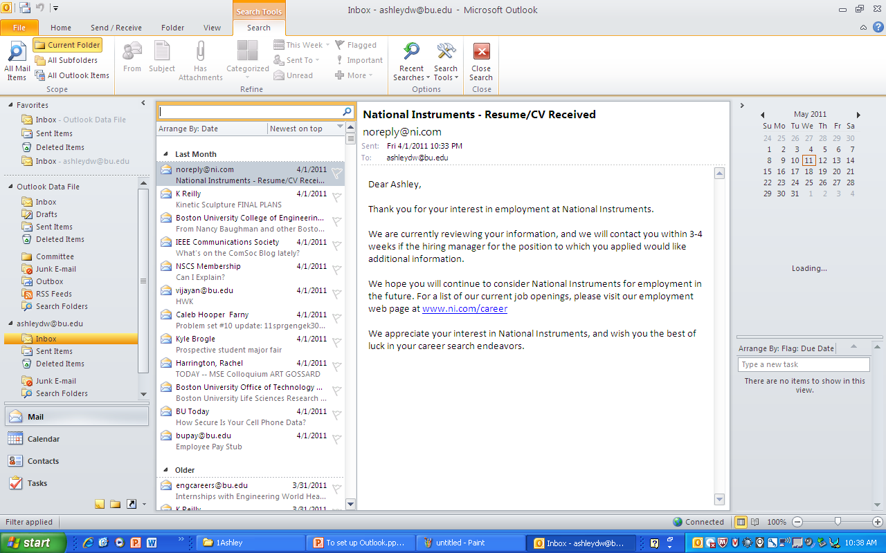
1. Ways to search for email. 2. Click current folders or All Outlook Items.
2
1

Slide 49
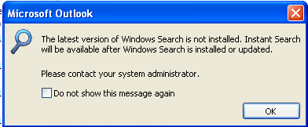
The first time you click on the Search bar, you may get this. Go ahead and download and install it.

Slide 50
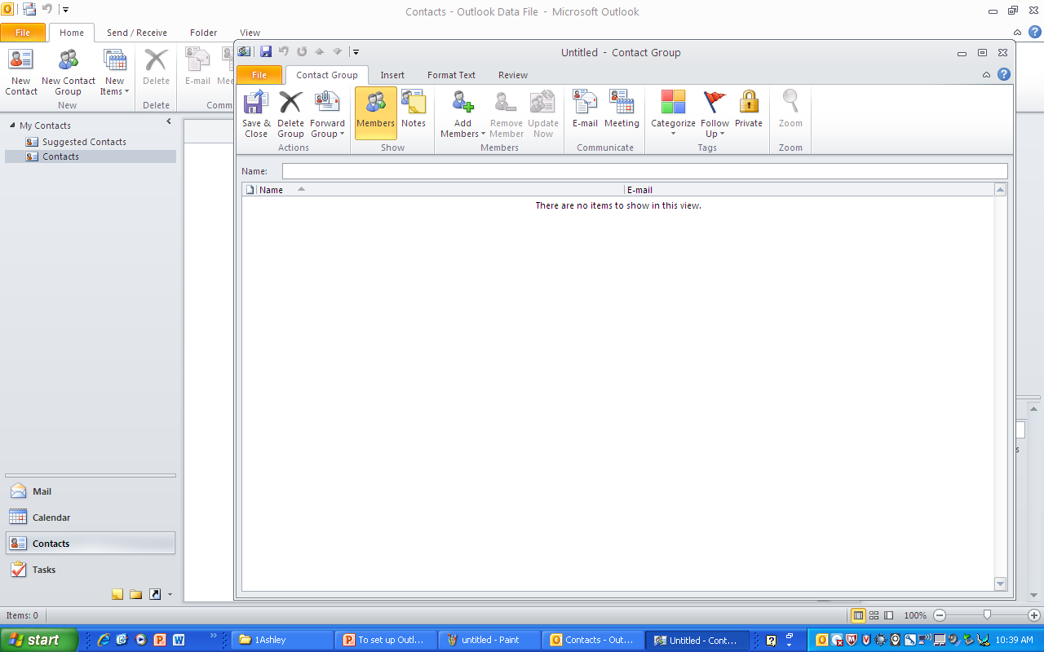
3
How to send a group email
2
1

Slide 51
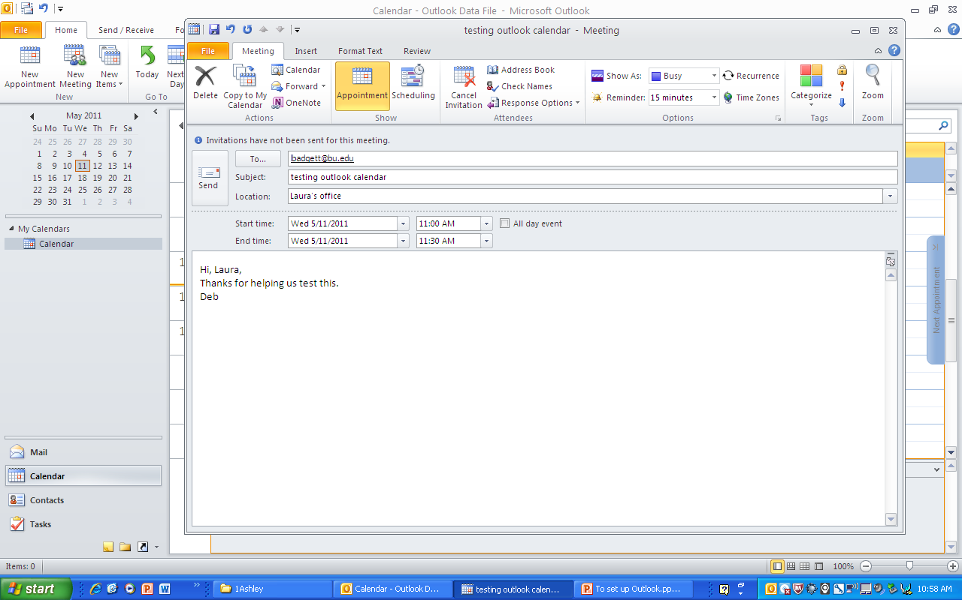
Appointments vs. Meetings
Appointments are for yourself only. Meetings are when you want to invite other people.
This is how you invite someone to a Meeting:
1

Slide 52
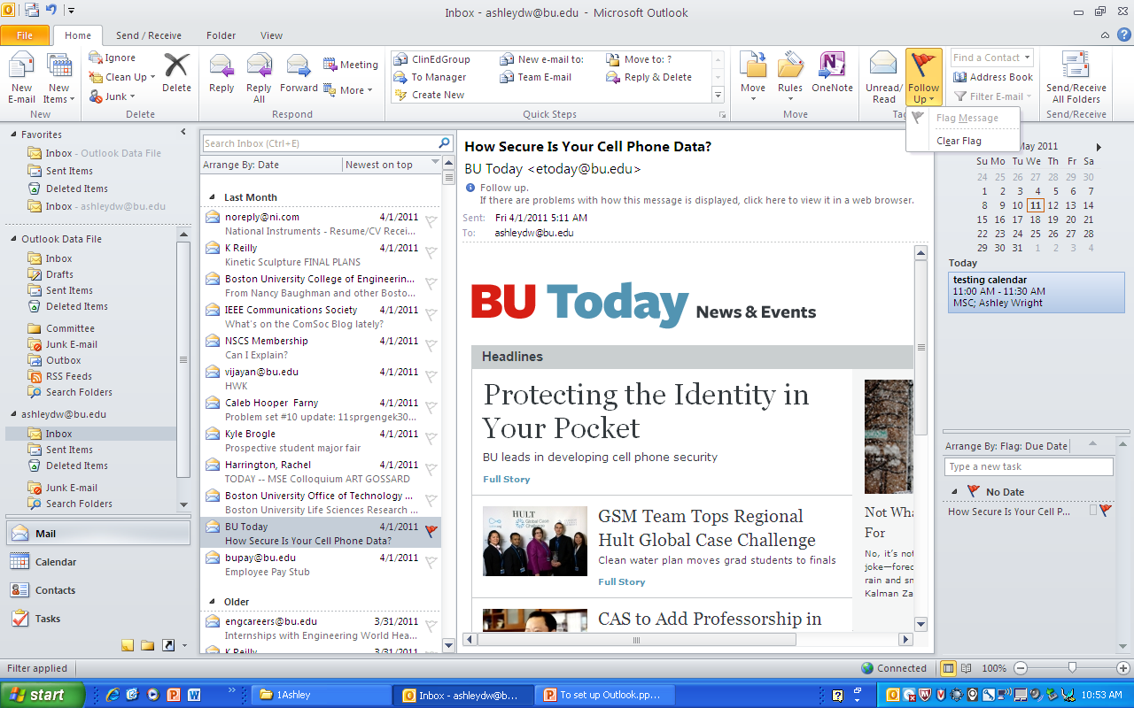
Flags and Tasks
1
2

Slide 53
How to do an E-Mail Merge Step 1
Create your data file in Excel.
  You need to use column headers in your Excel spreadsheet. The column headers will become the field names when you do the merge.
  You should always use easy to identify names such as E-Mail for the column that has the e-mail addresses.
  Save the Excel file.

Slide 54
How to do an E-Mail Merge Step 2, Part 1
Create your Main document in Word.
  Open Word and click the Mailings Tab.
    Click Start Mail Merge then select E-mail Messages
    Click Select Recipients then select Use Existing List. Navigate to where you saved your Excel data file (from Step 1) and click Open. If the Select Table box opens, select the appropriate worksheet (Sheet1$ is the default, use that if you haven’t created additional worksheets). Make sure the First row of data contains column headers box is checked then click OK

Slide 55
How to do an E-Mail Merge Step 2, Part 2
  Type the text of your e-mail message. You may include personalized data such a name if that data is included in your Excel spreadsheet.
    To insert a field click Insert Merge Field and select the field you want from the drop-down list
  When you are finished writing your message you may preview the results by clicking the Preview Results button.

Slide 56
How to do an E-Mail Merge Step 2, Part 3
  When you are ready to do the merge click Finish & Merge and select Send E-mail Messages. Note your document will be sent in the body of the e-mail so recipients do not need to have Word on their computer to see the e-mail message.
  You will be prompted for a subject line, please type an appropriate subject. IMPORTANT: Your e-mail will be sent automatically as soon as you click the OK so make your happy with your message. If you are happy then click OK.

Slide 57
How to do an E-Mail Merge Step 2, Part 4
  You’re done. If you think you will want to use this Word merge document again then save. Otherwise you may close without saving.

