Slide 1
Chapter 1:
Economic Activity in Context

Slide 2
Table 1.1 A Potential List of Final Goals

Slide 3
Figure 1.1 The General Stock-Flow Diagram
Stock
Flows
Stock
Additions
Initial
Next
Initial
Next
Stock
Stock
Stock
Stock
Subtractions
Time
Notes:
Figure 1.1

Slide 4
Figure 1.2 “Bathtub”-Style Diagram
Additions
or Inflows
Stock
Subtractions
or Outflows
Notes:
Figure 1.2

Slide 5
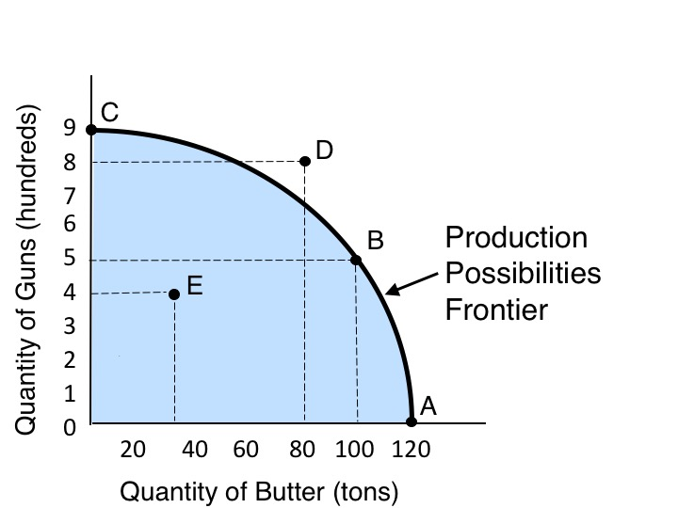
Figure 1.3 Society’s Production-Possibilities Frontier

Slide 6
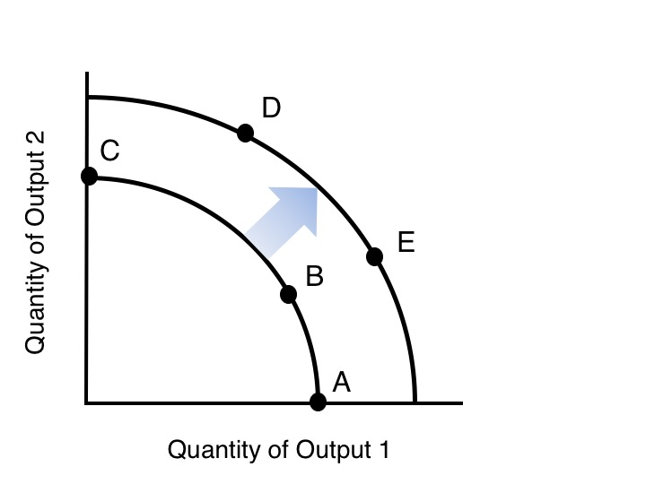
Figure 1.4 An Expanded Production-Possibilities Frontier

Slide 7
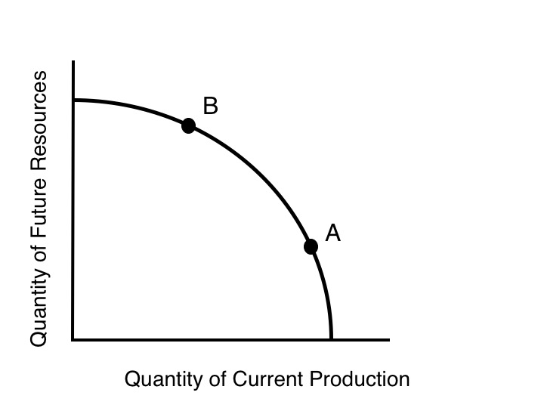
Figure 1.5 Society’s Choice between Current Production and Future Resource Availability

Slide 8
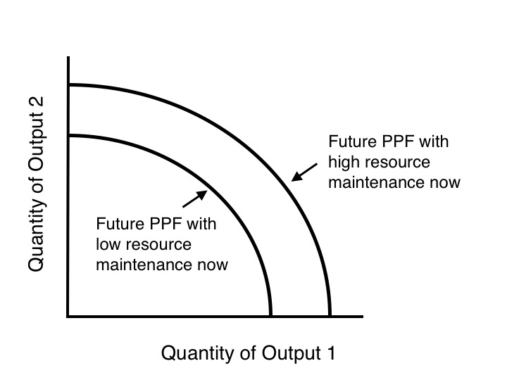
Figure 1.6 Potential Future Production-Possibilities Frontiers

