Slide 1
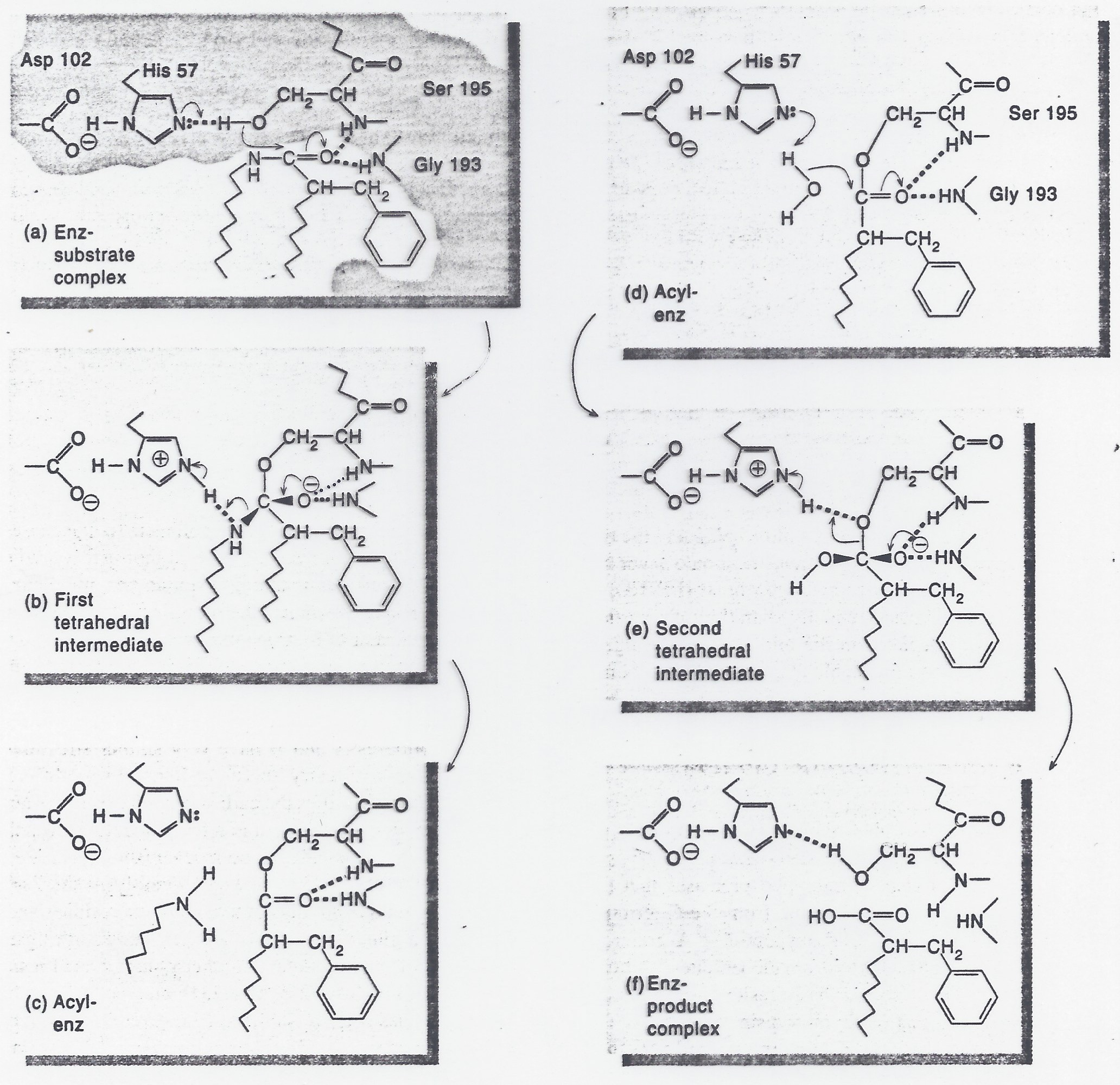
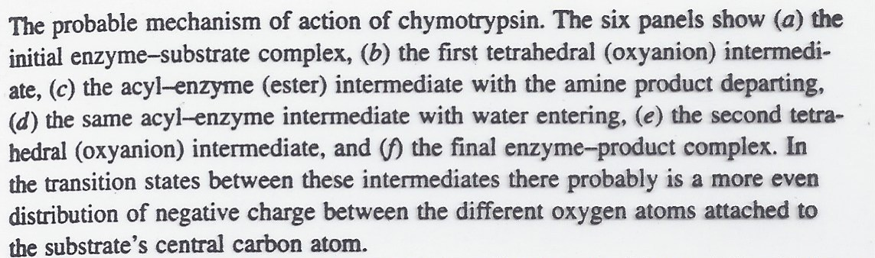
SUMMARY
1st half-reaction
2nd half-reaction
Recall, the second half-reaction is slow
❶
❷
E
❺
❹
❸
❻
What evidence is in support of this mechanism?
❼
Notes:
Intentionally leaving arrows off of this slide on the web site for you to practice!!

Slide 2
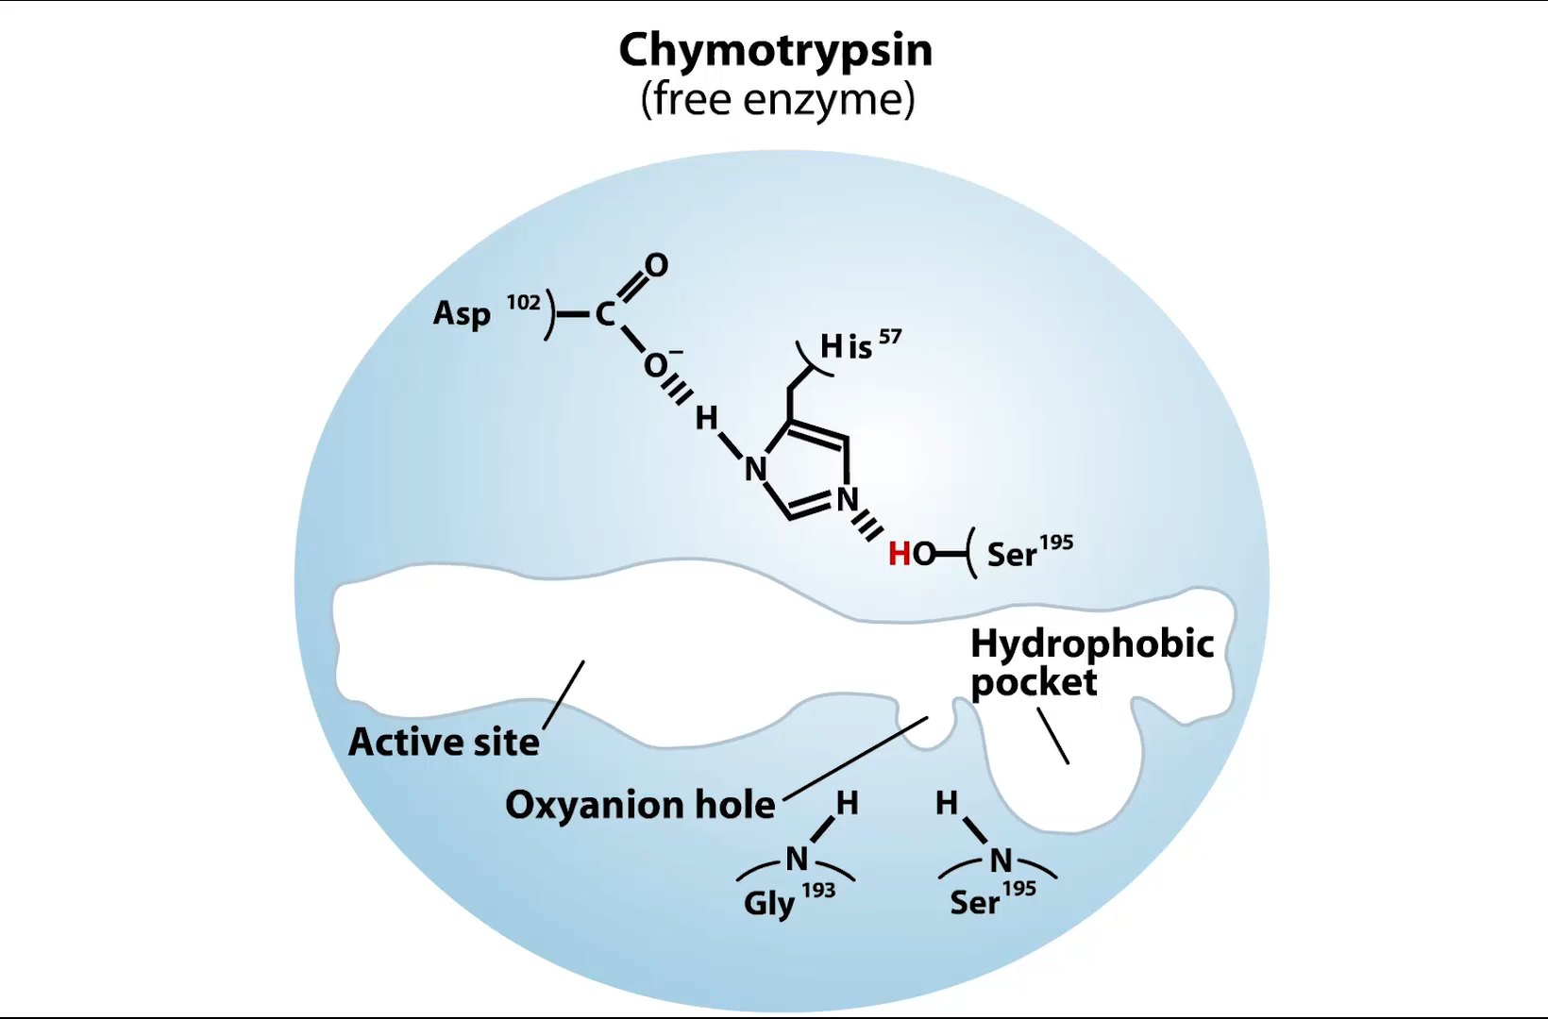
Chymotrypsin Mechanism
Animation
Notes:
NOTE that the active site is flipped around from the previous depiction

