Slide 1
Molecular Cloning: Polymerase Chain Reaction
Besides using host to MAKE MORE copies of DNA sequences, they can be made by the polymerase chain reaction (PCR) technique (in vitro).
PCR is a cyclical process:
DNA fragments are denatured by heating g single-stranded DNA
Primers (one complimentary to each strand), plus dNTPs, and DNA polymerase are added g annealing and extension g new double-stranded DNA
Repeat
An initial problem with PCR was its temperature requirements.
The key insight was the use of an enzyme that could withstand the heat needed to denature the DNA g DNA polymerase from Thermus aquaticus, Taq Polymerase (insight of Kerri Mullis).
The amplified DNA can then be inserted into plasmids to create recombinant DNA and cloned in host cells. Synthetic DNA can be manipulated to create specific mutations in order to study the consequences of the mutation: Site-directed Mutagenesis.

Slide 2
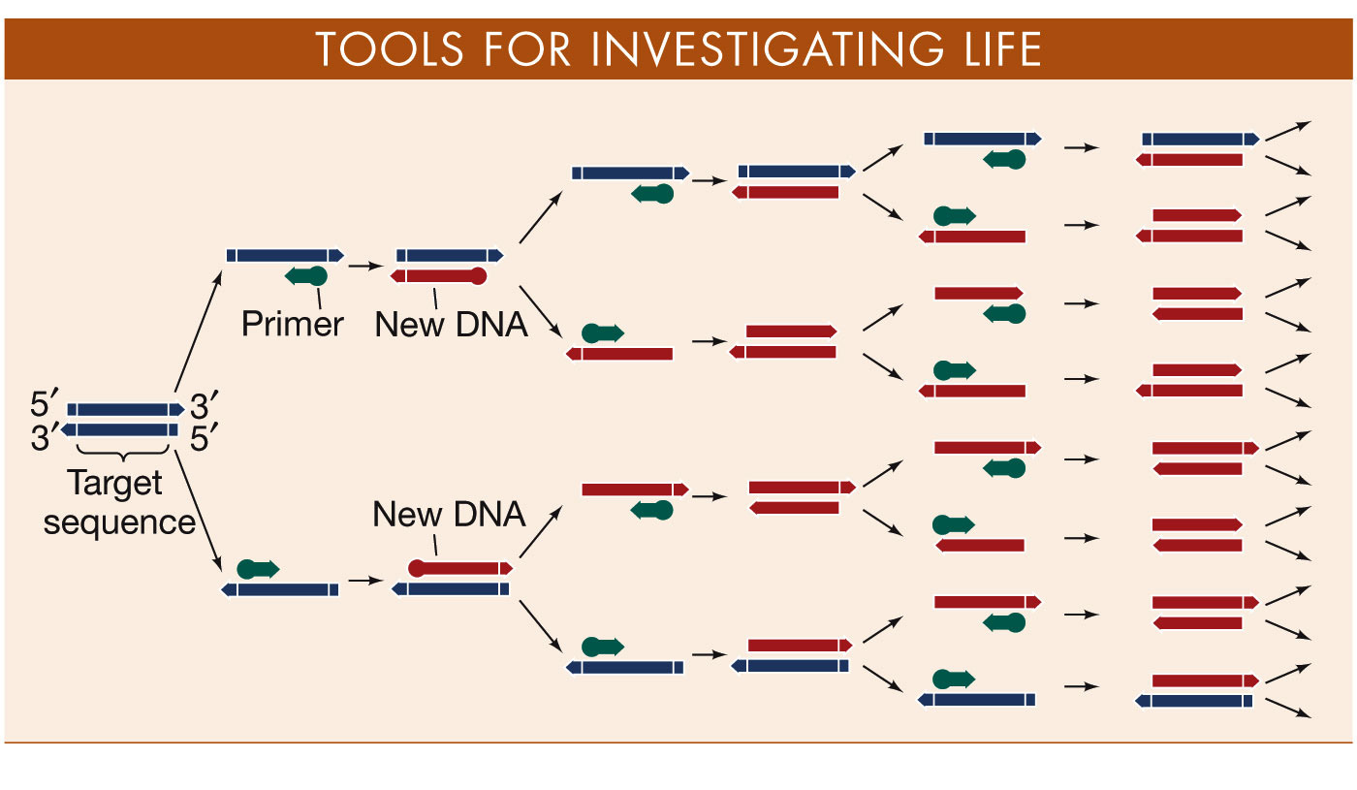
Process Diagram:
Polymerase Chain Reaction (PCR)
Molecular Cloning: Polymerase Chain Reaction

Slide 3
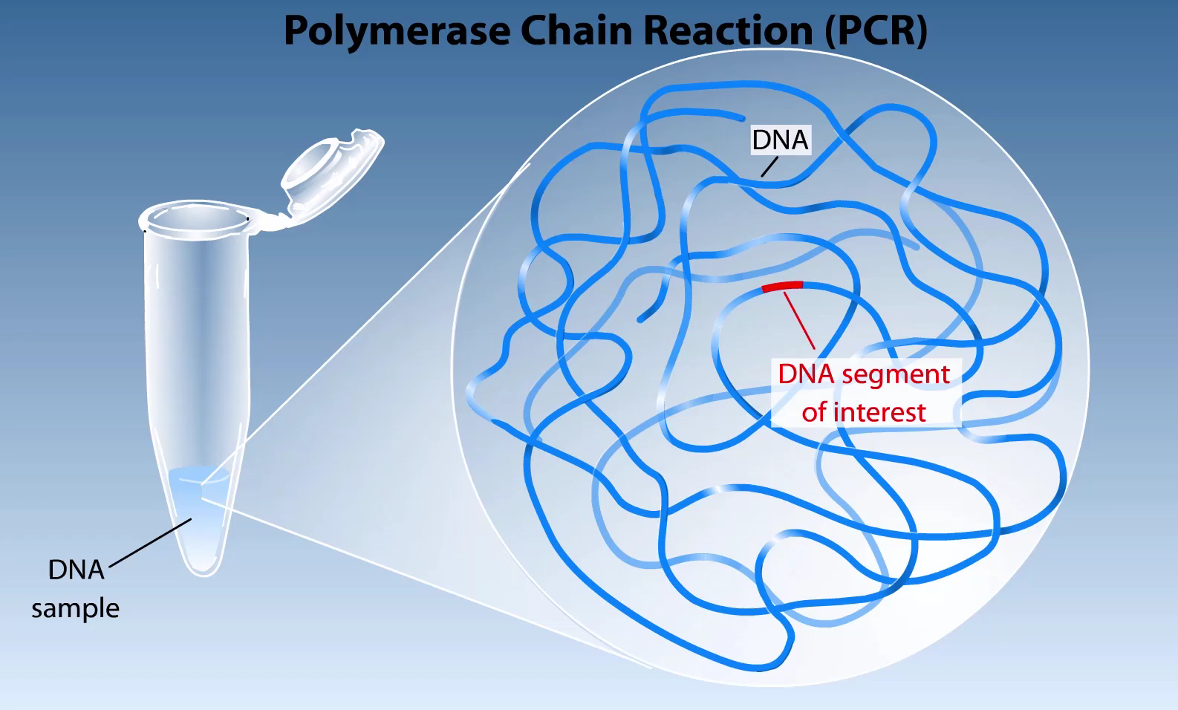
Video of PCR

