Slide 1
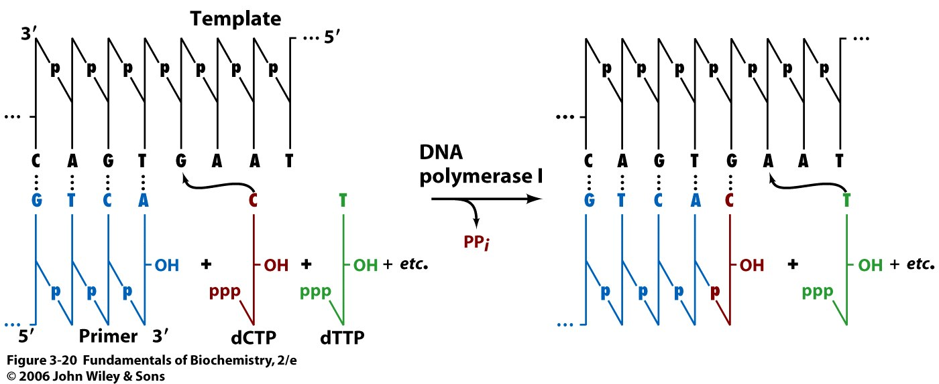
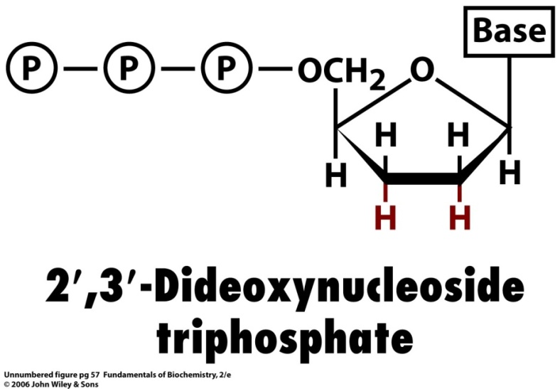
DNA Sequence Determination (Sanger)
Notes:
DNA polymerization reaction needs four components: template, primer, dNTP, and DNA polymerase.
A. Template: double stranded DNA has to be separated into single stranded DNA to be used as the template
B. Primer: a short single stranded DNA, which is complementary to the template
C. dNTP: a mixture of dATP, dTTP, dGTP, and dCTP
D. DNA polymerase
2. If some of the dNTP is replaced by the 2’, 3’-dideoxy nucleotide, the reaction will not able to proceed because it can not form the 3’, 5’-phosphodiester bond. This is the method used for DNA sequencing.

Slide 2
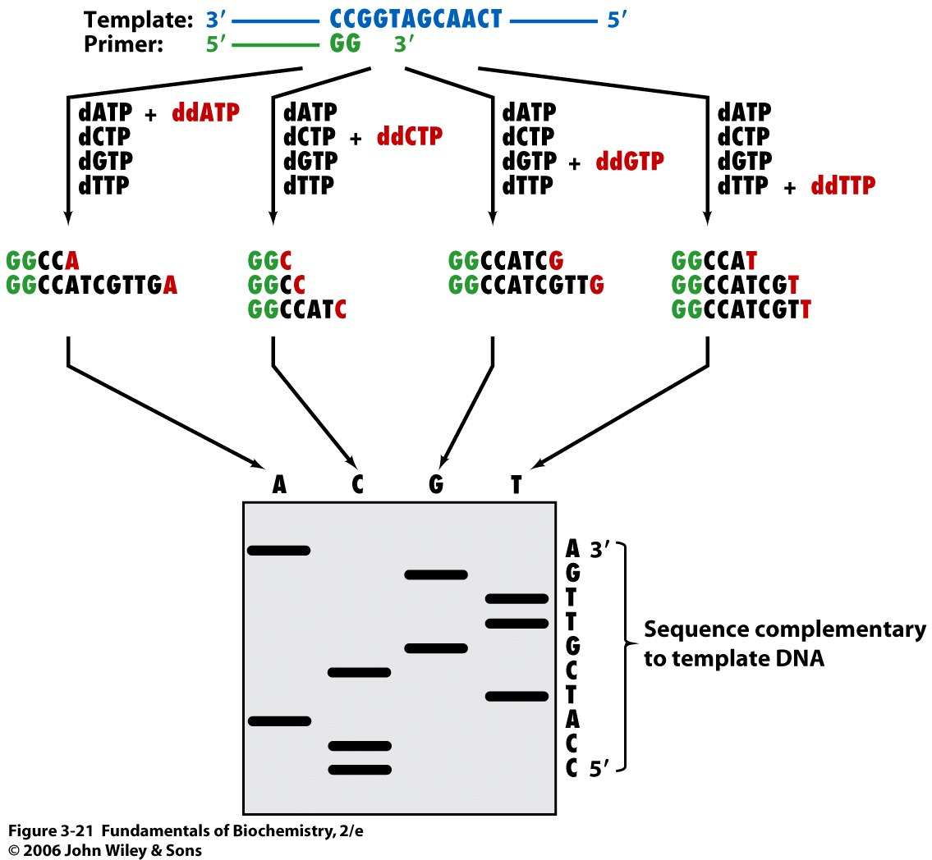
DNA Sequencing
Notes:
Need to understand how the sequencing reaction work

Slide 3
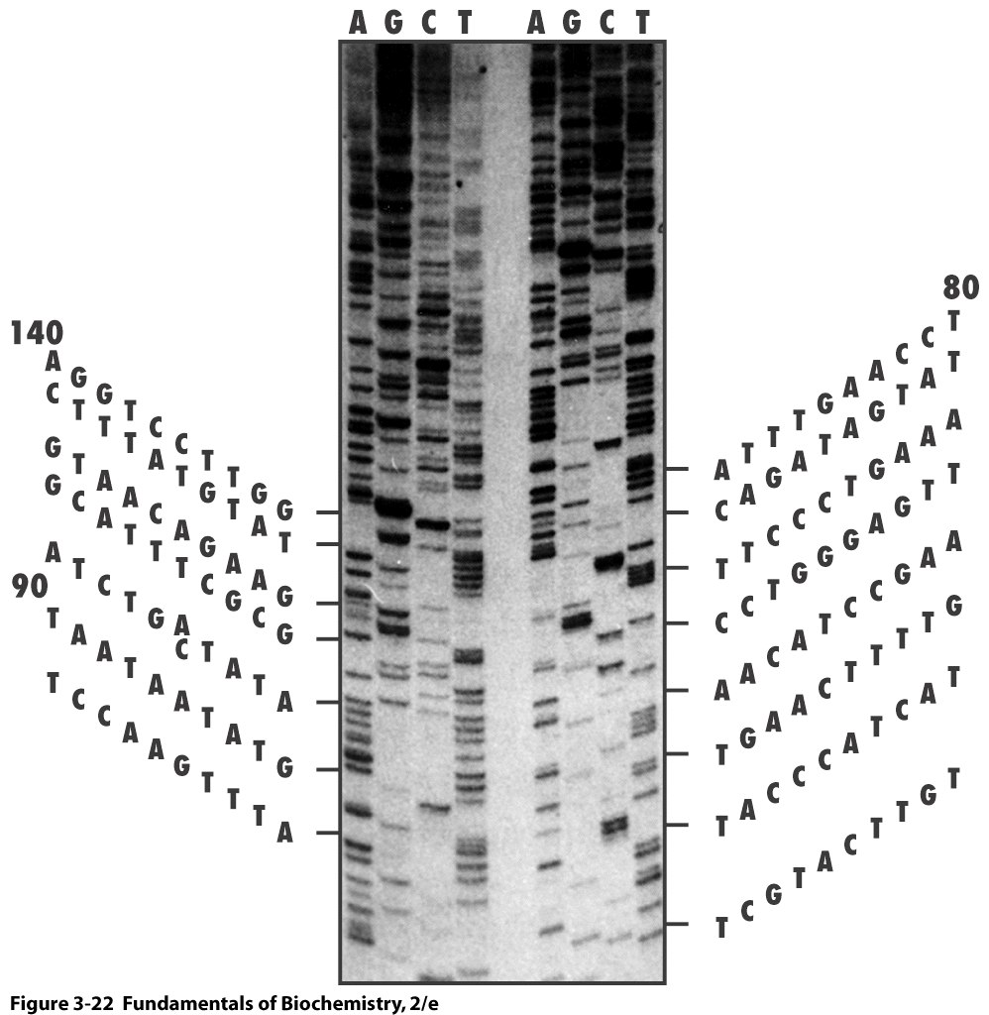
Visualize the DNA Sequence (I)
Notes:
The first method developed is to used radioactive labeled ddATP, ddTTP, ddCTP, and ddGTP to run four different reactions.
The resulted DNA is separated on polyacrylamide gel.
The sequence can then be directly read based on the gel.
Problem: the resolution is not very high. In Maximum, only 200 – 300 bp can be determined. Also, because it is read manually, it is easily to introduced errors. This is the first generation sequencing method. Very time consuming and easy to make mistakes.

Slide 4
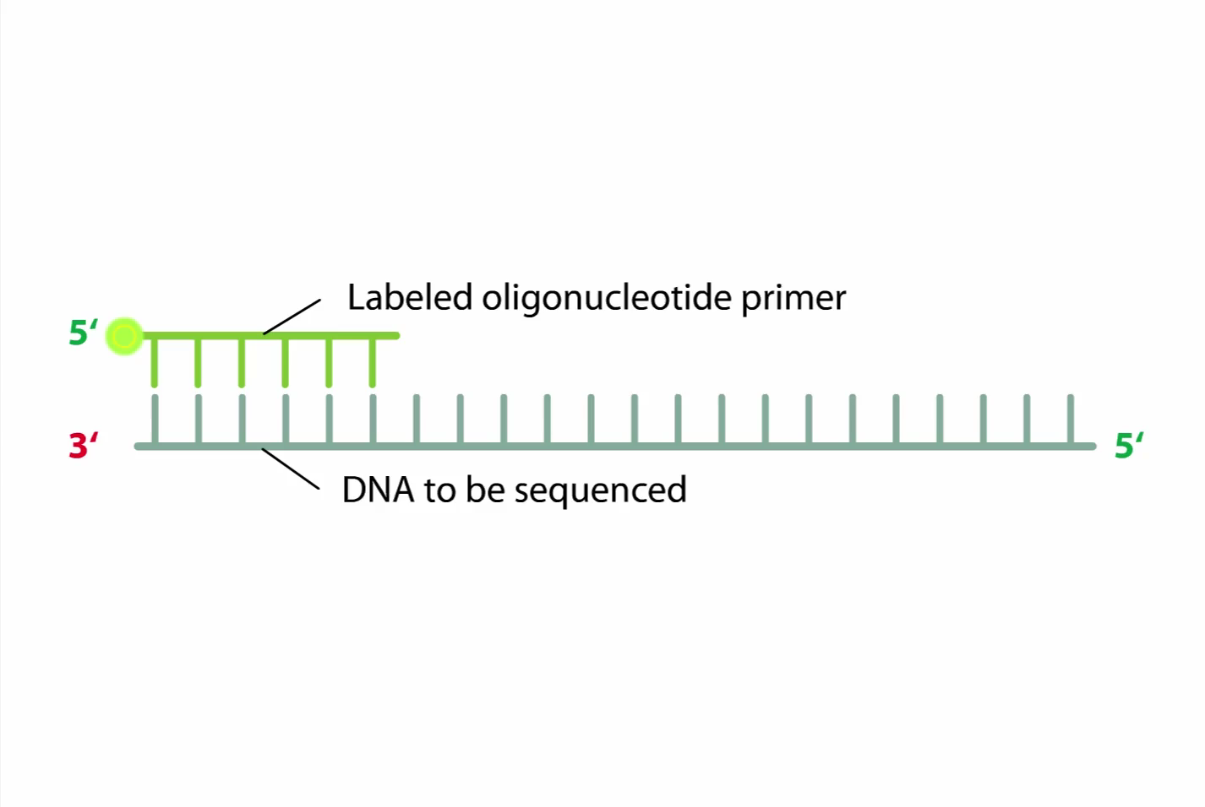
Video of DNA Sequencing

Slide 5
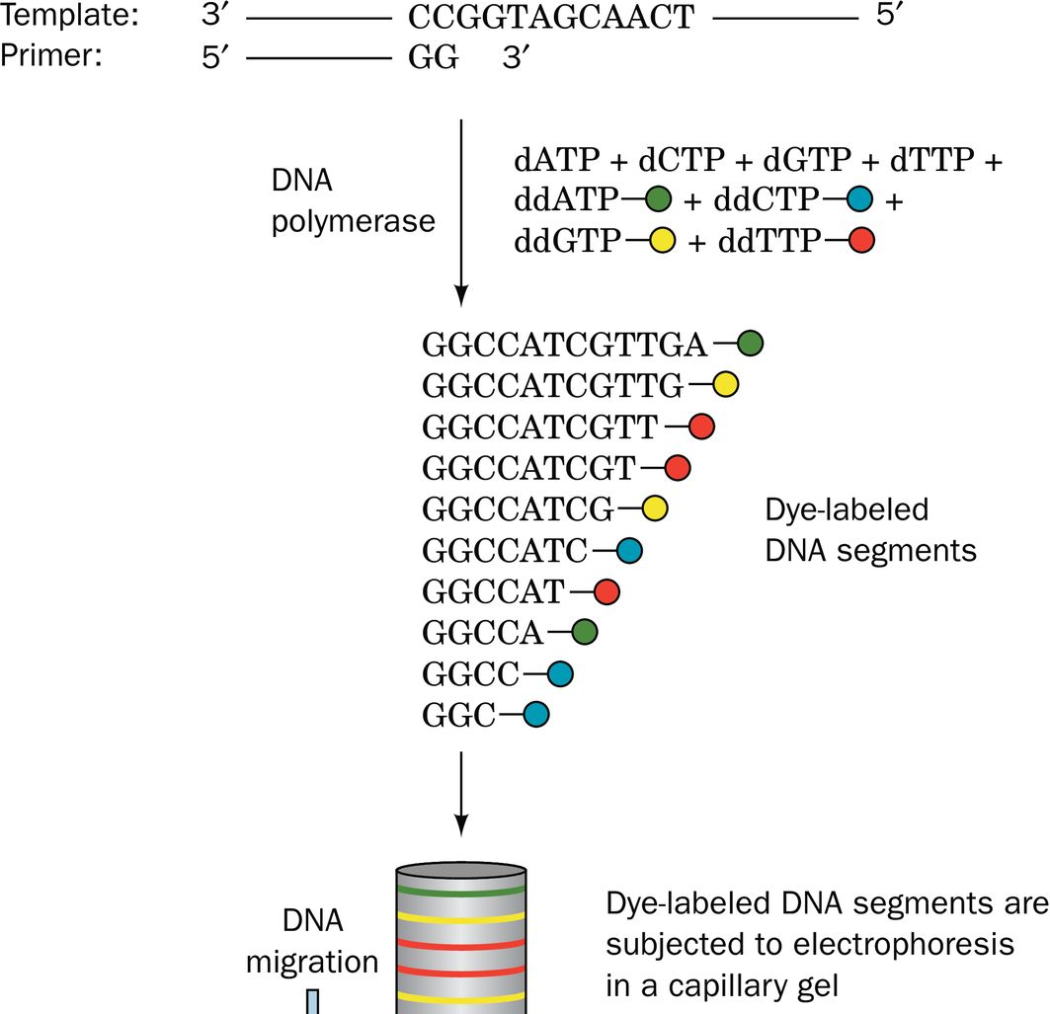
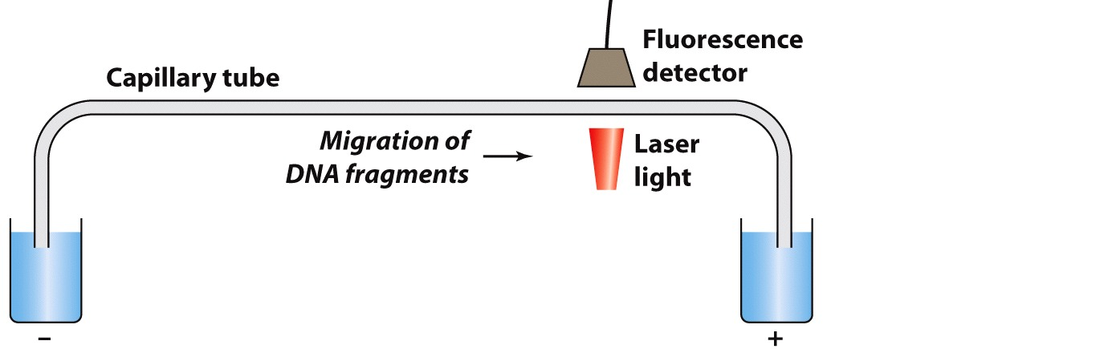
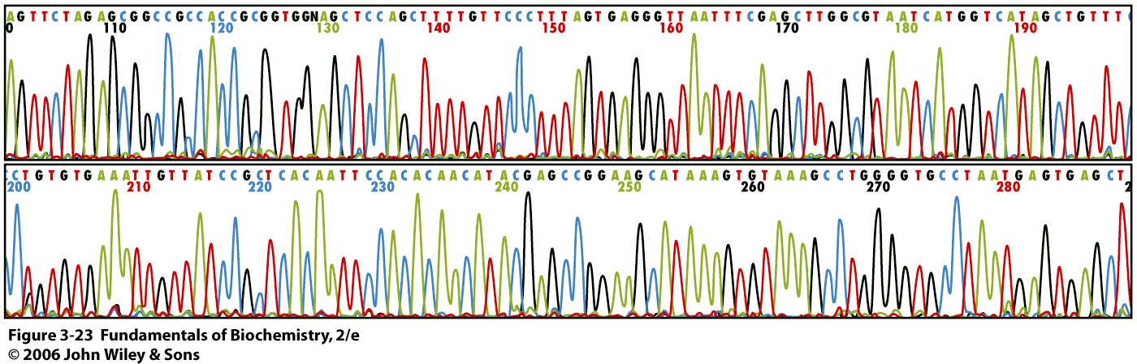
Chain-Terminator Sequencing Method
Notes:
This is the second generation of DNA sequencing method.
Instead of radioactive label of the ddNTP, the ddNTPs are labeled with four different fluorescent dyes. The reaction is stopped with ddATP, ddTTP, ddCTP, or ddGTP .
The reaction products from the above four reactions are mixed and injected into a capillary tube to separated.
There is a fluorescence detector at the end of the capillary tube, which can be used to read the color of the fluorescence. The order of the fluorescence will give the sequence of the DNA.
With the modern instrument, 550 Kb can be sequenced per day.

