Slide 1
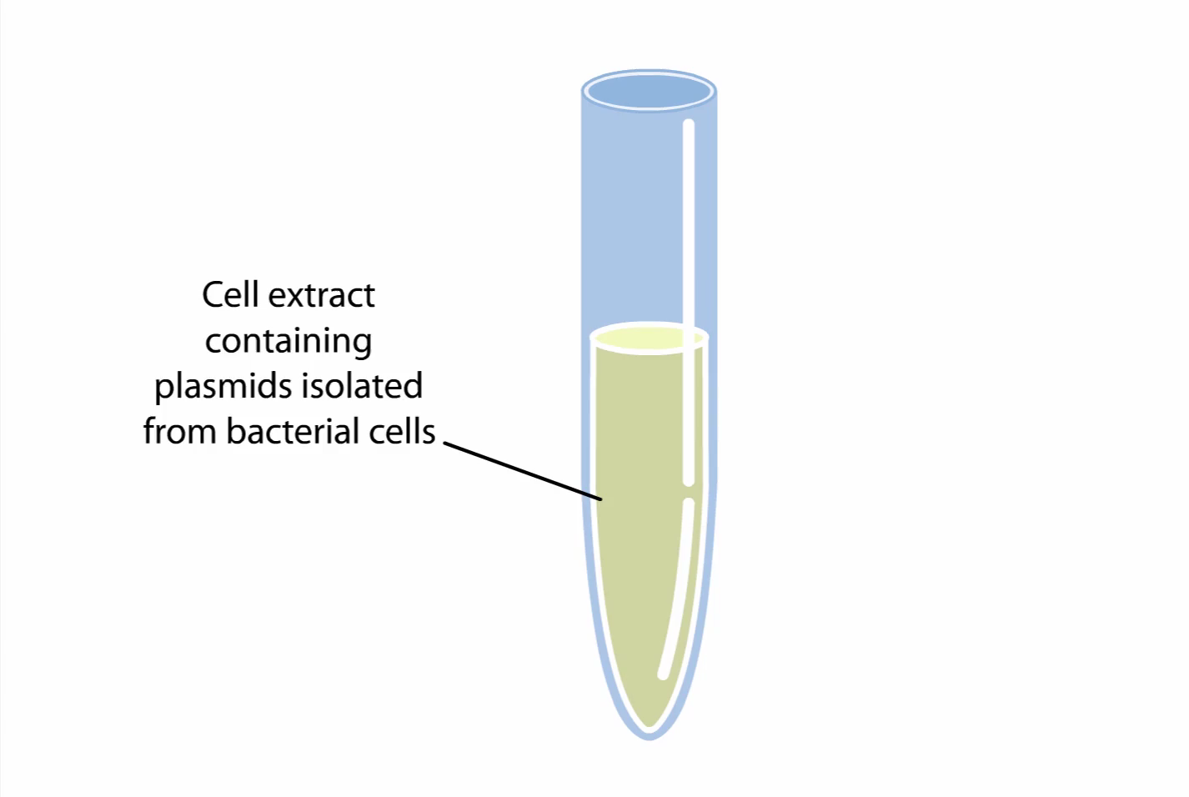
Video of Cloning

Slide 2
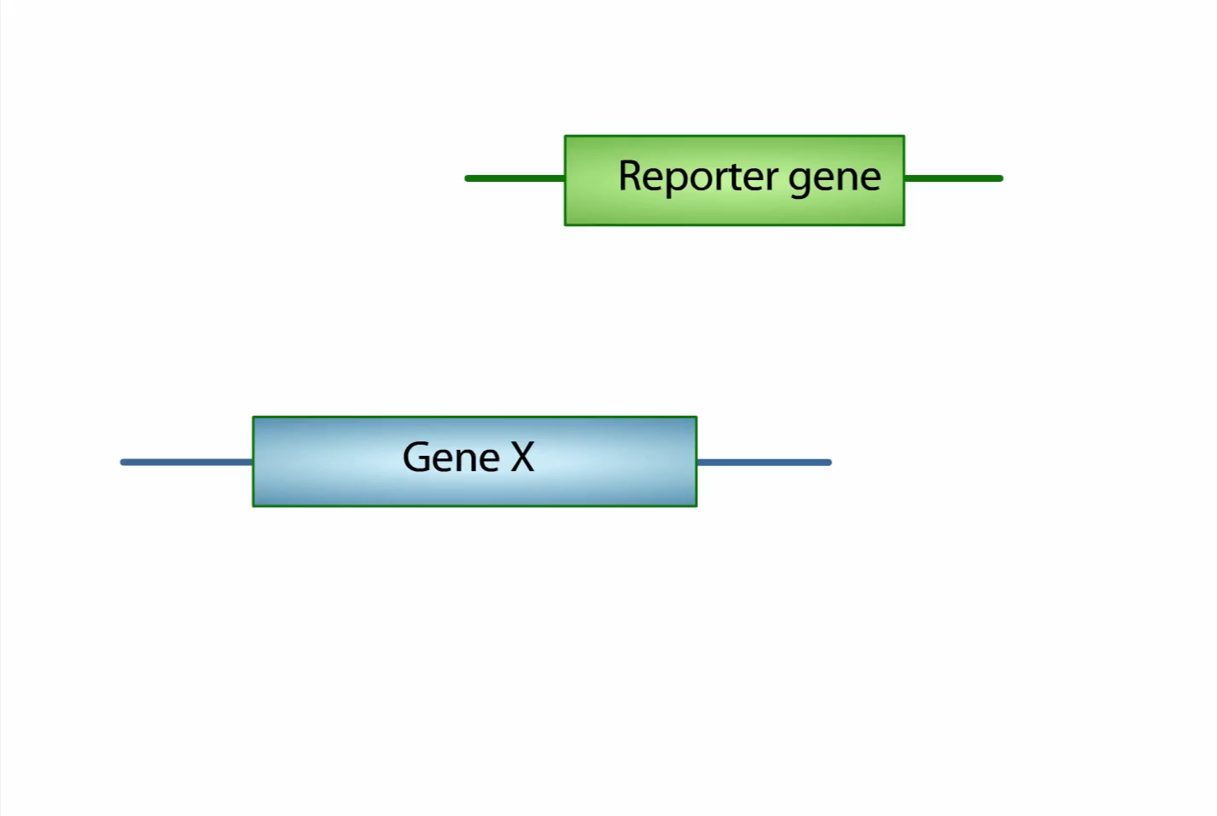
Video of DNA Reporter Construct

Slide 3
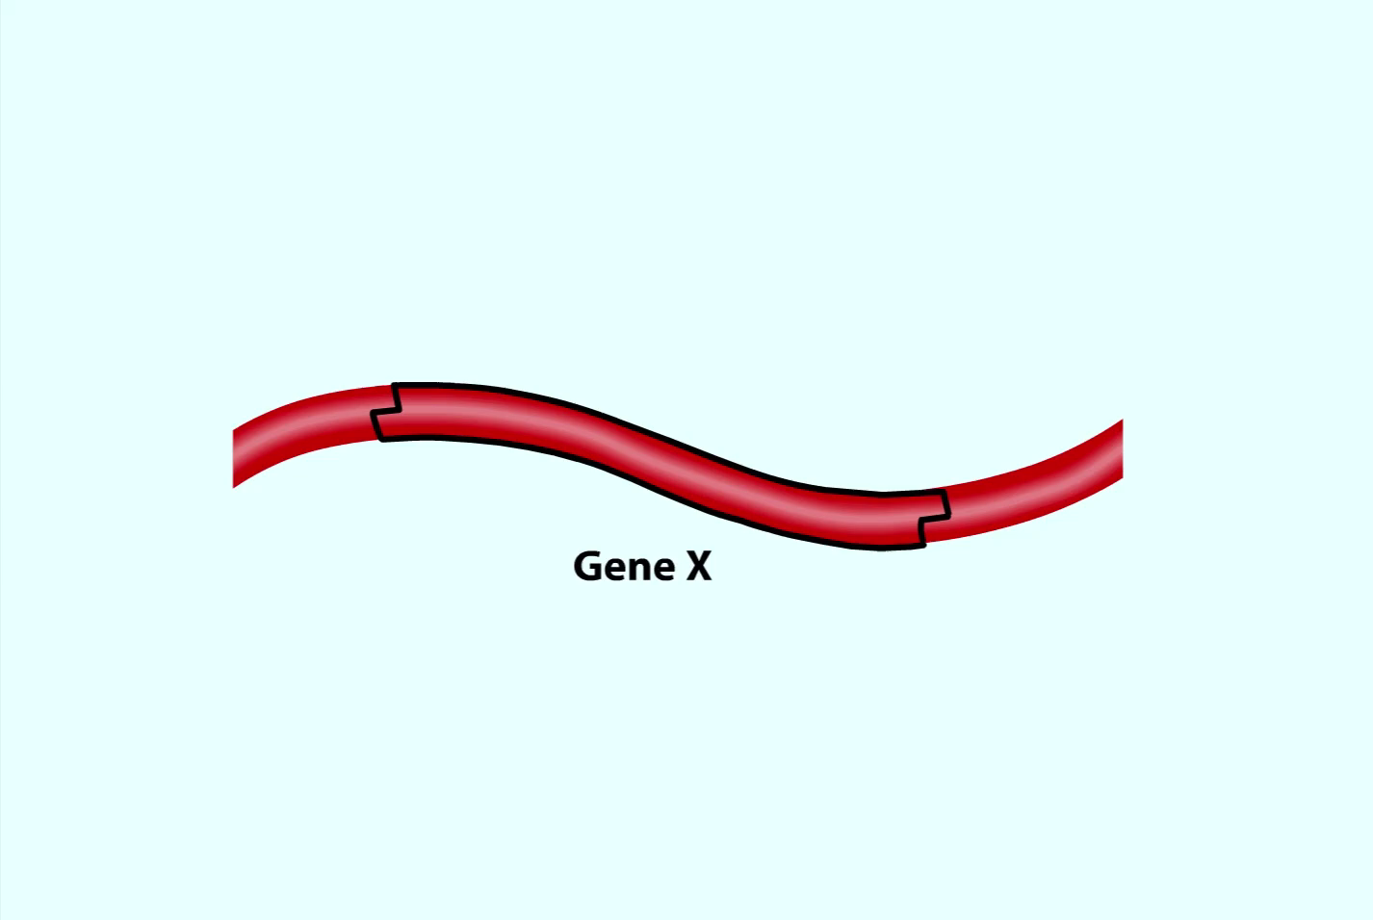
Video on making a Transgenic Mouse
Be sure that you have a look at PCR video/slides first

